Slide 1
EPA’s Urban Waters Program and
Region 9’s Watershed Approach in Arizona
Jared Vollmer
EPA Region 9

Slide 2
EPA’s Urban Waters Program
Goal: To reconnect communities to their surface water through better federal coordination, enhanced networking tools, and a tiny bit of money.
http://www.epa.gov/urbanwaters

Slide 3
Two Main Parts of the Urban Waters Program
Partnerships
  Where federal agencies work together guided by local stakeholder input.
  19 locations in the US.
  Region 9’s partnership location: Los Angeles Watershed
Small Grants
  Advance EPA’s water quality and environmental justice goals by addressing urban runoff through diverse partnerships that produce multiple community benefits.
  Up to $60,000
  Request for proposals announced every other year

Slide 4
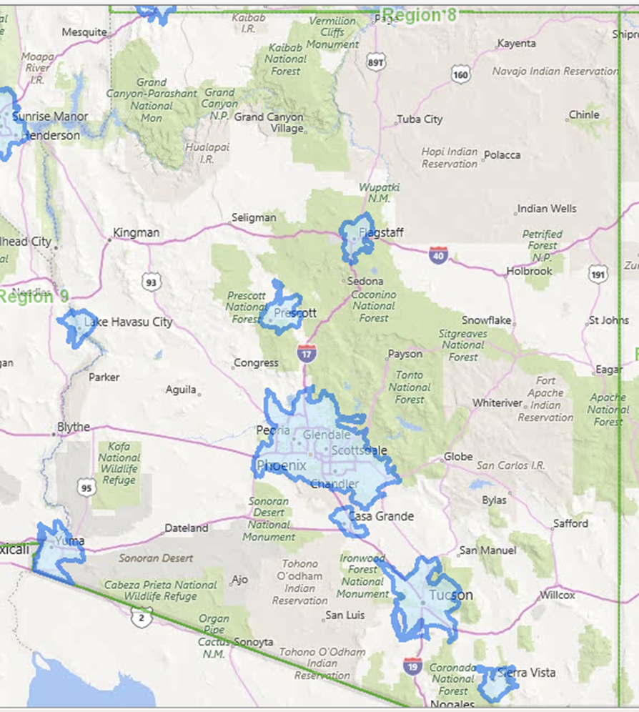
Eligible Urban Areas in Arizona

Slide 5
Region 9’s Watershed Approach in Arizona

Slide 6
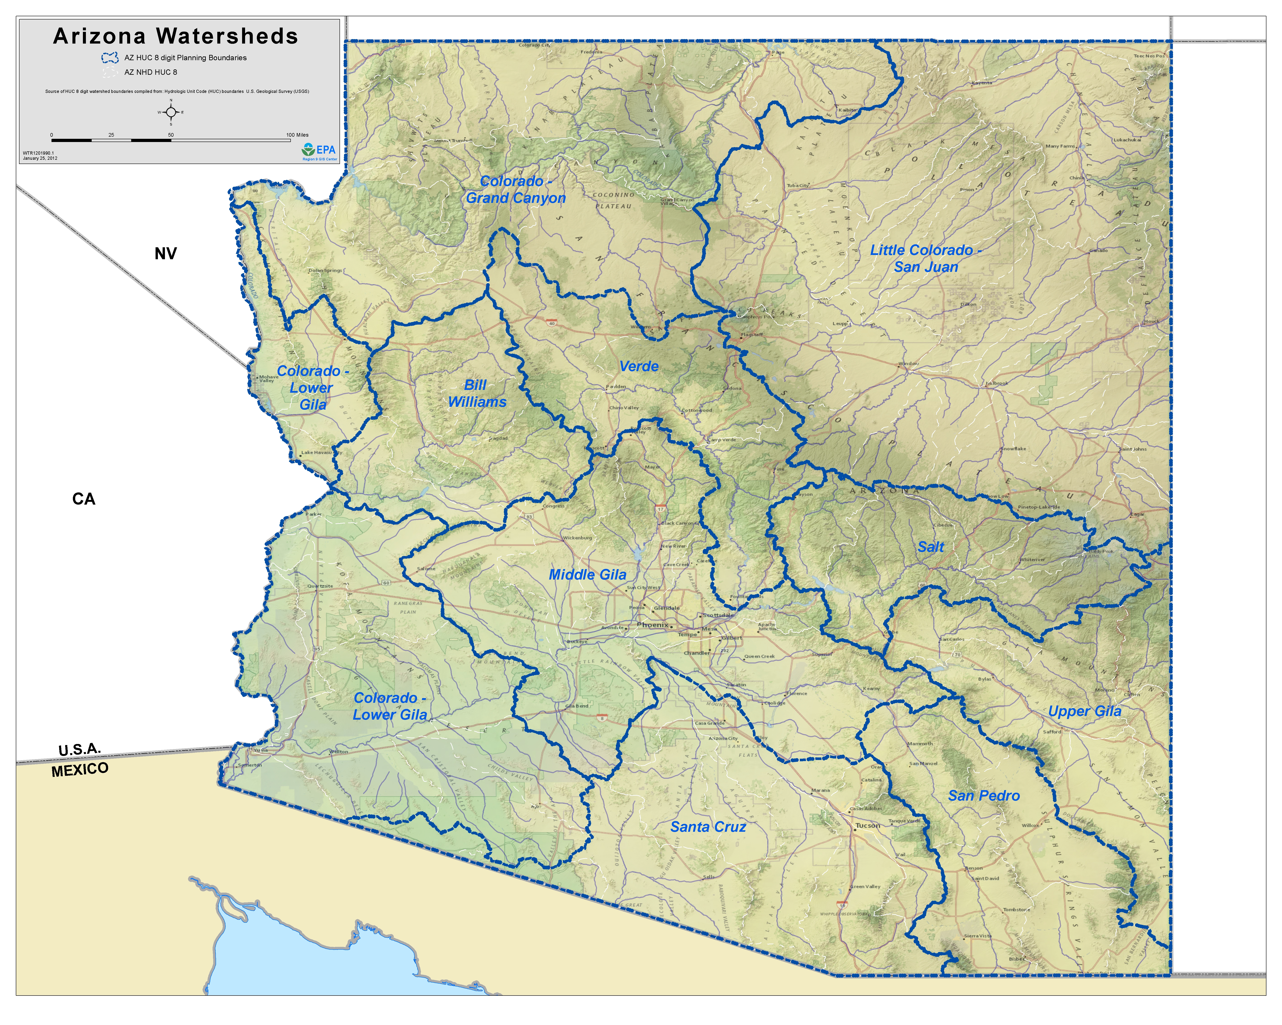

Slide 7
Oak Creek
Granite Creek
Little Colorado headwaters
Tonto Creek
Hillside Mine –
Boulder Creek
San Francisco and Blue Rivers
Upper San Pedro
Upper Santa Cruz

Slide 9
For More Information, Contact:
Jared Vollmer
Arizona Watershed Coordinator, EPA Region 9
Vollmer.jared@epa.gov
(415) 972-3447
http://www3.epa.gov/region9/water/index.html

