Slide 1
Phoenix-Goodyear Airport-North (PGA-North) Superfund Site
Stephanie Lyn Koehne Amec Foster Wheeler Environment & Infrastructure, Americas (Amec Foster Wheeler)

Slide 2
PGA-North Superfund Site – Cooperation with Agencies and Stakeholders
Cooperation and open communication among the EPA, Arizona Department of Environmental Quality (ADEQ), Crane Co., the City of Goodyear (COG) and local businesses has allowed a synergy to be developed which has allowed for beneficial reuse of treated groundwater.
COG and Crane Co. have entered into an Environmental Access and Remediated Groundwater Reuse Agreement.
This Agreement is mutually beneficial to both the COG and Crane Co.
It helps the Primary Responsible Party to carry out necessary clean-up activities in an expedited fashion and allows the treated groundwater to be beneficially reused within the City boundaries.

Slide 3
PGA-North Superfund Site – Technical Components for Clean-up of Groundwater
Five Groundwater Treatment Systems (GTSs)
Summary of each GTS and the technical components of how the contaminated groundwater is treated.
Main Treatment System (MTS)
EA-05 GTS
EA-06 GTS
EA-08 GTS
33A GTS
Review of associated Reuse Activities once the groundwater has been treated for all GTS.

Slide 4
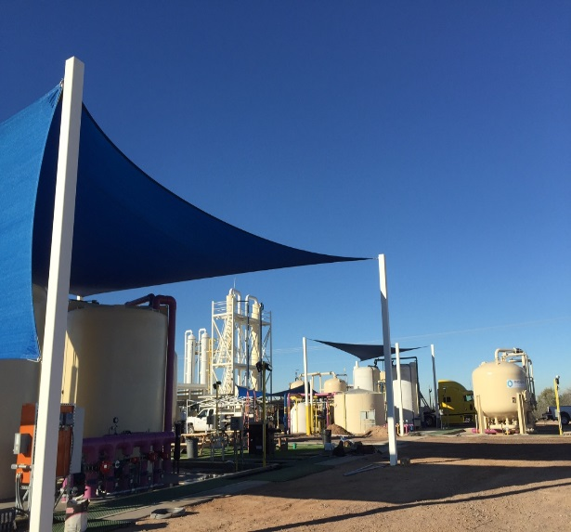
PGA-North Superfund Site – Technical Components for Clean-up of Groundwater at the MTS
MTS – Contaminated groundwater is supplied by a series of nine extraction wells – approximately 850 gallons per minute (gpm).
Contaminated groundwater is conveyed to the MTS for volatile organic compound (VOC) and perchlorate treatment.
VOCs are treated using either air stripping techniques or liquid granular activated carbon (LGAC).
Perchlorate is treated using ion-exchange technology.
View of MTS looking southwest at the effluent distribution system, Phase 1 and Phase 2/3 Packed Air Stripping towers, irrigation system, and liquid-phase granular activated carbon treatment train.

Slide 5
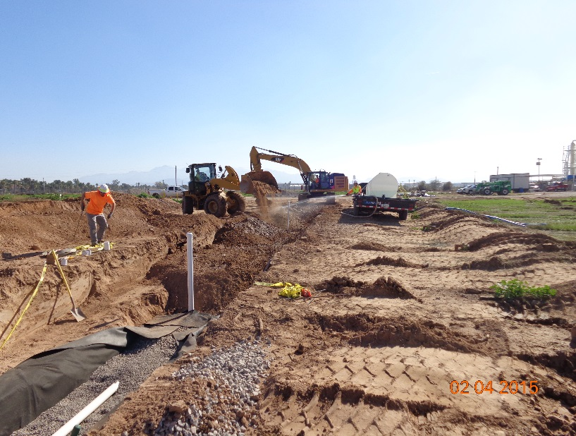
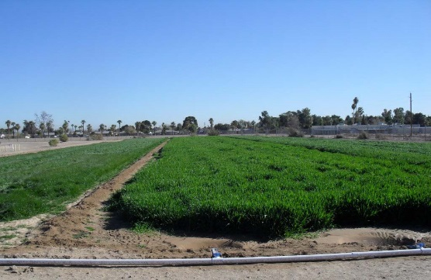
PGA-North Superfund Site – Reuse Activities at the MTS
Following treatment through the perchlorate and VOC treatment trains, the treated groundwater is conveyed to two 12,500-gallon capacity effluent equalization tanks and subsequently discharged via the effluent distribution header to:
A network of seven injection wells (IA-01 through IA-06 and IA-09).
Two infiltration galleries located on-site – East and West.
On-Site Grass Plots, a partnership between Crane Co. and a local farmer.
View of the infiltration gallery during construction.
View of the grass plots, used to improve visual appeal and help control dust.

Slide 6
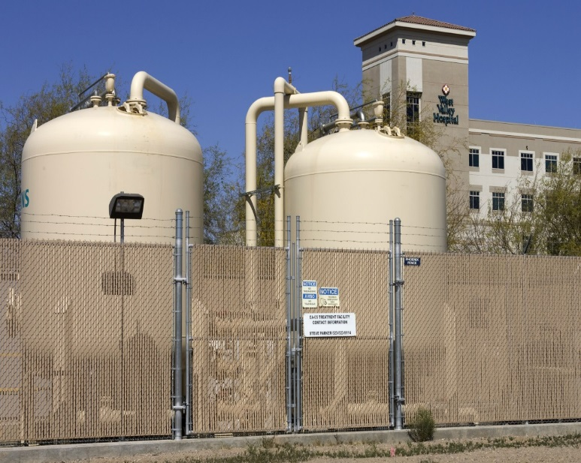
PGA-North Superfund Site – Technical Components for Clean-up of Groundwater and Reuse at the EA-05 GTS
EA-05 – Contaminated groundwater is extracted from one well (450 – 500 gpm).
Contaminated groundwater is conveyed to the EA-05 GTS for VOC treatment.
EA-05 GTS consists of two LGAC vessels and associated influent and effluent bag filters, which help remove the small particles.
Treated groundwater is injected back into the aquifer through injection well IA-10.
Some of the treated groundwater is used by the Maricopa County Flood Control District for dust control.
View of EA-05 groundwater treatment system looking north.

Slide 7
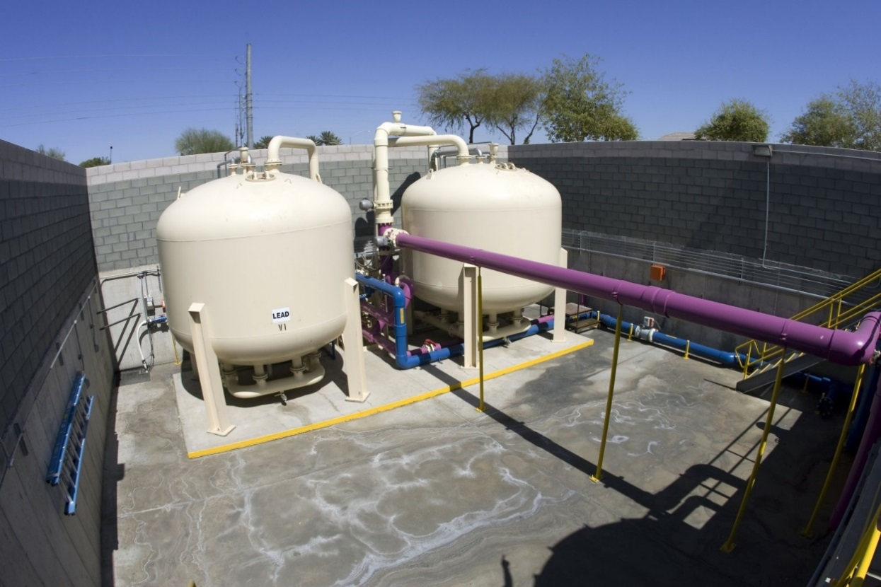
PGA-North Superfund Site – Technical Components for Clean-up of Groundwater at the EA-06 GTS
EA-06 GTS – Contaminated groundwater is extracted from two extraction wells, EA-06 and EA-07 (combined 625 gpm).
Contaminated groundwater is conveyed to two LGAC vessels for VOC treatment.

Slide 8
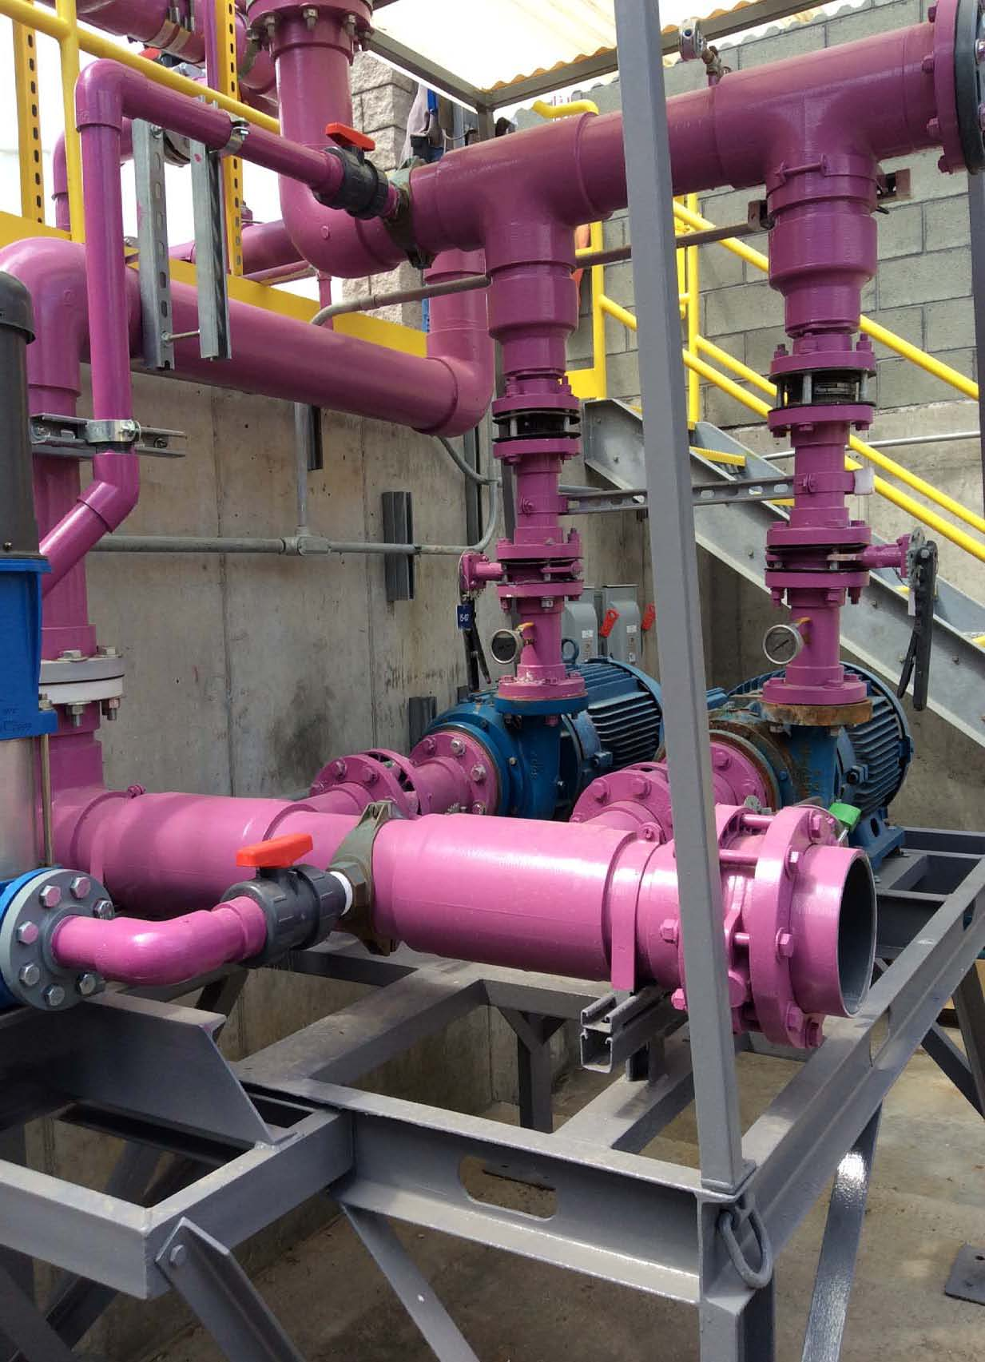
PGA-North Superfund Site – Reuse Activities at the EA-06 GTS
The treated groundwater is discharged into:
The aquifer via a series of five injection wells.
Used for irrigation at the adjacent Goodyear Community Park.
Treated groundwater being conveyed to the injection well network is also routed through a closed loop heat exchanger at a local Church (St. Thomas Aquinas) to condition cooling water and reduce heating and cooling cost by an estimated 40 percent.
Goodyear Community Park
COG previously purchased potable water from a nearby water supply company to irrigate the baseball fields and other turf areas within the Goodyear Community Park. The COG and Crane Co. worked together to develop an agreement to use treated groundwater for this purpose.
In the beginning of 2012, Crane Co. constructed an irrigation system and the COG began using treated groundwater from the EA-06 GTS to irrigate the Goodyear Community Park.
In 2013, the COG used 21 million gallons of treated groundwater from PGA-North to irrigate the park. This water reuse saves the COG an estimated $75,000 a year in irrigation costs.

Slide 9
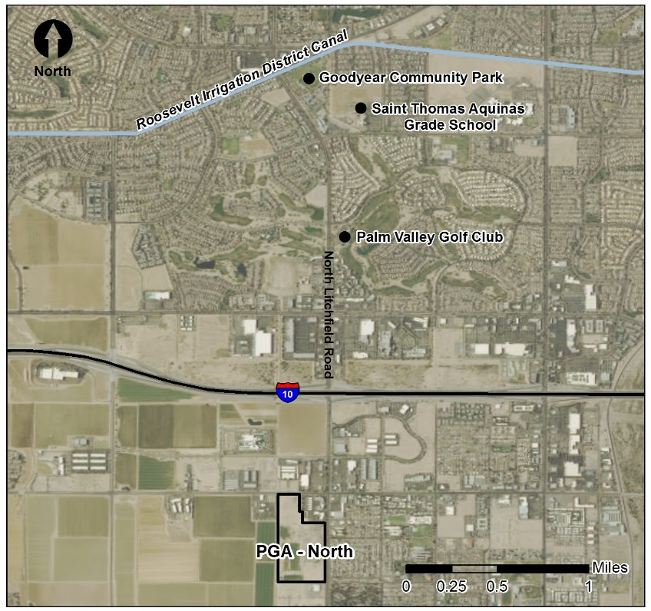
PGA-North Superfund Site – Reuse Activities at the EA-06 GTS
Saint Thomas Aquinas Grade School
Located two miles north of the PGA-North Superfund Site, in the City of Avondale.
As the EA-06 GTS was being expanded the church also began expanding it’s school, so the parties came to a agreement that proved beneficial for both parties.
The church allowed for the pipeline to be installed on their property at no cost and in exchange Crane Co. worked with the engineers from the church to design a closed loop system that provides the school with treated water which cools the heat exchanger; thus, cooling the new school buildings and providing the church a significant cost savings on air conditioning.

Slide 10
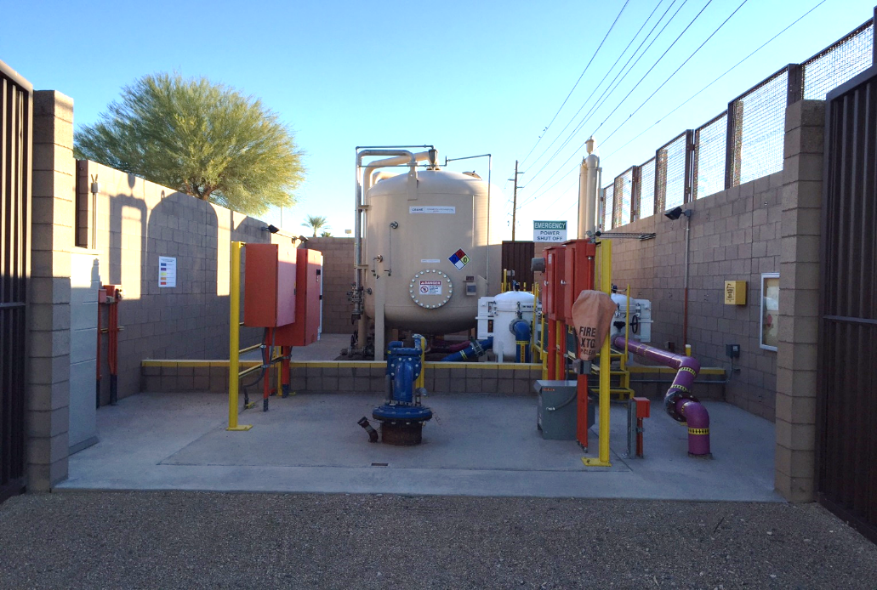
PGA-North Superfund Site – Technical Components for Clean-up of Groundwater and Reuse at the EA-08 GTS
EA-08 – Contaminated groundwater is extracted from one well (325 – 360 gpm).
Contaminated groundwater is conveyed to the EA-08 GTS for VOC treatment.
EA-08 GTS consists of two LGAC vessels and associated influent bag filters, which help remove the small particles.
Treated groundwater is injected back into the aquifer through injection wells IA-07 and IA-08.

Slide 11
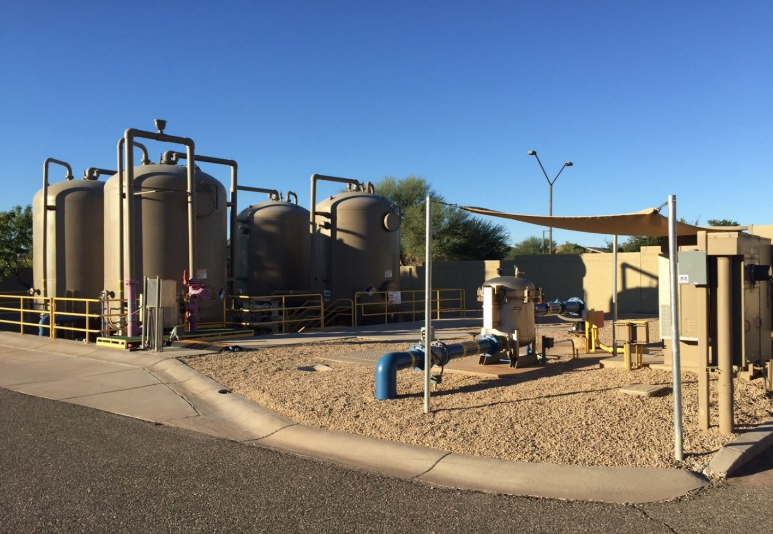
PGA-North Superfund Site – Technical Components for Clean-up of Groundwater and Reuse at the 33A GTS
33A GTS – Contaminated groundwater is extracted from a single extraction well 33A (350 – 400 gpm).
Groundwater is conveyed to two parallel LGAC treatment trains for VOC treatment.

Slide 12
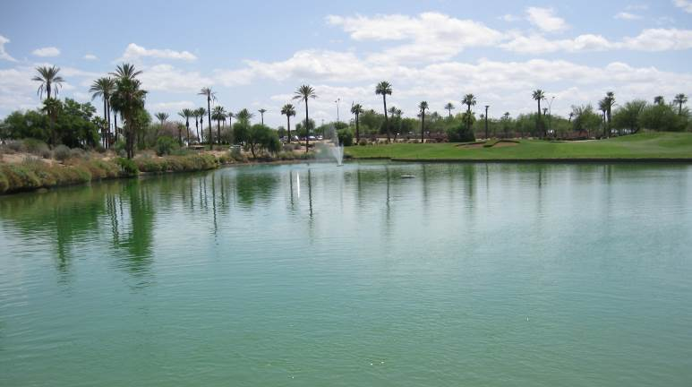
PGA-North Superfund Site – Reuse Activities at the 33A GTS
The treated groundwater is discharged into:
Roosevelt Irrigation District (RID) canal
Provided to Golden Buffalo, LLC, for irrigation of the Palm Valley Lakes Golf Course.
The Palm Valley Golf Club is located about 1.5 miles north of the PGA-North Superfund Site.
In 2010, Crane Co. approached the new owners to request permission to continue to operate extraction well 33A.
Crane Co. and the new owners came to an agreement that Crane Co. could continue to operate the extraction well in return for free treated groundwater to fill their on-site irrigation ponds and irrigate the 18-hole golf course.
The Palm Valley Golf Club fills their ponds with treated groundwater from the 33A GTS and then uses it to irrigate the golf course.

Slide 13
For More Information, Contact:
Stephanie Lyn Koehne, MBA
Associate Project Manager/Scientist, AMEC Foster Wheeler
stephanie.koehne@amecfw.com

