Slide 1

Mixing Zone Modeling Webinar Workshop Series
January 22- 24 2013
CORMIX Mixing Zone Modeling
Presentation by
Dr. Robert L. Doneker, P.E.
MixZon Inc.
E-mail: support@mixzon.com

Slide 2
CORMIX Mixing Zone Modeling - Outline
Part 1
  Types & Scale of mixing models
  CORMIX Description, Access, Input data requirements, specification, schematization
  Single port & Multiport diffuser specification
  Q & A
Break (10 minutes)
  CORMIX GUI Overview – Demo
Part 2
  Flow Classification Process
  CORMIX Output
  Q & A
Break (10 minutes)
Part 3
  Case Study – Single Port and Multiport Diffuser - Demo
  Q & A
Break (10 minutes)
Part 4
  Advanced CORMIX, Validation, QA/QC
  Q & A
  Wrap Up

Slide 3
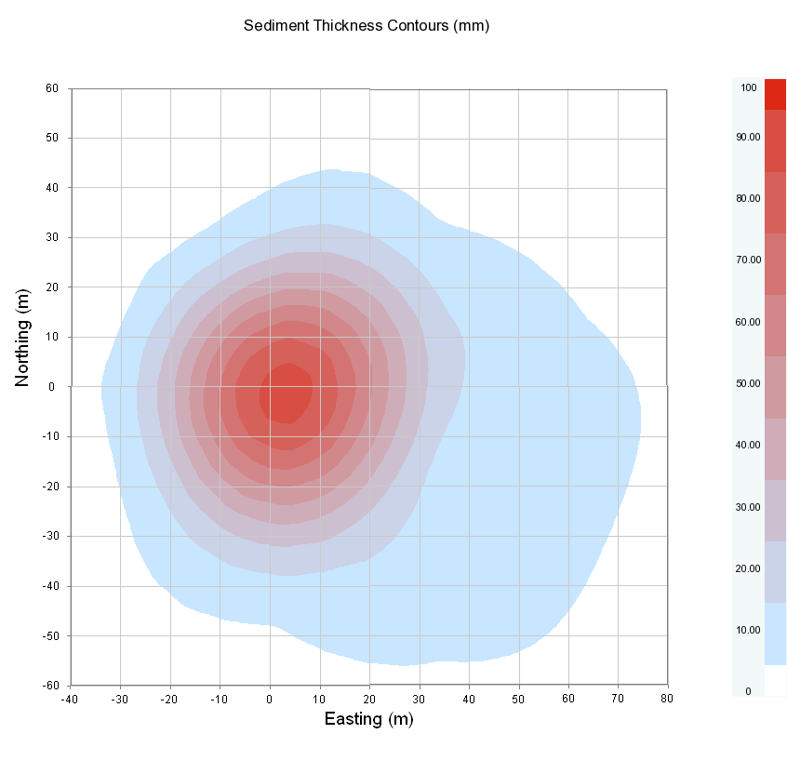
Models for Mixing Processes: Part1
CorPlot visualization of sediment bottom deposition contours
of a offshore WBM discharge study – modeled using CORMIX

Slide 4
Predictive Models for Mixing Processes – Types & Scale
Complete Models:
Single domain with one set of governing equations
  Drawbacks
    Numerical limitations
    Turbulence Models
    Boundary Conditions
Fluent, Flow3D, STAR3D
Zone Models:
Divide domain into sub-regions with specific mixing processes
  Allows use of simplified equations
Jet Integral Models
Mixing Zone Expert System – CORMIX
Model
Scale
Typical Grid Resolution
Ocean Circulation
Ocean wide
10 - 100 of km
Coastal Circulation (Far-field)
Coastal Zones, Estuaries
0,1 - 1km
Discharge Mixing Models (Near-field)
Local (scale of outfall)
no grid;
predictions up to 10m - 5km

Slide 5
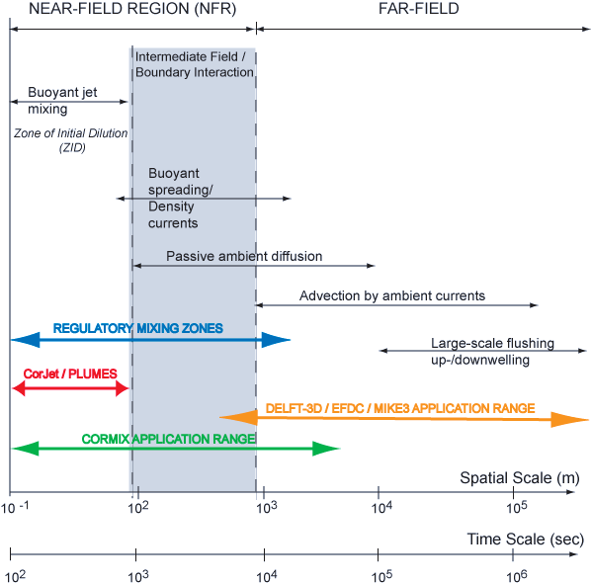
Physical Mixing Processes

Slide 6
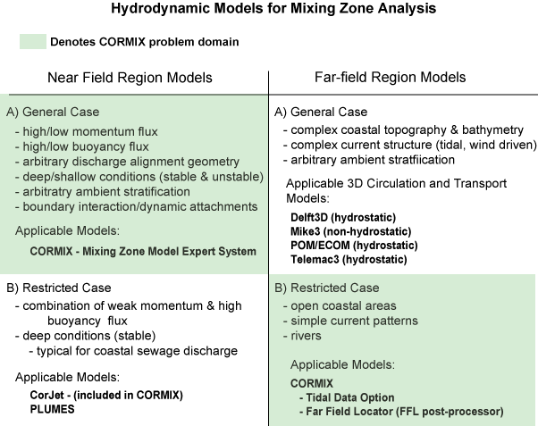
Modeling Approaches

Slide 7
Near-field Models
Jet Integral Models (CORJET)
  Integrate dynamic terms along trajectory, across cross-sectional plane
    Simple ordinary differential equations
  Empirical equations for turbulence closure: rate of entrainment, ambient drag force, and frontal spreading velocity
  fast & easy
    BUT: infinite, steady ambient waters (no boundary interactions)
Mixing Zone Models (CORMIX)
  Amplifications for boundary interaction, unstable near-field, buoyant spreading, passive diffusion
  Full range of discharge geometries and ambient conditions
  Boundary interaction, buoyant spreading and passive diffusion
  Few parameters
    Easy input, fast calculations, no calibration
  Limits: only simple reversals, 1st order decay, single source

Slide 8
Far-field Models
  Eulerian hydrodynamics and transport models
      Solve unsteady, baroclinic, shallow water equations in 3D (hydrostatic)
      Orthogonal curvilinear co-ordinates
      Terrain-following, sigma - coordinate system
      k-ε turbulence closure
      Water quality module: Mancini model for coliform inactivation
  Limits
      Ignores dominant NF processes or treats them superficially
      Spatial and temporal resolution limited by calculation power
      Difficult to match boundary / initial conditions, shear turbulence
      Not particularly useful for Outfall Design

Slide 9

CORMIX – Introduction and History
Simulation and decision support system
  Environmental impact assessment of mixing zones from continuous point source discharges
Focus on role of boundary interaction to predict mixing behavior and plume geometry
Mixing Zone Modeling & Outfall Design
  single-port, multiport diffuser discharges and surface shoreline discharge sources
  Submerged, Near-Surface, Above Surface Discharges
Effluents
  conservative, non-conservative, heated, dense brine discharges suspended sediments (dredge and drilling muds and cuttings)
> 25 years of R&D
  USEPA - ORD, Office of Water, OST
  MEDRC
  USBR
  Sates of MD and DE
  Cornell, OGI, PSU
CORMIX Support, Licensing, Distribution
  MixZon Inc. (Small Business in Portland, OR)
Portland, Oregon youth of 1938 join the
mayor in protest of Willamette River pollution.
Photo: Oregon Historical Society.

Slide 10
CORMIX - Access
USEPA Federal, State, Local & Tribal Regulators
  Licensing to CORMIX General Release – CORMIX v8.0G @ NO CHARGE
  Discounted Site Licensing and Technical Support to other versions
  Contact support@mixzon.com
Web Resources
  www.mixzon.com
    User Registration and Access to CORMIX Evaluation version downloads
    User Manuals
    CORMIX Technical Reports
    Licensing and Support
  www.cormix.info
    CORMIX Information
    Applications
    Methodology
    References
    Validations
    FAQ

Slide 11
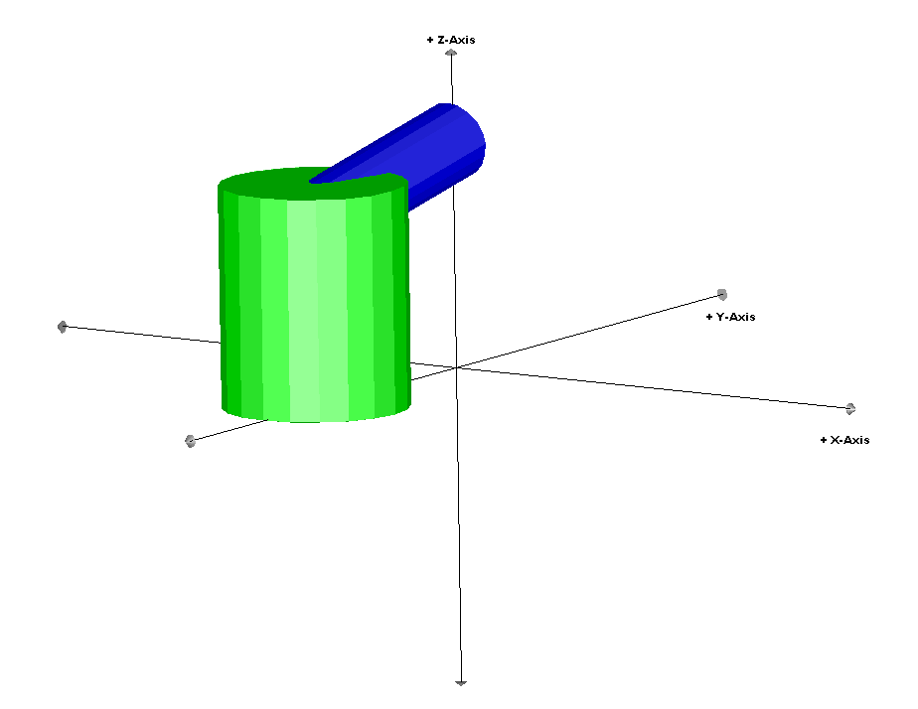
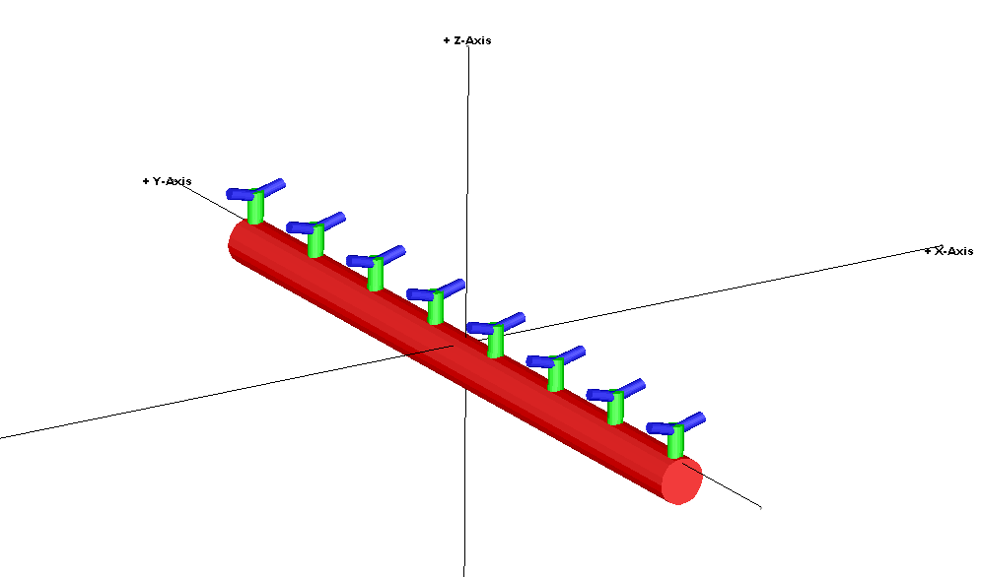
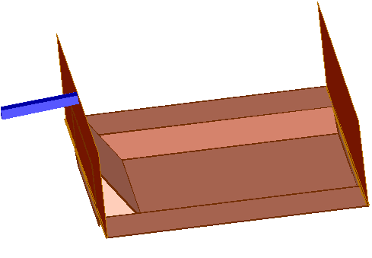
CORMIX - Cornell Mixing Zone Expert System
CORMIX1: Single Port Discharges (Doneker & Jirka, 1989)
Bounded & Unbounded channels
  rivers, estuaries, coastal, lakes
Crossflows or stagnant
Buoyant (positively, negatively, or neutral)
Uniform or Stratified Ambient (up to 3 density layers)
Submerged, Near & Above Surface Discharges
Brine, Sediment (Drill Cuttings and Muds)
Covers > 95 % of cases
CORMIX2: Multiport Diffusers (Akar & Jirka, 1990)
Similar conditions as CORMIX1
3 Major Diffuser Types
  Alternating, Unidirectional, Staged
Covers > 80 % of cases
CORMIX3: Surface Discharges (Jones & Jirka, 1990)
Similar conditions as CORMIX1
Covers > 90 % of cases
CorSpy visualizations of single port, multiport & surface discharge

Slide 12
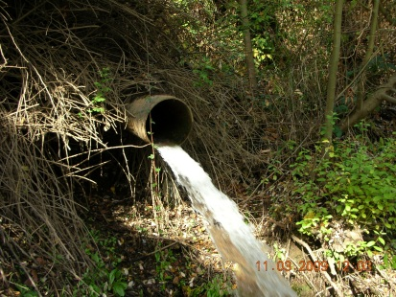
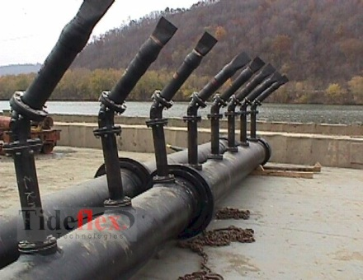
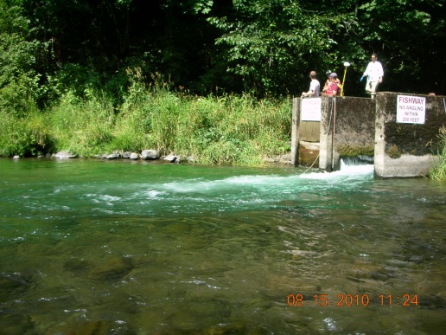
CORMIX1, 2, 3 ?
All versions of CORMIX 8.0 include CORMIX1, CORMIX2 and CORMIX3 modules
CORMIX
CORMIX1
Single Port Discharges
CORMIX2
Multiport Discharges
CORMIX3
Surface Discharges

Slide 13
Why An ”Expert” or ”Rule Based” System?
Data Driven System – specify data, system selects the model
Proper model choice; Correct model application
Guides in data acquisition
Addresses CREM guidelines - http://www.epa.gov/crem/index.html
Flexible:
  Screening of alternatives
  Switch to other models
Continuous update of knowledge base
Documented analysis - Not a ”black box”
Design System
Advanced CAD 3-D Graphics tools (CorVue, CorSpy, CorPlot)
Advanced tools (CorHyd, CorTime, Far-field model linkage)
Common Framework
  Regulator
  Applicant
Teaching environment
  Adapts to user

Slide 14
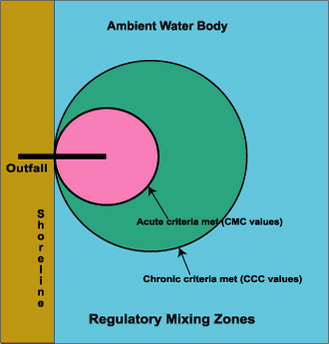
General Features of CORMIX
Data screening
Predicts quantitative & qualitative features of mixing process
Covers NPDES regulatory concerns for conventional & toxic discharges
Provides guidance to improve designs and associated dilutions
Flags undesirable designs
Provides descriptions of mixing processes
Chronic and acute Regulatory Mixing Zones for conventional and toxic discharges, respectively

Slide 15
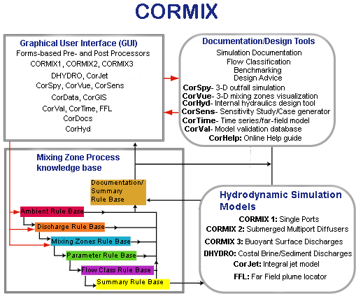
CORMIX System Components

Slide 16
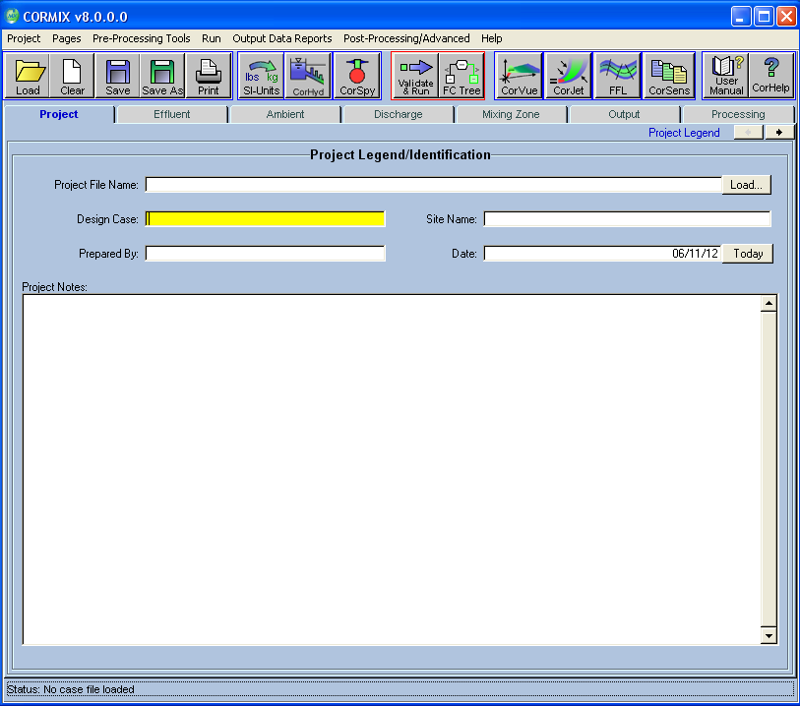
CORMIX GUI
Intuitive windows based GUI
Tab data input forms
  Project
  Effluent
  Ambient
  Discharge
  Mixing Zones
  Output
  Processing
Data screening
Validation
Extensive built in user help and advice
CORMIX Graphical User Interface (GUI)

Slide 17
CORMIX Rule Base
Input data automatically screened for logic, data type, data range and validation errors
Rule Base
  Ambient , Discharge, Zone
  Parameter
    Automatically computes all flow parameters, Length scales, fluxes, other values
    Describes near -field flow properties
  Classification & Summary
Parameter Calculations for buoyant jet mixing

Slide 18
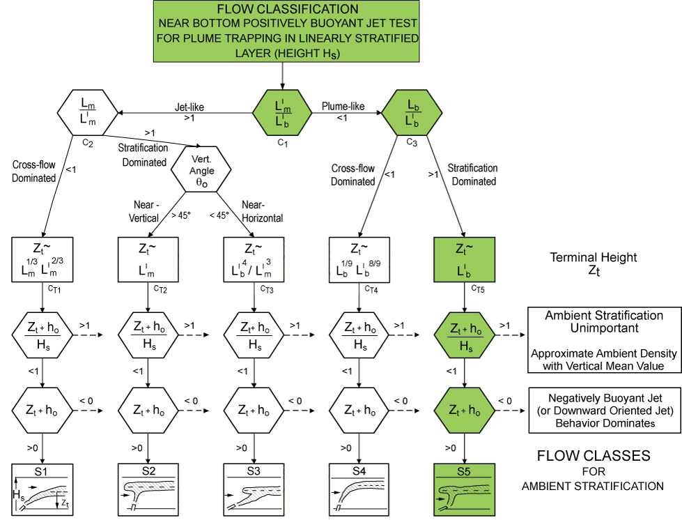
CORMIX Rule Base
Flow CLASSIFICATION Rule Base
Determines correct flow classification for given discharge/environment interaction
Develops a generic qualitative description of flow patterns
Specifies flow protocol for hydrodynamic simulation
Flow class description gives a qualitative description of the physical processes of near-field and far-field mixing
Heart of CORMIX ”knowledge base”
Compilation of 200 years of hydraulic research
CORMIX1 Classification system for plumes trapped by ambient density stratification.

Slide 19
CORMIX HYDRODYNAMIC SIMULATION Modules
FORTRAN hydrodynamic simulation program for selected flow classification
Singe Port Discharge - CORMIX1
Submerged Multiport Diffusers - CORMIX2
Shoreline/Surface Discharges - CORMIX3
Coastal Brine/Sediments/Drilling Effluents - DHYDRO
CorJet - Stable Near-field model for detailed CORMIX1 & CORMIX2
FFL - Far-Field Plume Locater
CorSens - Sensitivity Study Post-processor
CorTime - Time series analysis, far-field model linkage
Contains about 400k + lines of code
25 + years R&D

Slide 20
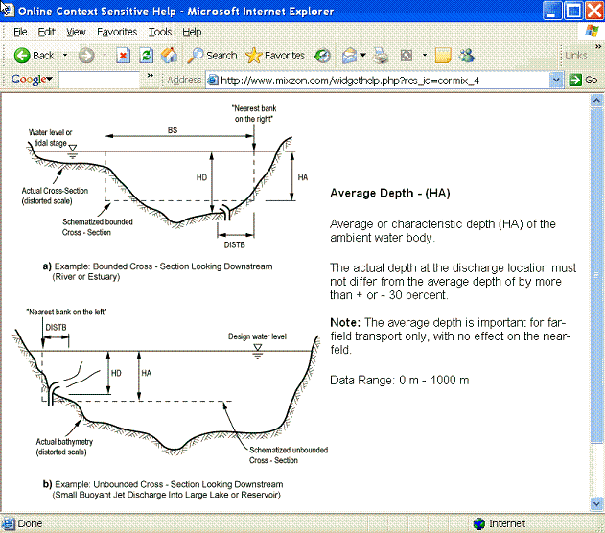


CORMIX Documentation User Help
Multiple-levels of help in GUI
  Yellow Tool Tip/hint
  CORMIX Help popup (right click)
  Context Sensitive Help
  “User Manual” button
  CorHelp – Online UI Help
  “Help -> CorHelp-Online User Guide" menu
  “Help -> CorDocs-Online Tech. Docs" menu
    Online CORMIX1/2/3 Tech. Reports
Download Manuals, Reports, FAQs, Support, QA/QC - http://www.mixzon.com
Information, Validations, References, FAQ’s , Glossary, Search Tool - http://www.cormix.info
Support Ticketing System
  E-mail to: support@mixzon.com
Online Context Sensitive Help

Slide 21
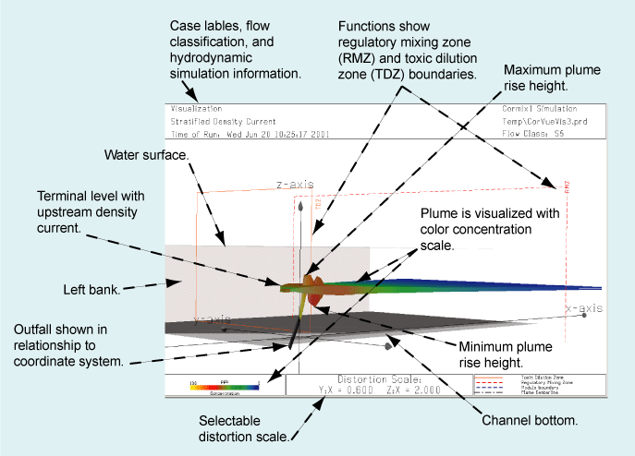
CORMIX Advanced Analysis & Design Tools
HYDRO simulation results summary
Specifies concentrations at regulatory mixing zones
Expert advice for design iteration
Data visualization & design
  CorVue (Plume Visualization)
  CorSpy (Outfall Visualization
  CorHyd (Hydraulics & Design)
  CorPlot
    2d plots
    S & C Isolines
    Deposition Contours
  CorTime
    Time Series Modeling and Analysis
    Far-Field Model Linkage
CorVue 3D Mixing Zone Visualization

Slide 22
CORMIX Data INPUT – General
All data input segments have similar features
Current data entry box is highlighted in yellow
Double-click clears entry
Open format: decimals not required for numerical input
Systems checks for data inconsistencies and errors
If error occurs during validation - user will be prompted to check and re-enter values
Units of Measure
  CORMIX uses metric SI units (MKS) in all internal calculations
  Automatically converts English/Mixed input units to metric SI equivalents
  Force all inputs to SI - “Convert to SI Units” button
  CORMIX reports only in SI units
  3 - 4 significant digits is sufficient; Densities – up to 5 significant digits

Slide 23
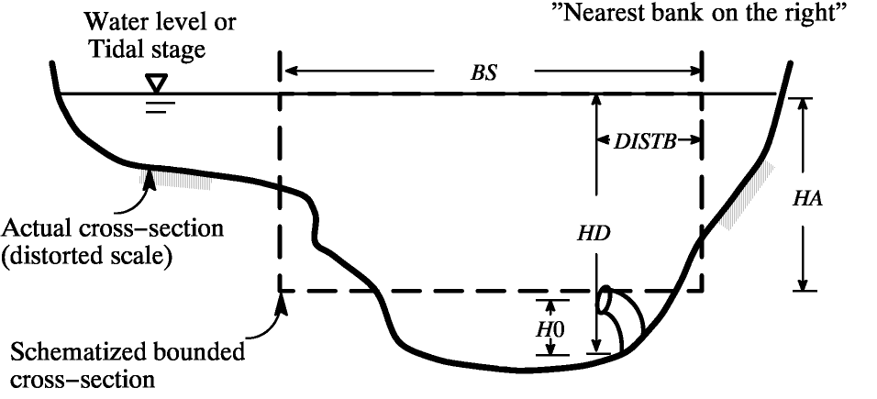
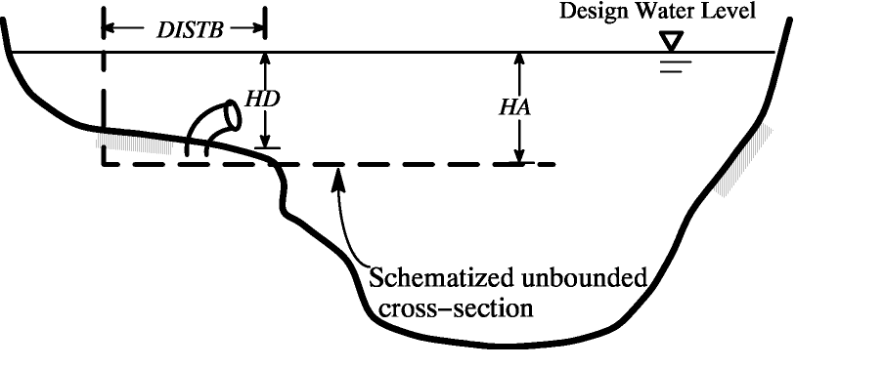
Ambient Cross-Section “Schematization”
Ambient environments always have boundaries
  Vertical
  Lateral
One must enter boundary information into CORMIX
  Process called Schematization
Assemble cross-section plots at several downstream locations
Determine “Equivalent rectangular Cross-sectional area” or schematization to account for plume boundary interaction
Negatively Buoyant Discharge
  Will sink downwards
A)
B)
Cross-Section Schematization

Slide 24
Ambient Cross-Section “Schematization”
A)
Positively Buoyant Discharge
  Will rise upwards
    Deeper areas irrelevant
  Neglect very shallow bank areas/shallow floodways
For highly non-uniform conditions:
  HD usually strongly influences near -field mixing
  HA usually strongly influences far -field mixing
Iterative process
B)
Schematizations for positively buoyant discharge

Slide 25
Ambient Density Specification
Specified as fresh water or non-fresh
Important dynamic parameter is density not temperature
If fresh water and above 10 deg C, ambient temperature can be specified
Ambient density can be uniform or non-uniform
  Neutral, Positive or Negatively buoyant discharges
    Up to 2 layer density profiles (CORMIX1 & 2)
  Brine/Sediment discharges
    Up to 3 layer density profiles (Brine & Sediment)
  CorJet allows any arbitrary density profile
    Up to 10 layers

Slide 26
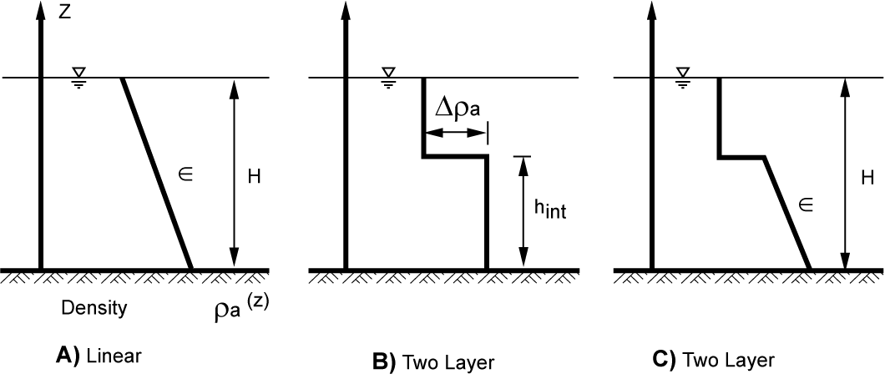
Ambient Density Specification
Neutrally, Negatively or Positively buoyant discharge density profiles:
If vertical variation of density < 1ºC or 0.1 kg/m³
  Specify as uniform
  Specify average ambient density or average ambient temperature
CORMIX1 and 2 allow for the stratification types shown in figure below
CORMIX3 (Surface Discharge) assumes positive or neutral discharge and uniform surface layer
Possible Approximations of Ambient Density Profiles

Slide 27
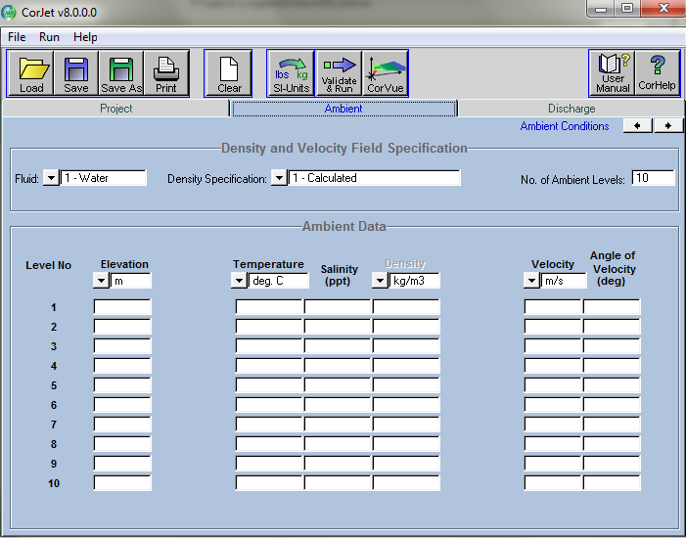
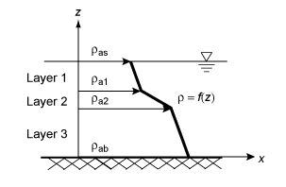
Ambient Density Specification
  Brine or Sediment discharges
  Up to 3 density levels
  CorJet
  Up to 10 density levels

Slide 28
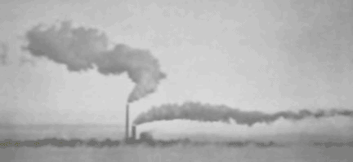
Wind Speed
Wind speed (U_{w})
Effects far-field mixing, for heated discharges
Wind is non-directional in CORMIX
  However wind direction may affect surface velocity field
  Surface currents should be captured by schematization
Wind direction can be captured in CorJet
CorVue visualization of a CorJet simulation

Slide 29
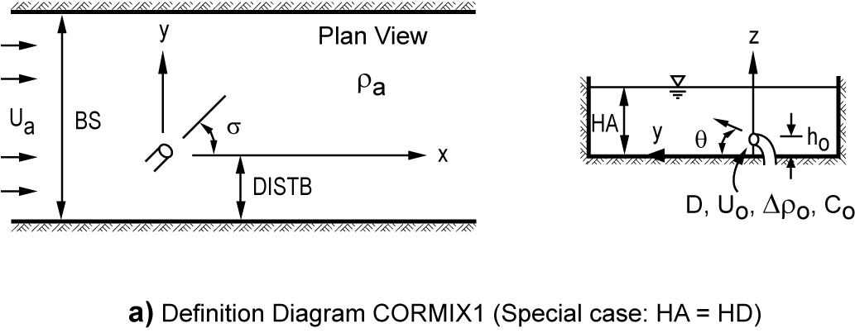
CORMIX1- Single Port Discharge - Data Input
Side View
Submerged, Near Surface, Above Surface
Ambient Data
  Distance from nearest bank (DISTB), Bounded Section Width (BS), Ambient Velocity (U_{A}), Ambient Density (RHO_{A}), Ambient Depth (HA)
Port Configuration/Geometry
  Port Diameter (D₀), Vertical Angle (THETA), Horizontal Angle (SIGMA), Port Height Above Channel Bottom (h₀)
Discharge Data
  Effluent Flow (Q₀) or Velocity (U₀), Effluent Density (RHO₀),
  Effluent Concentration – Excess above background (C₀)
    Tip: Enter as % for simplicity

Slide 30
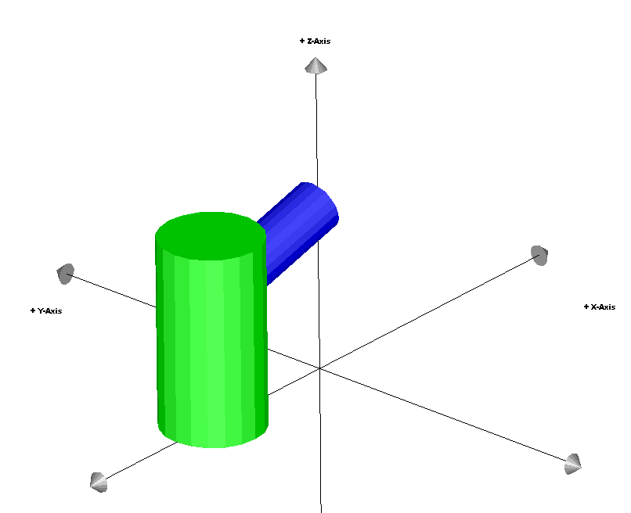
CORMIX1 - Coordinate System
Right hand coordinate system
Origin: (0,0,0) on bottom directly below port
  Index finger
    +x direction of ambient flow, u_{a}
  Middle finger:
    +y lateral direction
  Thumb:
    +z direction upwards
  Always specified in PRD file
+z -axis
+x -axis
+y -axis
Origin (0,0,0)
Coordinate System shown in CorSpy for co-flow discharge. +x is the direction of the ambient velocity u_{a}

Slide 31
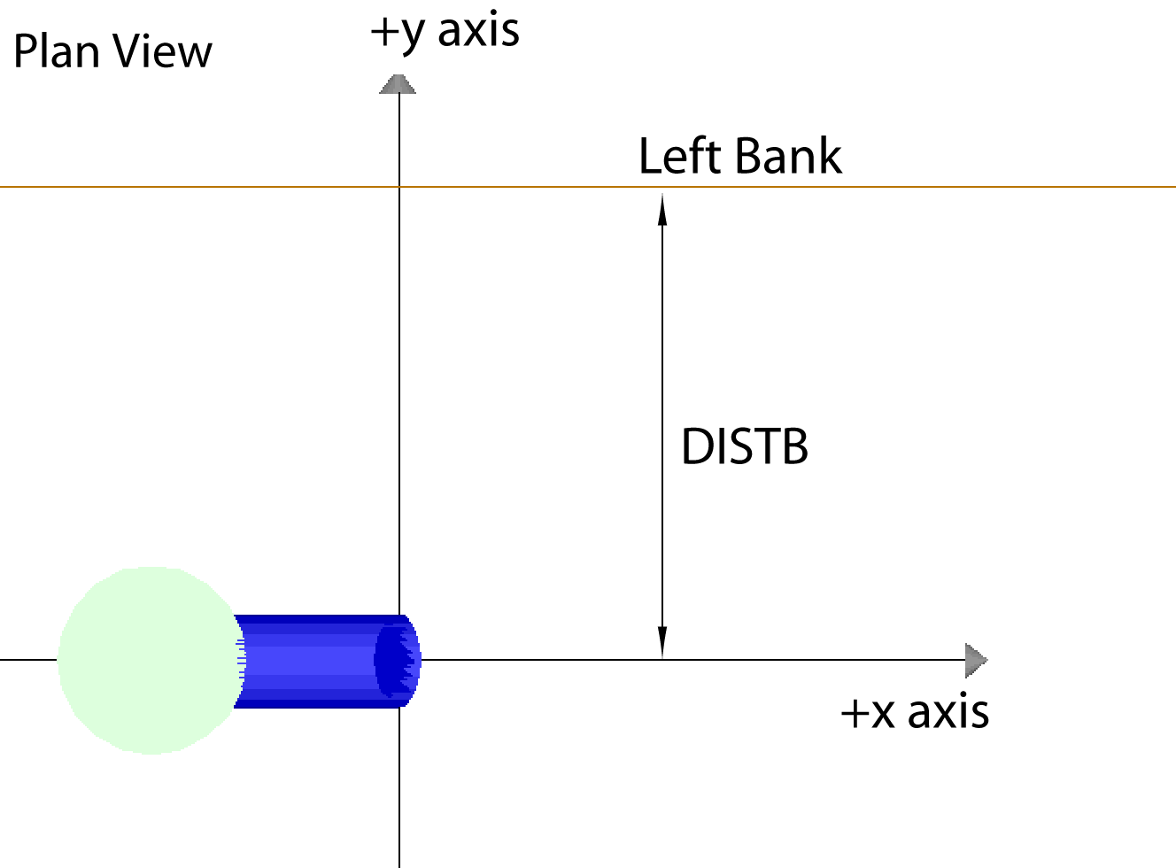
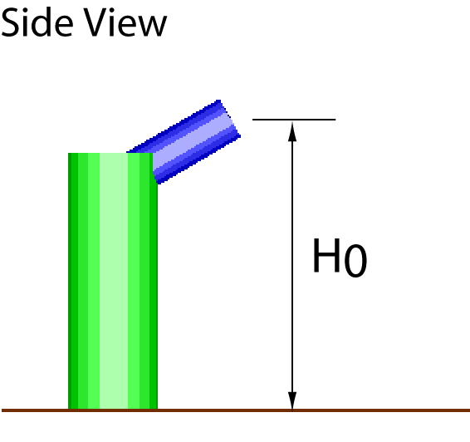
CORMIX1- Discharge Location
Nearest bank
  Left or Right as seen by observing facing downstream
DISTB
  lateral distance to nearest bank
Port diameter (D₀), or cross-sectional area (A₀)
Height of port above bottom (H₀)
A)
B)
A) Distance to bank DISTB, and
B) Port height H0 in CorSpy

Slide 32
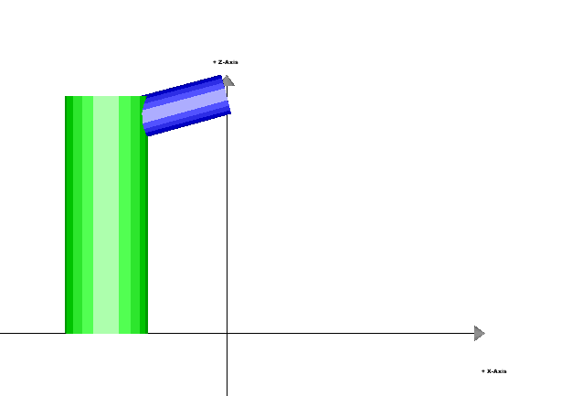
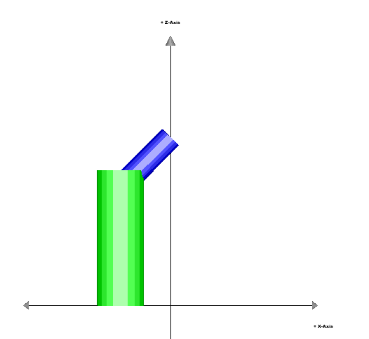
Port Orientation - Vertical Angle of Discharge θ
z- axis
Vertical angle of discharge THETA
Angle between port centerline and horizontal plane
Near Bottom Discharges
  -45 <= θ <= 90º
Near Surface Discharges
  -90 <= θ <= 90º
= 15⁰
σ= 0⁰
x- axis
z- axis
θ = 45⁰
σ= 0⁰
x- axis
Side views of single port discharge showing the discharge angle θ, in CorSpy

Slide 33
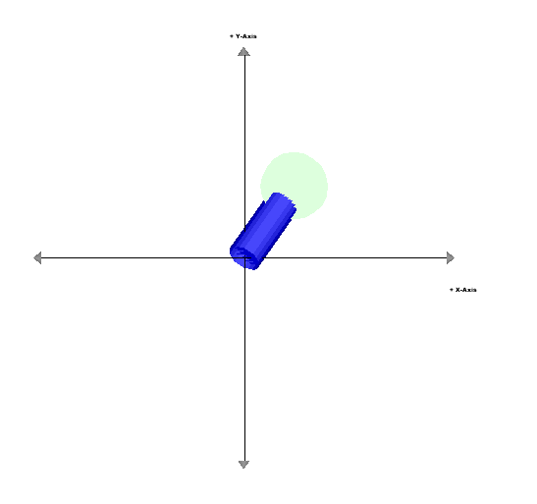
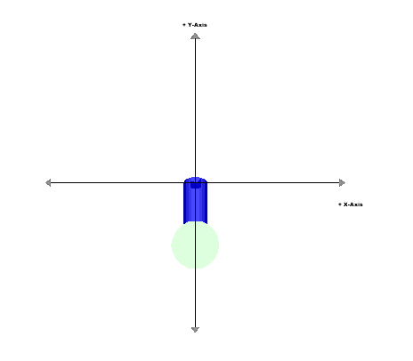
Port Orientation - Horizontal Angle of Discharge σ
A)
+y axis
Horizontal angle of discharge SIGMA
Angle between ambient current and plan projection of port centerline measured counterclockwise
0º ≤ σ ≤ 360º
  σ = 0º or 360º : Co-flow
  σ = 90º : Crossflow to left
  σ = 180º : Counter-flow
+x axis
+y axis
+y axis
B)
C)
+x axis
+x axis
Plan Views of A) σ = 0º,
B) σ = 90º, and,
C) σ = 235º in CorSpy

Slide 34
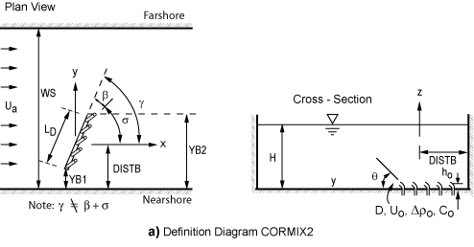
CORMIX2 - Multiport Diffuser Data Entry
Generalized definition sketch appears below
Many parameters similar to single port definitions
Definition Diagram for CORMIX2 (special case HA= HD)

Slide 35
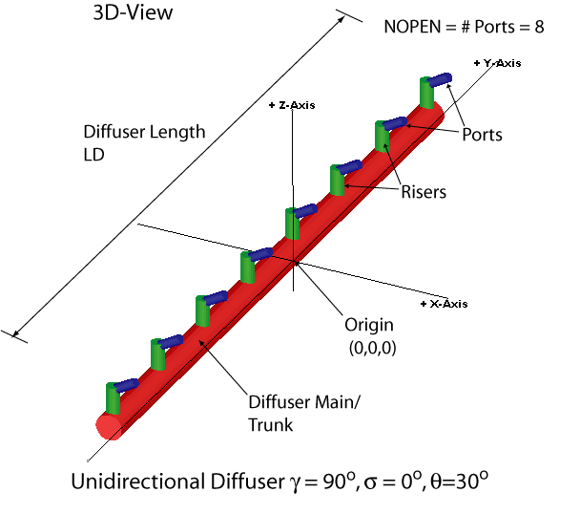
CORMIX2 - Basic Diffuser Definitions
Multiport diffuser:
  Linear structure w/ many port/nozzles discharging w/ high velocity
Diffuser line/main/trunk:
  Line connecting first port to last port
Ports/Nozzles may be connected to vertical risers
Simple pipe openings
CORMIX2 assumes a straight diffuser line
  If NOT, Approximate by straight line
Multiport Diffuser Specification & Visualization In CorSpy

Slide 36
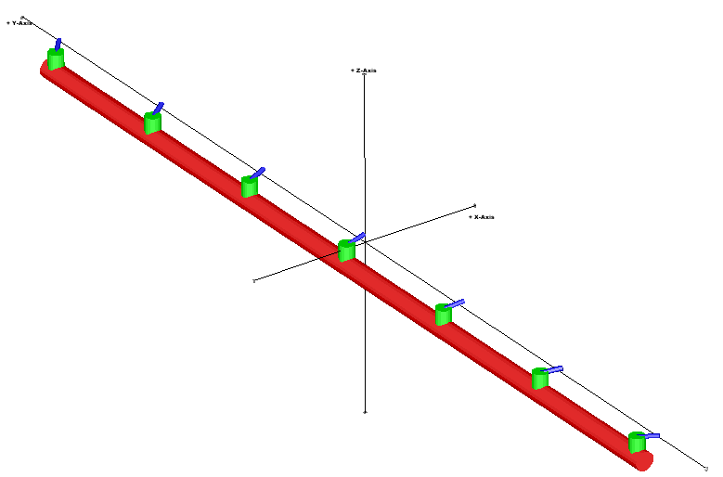
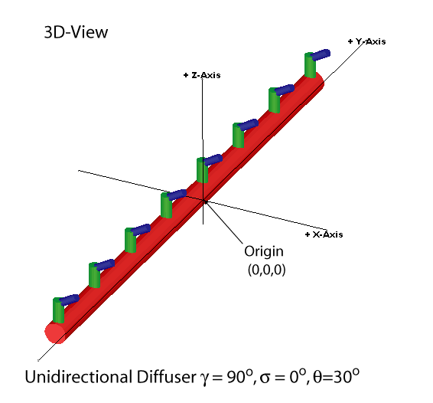
CORMIX2 - Coordinate System
Similar Ambient and Effluent Discharge data as Single Port
Right hand coordinate system:
  Index finger: +x direction of ambient flow UA
  Middle finger: +y lateral direction
  Thumb : +z direction upwards
Origin: (0,0,0) on bottom, at depth HD below water surface
Origin (0,0,0) located at diffuser mid –point
If diffuser starts on shoreline, origin on shoreline
+ y - axis
+ z - axis
+ x- axis
Origin (0,0,0)

Slide 37
CORMIX2 - Diffuser Geometry
CORMIX2 assumes uniform discharge conditions along diffuser line
Local ambient depth at discharge HD
  Offshore slopes should be approximated by mean depth
  w/ possible bias to shallow near-shore conditions
Mean values should be specified for variable diffuser geometry
Average diameter D₀ of discharge ports/nozzles
Number of ports or risers and number of ports per riser
Jet contraction coefficient value
  Set = 1.0 for conservative design

Slide 38
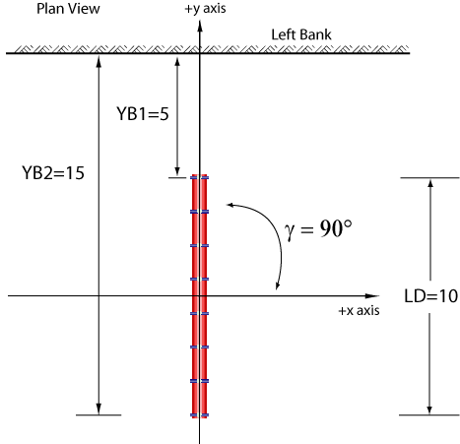
CORMIX2 - Diffuser Geometry – Alignment Angle γ
Average alignment angle GAMMA
Measured counterclockwise from ambient current (x-axis) to diffuser axis
  0º<= γ <= 180º
Distance from the shore to the first and last port/riser YB1, YB2
Figure shows an alternating perpendicular diffuser
  Length LD = 10m
  γ = 90º
Multiport diffuser geometry example for typical alternating diffuser.

Slide 39
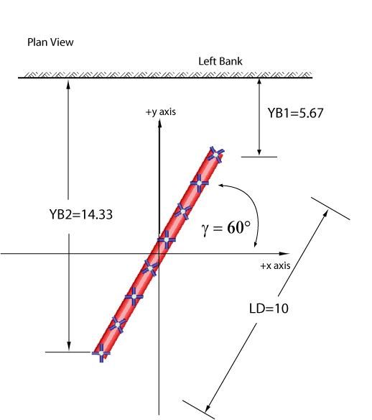
CORMIX2 - Diffuser Geometry – Alignment Angle γ
Average alignment angle GAMMA
Measured counterclockwise from ambient current (x-axis) to diffuser axis
  0º<= γ <= 180º
Distance from the shore to the first and last port/riser YB1, YB2
Figure shows an alternating rosette diffuser
  γ = 60º
Multiport diffuser geometry example for oblique rosette alternating diffuser.

Slide 40
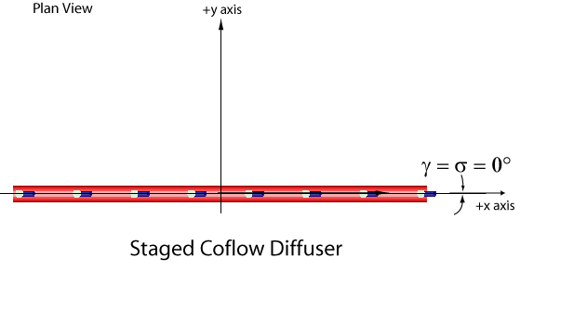
CORMIX2 - Diffuser Geometry – Alignment Angle γ
Average alignment angle GAMMA
Measured counterclockwise from ambient current (x-axis) to diffuser axis
  0º≤ γ ≤ 180º
Figure shows an staged diffuser
  γ = 0º
Multiport diffuser geometry example for co-flowing staged diffuser.

Slide 41
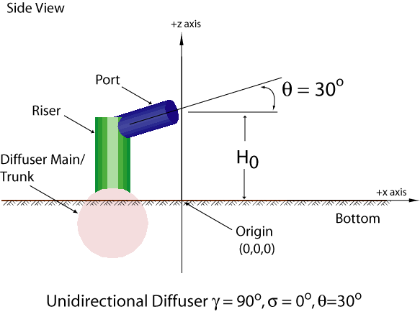
CORMIX2 - Diffuser Geometry - Vertical Angle θ, Port Height H₀
Average Vertical angle of discharge THETA (θ)
  Angle between port centerline and horizontal plane
  -45º ≤θ ≤ 90º
  Horizontal discharges θ = 0º
  Vertical discharges θ = 90º
Average height of port centers H₀ above bottom
Example of local port geometry for multiport diffuser

Slide 42
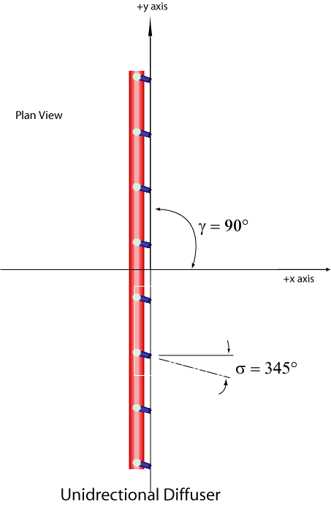
CORMIX2 - Diffuser Geometry – Horizontal Angle σ
For unidirectional and staged diffusers only:
Horizontal angle of discharge SIGMA (σ)
Angle between ambient current and plan projection of port centerline measured counterclockwise
  0º <= σ <= 360º
  Coflow: σ = 0º or 360º :
  Crossflow: σ = 90º

Slide 43
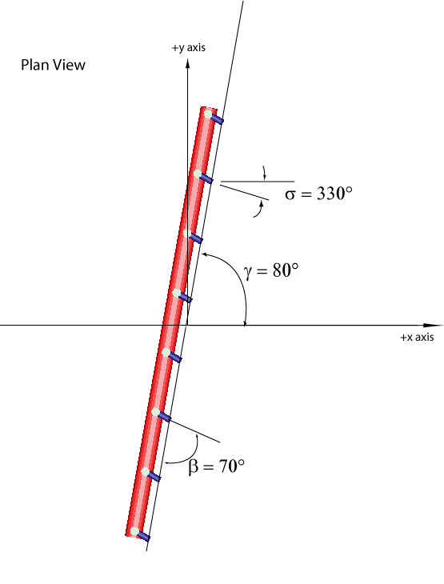
CORMIX2 - Diffuser Geometry – Relative Orientation β
For unidirectional and staged diffusers only:
Relative orientation angle BETA β
  Measured from average plan projections of port centerlines to nearest diffuser axis (clockwise or counterclockwise)
  0º<= β <=360º
Unidirectional diffuser
  β  90º
Staged diffuser
  β  0º

Slide 44
CORMIX2 Multiport Diffuser Types
3 Major CORMIX2 Diffuser Types
Unidirectional diffuser: all ports point to one side of diffuser line, more or less horizontally
  Imparts net horizontal momentum perpendicular to diffuser line
Staged diffuser: all ports point in one direction along diffuser line, more or less horizontally
  Imparts net horizontal momentum along diffuser line
Alternating diffuser: ports do not point in single horizontal direction
  Imparts no net horizontal momentum
  May point more or less horizontally in alternating directions
  May point vertically upwards
CORMIX always assumes uniform spacing and round port
cross-sections

Slide 45
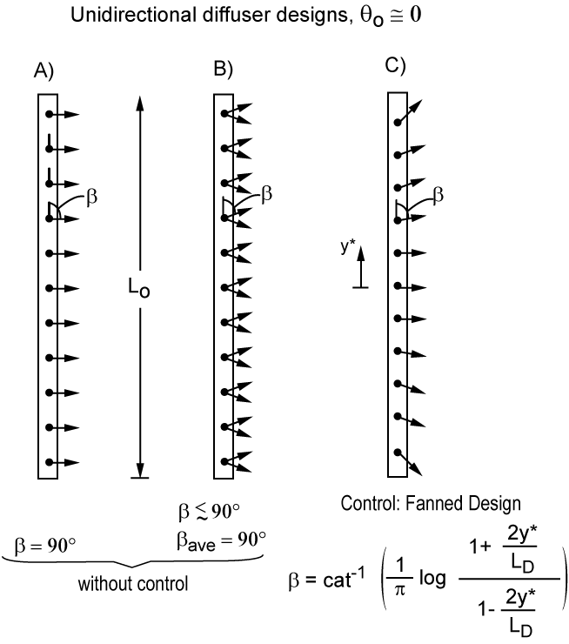
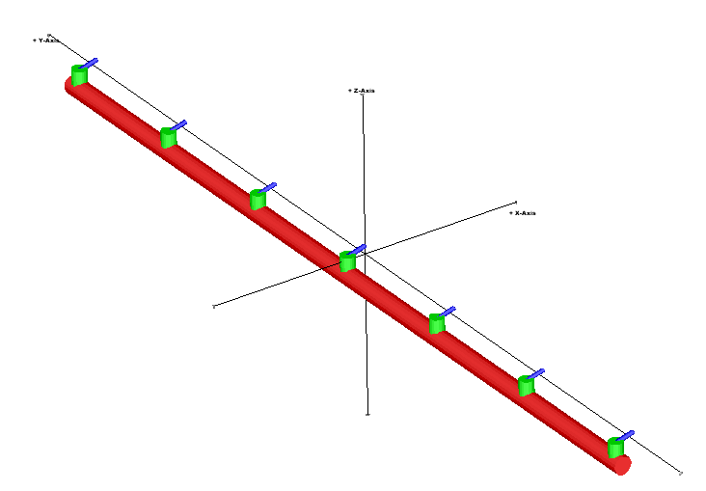
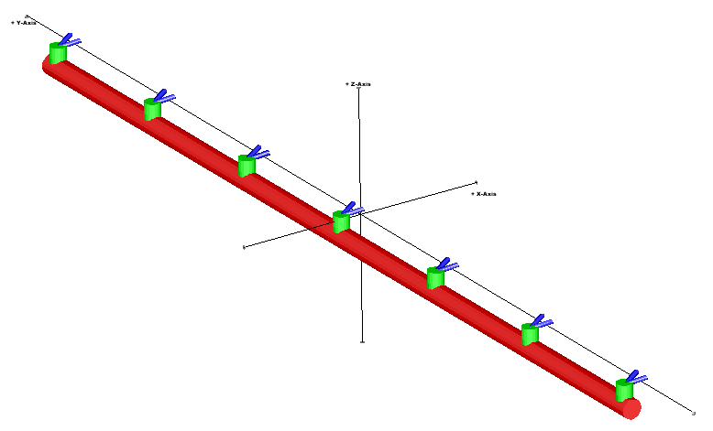
Unidirectional Diffusers
A)
B)
LD
C)

Slide 46
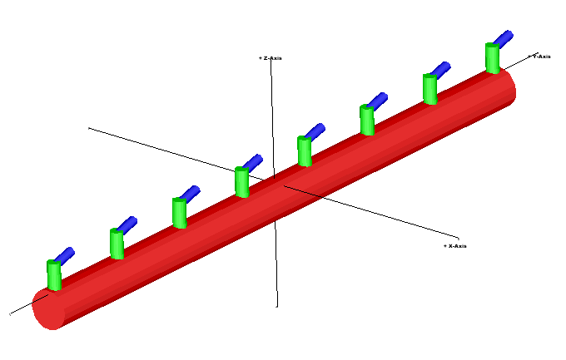
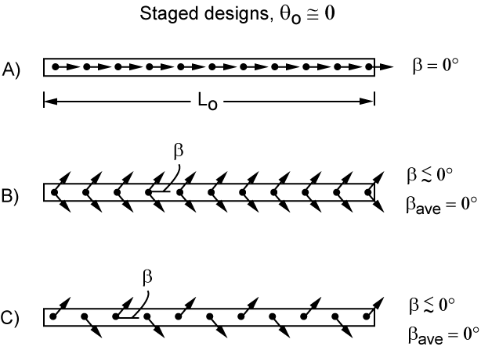
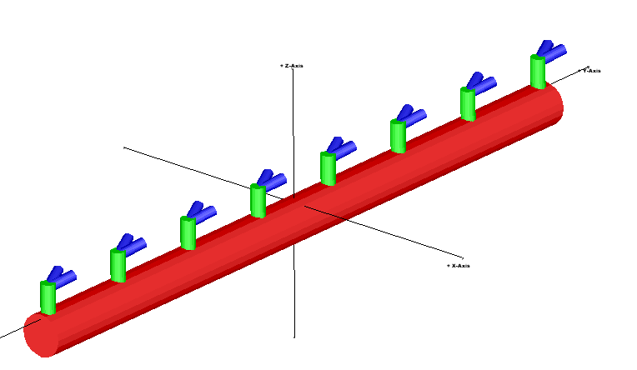
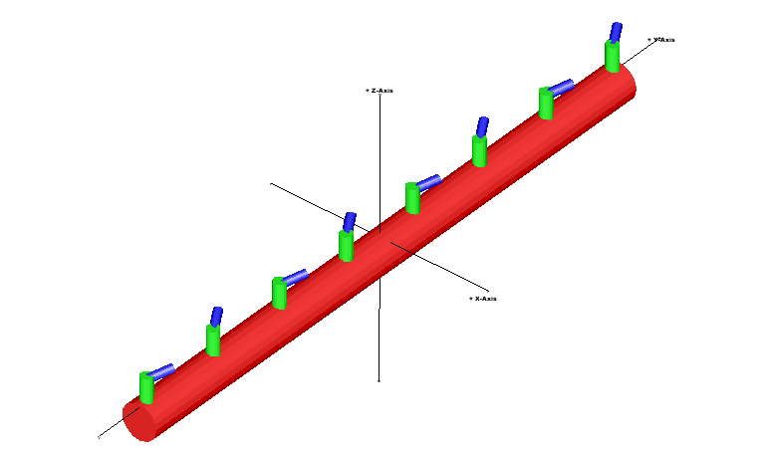
Staged Diffusers
A)
LD
B)
C)

Slide 47
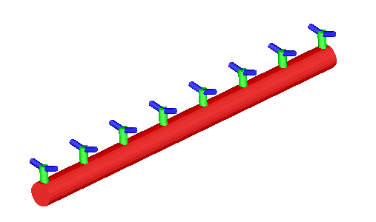
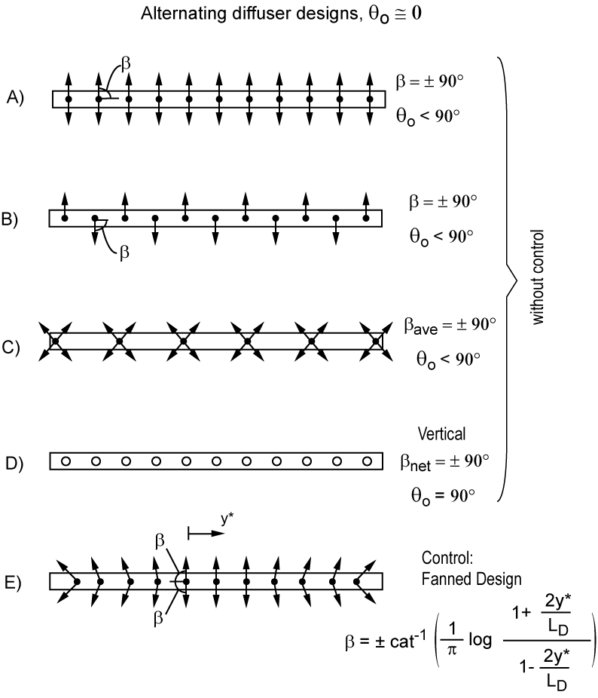
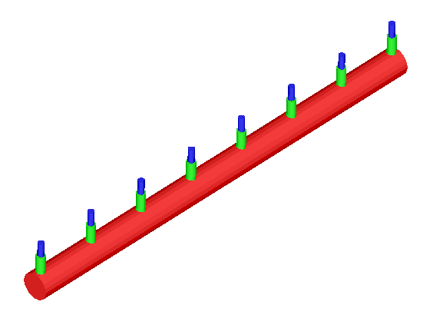
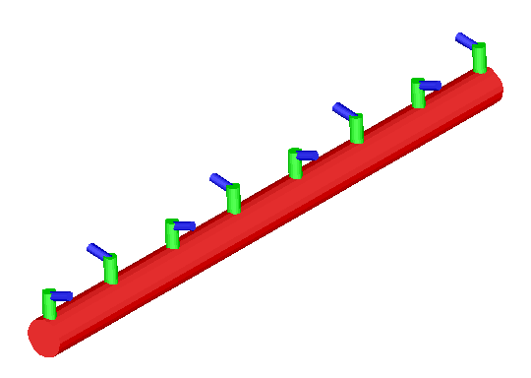


Alternating Diffusers
A)
B)
D)
C)
E)

Slide 48
Models for Mixing Processes: Part 1 Summary
Types & Scale of mixing models
CORMIX Model
  CORMIX Input Specification
Q & A

Slide 49

Break
10 minute break

Slide 50
CORMIX – GUI Demo
GUI Components
  Menu & Tool bars
  Input Tab Pages
Levels of Help
  Tool Tips
  Help Windows
  Online Context sensitive help
  CORMIX User Manual
  CorHelp – Online User Interface Help
  Flow class tree – FC-DTree Button
CORMIX Files
  Input file (*.cmx)
  Prediction File (*.prd)
  Sessions Report (*.ses)
  Processing Journal (*.jrn)
Brief Overview of CORMIX Pre-Post Processing and Advanced Tools
  CorVue, CorSpy
  CorSens
  CorPlot
  CorHyd
  CorTime

Slide 51
Models for Mixing Processes: Part 2
Flow Classification Procedure
  Flow Classification - Basic Parameters
  Basic Flux quantities – Source Properties
  Length Scales – Measures of Influence
CORMIX Output
  Hydrodynamic Simulation Module
  Prediction File
  Processing Journal
  Session Report

Slide 52
CORMIX Flow Classification – Basic Parameters
u_{a} = ambient velocity
u_{o} = discharge velocity
A₀ = port area
H = water depth
h_{int}= pycnocline height
W = width of channel
g’₀ = discharge buoyancy
  Reduced gravitational acceleration due to density difference
ε = ambient buoyancy gradient

Slide 53
Basic Discharge Flux Quantities – Source Properties
Discharge Volume Flux Q₀ - Source Strength
  Q₀ = U₀A₀ [L³/T]
Discharge Momentum Flux M₀ - Source Kinetic Energy
  M₀ = Q₀U₀ [L⁴/T²]
Discharge Buoyancy Flux J₀ - Source Gravitational Energy
[L⁴/T³]

Slide 54
Length Scales – Discharge Length Scale L_{Q}
NOT precise measurements for influence of different processes
Only scale estimates, .i.e. “on the order of”
Discharge (volume, geometric) length scale L_{Q}
Measures Length of Zone of Flow Establishment (ZOFE)
  Change in velocity profile from logarithmic to free jet
*

Slide 55

Length Scales - Jet/Plume Transition Length Scale L_{M}
For combined buoyant jet flow, the distance at which the transition from jet to plume behavior occurs in stagnant uniform ambient

Slide 56

Length Scales - Jet/Crossflow Transition Length Scale L_{m}
In the presence of crossflow, the distance of jet penetration before jet is strongly deflected by ambient flow
Several length scales defined for various transitions, interactions
Similar length scales defined for CORMIX2 and CORMIX3
  User Manual
  Technical Reports
  CORMIX Workshops, Online Training

Slide 57


Stable vs. Unstable Discharge Conditions
Stable
Unstable
Experiments and Photos: Philip J.W. Roberts, Georgia Institute of Technology

Slide 58
General CORMIX Flow Classification Procedure
CORMIX analyzes the dynamic interaction of the plume with the ambient environment
Plume momentum and buoyancy at boundary interaction control mixing hydrodynamics and flow classification
Example for CORMIX1 Flow Classification:
  Is stratification dynamically important?
    Does jet/plume get trapped?
    Yes: Stratified flow classes S (e.g. S1, S2, etc)
  Negatively buoyant?
    Yes: Negatively buoyant flow classes N (e.g. NV1, NH3, etc.)
  Positively buoyant or neutral?
    Yes: Buoyant flow classes V,H (e.g. V1, H4-0, etc)
  Bottom attachment effects?
    Yes: Attached flow classes ..A (e.g. V1A2, S3A3, etc)

Slide 59
CORMIX Flow Class
CORMIX1 (126 flow classes)
  Classes S Flows trapped within linear stratification
  Classes V,H Positively buoyant flows in uniform density layer
  Classes NV,NH Negatively buoyant flows in uniform density layer
  Classes A Flows affected by dynamic bottom attachments
  Classes I Images of S,V,H,A e.g.: IS, IV1, IH2, IPV3, IPH4 (Near Surface)
CORMIX2 (64 flow classes)
  Classes MS Flows trapped within linear stratification
  Classes MU Positively buoyant flows in uniform density layer
  Classes MNU Negatively buoyant flows in uniform density layer
  Classes I Images of MS,MU,MNU e.g.: IMS, IMU, IMPU (Near Surface)
CORMIX3 (9 flow classes)
  Classes FJ Free jet flows w/o near-field shoreline interaction
  Classes SA Shoreline attached discharges in crossflow
  Classes WJ Wall jets/plumes from discharges parallel to shoreline
  Classes PL Upstream intruding
  Flow Class Categories and Descriptions

Slide 60

CORMIX1 Flow Classification Example
Example for deeply submerged near-vertical single port discharge (Vx)
CORMIX User Manual - Appendix A – complete set of flow classifications
For a particular input case - “FC-Tree” button in CORMIX UI

Slide 61

CORMIX2 Flow Classification Example
MU flow classes: Positively buoyant multiport flows in uniform density layer

Slide 62

Hydrodynamic Simulation Modules
CORMIX uses regional flow models
Distinct Series of “hydrodynamic modules” are executed sequentially to simulate entire flow field for a given flow classification
Flow class descriptions give qualitative description of physical mixing processes likely to be present for flow
Illustrative example of a sequence of CORMIX hydrodynamic flow modules
executed for plume simulation for flow classification V1

Slide 63
CORMIX Hydrodynamic Simulation & Prediction File
CORMIX Hydrodynamic Simulation and Flow Modules
The FORTRAN tabular simulation output is available as filename.prd
x, y, z trajectory of plume centerline
Concentration c of pollutant
Dilution S = c₀/c
Plume width (B, BH, or BV)
Continuous modules
Most subsurface modules based on CORJET or CorSurf
Some buoyant spreading modules are integral
Control volume modules
Used when no mechanistically based mathematical description is available
Based on conservation of mass, momentum
Transitions from module to modules
Continuous, satisfying conservation of mass, momentum, energy
Occasional mismatches in plume width will result
Most mismatches are small

Slide 64
CORMIX Hydrodynamic Simulation & Prediction File
Maximum Centerline vs. Flux Average Dilution
To obtain flux average or bulk dilution (S_{f})
For single port discharges: S_{f}/S = 1.7
For multiport discharges or surface discharges: S_{f}/S = 1.3
Dilution vs. Concentration
CORMIX gives minimum centerline dilution S
  maximum concentration C
Dilution S is ratio of initial concentration C₀ to concentration C at given location
Dilution neglects any decay or growth for non-conservative pollutants
Dilution S will NOT include 1st order effects; while Concentration C does!
Hydrodynamic Display
Plume centerline shift to bank after attachment more gradual than predicted

Slide 65
CORMIX Output - CORMIX1 Prediction File - Header
CASE DESCRIPTION
……….
ENVIRONMENT PARAMETERS (metric units)
Unbounded section
HA = 35.00 HD = 30.50
UA = 0.015 F = 0.010 USTAR =0.5197E-03
UW = 2.000 UWSTAR=0.2198E-02
Density stratified environment
STRCND= C RHOAM = 997.6240
RHOAS = 996.2053 RHOAB = 999.6072 RHOAH0= 999.5599 E =0.7725E-03
DRHOJ = 2.1813 HINT = 15.50 ES =0.2153E-02
DISCHARGE PARAMETERS (metric units)
BANK = RIGHT DISTB = 46.00
D0 = 0.254 A0 = 0.051 H0 = 0.60 SUB0 = 29.90
THETA = 10.00 SIGMA = 90.00
U0 = 3.019 Q0 = 0.153 =0.1530E+00
RHO0 = 998.2051 DRHO0 =0.1355E+01 GP0 =0.1329E-01
C0 =0.3500E+04 CUNITS= ppb
IPOLL = 1 KS =0.0000E+00 KD =0.0000E+00
FLUX VARIABLES (metric units)
Q0 =0.1530E+00 M0 =0.4620E+00 J0 =0.2034E-02 SIGNJ0= 1.0
Associated length scales (meters)
LQ = 0.23 LM = 12.43 Lm = 45.31 Lb = 602.58
Lmp = 4.95 Lbp = 3.12
NON-DIMENSIONAL PARAMETERS
FR0 = 51.97 R = 201.30
FLOW CLASSIFICATION
111111111111111111111111111111111111111111
1 Flow class (CORMIX1) = S3 1
1 Applicable layer depth HS = 15.50 1
111111111111111111111111111111111111111111
MIXING ZONE / TOXIC DILUTION / REGION OF INTEREST PARAMETERS
C0 =0.3500E+04 CUNITS= ppb
NTOX = 1 CMC =0.1200E+04 CCC = CSTD
NSTD = 1 CSTD =0.6000E+03
REGMZ = 1
REGSPC= 2 XREG = 0.00 WREG = 120.00 AREG = 0.00
XINT = 3500.00 XMAX = 3500.00
Project Tab Information: Case description, date, time, site name, etc.
Effluent & Ambient Tab Information:
Summary input ambient and discharge data, Densities, currents, flow rates, channel data.
Computed Flux Variables and Length Scales - based on input data
Computed Froude number and cross flow ratio – based on input data
Predicted Flow Class and layer depth
Mixing Zone Tab: Summary mixing zone input data

Slide 66
CORMIX Output - CORMIX1 Prediction File - Near-field
X-Y-Z COORDINATE SYSTEM:
ORIGIN is located at the bottom and below the center of the port:
46.00 m from the RIGHT bank/shore.
X-axis points downstream, Y-axis points to left, Z-axis points upward.
NSTEP = 10 display intervals per module
----------------------------------------------------------------------------------------------
BEGIN MOD101: DISCHARGE MODULE
X Y Z S C B Uc TT
0.00 0.00 0.60 1.0 0.350E+04 0.13 3.019 .00000E+00
END OF MOD101: DISCHARGE MODULE
----------------------------------------------------------------------------------------------
BEGIN CORJET (MOD110): JET/PLUME NEAR-FIELD MIXING REGION
Jet-like motion in linear stratification with weak crossflow.
Zone of flow establishment: THETAE= 10.00 SIGMAE= 89.88
LE = 1.25 XE = 0.00 YE = 1.23 ZE = 0.82
Profile definitions:
B = Gaussian 1/e (37%) half-width, normal to trajectory
S = hydrodynamic centerline dilution
C = centerline concentration (includes reaction effects, if any)
Uc = Local centerline excess velocity (above ambient)
TT = Cumulative travel time
X Y Z S C B Uc TT
0.00 0.00 0.60 1.0 0.350E+04 0.13 3.019 .00000E+00
……………………………
** CMC HAS BEEN FOUND **
The pollutant concentration in the plume falls below CMC value of 0.120E+04 in the current prediction interval.
This is the extent of the TOXIC DILUTION ZONE.
0.08 5.86 1.70 4.4 0.804E+03 0.66 0.824 .35600E+01
**WATER QUALITY STANDARD OR CCC HAS BEEN FOUND**
The pollutant concentration in the plume falls below water quality standard or CCC value of 0.600E+03
in the current prediction interval. This is the spatial extent of concentrations exceeding the water quality standard or CCC value.
0.18 8.22 2.22 6.1 0.571E+03 0.93 0.587 .71119E+01
0.32 10.68 2.82 8.0 0.436E+03 1.21 0.450 .12113E+02
Level of buoyancy reversal in stratified ambient.
0.51 13.02 3.39 9.8 0.356E+03 1.48 0.367 .18106E+02
……………………………
Maximum jet height has been reached.
1.31 20.03 4.27 15.2 0.231E+03 2.30 0.231 .43204E+02
……………………………
Terminal level in stratified ambient has been reached.
Cumulative travel time = 66.3937 sec ( 0.02 hrs)
END OF CORJET (MOD110): JET/PLUME NEAR-FIELD MIXING REGION
Explanation of coordinate system
Every module has a description, BEGIN and END
Each module will include a description of the Plume Profile.
Eg: Gaussian profiles, top-hat profiles, etc.
x, y, z value of plume centerline trajectory, Centerline Dilution - S , Concentration - C, Width - B, Excess Velocity - Uc, Travel Time - TT
CMC (TDZ) and CCC (WQS) alert messages.
Buoyant Jet reversal
Maximum buoyant jet trajectory height
Cumulative plume travel time and end of module

Slide 67
CORMIX Output: CORMIX1 Prediction File - Boundary Interaction
BEGIN MOD137: TERMINAL LAYER INJECTION/UPSTREAM SPREADING
UPSTREAM INTRUSION PROPERTIES:
Maximum elevation of jet/plume rise = 7.62 m
Layer thickness in impingement region = 1.30 m
Upstream intrusion length = 94.44 m
X-position of upstream stagnation point = -92.35 m
Thickness in intrusion region = 1.30 m
Half-width at downstream end = 197.08 m
Thickness at downstream end = 0.93 m
Control volume inflow:
X Y Z S C B TT
2.09 24.72 3.42 19.2 0.182E+03 2.87 .66394E+02
Profile definitions:
BV = top-hat thickness, measured vertically
BH = top-hat half-width, measured horizontally in Y-direction
ZU = upper plume boundary (Z-coordinate)
ZL = lower plume boundary (Z-coordinate)
S = hydrodynamic average (bulk) dilution
C = average (bulk) concentration (includes reaction effects, if any)
TT = Cumulative travel time
X Y Z S C BV BH ZU ZL TT
-92.35 24.72 3.42 9999.9 0.000E+00 0.00 0.00 3.42 3.42 .66359E+04
-88.49 24.72 3.42 75.9 0.461E+02 0.33 27.87 3.58 3.25 .66394E+02
……………………………
** REGULATORY MIXING ZONE BOUNDARY is within the Near-Field Region **
In this prediction interval the TOTAL plume width meets or exceeds the regulatory value = 120.00 m.
This is the extent of the REGULATORY MIXING ZONE.
6.07 24.72 3.42 19.3 0.181E+03 1.29 140.75 4.06 2.77 .33181E+03
24.98 24.72 3.42 22.5 0.155E+03 1.23 153.68 4.03 2.81 .15926E+04
……………………………
100.63 24.72 3.42 36.1 0.970E+02 0.93 197.08 3.89 2.95 .66359E+04
Cumulative travel time = 6635.8916 sec ( 1.84 hrs)
END OF MOD137: TERMINAL LAYER INJECTION/UPSTREAM SPREADING
----------------------------------------------------------------------------------------------
** End of NEAR-FIELD REGION (NFR) **
In this design case, the discharge is located CLOSE TO BANK/SHORE. Some boundary interaction occurs at end of near-field.
This may be related to a design case with a very LOW AMBIENT VELOCITY.
The dilution values in one or more of the preceding zones may be too high.
Carefully evaluate results in near-field and check degree of interaction.
Consider locating outfall further away from bank or shore. In the next prediction module, the plume centerline will be set to follow the bank/shore.
Boundary approach module with Upstream Intrusion
Upstream stagnation point
Control volume inflow boundary conditions
Plume profile definition – 2 dimensional profile
-x values – upstream intrusion points.
S at stagnation point is undefined so S = 9999.9
Extent of Regulatory Mixing Zone
(within NFR in this case)
Control volume outflow boundary conditions
End of Near Field Region
Shore interaction & low Ua warnings
Design Advice

Slide 68
CORMIX Output: CORMIX2 Prediction File - Far-field Density Current
BEGIN MOD241: BUOYANT AMBIENT SPREADING
Profile definitions:
BV = top-hat thickness, measured vertically
BH = top-hat half-width, measured horizontally in y-direction
ZU = upper plume boundary (Z-coordinate)
ZL = lower plume boundary (Z-coordinate)
S = hydrodynamic average (bulk) dilution
C = average (bulk) concentration (includes reaction effects, if any)
TT = Cumulative travel time
Plume Stage 1 (not bank attached):
X Y Z S C BV BH ZU ZL TT
32.26 0.00 0.00 8.7 0.115E+02 0.49 62.07 0.49 0.00 .15603E+04
39.94 0.00 0.00 8.8 0.113E+02 0.48 63.76 0.48 0.00 .19443E+04
47.62 0.00 0.00 8.9 0.112E+02 0.48 65.40 0.48 0.00 .23282E+04
55.30 0.00 0.00 9.0 0.111E+02 0.47 67.00 0.47 0.00 .27122E+04
62.98 0.00 0.00 9.1 0.110E+02 0.46 68.54 0.46 0.00 .30962E+04
70.66 0.00 0.00 9.2 0.109E+02 0.46 70.05 0.46 0.00 .34802E+04
Cumulative travel time = 3480.2034 sec ( 0.97 hrs)
----------------------------------------------------------------------------------------------
Plume is ATTACHED to RIGHT bank/shore.
Plume width is now determined from RIGHT bank/shore.
Plume Stage 2 (bank attached):
X Y Z S C BV BH ZU ZL TT
70.66 -70.00 0.00 9.2 0.109E+02 0.46 140.00 0.46 0.00 .34802E+04
356.53 -70.00 0.00 11.6 0.865E+01 0.47 171.25 0.47 0.00 .17774E+05
642.40 -70.00 0.00 14.7 0.682E+01 0.52 198.45 0.52 0.00 .32067E+05
928.26 -70.00 0.00 18.6 0.538E+01 0.58 223.58 0.58 0.00 .46360E+05
1214.13 -70.00 0.00 23.4 0.428E+01 0.66 247.53 0.66 0.00 .60654E+05
1500.00 -70.00 0.00 29.1 0.344E+01 0.75 270.74 0.75 0.00 .74947E+05
Cumulative travel time = 74947.1719 sec ( 20.82 hrs)
Simulation limit based on maximum specified distance = 1500.00 m.
This is the REGION OF INTEREST limitation.
END OF MOD241: BUOYANT AMBIENT SPREADING
----------------------------------------------------------------------------------------------
----------------------------------------------------------------------------------------------
CORMIX2: Multiport Diffuser Discharges End of Prediction File
22222222222222222222222222222222222222222222222222222222222222222222222222222222222222222222222
Buoyant Ambient Spreading Module Start
Plume profile definition – 2 dimensional rectangular profile
Plume has NOT yet contact lateral bank
Plume contact with RIGHT bank (looking downstream); Hence “–ve” Y values
Y coordinate shifts to right bank after shoreline contact
Simulation limit/ROI and end of module

Slide 69
CORMIX Output: CORMIX3 Prediction File - Far-field Passive Diffusion
Far-Field passive diffusion – Begin Module
BEGIN MOD361: PASSIVE AMBIENT MIXING IN UNIFORM AMBIENT
Vertical diffusivity (initial value) = 0.179E+00 m^2/s
Horizontal diffusivity (initial value) = 0.224E+00 m^2/s
Profile definitions:
BV = Gaussian s.d.*sqrt(pi/2) (46%) thickness, measured vertically
= or equal to water depth, if fully mixed
BH = Gaussian s.d.*sqrt(pi/2) (46%) half-width,
measured horizontally in Y-direction
S = hydrodynamic centerline dilution
C = centerline concentration (includes reaction efects, if any)
TT = Cumulative travel time
Plume Stage 2 (bank attached):
X Y Z S C BV BH TT
292.93 -10.00 0.00 119.6 0.836E+00 4.13 36.19 .39545E+03
Plume interacts with BOTTOM.
The passive diffusion plume becomes VERTICALLY FULLY MIXED within this
prediction interval.
663.64 -10.00 0.00 323.9 0.309E+00 10.00 40.43 .85826E+03
1034.34 -10.00 0.00 354.6 0.282E+00 10.00 44.27 .13211E+04
** REGULATORY MIXING ZONE BOUNDARY **
In this prediction interval the plume DOWNSTREAM distance meets or exceeds
the regulatory value = 1200.00 m.
This is the extent of the REGULATORY MIXING ZONE.
1405.05 -10.00 0.00 382.9 0.261E+00 10.00 47.80 .17839E+04
1775.76 -10.00 0.00 409.2 0.244E+00 10.00 51.09 .22467E+04
2146.47 -10.00 0.00 434.0 0.230E+00 10.00 54.18 .27095E+04
2517.17 -10.00 0.00 457.4 0.219E+00 10.00 57.10 .31723E+04
2887.88 -10.00 0.00 479.7 0.208E+00 10.00 59.88 .36351E+04
3258.59 -10.00 0.00 500.9 0.200E+00 10.00 62.54 .40979E+04
3629.29 -10.00 0.00 521.3 0.192E+00 10.00 65.09 .45607E+04
4000.00 -10.00 0.00 541.0 0.185E+00 10.00 67.54 .50235E+04
Cumulative travel time = 5023.5024 sec ( 1.40 hrs)
Simulation limit based on maximum specified distance = 4000.00 m.
This is the REGION OF INTEREST limitation.
END OF MOD361: PASSIVE AMBIENT MIXING IN UNIFORM AMBIENT
---------------------------------------------------------------------------------
---------------------------------------------------------------------------------
CORMIX3: Buoyant Surface Discharges End of Prediction File
3333333333333333333333333333333333333333333333333333333333333333333
Ambient diffusivity values
Plume profile definition
Plume has contacted lateral RIGHT bank
Y coordinate shifts to RIGHT bank after shoreline contact
Plume contacts BOTTOM and VERTICALLY Fully Mixed
BV = HS
Extent of Regulatory Mixing Zone Boundary
Cumulative plume travel time
Simulation limit/ROI and end of module
End of Prediction File

Slide 70

CORMIX Output: Processing Record
Basic information on mixing processes using careful terminology
  Logic and parameter range errors encountered during automatic data screening
Additional checks for data consistency with modeling assumptions
Computed length scales and dynamic parameters
Describes key calculations & assumptions
Subsequent tests may alter or amplify initial results
  Ambient density profiles may not be stable
    Stability is checked with a flux Richardson number
  Dynamic bottom attachments
  Near-field instabilities may prevent sinking plume
Collects information for Flow Classification
  Logic of flow classification
Alerts user to FLOW CLASSIFICATION
  Alerts user if simulation is available for the assigned flow class
*.jrn file extension
Processing record

Slide 71
CORMIX Output: Processing Record Messages
Some Examples:
“The effluent density (1000.45 kg/m^3) is greater that the surrounding water density at the discharge level (997.2 kg/m^3). Therefore, the effluent is negatively buoyant and will tend to sink towards the bottom”
“STRONG BANK INTERACTION will occur for this perpendicular diffuser type due to its proximity to the bank (shoreline). The shoreline will act as a symmetry line for the diffuser flow field. The diffuser length and total flow variables are doubled (or approximately doubled, depending on the vicinity to the shoreline). All of the following length scales are computed on that basis”
“The specified two layer ambient density stratification is dynamically important. The discharge near field flow will be confined to the lower layer by the ambient density stratification. Furthermore, it may be trapped below the ambient density jump at the pycnocline.”
“The discharge port or nozzle points towards the nearest bank/shoreline. Since this is an unusual design, make sure you have specified the discharge horizontal angle (SIGMA) correctly.”

Slide 72
CORMIX Output: Session Report
Contains concise summary of simulations (*.ses file extension)
Interprets prediction results in relationship to regulatory criteria
Alerts user to special plume characteristics
Session Report:
  Date and Time of analysis
  Complete echo of data input
  Calculated flux, length scale and non-dimensional parameter values
  The CORMIX flow classification assigned
  The coordinate system used in analysis
  Summary of near-field hydrodynamic mixing zone (HMZ) conditions
  Far-field locations where plume becomes fully mixed vertically and horizontally
  Summary of toxic dilution zone (TDZ) conditions
  Summary of regulatory mixing zone (RMZ) conditions
  Describes bottom attachments, bank interaction, upstream intrusions

Slide 73
Models for Mixing Processes: Part 2 Summary
CORMIX Flow Classification
Output
Q & A

Slide 74
Break
10 minute break

Slide 75
Models for Mixing Processes: Part 3
Case Study - Demo
  Single Port Discharge
  Dye study comparison with CORMIX Predictions
  Multiport Discharge
  Exercise, Demo and Review
  Q & A

Slide 76


Case Study: Single Port Mixing Dye Study & Multiport Diffuser Design

Slide 77
Case Study Objectives
Case Study 2 – Submerged Single Port Discharge, Multiport Diffuser Design
  (Appendix C CORMIX User Manual – pg. 149 onwards)
Objectives:
  Read through the complete example description
  Simulate existing single port discharge in a shallow river
  Reconcile Dye study data and CORMIX Predictions
    Use FFL (far-field locator)
  Specify and Simulate new multiport diffuser design

Slide 78
CORMIX1 – Single Port Data

Slide 79

Case Study: Ambient Data
Q_{A} = 840 cfs (23.7 m³/s) during dye test
Figure shows cross-section of discharge reach
Data can be used with FFL to plot plume results
Discharge appears geographically nearer to right bank
However, discharge is located on 60% isoline of Q_{AC}
  Hence, discharge hydraulically closer to left bank
  Reflected in ambient schematization
Plan view of single port discharge location
and cumulative discharge

Slide 80

Case Study: Ambient Data
Ambient Schematization of discharge location
Average depth of H_{A} = 0.6 m in near/far field for given Q_{A}
Average Temperature, T_{A} = 20 ºC
Discharge is 165 ft. (50m) wide channel, located 20 m from left bank
  Schematization based on location of discharge on 60% Q_{AC}

Slide 81
Case Study: Discharge Data
Existing Single Port Discharge:
Port Diameter D₀ = 8” = 0.2 m
  Port Angles (Pointing downstream, parallel to bottom)
  Vertical Angle THETA = 0º
  Horizontal Angle SIGMA = 0º
95 ft. (28.9 meters) from right bank – physically
  Remember hydraulically closer to left bank
Discharge port elevation H₀ = 0.15 m
Discharge flow is Q₀ = 0.092 m³/s
Discharge (density), temperature is T₀ = 22ºC
Discharge Concentration (dye) is C₀ = 560 ppb

Slide 82


Case Study: Dye Study vs. Single Port Predictions
Reconcile CORMIX Predictions to Dye data using FFL
Measured dye concentrations plotted as a function of distance from right bank
Dye concentrations predicted by CORMIX1 plotted as a function of distance from right bank in schematized channel

Slide 83

Case Study: Reconciliation of Dye Data & Prediction
Dye Data and FFL predictions

Slide 84
Case Study: CORMIX1 – Single Port Data - Demo
Overview of Single Port Data & Description
Load Case File
Review Input Data
Run Simulation
Review Processing Record, Prediction File, Session Report,
FC-DTree
Brief Demo of CorVue, CorSpy
Describe and Demo FFL

Slide 85

Case Study: CORMIX2 - Multiport Diffuser Design
Strategy to Improve Near-Field Mixing of Single Port:
Multiport Diffuser Discharge
  Improves Initial Dilution by using line source
Use ambient Q₇₋₁₀ = 285 cfs (8.06 m³/s)
Ambient depth H_{A} at Q₇₋₁₀ = 0.3 m
Investigate Multiple diffuser configurations and locations
Consider 15-m long unidirectional diffuser
  7 ports each 0.0635 m diameter
  Perpendicular to shoreline
  Move closer to right bank to delay contact with left shoreline
  Proposed Port Height H₀ = 0.09m
  Fanned and un-fanned designs
Multiport diffuser under construction

Slide 86

CORMIX2 - Multiport Diffuser Data

Slide 87
Case Study: CORMIX2 – Multiport Data - Demo
Overview of Multiport Data & Description
Load Case File
Review Input Data
Run Simulation
Review Processing Record, Prediction File, Session Report, FC-DTree
Brief Demo of CorVue, CorSpy

Slide 88
Case Study - Questions
What is the single port flow class, dilution S at the end of the near-field and at 1000 ft.?
For the single port, how far downstream is the end of the near-field and what is the travel time?
What is the multiport diffuser flow class, dilution at the end of the near-field and at 1000 ft.?
For the multiport diffuser, how far downstream is the end of the near-field and what is the travel time?
What happens to plume dimensions within the near-field for the multiport diffuser?
How does a “fanned” diffuser design affect dilution S at the end of the near-field and at 1000 ft.?
What happens to dilution S if the number of ports N is decreased from 7 to 5 or increased from 7 to 9?
What happens to dilution S if the diffuser length LD is changed ±10% from 15 m to 13.5 m or 16.5 m?
What is the maximum dilution S possible at the site?
What information does the far-field locator (FFL) give?

Slide 89
Models for Mixing Processes: Part 3 Summary
Case Study Demo
  Single Port Discharge
  Reconcile Dye Study and CORMIX Predictions
  Multiport diffuser discharge design and analysis
Q & A

Slide 90
Break
10 minute break

Slide 91
Models for Mixing Processes: Part 4
Advanced CORMIX
  Introduction
Validation, QA/QC
Field Data Collection
  Integrated Remote Sensing System
Summary of Topics Covered
Q & A
Wrap Up

Slide 92

CORMIX Advanced Design Tools: CorVue & CorSpy
CorVue 3D visualization of a CORMIX simulation
CorVue visualization of CorJet simulation
of atmospheric plume mixing
CorSpy visualization of an Unidirectional Multiport Diffuser

Slide 93


CORMIX Advanced Design Tools: CorHyd
Schematic sketch (above) and CorHyd visualization (right) of a multiport diffuser outfall
CorHyd - Multiport Diffuser hydraulic design and specification tool.
Internal diffuser head loss and flow distribution calculation
A properly designed diffuser will have a constant mass flux along the diffuser line with high port velocity.
Originally developed by Dr. Tobias Bleninger and Dr. Gerhard H. Jirka at KIT, Germany.

Slide 94


CORMIX Advanced Design Tools: CorPlot
CorPlot– Sediment Bottom Deposition Contour plot
for offshore oil and gas drilling muds and
cuttings discharge
CorPlot - ambient current time series data

Slide 95

CORMIX Advanced Design Tools: CorTime
CorTime: CORMIX – Far Field Model (Delft3D) linkage.
Time series analysis and visualization of depth averaged concentration [MPN / m³] of total coliforms from offshore multiport discharge
Ref: “Coupling hydrodynamic models for multiport diffusers: design and siting of the Cartagena outfall“
Dr. Tobias Bleninger, IFH – University of Karlsruhe

Slide 96

CORMIX Advanced Design Tools: CorUCS

Slide 97

CORMIX - QA/QC & Validation
Independent Validations
Extensive documentation and validations
  http://www.cormix.info
CorVal
  Validation database
  Model development
Benchmarks
  Test cases
Support Tickets
  Stalled cases
  Bug fix queue
  Documented revision
  Update/Upgrade cycles

Slide 98

CORMIX - QA/QC & Validation – Support Tickets
Support Ticketing E-mail: support@mixzon.com
Documented Revisions/Updates: http://www.mixzon.com/quality_assurance.php

Slide 99


Field Data: Integrated Remote Sensing of Mixing Zones
EPA SBIR Program
  Phase 1: EP-D-06-049
  Phase 2: EP-D-07-086
Aerial Remote Sensing System
  Helium Balloon Platform
  Temperature as a dilution tracer

Slide 100


Field Data: Integrated Remote Sensing of Mixing Zones
Aerial Platform
FLIR A320 Thermal Measurement Camera
IQEye Visual Camera
DGPS
Trimble Ag114 DGPS
Sub-meter accuracy
GPS Tagging of ALL data
MicroCTD w. Flourometer
Applied Microsystems – Micro CTD
Turner Designs – Cyclops-7 fluorometer
GPS & Depth Tagging of:
  Conductivity
  Temperature
  Fluorescence
ADCP
Teledyne RDI Workhorse Rio Grande
Ambient velocimetry & bathymetry
Cumulative (Q) Discharge
Notes:
MixZon Data Acquisition System
- Integrates data from land, air, and water based sensors for WQ monitoring and measurement
Aerial Platform
- FLIR A320 Thermal Camera
- IQEye Visual Camera
- Range Finder
- Temperature & Humidity Sensors
- Digital Compass & GPS
- Pan Tilt Control
- Tethered Helium Balloon
- 802.11 wireless communication
- Near-real time aerial images
- Custom Integration Software developed in-house
- Developed w. USEPA SBIR awards
- Assists boat crew w. sample collection

Slide 101

Field Data: Integrated Remote Sensing of Mixing Zones
River bathymetry contours based on ADCP data
Thermal Plume discharge via a surface canal
Thermal signature of 20 foot boat with Integrated Aerial Remote Sensing System, ADCP, DGPS, CTD sensors
Geo-rectified aerial thermal IR image of a Cooling Water Discharge Mixing Zone into the Columbia River, OR. Bathymetry data collected using a boat mounted ADCP and presented using false coloring.

Slide 102

Field Data: Integrated Remote Sensing of Mixing Zones
  Acoustic Video Camera - DIDSON
  Outfall condition survey
  Discharge Geometry
Safer, Cheaper than manned diver inspection
Useful in turbid conditions
Acoustic camera inspection of a Unidirectional Multiport WWTP Diffuser

Slide 103
Wrap up: CORMIX - Topics Covered in 3 Hours!
CORMIX Functionality/Feature | Topics covered in this presentation
CORMIX Basics
CorSpy – Outfall Visualization Tool
CorVue – Plume Visualization Tool
CorSens – Sensitivity Analysis Tool
Length Scales
CORMIX1 – Single Port Discharges
CORMIX2 – Multiport Discharges
CORMIX3 – Surface Shoreline Discharges
CorJet – Near-Field Jet Integral Model
CorGis – ArcView/Basins Data Extension
FFL – Far-Field Locator
Brine & Sediment Discharge Modeling
Tidal Cases
CorHyd – Diffuser Hydraulics and Design
CorPlot – 2d and 3d plots
CorUCS – Universal Coordinate System Converter
CorTime/Far-Field Linkage
CorVal – Validation Database
CorHelp – Online UI Help
CorDocs – Online Hypertext Technical Reports
50%
20%
20%
30%
50%
30%
10%
40%
10%
10%
10%
10%
10%
10%
10%
90%
80%

Slide 104
Wrap Up: CORMIX - Resources, Support & Training
Evaluation Version, Licensing, Websites, Manuals, Technical Reports, Validations, Applications, References & Documentation
  www.mixzon.com
  www.cormix.info
Support
  support@mixzon.com
Training
  CORMIX Online Training for Regulators
    April 02nd - April 25th 2013
    8, 1-hour online training classes
  CORMIX 2 Day Training Workshops in Portland OR.
    June 17th - 18th 2013
    2 day workshop
  http://www.mixzon.com/training/

Slide 105

Wrap Up: CORMIX Model Applicability

Slide 106

Wrap Up: Unique CORMIX Features
Data-driven Model Selection
Boundary Interaction
Discharge Stability
Near-field dynamic plume attachments
Density Current Mixing
Upstream Spreading
Variable current speed and directions (CorJet)
Visualization Tools
Advanced Analysis Tools
Design Tools
Benchmarking/Validation Tools
Extensive Validations
QA/QC

Slide 107
Models for Mixing Processes: Part 4 Summary
Advanced CORMIX – Intro
Validations, QA/QC
Field Data Collection
Wrap - UP
Q & A

Slide 108

Acknowledgements
USEPA Region10, Catherine Gockel
USEPA TISFD, Jean Balent
USEPA ORD
Environmental Management Support, Inc.
University of Karlsruhe
  Prof. G.H.Jirka
  Dr. Tobias Bleninger
USEPA
  Hira Biswas, Lauren Wisniewski
USBR
  Ken Yokoyama
Portland State University
MixZon Inc
  Brenda S McCoy, Ruta Stabina
  Kent Thompson, Adi S. Ramachandran
Prof. Gerhard H. Jirka, Ph.D.
1946 - 2010

Slide 109

CORMIX Systems
Good Luck & Good Mixing!

