Slide 1
What is Dilution??
Ocean Plan (2001)
p. 15:
INITIAL DILUTION is the process which results in the rapid and irreversible turbulent mixing of wastewater with ocean water around the point of discharge.
For a submerged buoyant discharge, characteristic of most municipal and industrial wastes that are released from submarine outfalls, the momentum of the discharge and its initial buoyancy act together to produce turbulent mixing.
Initial dilution in this case is completed when the diluting wastewater ceases to rise in the water column and first begins to spread horizontally.

Slide 2
What is Dilution??
Ocean Plan (2001)
For the purpose of this Plan, minimum initial* dilution is the lowest average initial* dilution within any single month of the year.
Dilution estimates shall be based on:
observed waste flow characteristics,
observed receiving water density structure,
and the assumption that no currents, of sufficient strength to influence the initial* dilution process, flow across the discharge structure.

Slide 3
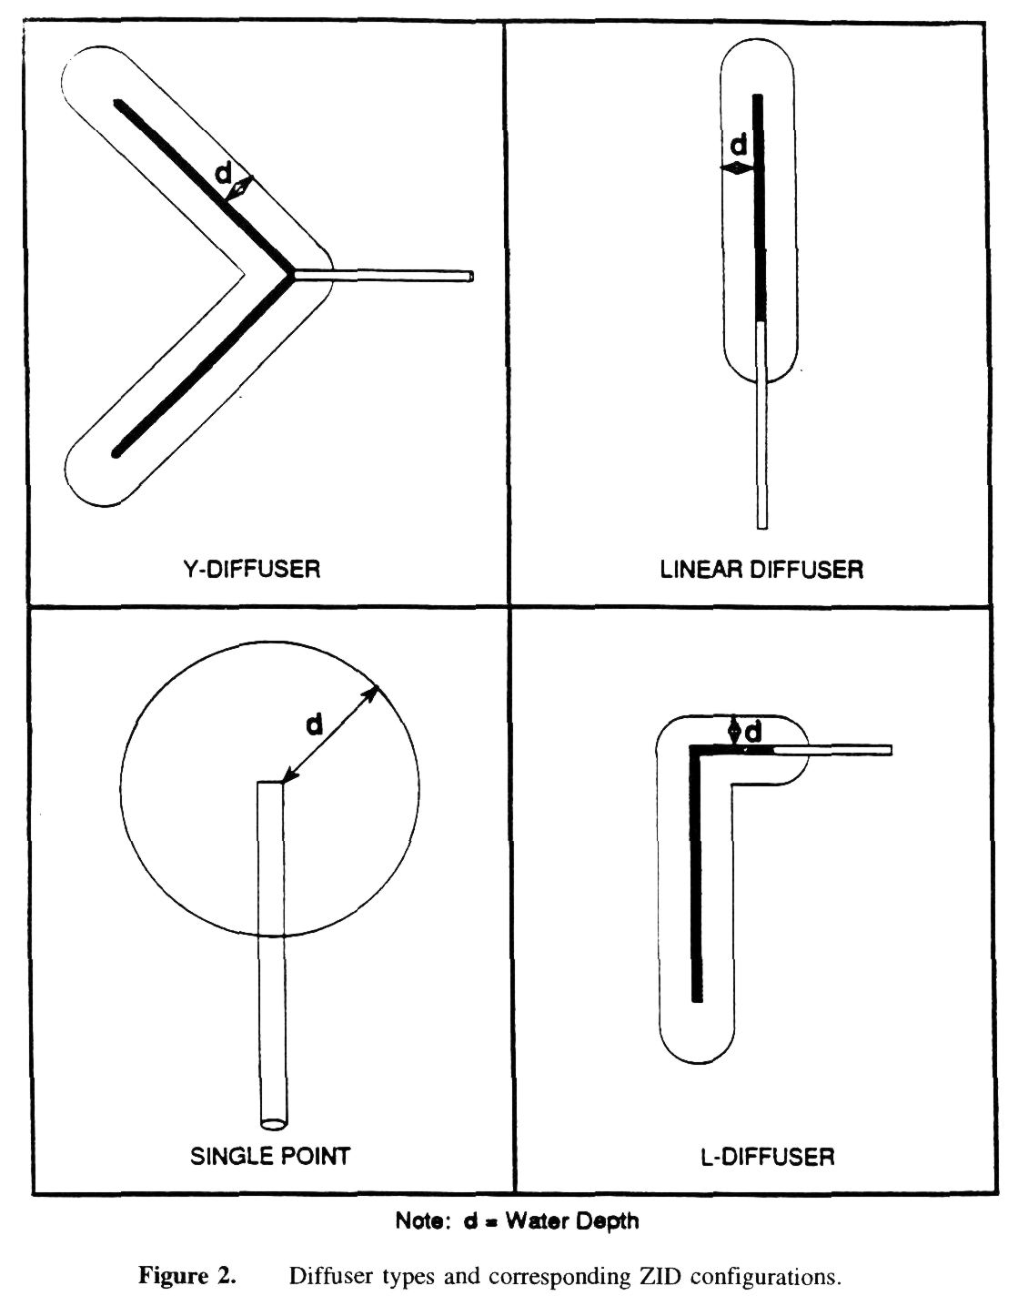
Clean Water Act 301(h) ZID
10 percentile current

Slide 4
Federal Criteria
Federal water quality regulations Ocean Discharge Criteria at 40 CFR 125.121(c) defines the mixing zone for federal waters as:
“The zone extending from the sea's surface to seabed and extending laterally to a distance of 100 meters in all directions from the discharge point(s) or to the boundary of the zone of initial dilution as calculated by a plume model approved by the director, whichever is greater…”
The federal regulations do not specify how the dilution calculations are to be done, so judgment is necessary to decide which oceanographic conditions, density stratification, flow rates, and averaging times are used.

Slide 5
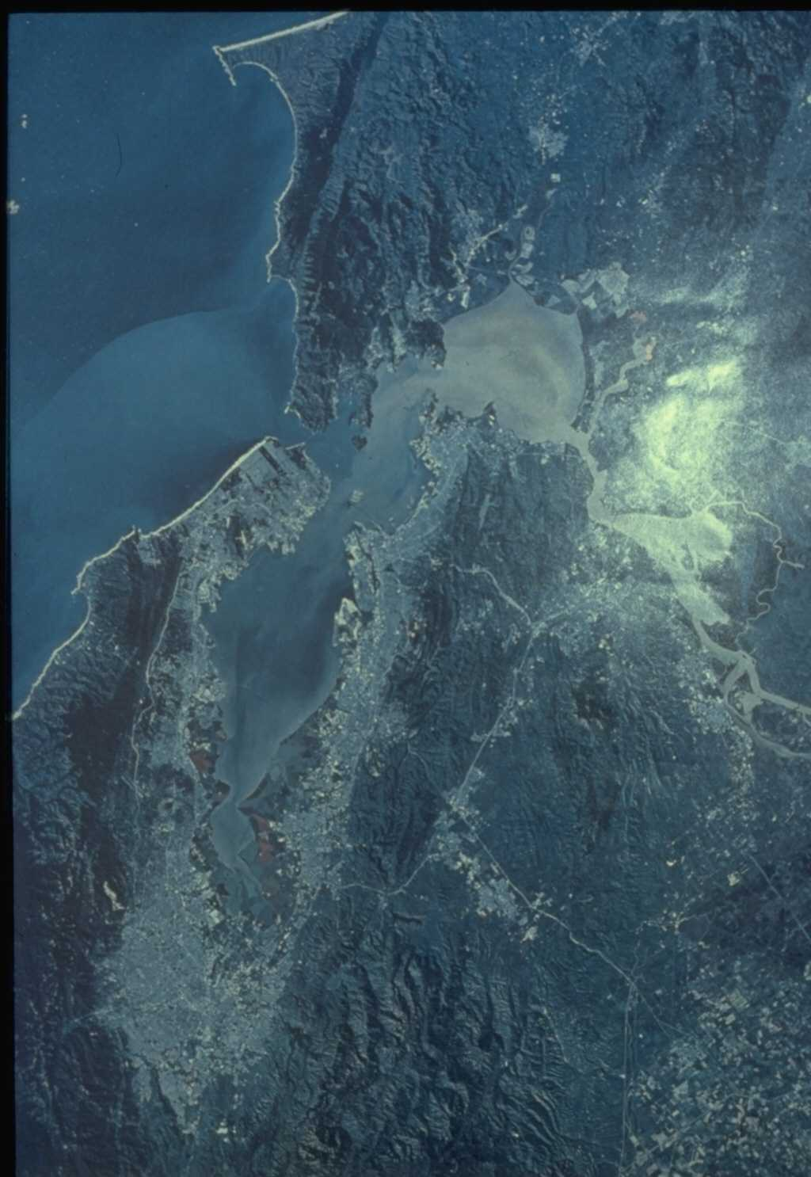
San Francisco Bay and Ocean Outfall
1990 NPDES permit dilution = 76:1
flux-averaged value
UDKHDEN
zero current speed
worst-case density profile
flow of 25.6 mgd
12 risers functioning
05
Notes:
Workshop 3

Slide 6
San Francisco Outfall
+
E
+
60′
D
30′
+
F
90′
+
A
+
+
B
C
N
3 km
+
Current meter array
Notes:
Workshop 3

Slide 7
Polar Scatter Diagrams of Near-Surface Currents
Notes:
Workshop 3

Slide 8
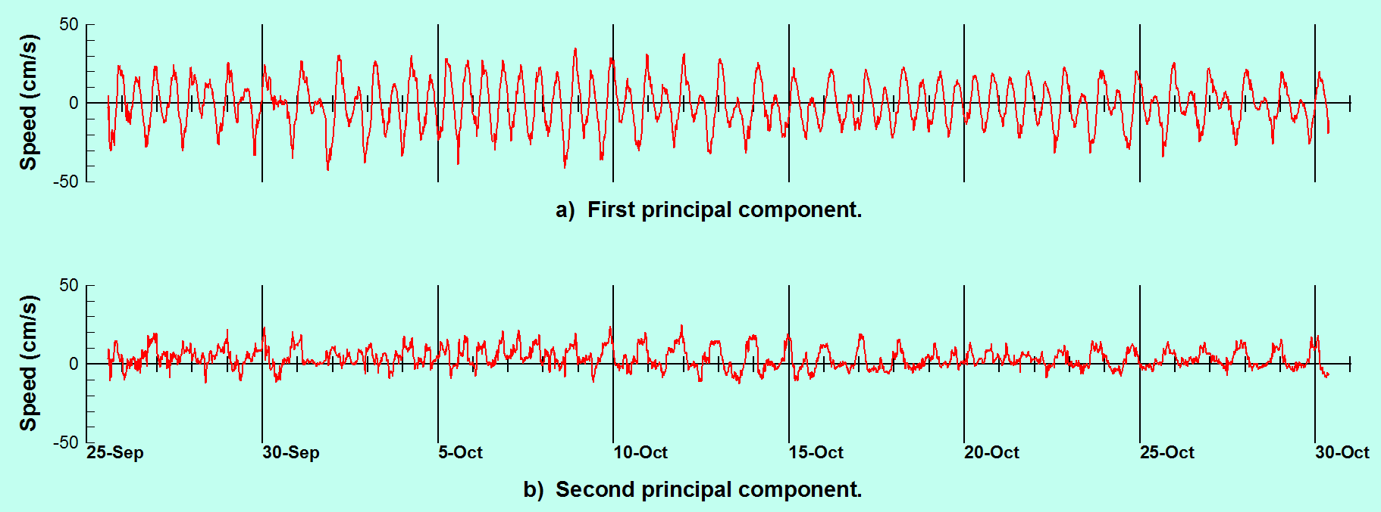
Principal Components of Near-Surface Currents at Station A
Notes:
Workshop 3

Slide 9
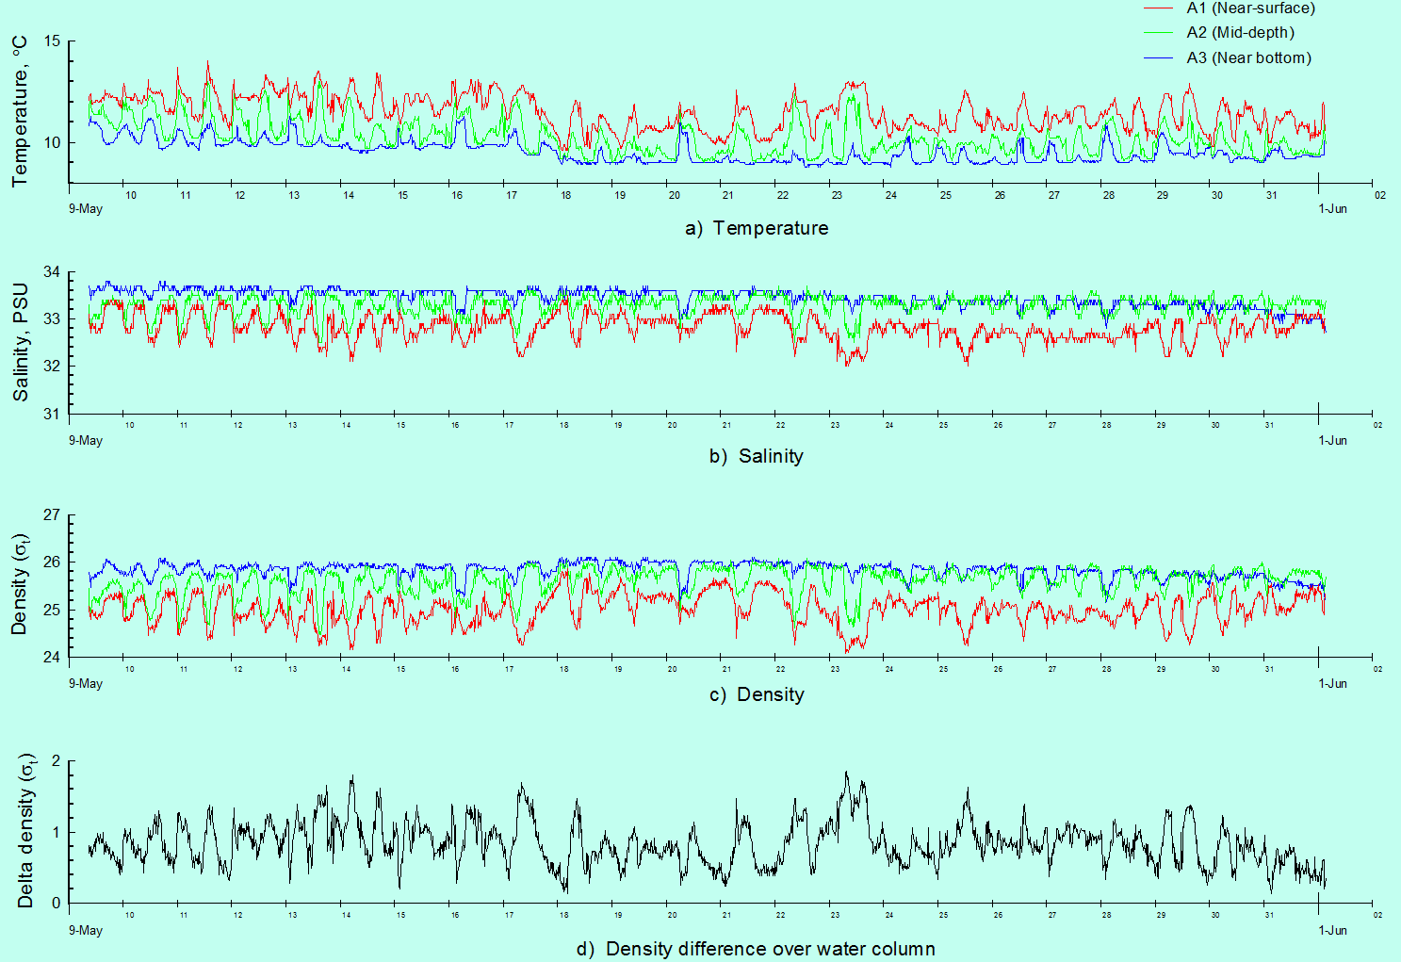
Temperature, Salinity, and Density at Three Depths

Slide 10
Temperature, Salinity, and Density at Three Depths

Slide 11
Temperature, Salinity, and Density at Three Depths

Slide 12
Temperature, Salinity, and Density at Three Depths

Slide 13
Average Diurnal Flow Variation Used in Simulations
Notes:
Workshop 3

Slide 14
Near Field Simulation Scheme
Current
speed:
Input data
Density
stratification
profiles:
Effluent
flowrate:
Mathematical model
NRFIELD
Dilution:
Results
Rise
height:

Slide 15
NRFIELD Simulation Results - May 1988 Data Set
Notes:
Workshop 3

Slide 16
NRFIELD Simulation Results - May 1988 Data Set
Notes:
Workshop 3

Slide 17
NRFIELD Simulation Results - May 1988 Data Set
Notes:
Workshop 3

Slide 18
Histograms of NRFIELD Predictions
Notes:
Workshop 3

Slide 19
Final Dilution Value
The average concentration of contaminants that occur following dilution cannot be directly computed from time-averaged dilution. Therefore, in keeping with the spirit of the CCC (Section 2), a more useful measure of dilution is the harmonic average:
where S is the dilution at time n. The time-average contaminant concentration in the water body is equal to the contaminant concentration in the effluent divided by the harmonic average dilution.
The harmonic average dilutions computed in this way are 250:1 at 100 m. This is the value we therefore recommend be used in the NPDES permit application.
05
Notes:
Workshop 3

Slide 20
Toxics Criteria
California Ocean Plan: Table B
Water Quality Objectives for Protection of Marine Aquatic Life
Compound | Limiting Concentrations
 | Units of Measurement | 6-Month Median | Daily Maximum | Instantaneous Maximum
Arsenic | μg/l | 8. | 32. | 80.
Cadmium | μg/l | 1. | 4. | 10.
Chromium (Hexavalent) | μg/l | 2. | 8. | 20.
Copper | μg/l | 3. | 12. | 30.
Lead | μg/l | 2. | 8. | 20.
Mercury | μg/l | 0.04 | 0.16 | 0.4
Nickel | μg/l | 5. | 20. | 50.
Selenium | μg/l | 15. | 60. | 150.
Silver | μg/l | 0.7 | 2.8 | 7.
Zinc | μg/l | 20. | 80. | 200.
Cyanide | μg/l | 1. | 4. | 10.
Total Chlorine Residual | μg/l | 2. | 8. | 60.
Ammonia (as nitrogen) | μg/l | 600. | 2400. | 6000.
Acute* Toxicity | TUa | N/A | 0.3 | N/A
Chronic* Toxicity | TUc | N/A | 1. | N/A
Phenolic Compounds (non-chlorinated) | μg/l | 30. | 120. | 300.
Chlorinated Phenolics | μg/l | 1. | 4. | 10.
Endosulfan | μg/l | 0.009 | 0.018 | 0.027
Endrin | μg/l | 0.002 | 0.004 | 0.006
HCH* | μg/l | 0.004 | 0.008 | 0.012
Radioactivity | Not to exceed limits specified in Title 17, Division 1, Chapter 5, Subchapter 4, Group 3, Article 3, Section 30253 of the California Code of Regulations. Reference to Section 30253 is prospective, including future changes to any incorporated provisions of federal law, as the changes take effect.
Effluent limitations shall be determined through the following equation:
Initial dilution
Ce = Co + Dm (Co - Cs)
Effluent concentration
Background concentration
Concentration (water quality objective) to be met at the completion of initial dilution

