Slide 1
Martin-Marietta, Sodyeco, Inc. - Bioenergy at ReVenture Park
Tom McKittrick - Forsite Development, Inc.

Slide 2
Martin-Marietta, Sodyeco, Inc. Superfund Site
The site is located in Charlotte, North Carolina.
For nearly 70 years the area was used by various chemical dye manufacturing and specialty chemical production companies.
EPA placed the site on the National Priorities List in 1983.
Between 1987 and 2011, EPA developed and amended cleanup plans for the Site.
EPA deleted the site from the National Priorities List in 2012.
2

Slide 3
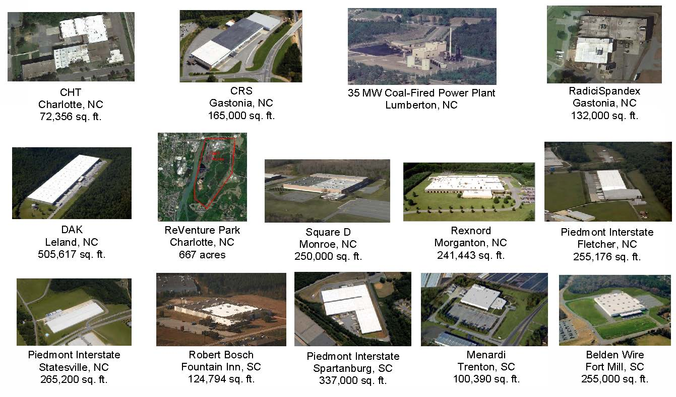
About Forsite…. “We Buy Ugly Buildings”
3

Slide 4
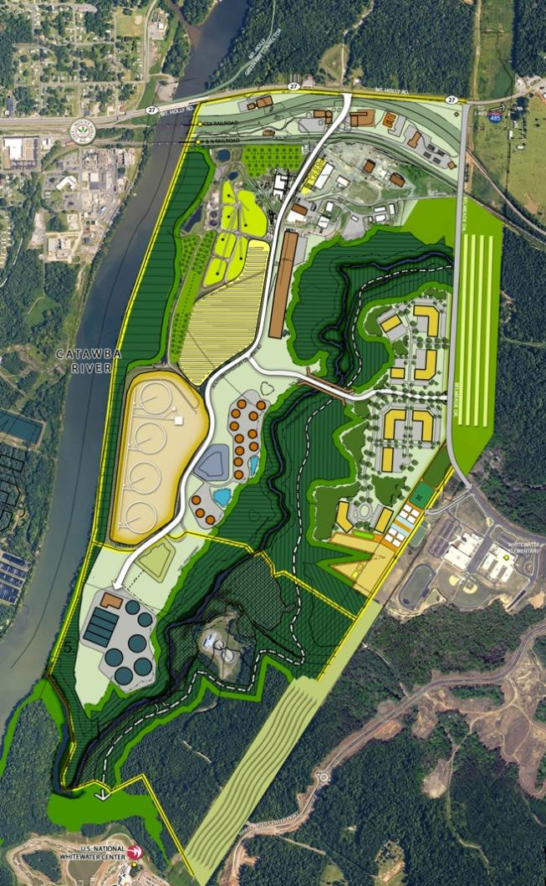
Projects at ReVenture
ENERGY & BIOENERGY PROJECTS
3.9 MW Biomass CHP
35 acre Aquaculture – Duckweed
Cellulosic Ethanol Pilot Project
Energy Crop Demonstration
Biodiesel Feedstock Processing
Small Solar Farm
Anaerobic Digestion (Proposed)
Micro Grid (Proposed)
OTHER PROJECTS
175 acre Conservation Easement
Electric Truck Assembly
Future 12 MGD WWTP ($185mm)
Synthetic Textile MFG
Carolina Thread Trail
Water Distillation
Plastics Recycling
Managed Timber
Algae Pilot Project
Multiple Habitat Enhancement Projects
Stream Wetland Mitigation
4

Slide 5
Renewable Energy at ReVenture Timeline
2009 – Proposed 20 MW Waste to Energy Project
2010 – SB 886 Law passed creating a Triple REC multiplier
2011 – 20 MW Waste to Energy Project dies
2012 – 4 MW Biomass Project Proposed
2013 – Pyrolysis Technology moved to ReVenture
2014 – Pyrolysis Technology dies
2015 – (2) Caterpillar 3520 Generators installed utilizing
“Directed Bio Gas” as biomass fuel
*Over $8mm invested to date. Cash flow just now being generated
5

Slide 6
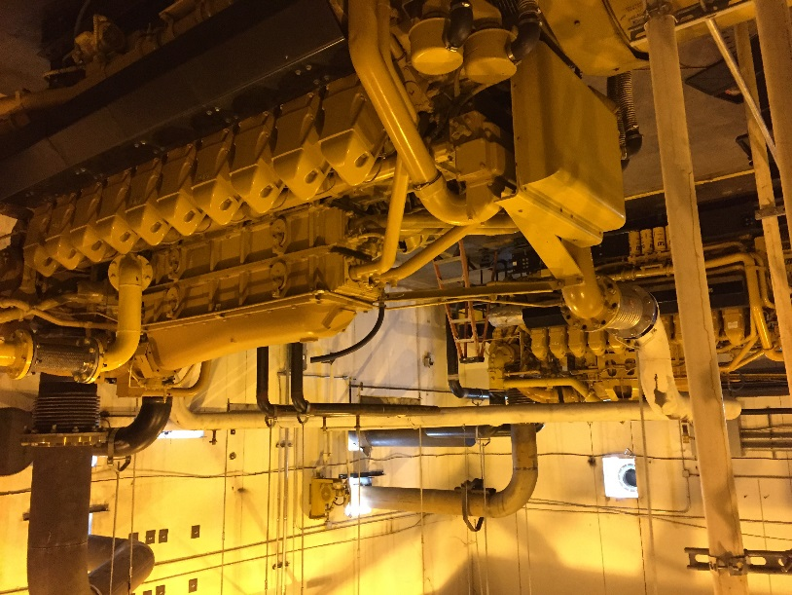
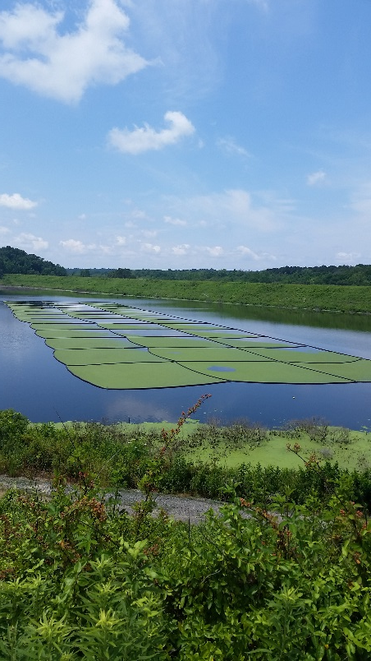
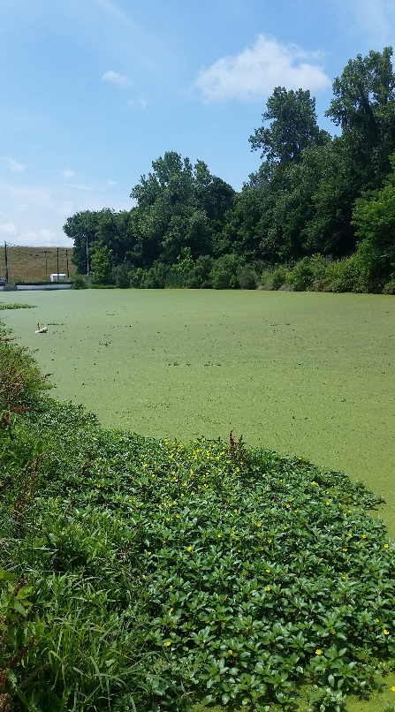
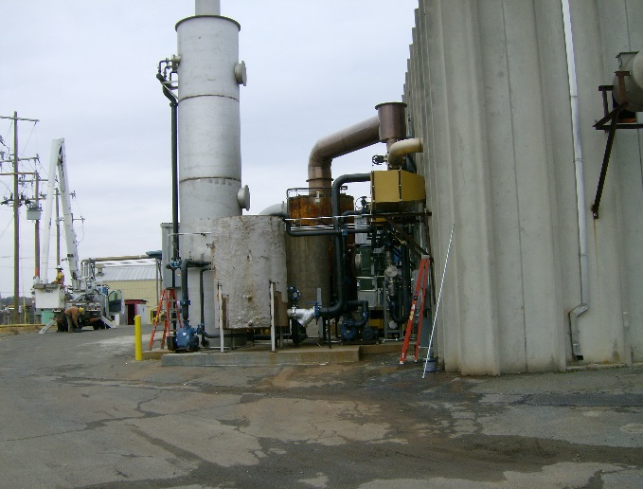
Renewable Energy at ReVenture – Electric and Thermal
Tucker Pyrolysis Technology
(2) CAT 3520 Generators Directed Biogas as Fuel
35 Acre Aquaculture Project
Direct Contact Heat Exchanger
6

Slide 7
What We’ve Learned & Key Questions
Is the state a regulated or de-regulated utility market?
Does the state have a Renewable Portfolio Standard (RPS)?
Electrical infrastructure could have real value for Utility Scale Solar or Wind Projects
If the site happens to be close to a municipal landfill or WWTP – potential to create a Directed Biogas Project
If the site has an active Title V Air Permit, don’t let it lapse (same for NPDES)
*Developing Power Projects is a difficult endeavor…..
Proceed cautiously.
[Everything you need to know about energy incentives and programs – www.dsireusa.org]
7

Slide 8
For More Information, Contact:
Tom McKittrick
President, Forsite Development
tom@forsiteinc.com
8

