Slide 1
Site selection
Shelly Griswold, Director of Community Development, City of Freeport

Slide 2
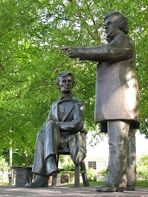
City of Freeport
Located in northwestern Illinois
Location of one of the historic Lincoln-Douglas debates
Population: 25,638
Median family income: $35,589
Growing momentum around economic revitalization of brownfields and other contaminated sites
Images: City of Freeport. http://www.ci.freeport.il.us/about/location.htm; http://www.ci.freeport.il.us/livinginfreeport/LincolnDouglas.htm

Slide 3
East Side Neighborhood
African-American community
Cut off from downtown by the Pecatonica River and a railroad
Quality of life impacted by:
Flooding
Dilapidated housing
Limited neighborhood-oriented amenities
Strained relationship with the City limits effectiveness of revitalization discussions

Slide 4
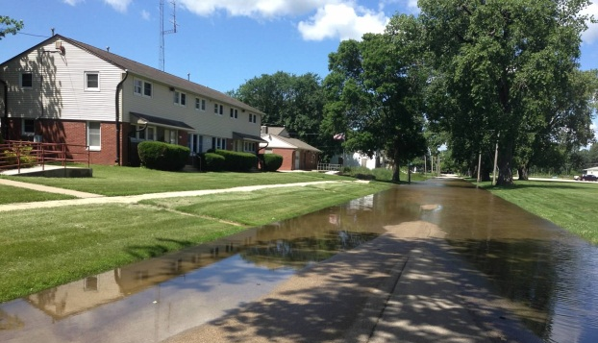
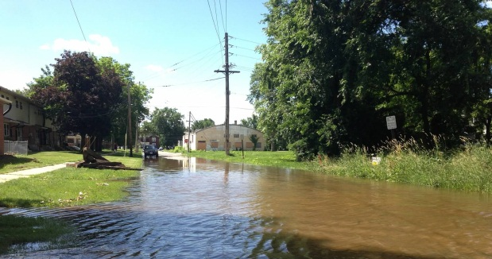
Flood Impacts and Regulation
Pecatonica River experiences frequent flooding.
Disrupts neighborhood life in several city neighborhoods.
FEMA is responsible for designation of floodway areas.
City is responsible for enforcement of floodway regulations related to permitting of construction and improvements.

Slide 5
Top Left: Flooding (ca. 1914-1940), source: http://www.robertbike.com/wienand-photo-album; Bottom Left: Flooding (2013), source: http://www.journalstandard.com
Top: Flooding (2013), source: EPA

Slide 6
Disproportionate Impact of FEMA Regulations
FEMA regulations currently limit improvements on structures located in a floodway to half of the structure’s value.
This regulation disproportionately impacts homeowners in the East Side neighborhood.
It has resulted in declining home values and housing quality, which further contributes to a cycle of disinvestment in homes and businesses in the neighborhood.

Slide 7
Engaging with SRI
City has actively partnered with EPA on site cleanup and revitalization for numerous contaminated sites.
In 2011, the City met with the Region 5 Reuse Coordinator to discuss the CMC Heartland site.
The City identified the opportunity to:
foster a broader conversation about neighborhood quality of life on the East Side,
improve strained relationships between the City and neighborhood residents, and
address revitalization of multiple contaminated sites.
SRI identified funding for an areawide planning effort.

