Slide 1
Superfund and Alternative Energy: Promising Futures for Sites with a Contaminated Past
April 29, 2014
1-3pm EDT

Slide 2
Webinar Overview
Introduction to SRI, Reuse and Alternative Energy: Melissa Friedland
Reilly Tar Indianapolis Plant Superfund Site: Dion Novak, EPA Region 5
Hanwha Q Cells, Maywood Solar Farm: Geoffrey Underwood
Hanwha Q Cells, Maywood Solar Farm: Matt McCullough
Regional Seeds and Renewable Energy: Frank Avvisato

Slide 3
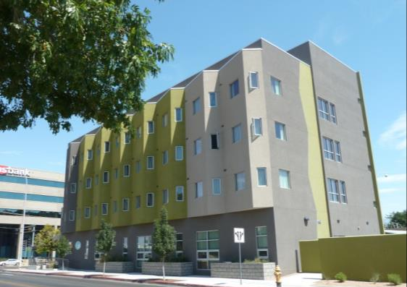
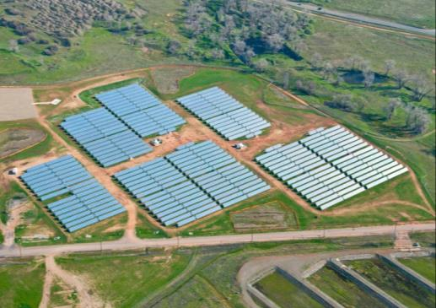
SRI: Superfund Redevelopment Initiative
Working with communities and other partners in considering future use opportunities and integrating appropriate reuse options into the cleanup process

Slide 4
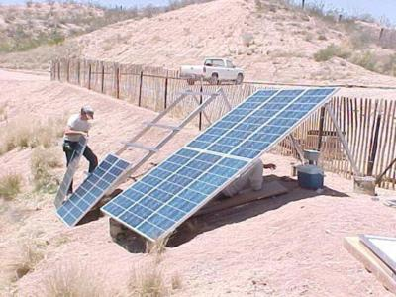
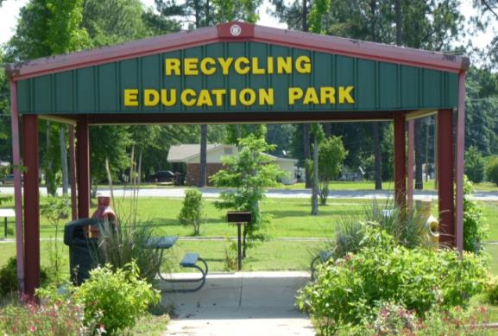
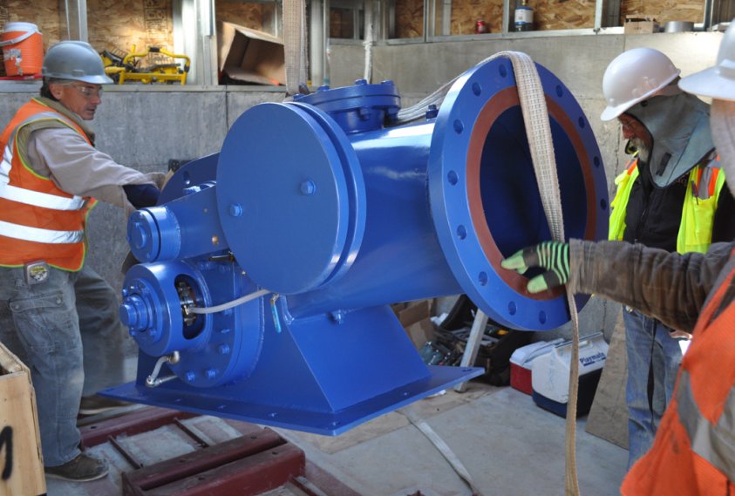
Reuse as a Priority

Slide 5
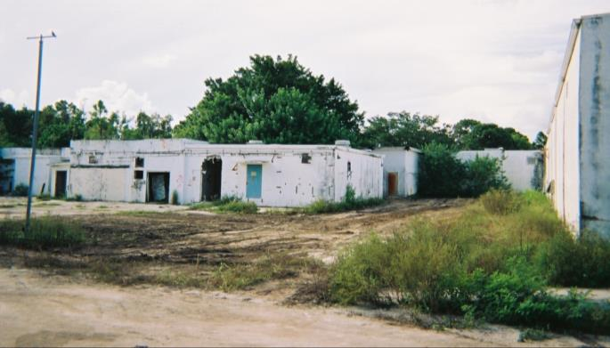
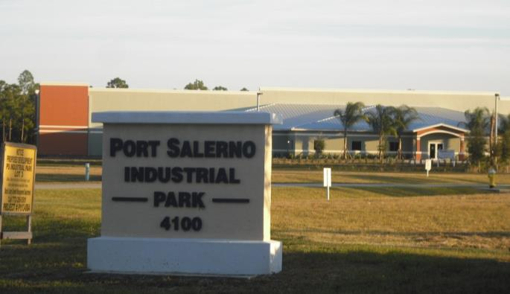
Reuse as a Priority (Cont.)
Benefits
Economic
Environmental
Social
Protection of human health

Slide 6
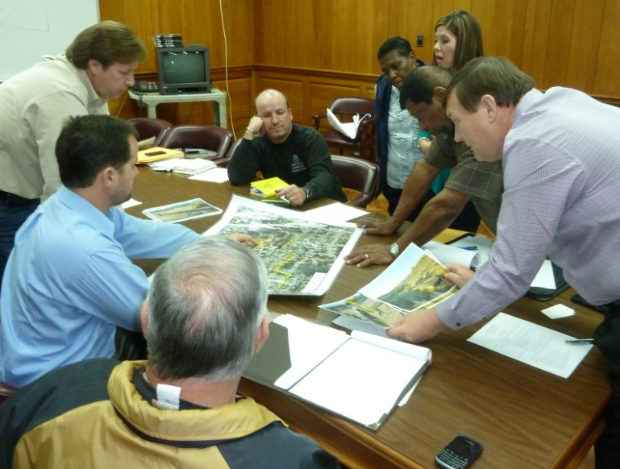
SRI Over the Years: From Pilots to Regional Seeds
Avtex Fibers, one of SRI’s 10 initial Pilot Projects
Picayune Wood Treating, a current SRI Regional Seed project

Slide 7
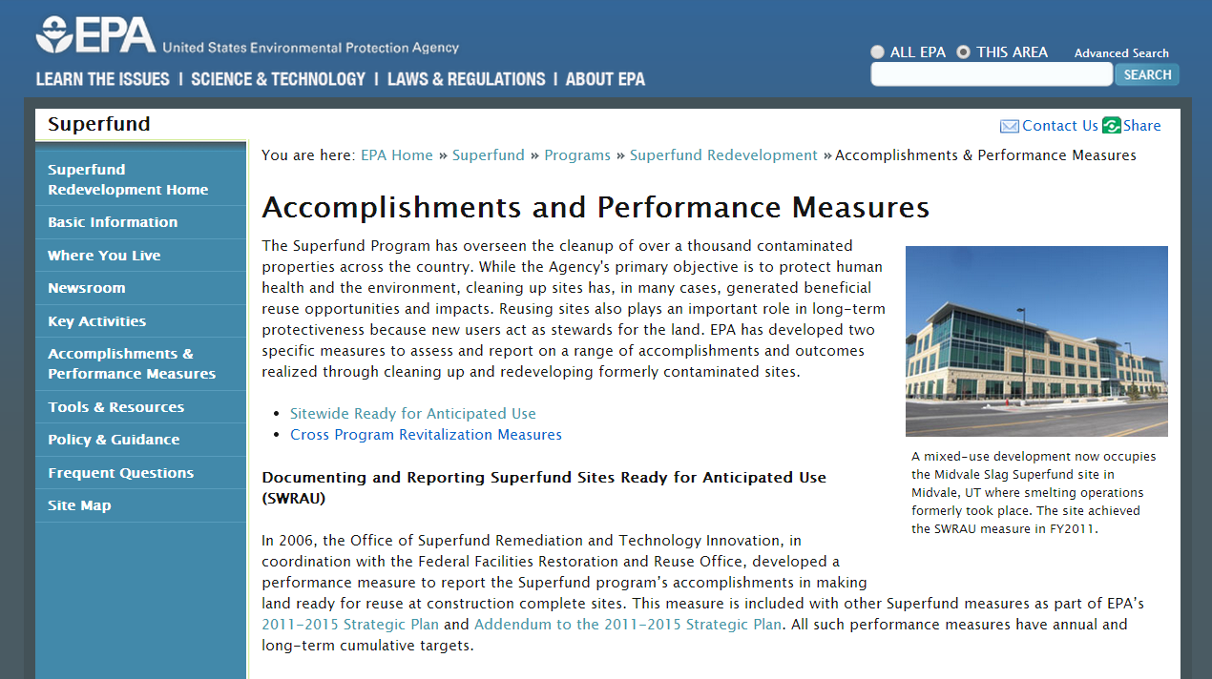
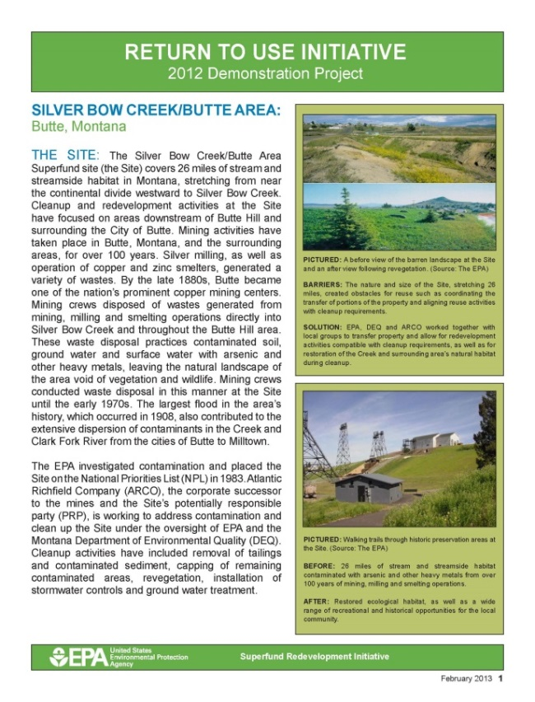
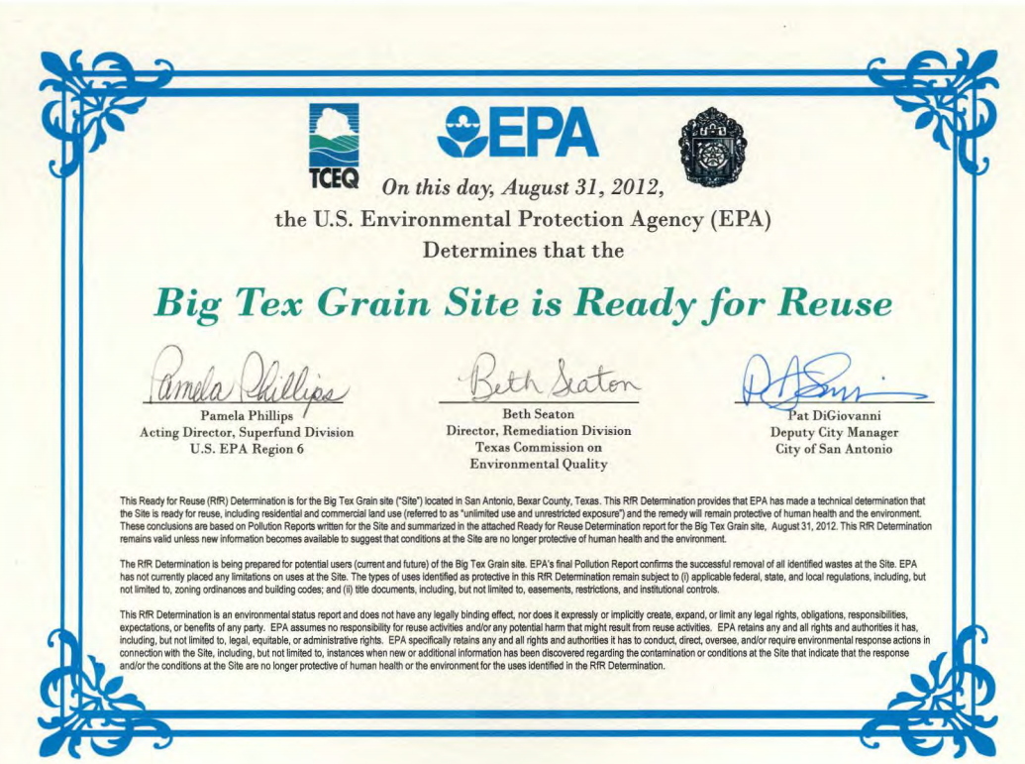
Tools

Slide 8
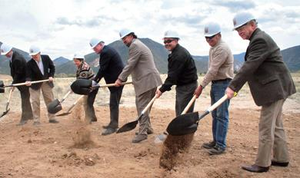
SRI: Then and Now
1990s: Many cleaned-up Superfund sites not in use
1995: EPA’s Land Use Directive
1999: EPA started SRI
2010: EPA’s Reuse Directive

Slide 9
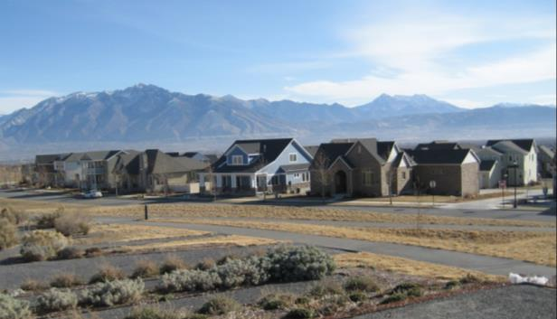
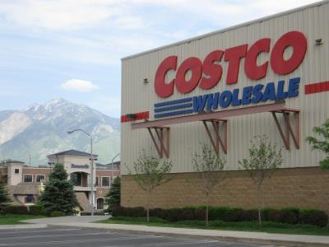
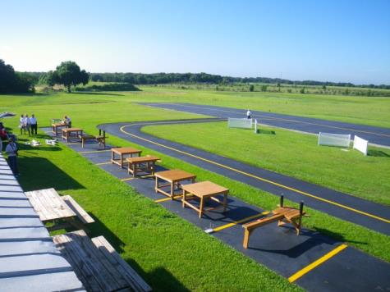
Types of Reuse
Commercial
Public Service
Residential
Industrial
Mixed Use
Agricultural
Green Space
Recreational
Ecological
Alternative Energy

Slide 10
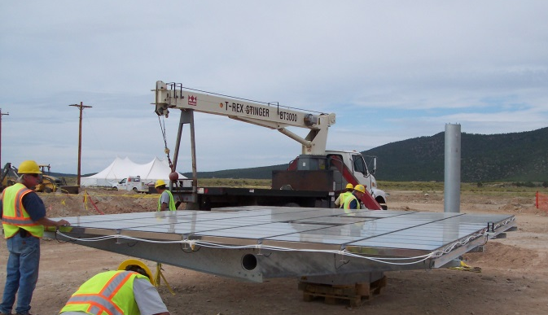
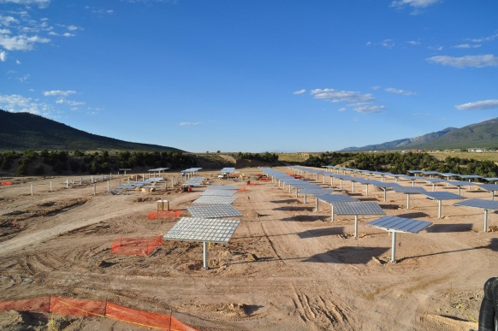
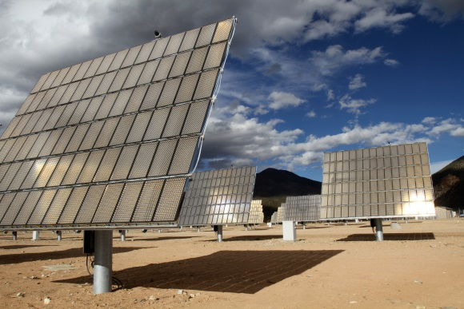
Alternative Energy
Remote Locations, Large Size
Urban and Suburban Locations, Small Size
Availability of Infrastructure
Green Remediation and Waste-into-Energy Recycling

Slide 11
Superfund Examples
Melissa Friedland,
Superfund Program Manager for Redevelopment

Slide 12
Solar Projects Examples
Commercial, Utility-Scale
E.I. Du Pont De Nemours & Co., Inc. (Newport Pigment Plant Landfill)
Chevron Questa Mine
Peterson/Puritan, Inc.
Remedial System/Green Remediation
Pemaco Maywood
FMC Corp. (Fridley Plant)
Aerojet General Corp.

Slide 13
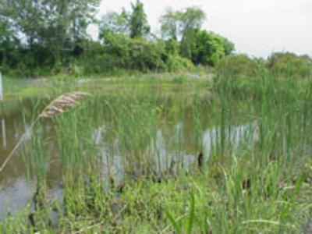
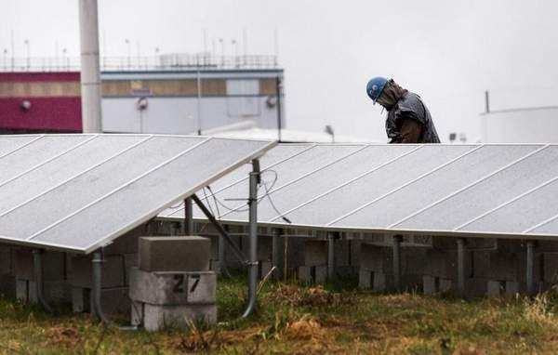
E.I. Du Pont De Nemours & Co., Inc. (Newport Pigment Plant Landfill)
Newport, Delaware (Region 3)
Source: The News Journal/Delaware Online

Slide 14
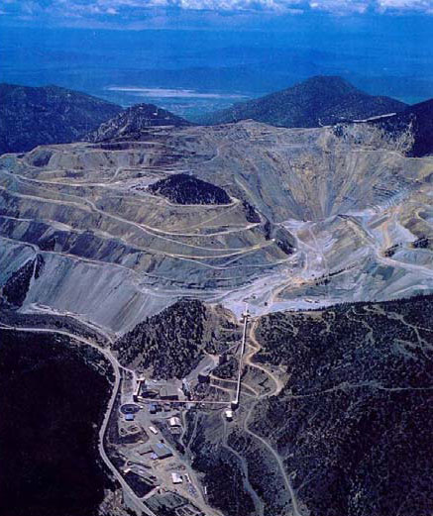
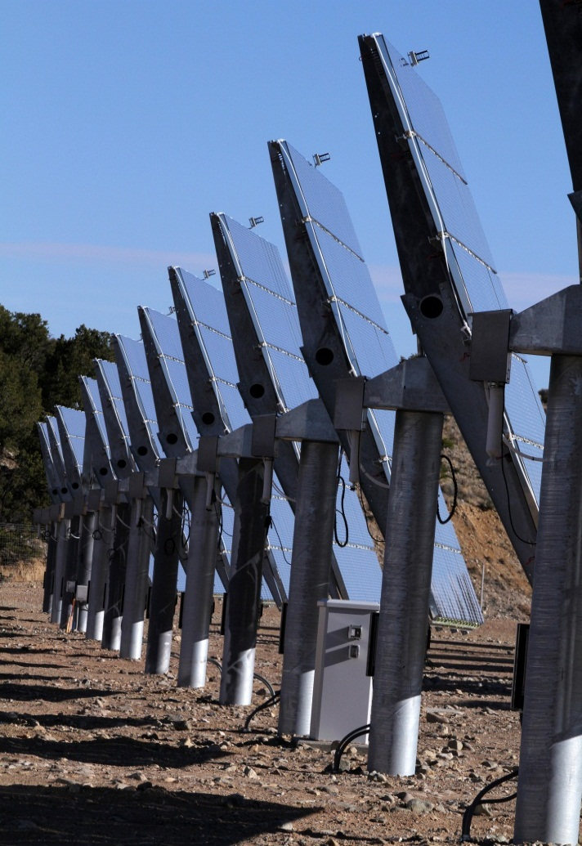
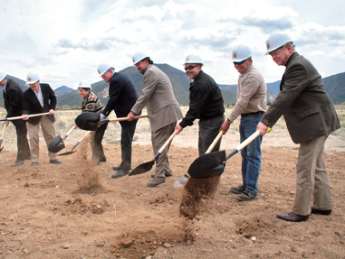
Chevron Questa Mine
Questa, New Mexico

Slide 15
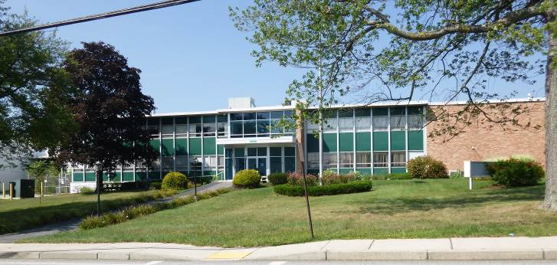
Peterson/Puritan, Inc.
Lincoln and Cumberland, Rhode Island

Slide 16
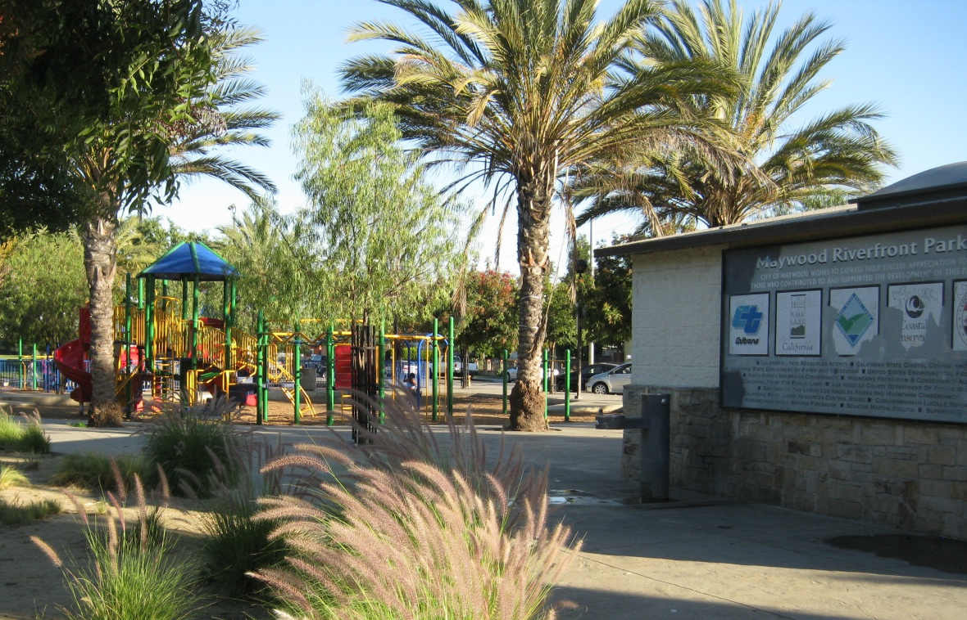
Pemaco Maywood
Maywood, California
Source:_http://www.epa.gov/renewableenergyland/docs/success_pemaco_ca.pdf

Slide 17
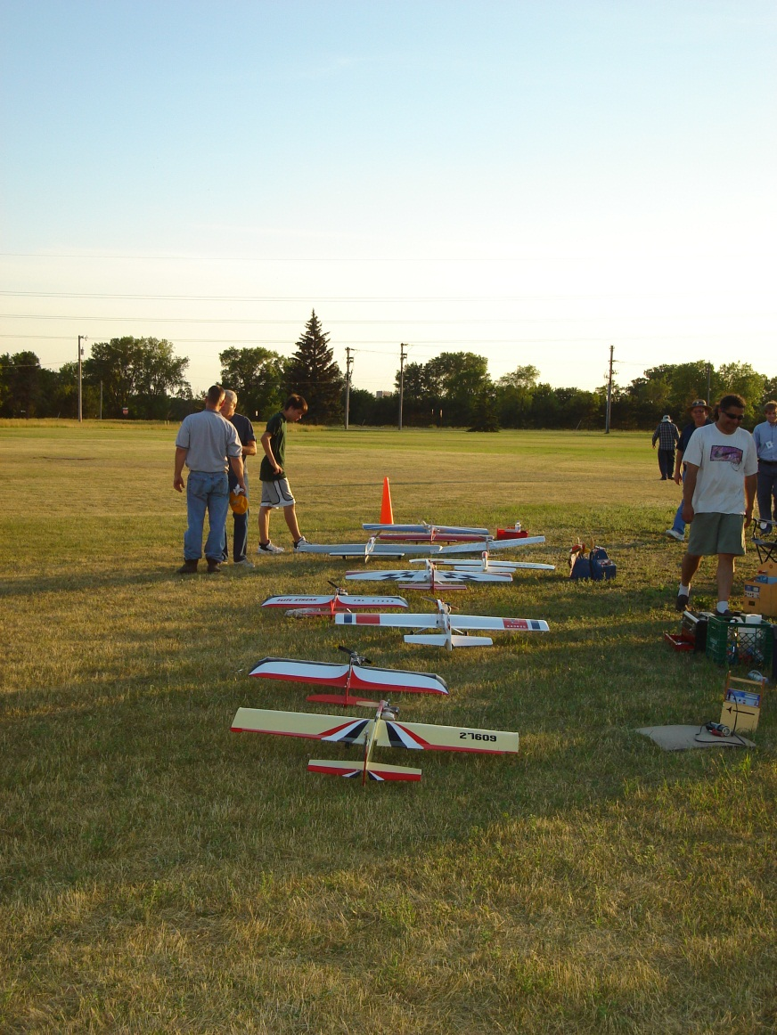
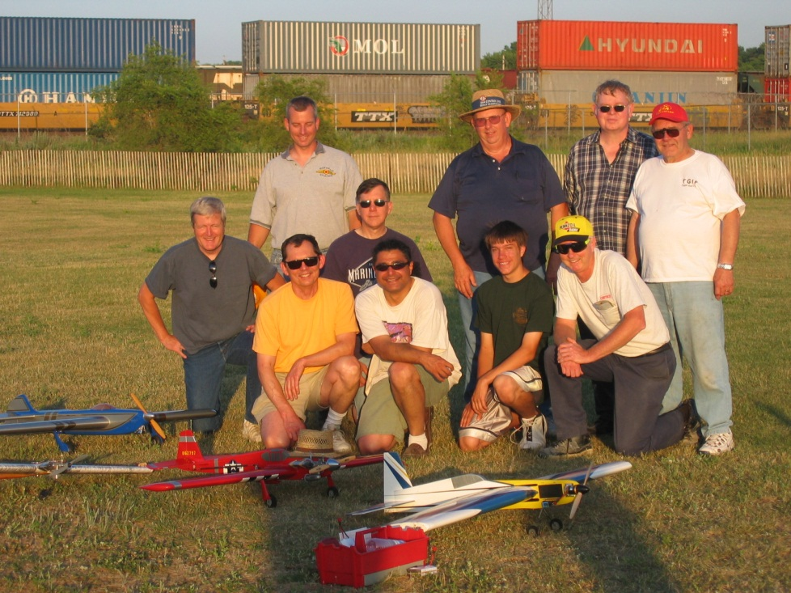
FMC Corp. (Fridley Plant)
Fridley, Minnesota

Slide 18
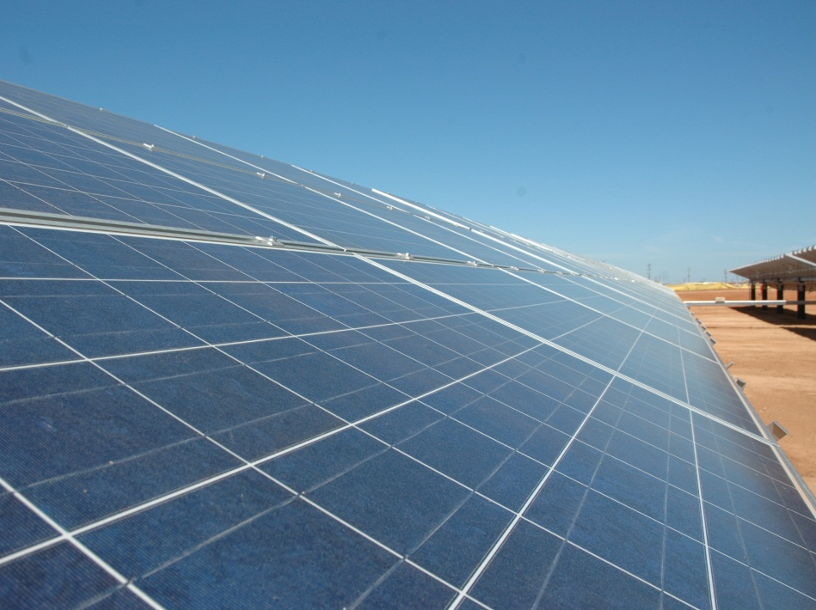
Aerojet General Corp.
Rancho Cordova, California

Slide 19
