Slide 1
1,4 Dioxane in Massachusetts: A case study
Wendy Heiger-Bernays, Ph.D.
Madeleine Kangsen Scammell, D.Sc.
Notes:
WHB

Slide 2
The Boston University Superfund Research Program
Directors: David Sherr, PhD. & David M. Ozonoff, MD, MPH
Five research projects
1: Prenatal Exposure to Tetrachloroethylene-Contaminated Drinking Water and the Risk of Birth Defects (Ann Aschengrau, PhD.)
2: Analyzing Patterns in Epidemiologic and Toxicologic Data (Veronica Vieira, D.Sc).
3: Environmental PPARγ Agonists: Dual B Lymphocyte and Bone Marrow Stromal Cell Toxicants (Jennifer Schlezinger, PhD.)
4: Mechanisms and Impacts of Dioxin Resistance in Fish (Mark Hahn, PhD.)
5: Developmental Toxicity of non-Dioxin-like PCBs and Chemical Mixtures (John Stegeman, PhD.)
Five Core facilities: Community Engagement, Research Translation, Training, Bioinformatics, Administration

Slide 3
BUSRP Research Translation Core
Leader: Wendy Heiger-Bernays, PhD
Specific Aims:
Coordinate communication of research;
Develop and maintain partnerships with governmental environmental and public health agencies;
Identify potential end-users of technologies, assays and resources developed by BUSRP project and facilitate their application;
Conduct BU-SRP-specific research translation activities, working with the CEC and Training Core.
Notes:
WHB

Slide 4
BU SRP Community Engagement Core
Leader: Madeleine K. Scammell, DSc.
Specific Aims:
Provide scientific expertise in response to community questions.
To develop materials and implement training for our community and governmental stakeholders, including boards of health in Massachusetts, on hazardous materials regulations and solid waste reduction resources.
Communicate activities of the community partners and coordinate activities with the Research Translation Core and the Training Core within the BU SRP.
Notes:
MLS

Slide 5
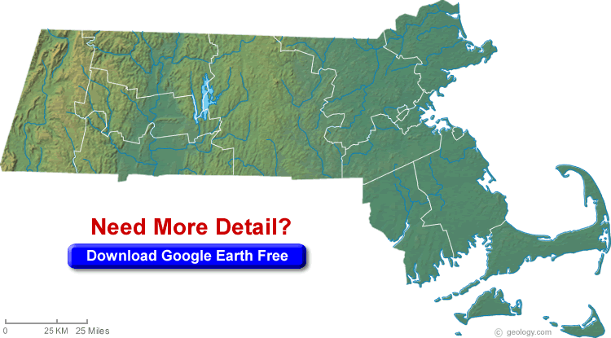
1,4-Dioxane Why Eastham? Why us?
Massachusetts
Notes:
MLS

Slide 6
Notes:
MLS

Slide 7
1,4-Dioxane. Why Eastham? Why us?
1,4-Dioxane measured in groundwater monitoring well very close to private well water supply.
Residential well with 1,4-dioxane above drinking water guideline
BUSRP contacted by: - Concerned resident
- Town of Eastham Health Director
- Mass DEP
Notes:
MLS

Slide 8
1,4-Dioxane Who else was involved?
Town of Eastham
Potentially responsible party
Health official/Board of Health agent
Mass DEP
Bureau of Water Resources (water contamination)
Bureau of Waste Prevention (solid waste landfill)
Bureau of Waste Site Clean-Up (hazardous waste)
EPA Region 1
- Provided four personnel from EPA Region 1 lab to conduct sampling of private water supply wells (analyses paid for by Town)
Notes:
WHB

Slide 9
1,4-Dioxane What is it and why be concerned?
http://www.bu.edu/sph/files/2015/03/14-dioxane-reference-guide-7_25_13.pdf
Notes:
WHB

Slide 10
1,4-Dioxane What is it and why be concerned?
http://www.newmoa.org/events/docs/175_165/MassDioxaneCaseStudySept2015.pdf
Notes:
WHB

Slide 11
1,4-Dioxane How is it regulated?
No Federal Drinking Water Standard for UCMR Chemicals
Notes:
WHB

Slide 12
1,4-Dioxane How is it regulated?
Health Research
UCMR Data
Treatment Technology
DW Guideline
No Drinking Water Standard
MassDEP Guideline is Risk-Based (protective)
Used to guide a process (investigation & action)
Risk Communication is Challenging
Interpretation of Guideline vs Standard
Board of Health Collected Well Nitrate Data
Indicator of Septic Impacts
Notes:
WHB

Slide 13
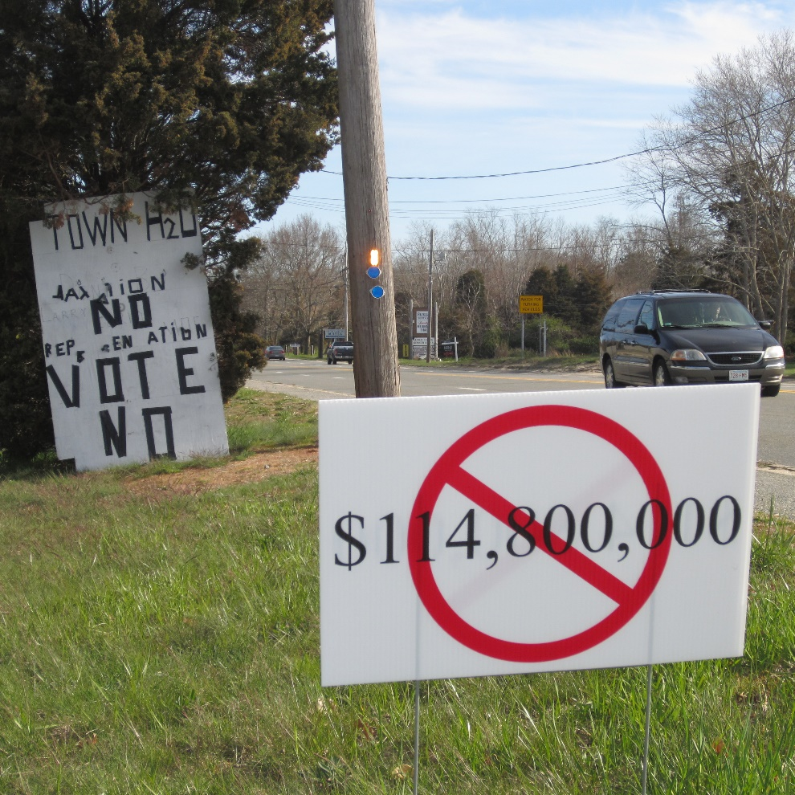
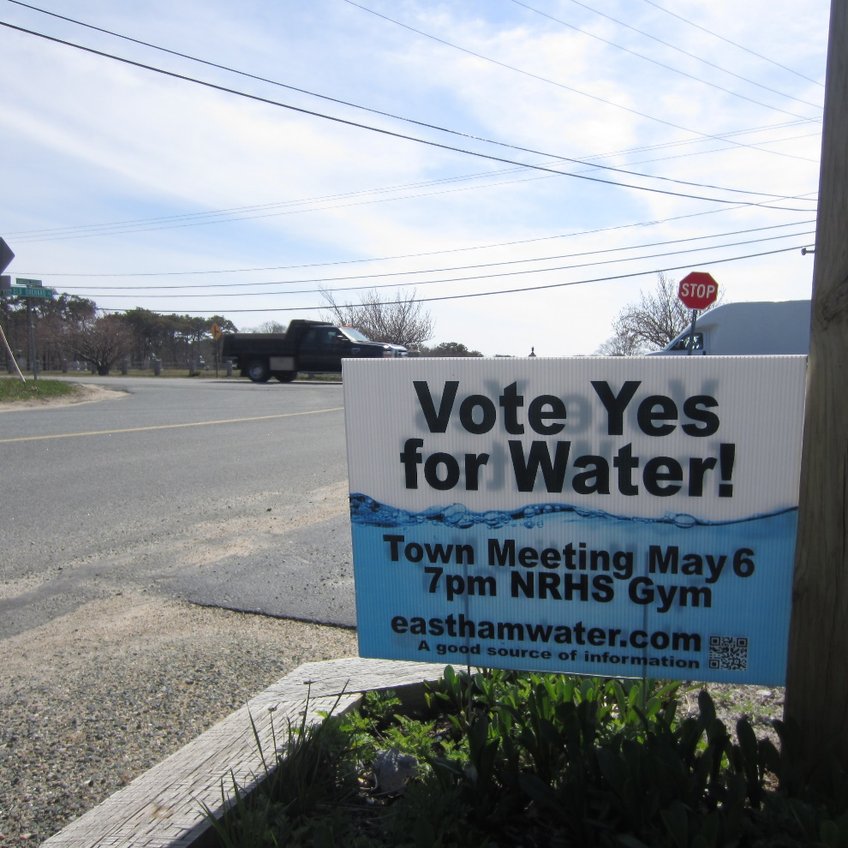
1,4-Dioxane What did we do in Eastham?
Notes:
MLS

Slide 14
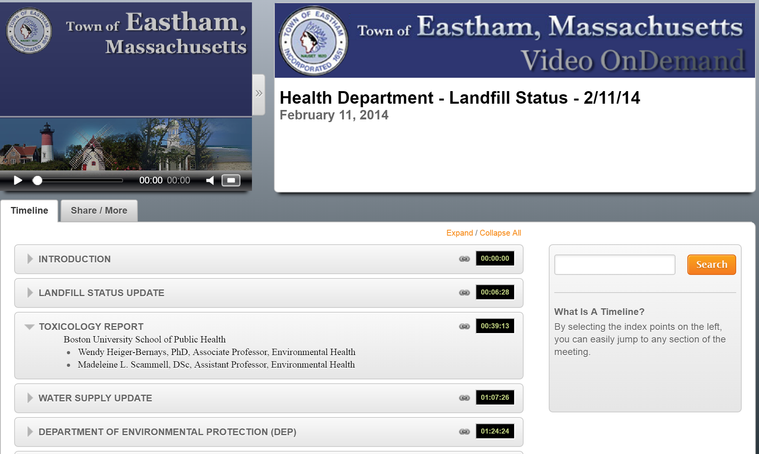
1,4-Dioxane What did we do in Eastham?
Notes:
MLS

Slide 15
Safe Drinking Water Act, 1974 Amendments, 1986 and 1996
Legal limits reflect both the level that protects human health and the level that water systems can achieve using the best available technology.
90+ USEPA regulated contaminants
100+ candidate contaminants
States can regulate more protective than USEPA
ONLY APPLIES TO PUBLIC WATER SUPPLIES
Notes:
MLS

Slide 16
1,4-Dioxane How did it end?
Notes:
MLS

Slide 17
Apr. 20, 2016 at 7:27 PM
“Casella representatives reported in October that human toxin 1,4-dioxane had been detected in 21 private wells in Charlton, eight at levels greater than safe drinking water guidelines.”
Notes:
MLS

Slide 18
Thank you
Jane Crowley, Town of Eastham, Health Agent
A. Gallagher, G. Martin, P. Locke, MassDEP
Ashley Miller, MPH; BU SRP
Veronica Vieira, DSc.; BU SRP

