Slide 1
Using Organic Amendments. Byproducts and Agronomy in Remediation of Hardrock Mining Sites.
Rufus L. Chaney¹, Sally L. Brown²,
Michele Mahoney³, Harry Compton⁴
and Mark Sprenger⁴
¹USDA-ARS-EMBUL, Beltsville, MD,
²University of Washington, Seattle,
³US-EPA-OSWER-OSRTI and ⁴EPA-ERT.
EPA Hardrock Mining Conference
April, 2012

Slide 2
Phytostabilization of Hardrock Sites
Hazardous mining and smelting sites are often so metal phytotoxic and nutrient deficient that plants cannot become established on the site soils.
Phytostabilization has been shown to alleviate risk to ecosystem and support persistent vegetative cover.
Acid soils rich in Zn, Ni, Cu or Mn may prevent plant growth.
Making soil calcareous can fully alleviate metal phytotoxicity.
Applying organic amendments rich in organic-N, P, and other required nutrients, and microbes, can solve infertility issues.
Including adsorbents in the amendments aids remediation.
Selecting plant species fit to purpose.
Adapted to local climate conditions; natives if work; if phtotoxicity and infertility alleviated, no longer difficult.
Metal excluders and low Cd:Zn ratio to protect food chains.
Soil Revitalization, not Ecosystem Restoration

Slide 3
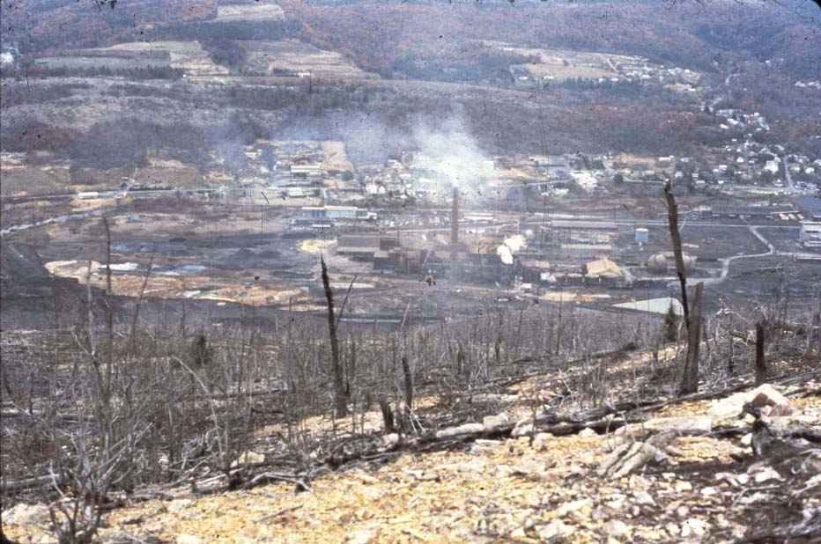
Palmerton, PA, 1980; Dead Ecosystem on Blue Mountain--Zn, Cd, Pb

Slide 4
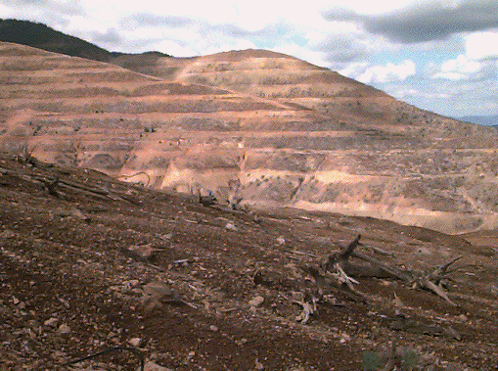
Bunker Hill, Kellogg, Idaho-Superfund Site – Zn, Cd, Pb

Slide 5
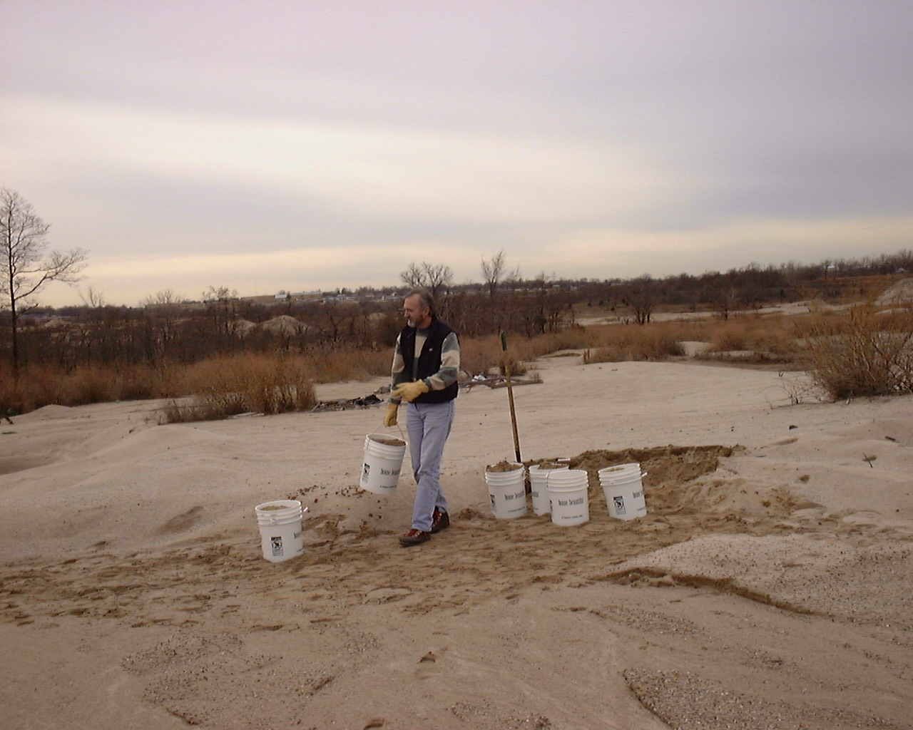
Chuck Henry collecting test soil at Leadville, CO site – Zn, Cd, Pb.

Slide 6
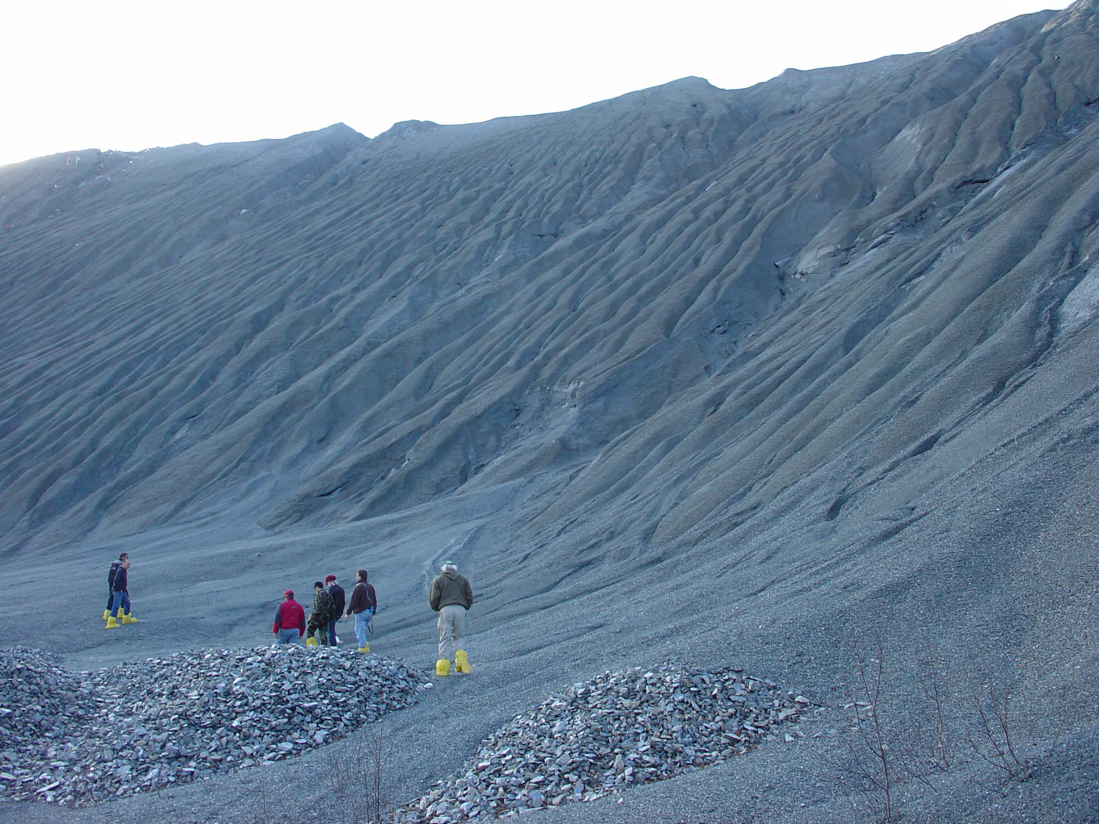
Belvidere Mountain Site, Vermont
Serpentine Asbestos Mine Wastes

Slide 7
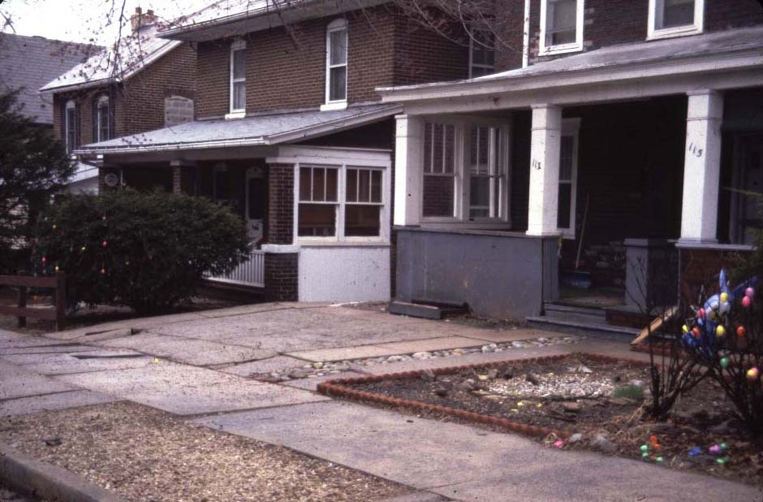
Palmerton, PA, 1980; because lawn grasses died from Zn, many residents covered their lawns with stones or mulch.

Slide 8
Phytostabilization -- in situ Remediation
Using biosolids, composts, and byproducts in remediation of phytotoxic or infertile soils.
Soil chemistry management may provide persistent/sustainable remediation:
Nearly all sites are intensely P deficient.
Manure, biosolids and their composts are richer in N and P than yard debris composts and many other organic amendments.
Inorganic N fertilizers cannot persist in root zone.
Zn, Cu, Ni and Mn are commonly phytotoxic if acidic.
Make calcareous to prevent metal cation phytotoxicity.
Leaching of alkalinity may alleviate metal toxicity at some sites where metals are in near-surface soil depth.
Amorphous Fe and Mn oxides provide increased metals adsorption and may be built into amendment mixture.

Slide 9
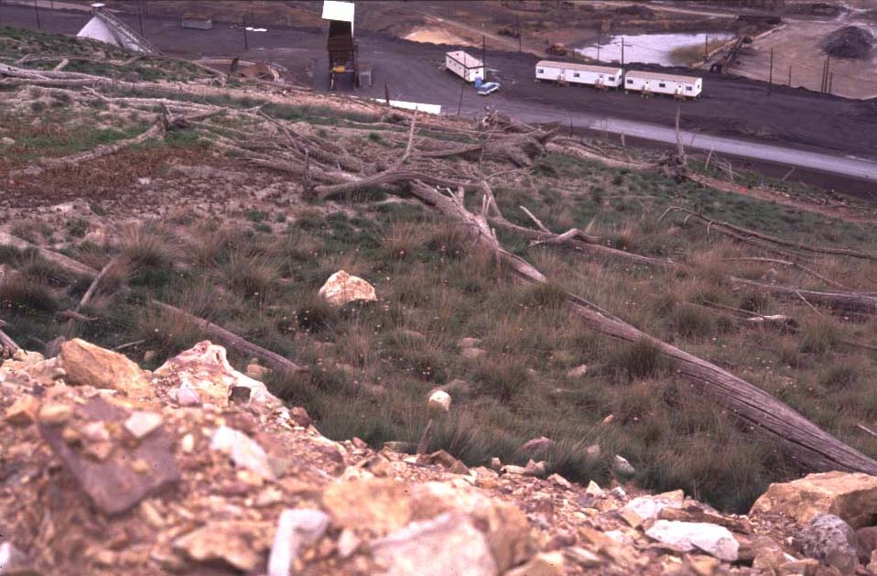
Palmerton, PA, 1990: Oyler’s First Test Plot Using Biosolids + FlyAsh + Limestone, with ‘Merlin’ Red Fescue; adjacent control.

Slide 10
Characteristics of the Blue Mountain North Slope Soils Sampled in bulk in 1998 for Thlaspi studies (Brown et al.)
mg/kg DW
44,100 Zn
25,500 Fe
8,920 Mn
863 Cd
pH 6.25

Slide 11
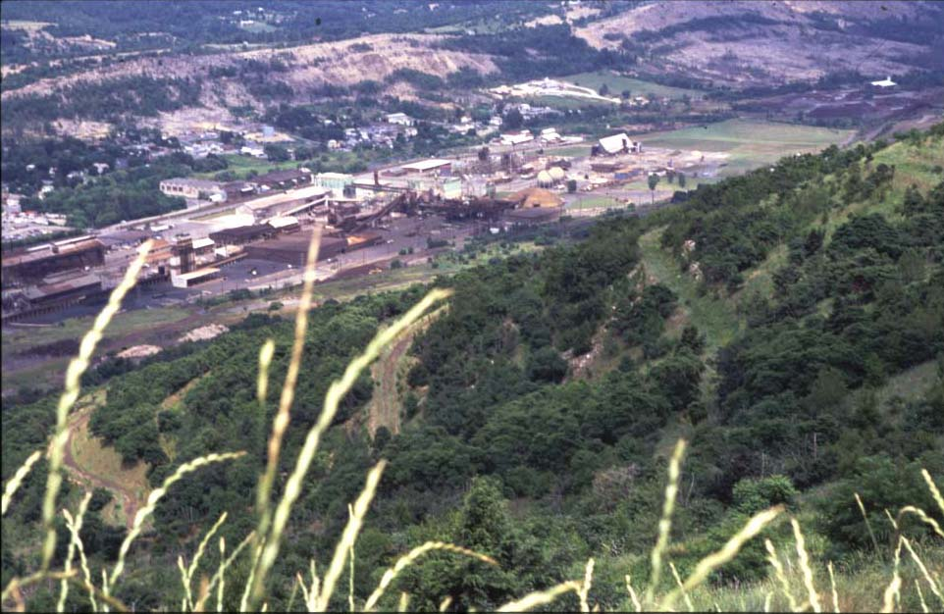
Palmerton, PA, 1999: Looking down revegetated Blue Mt.

Slide 12
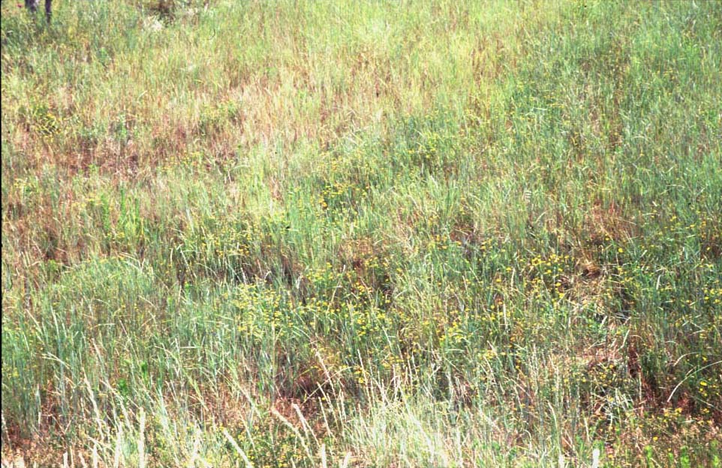
Palmerton, PA -- Revegetated Area in 1999: Area
with good intermediate wheatgrass and lespedeza cover.

Slide 13
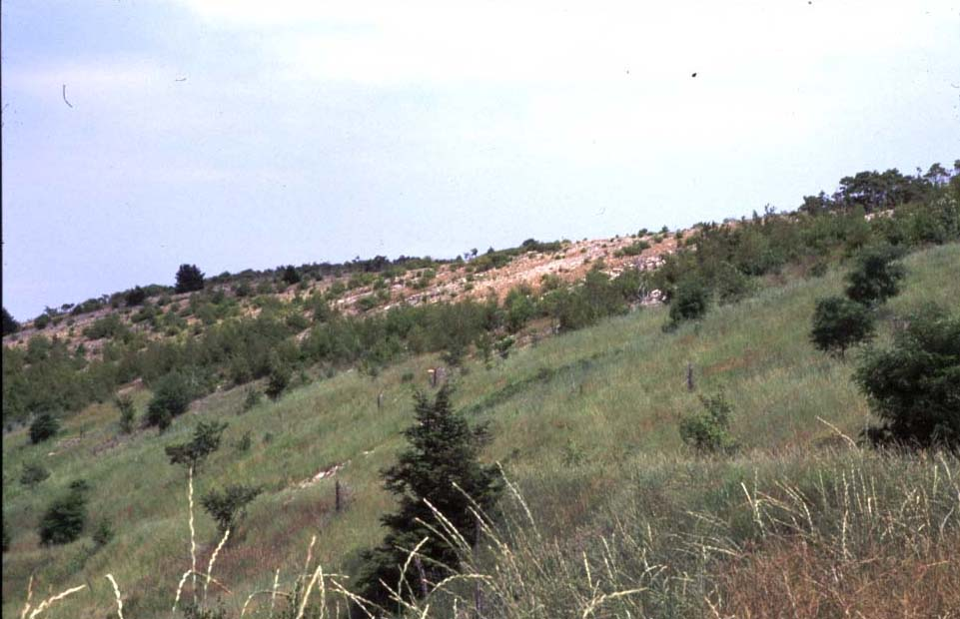
Palmerton, PA: Blue Mountain – 1999; Foreground =
Biosolids+Limestone+FlyAsh; Background = untreated Control

Slide 14
Mean total Zn, Cd and Pb, and DTPA-extractable Zn and Cd (at 100 mL extractant/2 g soil) in Palmerton “Revival Field” Test Plots Comparing Traditional and Biosolids Compost Remediation Treatments (Li et al., 2000).
Treatment Total DTPA-Extractable
Zn Cd Pb Zn Cd
-------------------------- mg kg⁻¹ ------------------------
Control 14900 a† 164. a 687. a 4940. a 83.1 a
Limestone 15700 a 161. a 680. a 4980. a 82.9 a
Compost 16000 a 170. a 767. a 4550. a 69.1 b
†Treatment means followed by the same letter are not significantly different at the 5% level (Duncan-Waller-test).
Use of DTPA-TEA extraction required using 5 g/50 mL rather than 10 g/20 mL because high soil metals saturated DTPA chelation capacity.

Slide 15
Zn Phytotoxic Soil-Palmerton, PA
14,000 mg Zn/kg DW, pH 6.0
Effect of Solution:Soil Ratio on DTPA-Extractable Metals.

Slide 16
Mean pH, Sr-extractable metals, pH, organic matter and
oxalate Extractable Fe and Mn in Palmerton “Revival Field”
Plots comparing remediation using traditional or biosolids
compost methods; plots Installed in 1993, last sampled
in 1998 (Li et al., 2000).
Treatment Sr(NO₃)₂-Extr. pH Organic Oxalate-Extr.
Zn Cd Matter Fe Mn
----- mg kg⁻¹ ------ % ----- g kg⁻¹ -----
Control 195. a 1.99 a 5.9 4.6 5.74 a 2.12
Limestone 156. a 1.65 a 6.5 4.7 5.61 a 1.92
Compost 4.8 b 0.033 b 7.2 9.5 16.7 b 2.44
†Treatment means followed by the same letter are not significantly
different at the 5% level (Waller-Duncan test.)

Slide 17
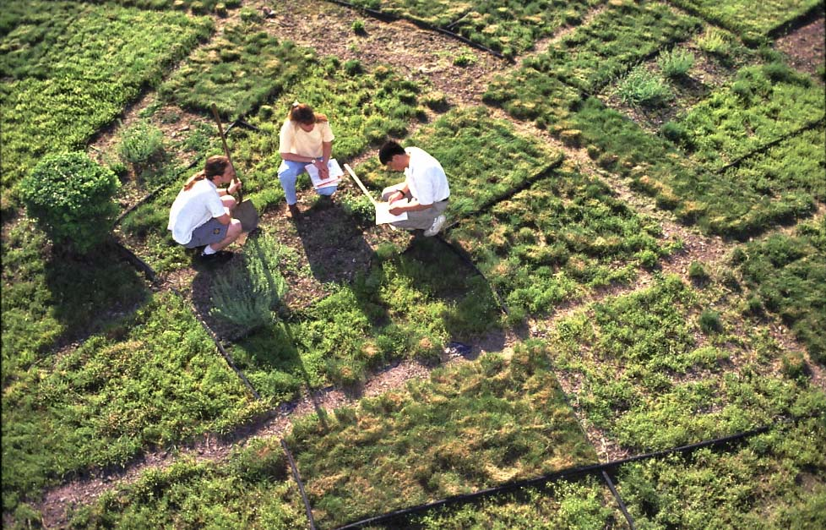
Revival Field-Palmerton: Yin-Ming Li
and Bev Kershner in ARS photograph.

Slide 18
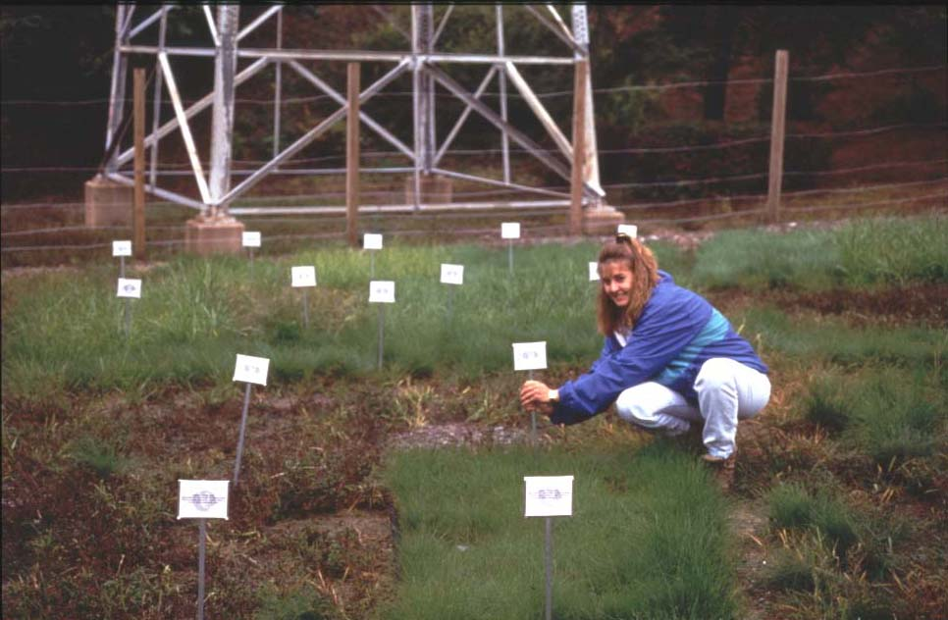
Compost
Bluegrass
Tall Fescue
Merlin
Control
Tall Fescue
Merlin
Palmerton, PA, Revival Field, Year-3: Grasses thrive only on Alkaline
Biosolids Compost Treatment (Cooperator Bev Kershner).

Slide 19
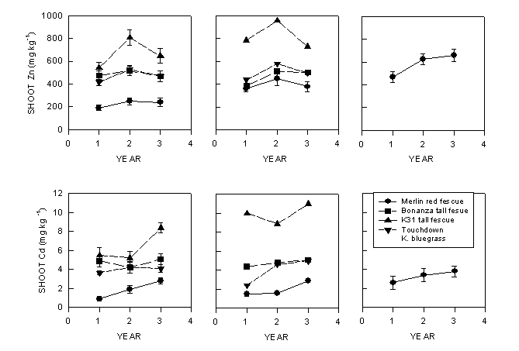
Compost Limestone Control
Cd and Zn in grasses grown on Palmerton Remediation Plots.

Slide 20
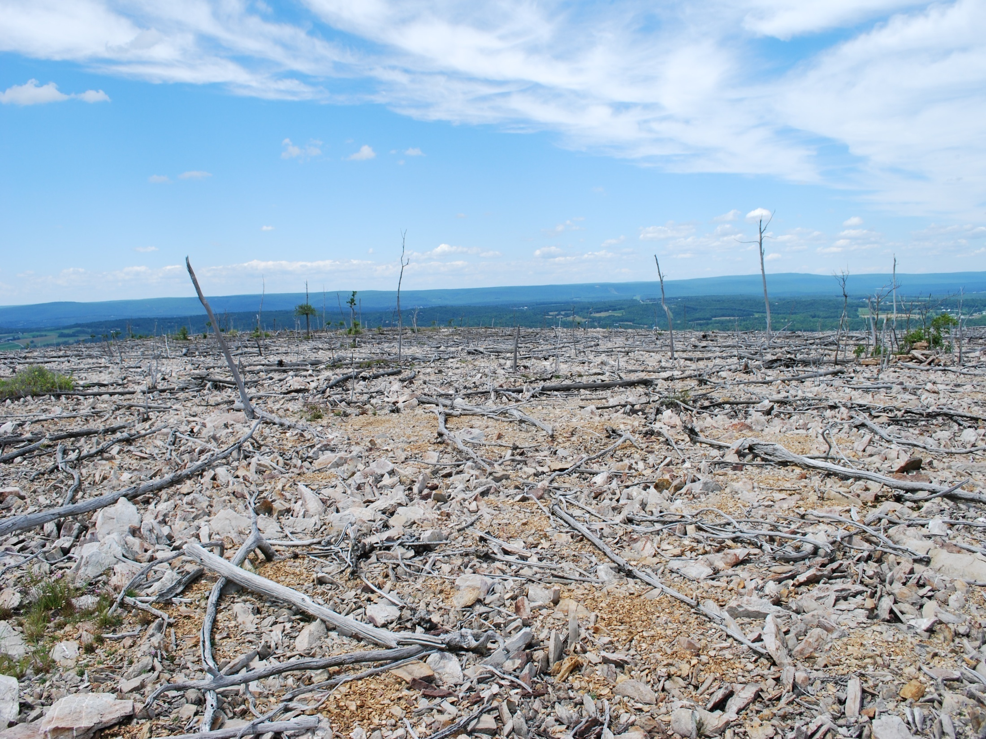
Appalachian Trail remained barren due to Zn phytotoxicity in 2008.

Slide 21
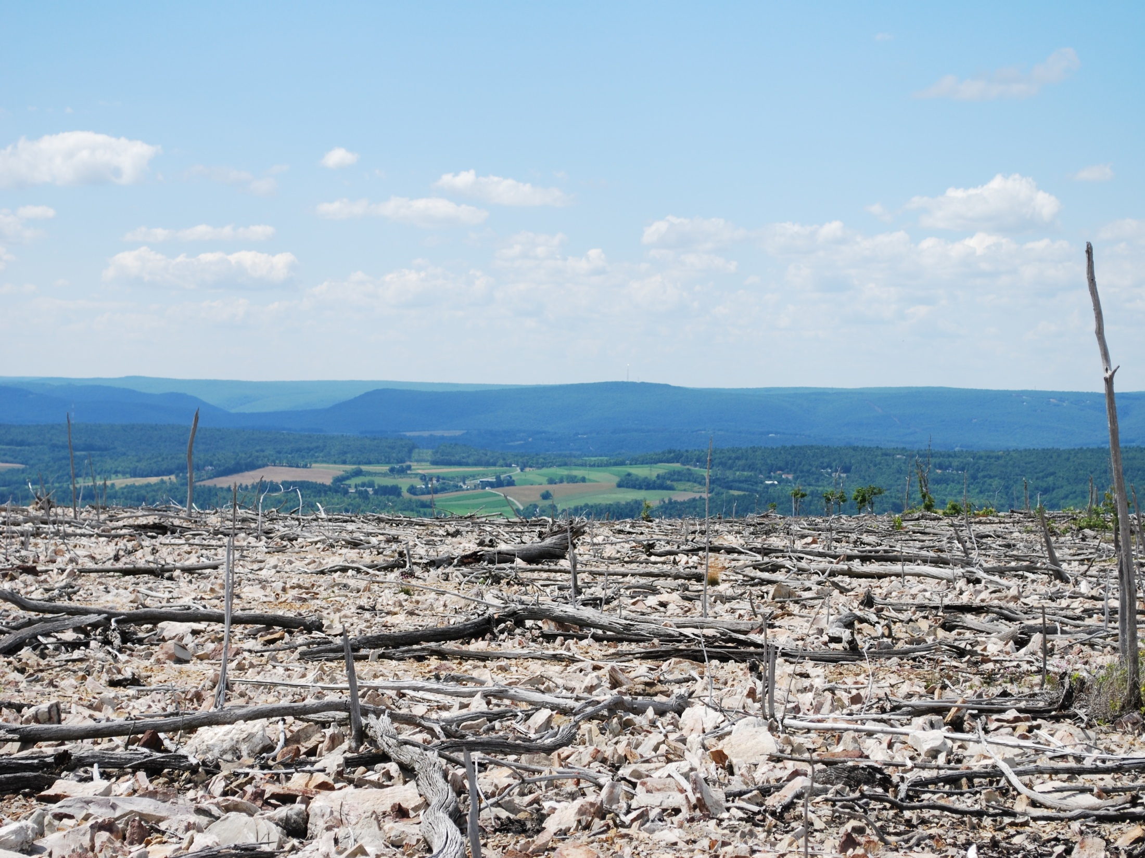

Slide 22
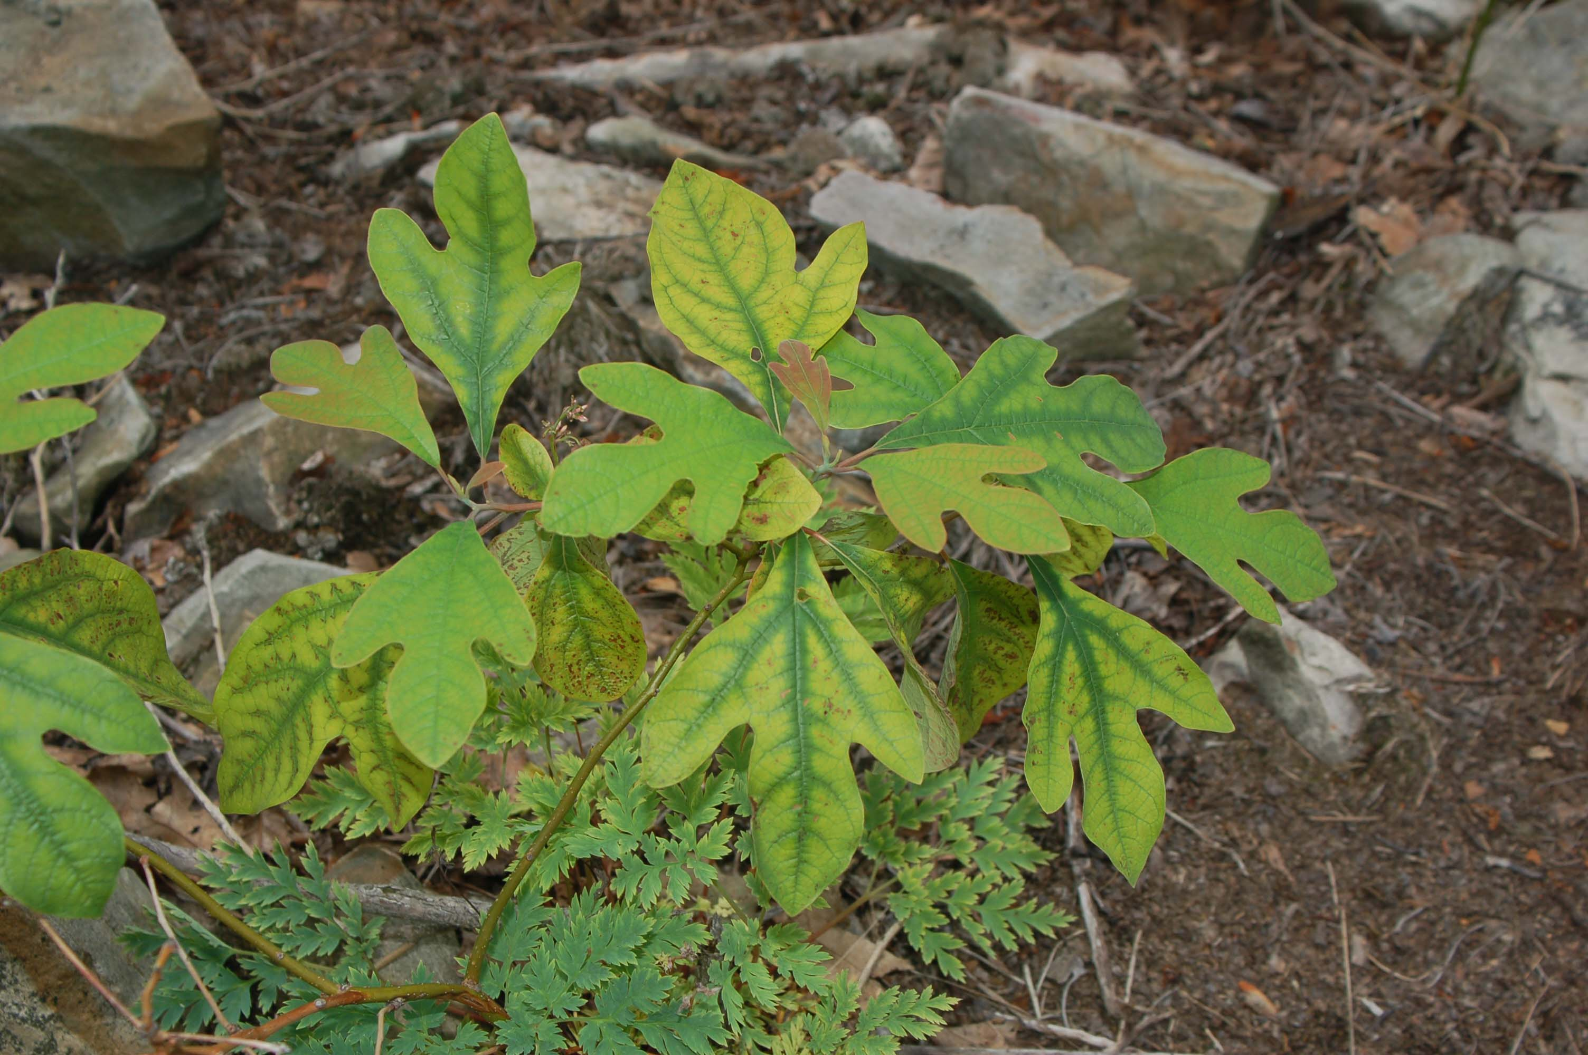
Sassafras growing on south face of Blue Mountain near Palmerton, PA., 6-21-2006
Leaves show severe interveinal chlorosis expected from Zn phytotoxicity.

Slide 23
Why Use High Quality Tailor-Made Biosolids Mixtures in Remediation of Soil Metals?
Fe and phosphate in biosolids increase metal “specific adsorption” ability of the amended soil, reducing metal phytoavailability.
Can remediate Zn phytotoxicity and food chain Cd risk.
Can reduce soil Pb bioavailability by forming Pb pyromorphite
Combining limestone equivalent and biodegradable organic matter causes alkalinity to leach down soil profile.
Incorporation to depth of contamination best alternative when possible to create fertile and non-toxic rooting depth.
Lime corrects subsoil acidity and metal phytotoxicity/leachability.
With pH buffered by applied limestone equivalent, metal adsorption is maximized, and occlusion promoted.
Some metals are occluded in crystalline Fe oxides, Mn oxides; LDH
Organic matter and balanced nutrient supply supports persistent plant cover especially if include legumes!
Tailor-Made Remediation Mixtures can immediately inactivate metals, provide microbial inoculum, add energy and nutrients.

Slide 24
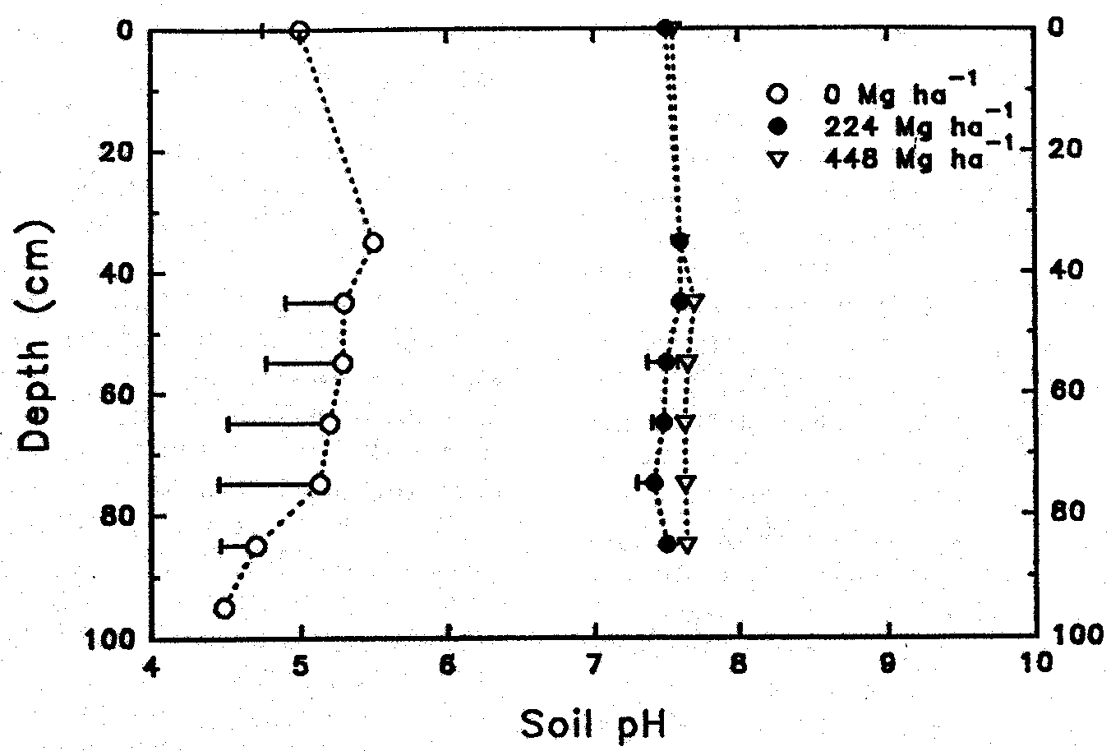
Effect of rates of limed digested biosolids applied to Galestown
loamy sand in 1976 on pH at soil depths in 1992 (Brown et al., 1997).

Slide 25
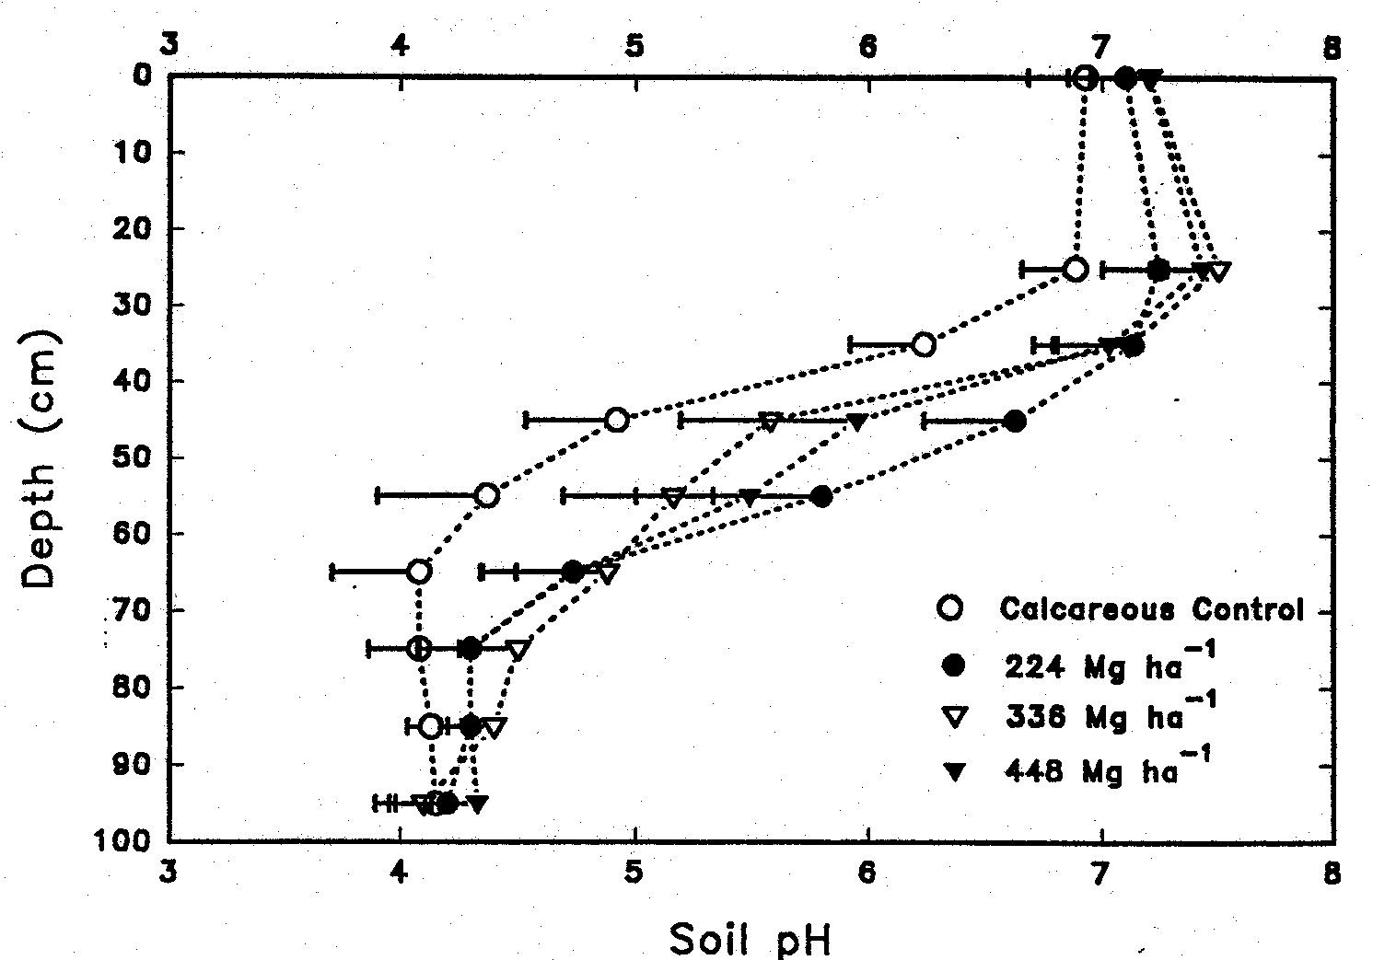
Effect of rates of limed digested biosolids applied to Christiana fine
sandy loam in 1976 on pH at soil depths in 1992 (Brown et al., 1997).

Slide 26
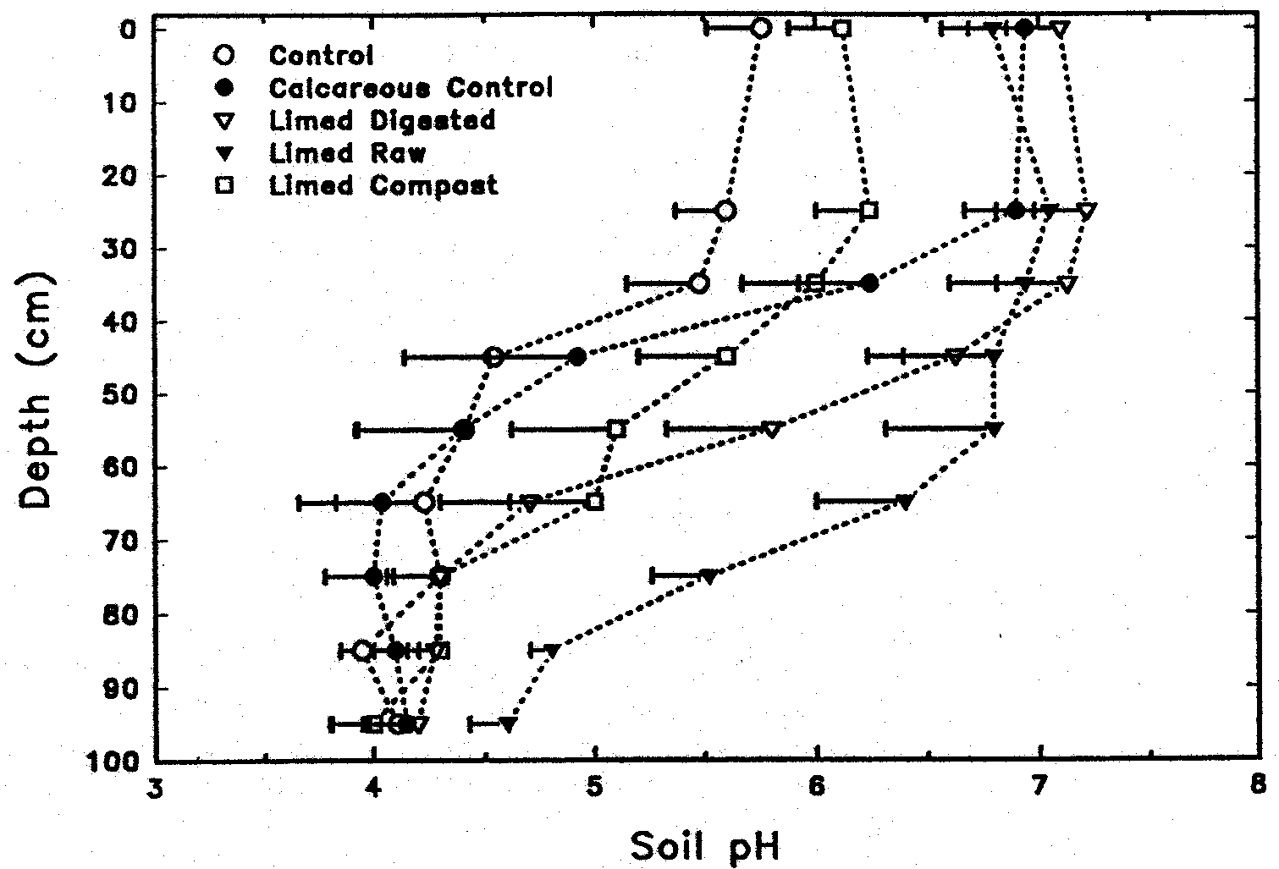
Effect of limed biosolids or composts applied to Christiana fine
sandy loam in 1976 on pH at soil depths in 1992 (Brown et al., 1997).

Slide 27
What Does it Take To Develop Local Tailor-Made Remediation Products?
Risk assessment and value information from testing in field studies of product utilization.
Courageous agencies and businesspersons who will seek out such combinations of biosolids, byproducts, and valuable commercial uses of the products.
Organized valid risk assessment information on:
Phytoavailability of applied and soil elements in field.
Bioavailability of soil and crop elements.
Improved risk communication, and honest risk assessments. Examples from Cd food-chain risk, soil Pb and As risk, and phytotoxicity risks from biosolids show massive errors of conservative assumptions.

Slide 28
Bunker Hill, Kellogg, Idaho-Superfund Site

Slide 29
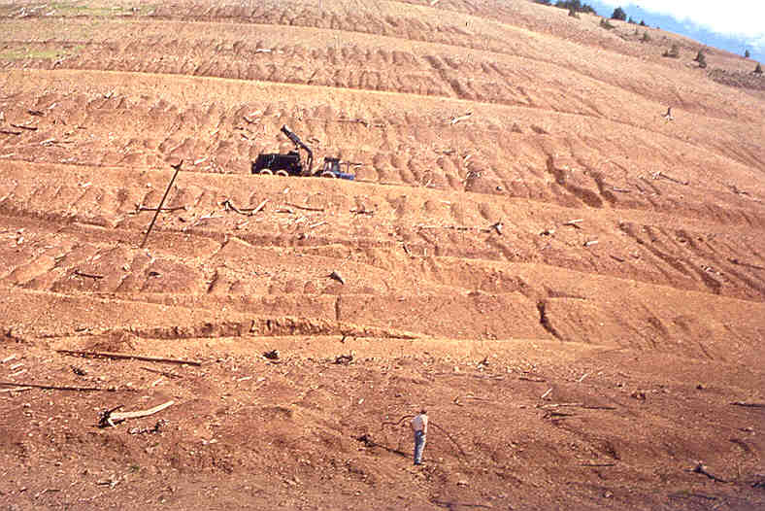
Bunker Hill, Idaho -- Smelter killed ecosystem Superfund Site.

Slide 30
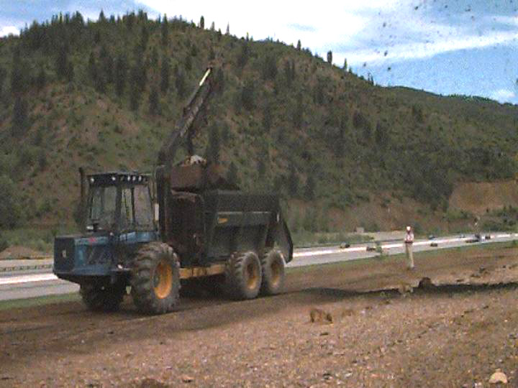
Aerospreader Applying Biosolids-Wood Ash Mixture at Bunker Hill

Slide 31
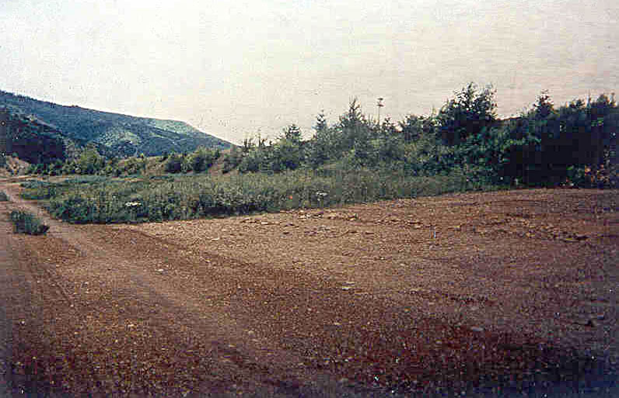
Highly Zn-phytotoxic smelter and mine waste contaminated soils at Bunker Hill, ID (15,000 mg Zn/kg);
Background = Biosolids+Wood-Ash Remediated
Foreground = Seeded control hazardous soil.

Slide 32
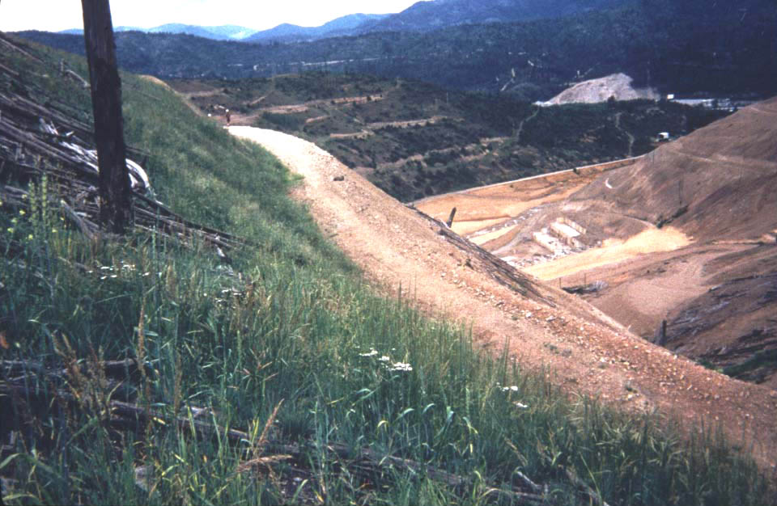
Revegetation of Bunker Hill Hillsides using mixture of biosolids, woodash and logyard debris, after 2 years.

Slide 33
Remediation of Page Swamp
The Page Swamp is a wetland constructed in a Pb-Zn-Cd mining waste storage pile near Kellogg, ID.
In cooperation with US-EPA Superfund ERT, Henry and Brown of Univ. Washington, Chaney et al. tested application of organic amendment plus alkaline byproducts to remediate the highly contaminated site soils.
Before treatment, the site lacked vegetation even when flooded. Further, the acidity allowed soil metals to inhibit soil microbes so that flooded soil did not become sufficiently reducing to form PbS.
Application of the composted biosolids plus wood ash mixture prevented toxicity to microbes or plants, soil became highly reducing and PbS was formed.
Formation of PbS reduces risk to birds which ingest sediments.
Vegetation was low in metals and safe for wildlife consumption.

Slide 34
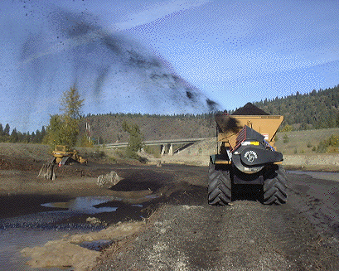
Page Swamp near Kellogg, ID; barren wetland built in mine wastes;
Mixture of compost and wood ash applied by Aerospreader.

Slide 35
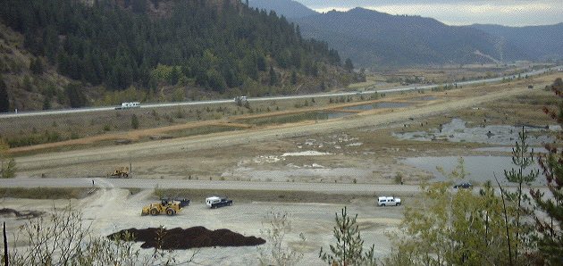
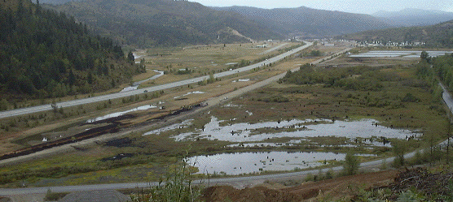
West Page Swamp prior to beginning treatment (10/7/98)
Overview and beginnings of final treatment by blower (9/21/00)

Slide 36
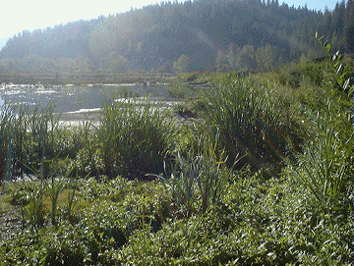
Page Swamp remediated area in next season after reactions
Of soil amendments and natural plant colonization.

Slide 37
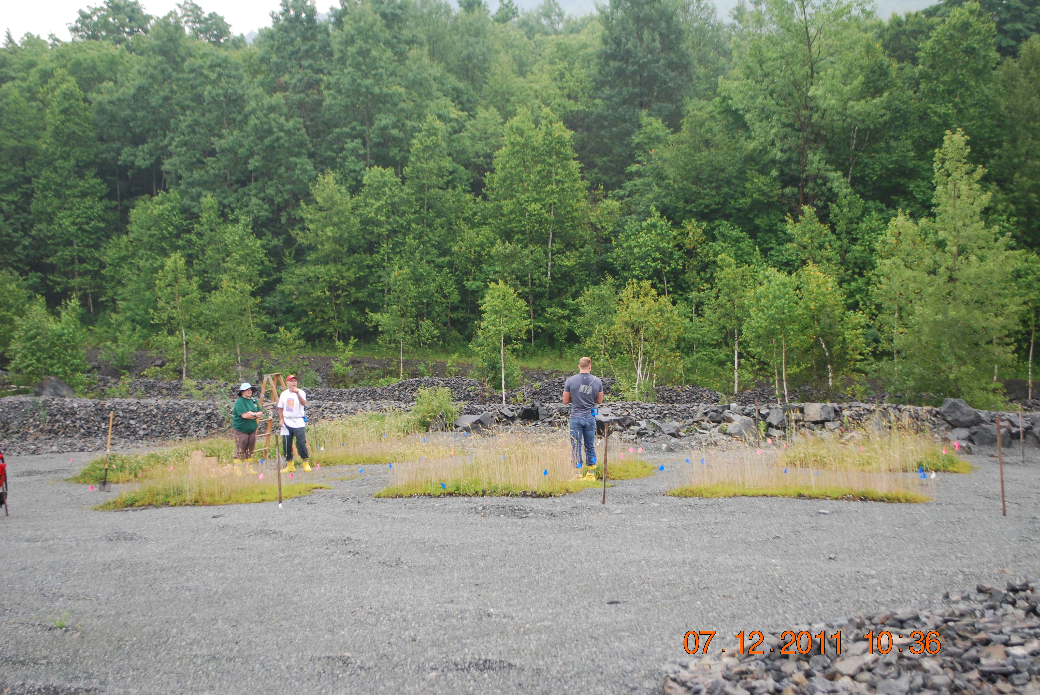
Vermont Asbestos Group Field plots in July, 2011 showing effective remediation using compost plus gypsum & NPK.

Slide 38
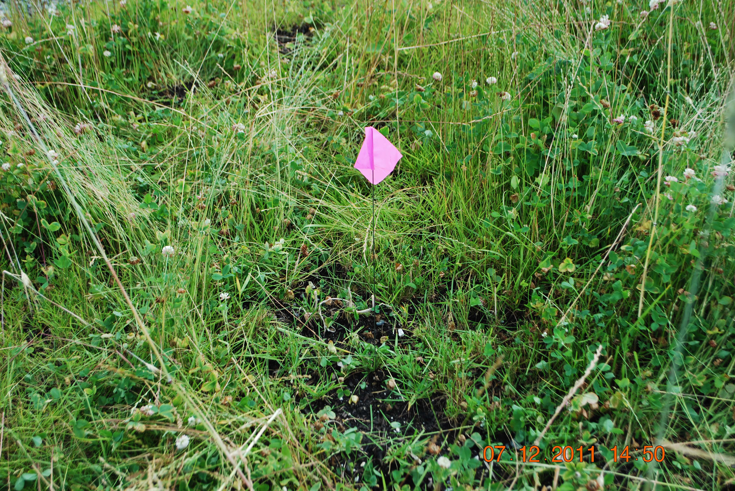
Strong growth of grasses and clover at VAG site in July, 2011

Slide 39
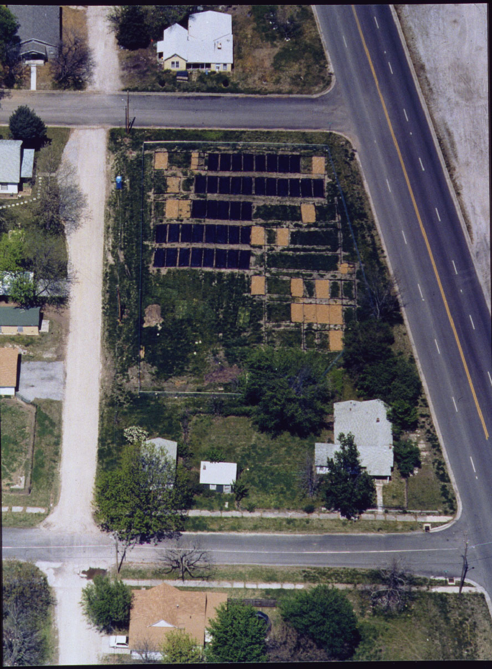
The IINERT Field Plots at Joplin,MO, Tested Soil Pb Remediation Using P and Fe.
Spectroscopic experiments on
field samples
Feeding Tests for
Pb Bioavailability:
Rats, Pigs, Humans
In-vitro Soil Pb
Bioaccessibility
Extractions
Lab scale experiments
to support field results

Slide 40
Joplin Soils
Phosphate Amendment Reduced
Soil Pb Bioavailability to Humans
Group Age Weight Pb Dose Soil Dose Bioavailability
yr kg µg mg %, Absolute
Untreated 29.6 62.2 238 45.7 42.2
(26.3-51.7)
P-Treated 34.5 72.2 261 61.5 13.1
(10.5-15.8)
Graziano, Maddaloni et al., 2001; unpublished.
From Ryan et al. (2004) Joplin Mo soil Pb remediation test.

Slide 41
PHOSPHATE INACTIVATION OF SOIL Pb IN JOPLIN TEST Comparative Bioavailability Results-- Pig, Rat, Human and In vitro
Method Bioavailability
%-Reduction
Pig (Casteel et al.) 29
Rat (Hallfrisch et al.) 40
Human (Graziaoni, Maddaloni et al.) 69
In vitro (pH 1.5) 18
In vitro (pH 2.5) 69
Soil tested 18 months after H₃PO₄ treatment in field.

Slide 42
Urban Soil Lead Bioaccessibility Test
We tested a simplified soil Pb bioaccessibility extraction test method (extraction of 5 g of <2 mm soil with 50 mL of 0.4 M glycine·HCl solution adjusted to pH 2.5 using 4 M NaOH (= 0.38 M), at 25⁰; shaking for 2 hr @ 100 rpm) which is 8-20 times less expensive than other Pb-bioaccessibility test methods.
The method was designed to have high correlation with the reduction in Pb bioavailability results from feeding Joplin, MO, control and phosphate-remediated smelter contaminated soils to humans, pigs and rats.
When applied to Pb rich urban garden soils, the method revealed that fractional bioaccessibility (bioaccessible compared to total) of Pb in urban garden soils is only 10±2.2% of total Pb in soils containing 37-2400 ppm Pb, far lower than the 30% absolute bioavailability presumed by US-EPA in evaluating risk from soil Pb (IEUBK model).

Slide 43
Fractional bioaccessibility of Pb in Urban Garden soils is much lower than assumed by US-EPA in the IEUBK Model

Slide 44
Adjusting Soil Pb Limit for Measured Bioavailability
In the US, Recommended Soil Pb Limits:
400 mg/kg for Play Area Bare Soil
1200 mg/kg for other soil.
IEUBK was used to identify the soil Pb limit:
Assumes soil Pb has 30% Absolute Bioavailability.
To adjust total soil Pb for reduced relative bioavailability:
Soil Limit ● IEUBK/BA_{M} = Soil Limi_{Adj.}
400 ● 30%/10% = 1200 mg/kg
1200 ● 30%/10% = 3600 mg/kg

Slide 45
Cooperators and Graduate Students
Phytostabilization:
Sally Brown and Charles Henry, University of Washington
Compton/Sprenger, EPA-ERT
Yin-Ming Li, USDA-ARS, Beltsville
Michele Mahoney and Ellen Rubin, EPA-OSWER-OSRTI
Jim Ryan, EPA-Cincinnati and INNERT RTDF Group
Grzeg Siebielec and Tom Stuczynski, IUNG, Poland
Donald Sparks, David McNear, University of Delaware
Allen David, University of Maryland
USDA Lab manager, Carrie Green
Other researchers also developing these methods:
Michele Mench, Jaco Vangronsveld, Ravi Naidu, Raina Miller, etc.

