Slide 1
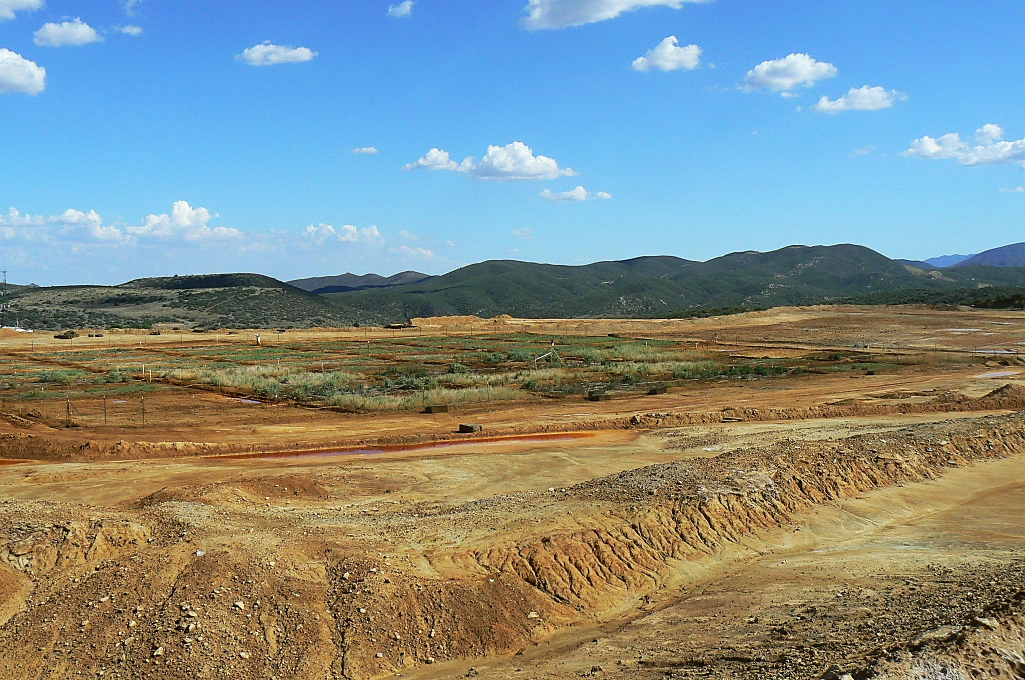


SCALING of an assisted PHYTOSTABILIZATION FROM GREENHOUSE TO FIELD-SCALE AT THE IRON KING MINE-HUMBOLDT SMELTER SUPERFUND SITE
Juliana Gil-Loaiza, M.S. student
Dept. of Soil, Water and Environmental Science
University of Arizona,Tucson AZ, USA.
April, 2010
September, 2011
U.S. EPA Hardrock Mining Conference 2012:
Advancing Solutions for a New Legacy
April 4th, 2012
Denver, CO

Slide 2
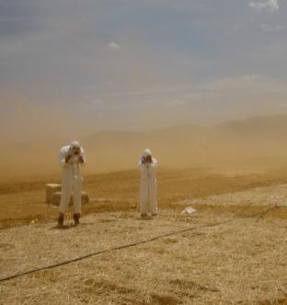
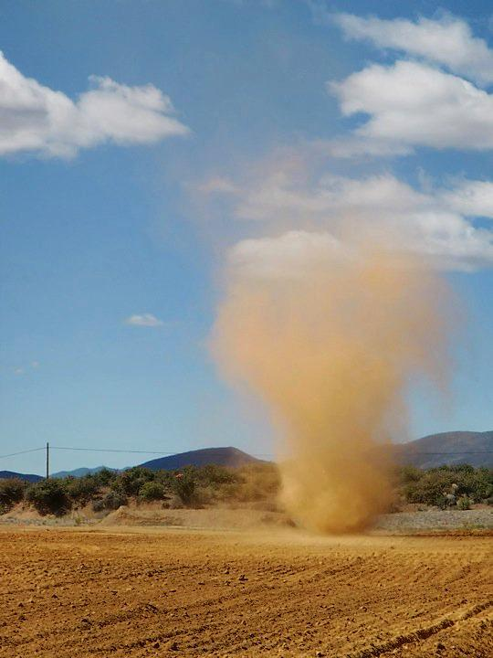
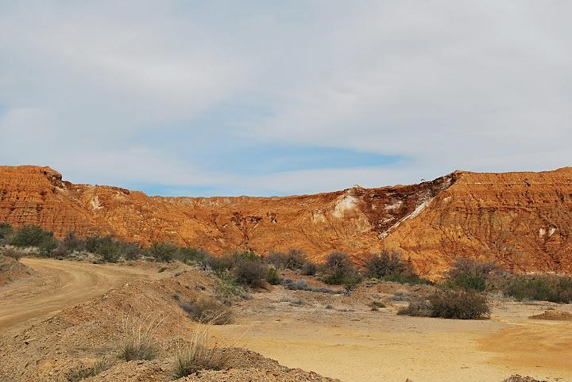
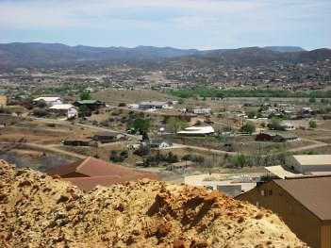
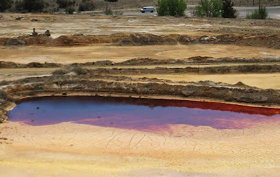
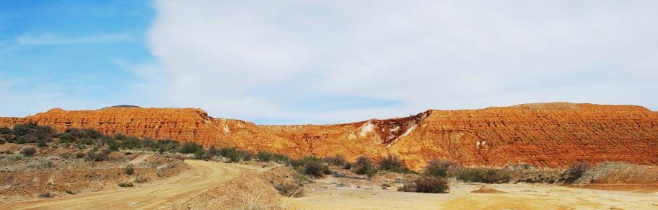
Mine Tailings
2
High concentration of metals
From acidic to neutral pH
Poor soil structure
Lack of nutrients
Low microbial community
Barren surface
Wind Erosion
Water Erosion
Risk Exposure
Human and
Environment
Iron King Mine Tailings

Slide 3
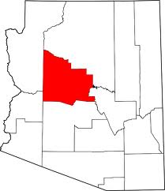
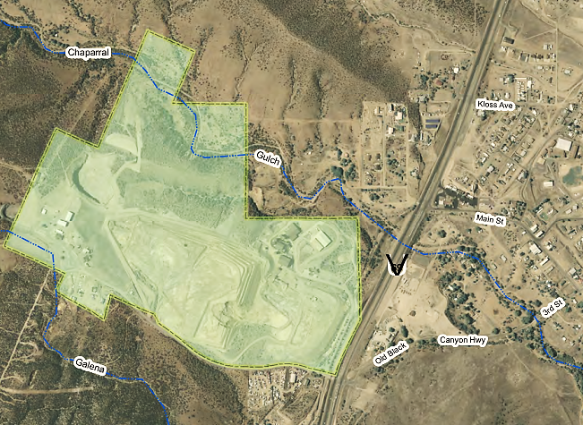
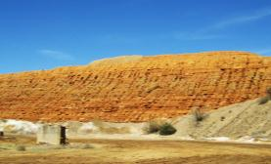

Site description
3
Iron King Mine-Humboldt Smelter Site (IKMHSS)
Superfund Site by Environmental Protection Agency (EPA) in 2008.
ARIZONA
Town of Dewey-Humboldt
  PROBLEM
  Arsenic and lead up to 4000 mg/kg
Phoenix
Tucson
Tucson
WWW.azdeq.gov
Source:http://www.azdeq.gov/environ/waste/sps/
PHYTOSTABILIZATION
Vegetative cap to stabilize metals in the root zone.
Reducing wind and water erosion.

Slide 4



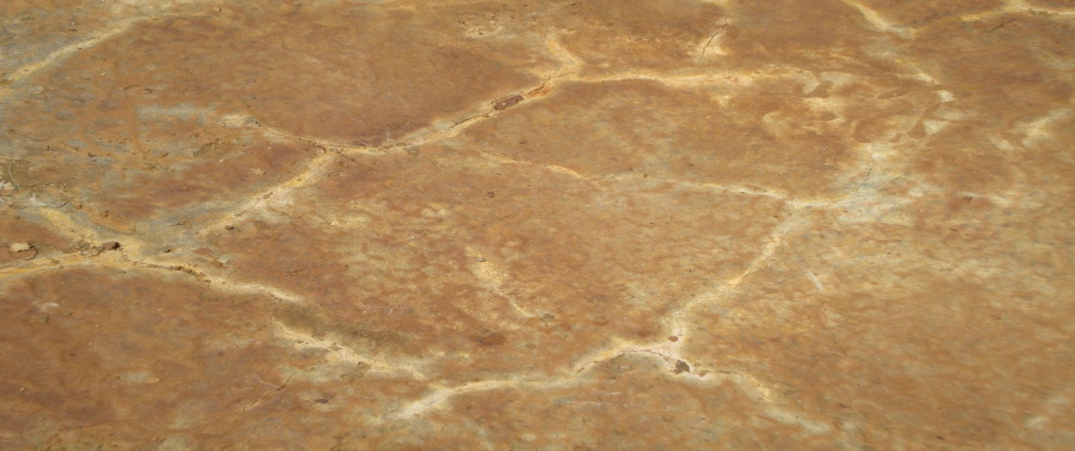

phytostabilization
4
Capping
Liability
Disadvantage
High cost for large tailing areas
Low durability in arid and semi-arid areas
Cost-effective
Planting directly into the tailings
Topsoil cap
Gravel layer or
Bentonite-cement seal
Tailings

Slide 5
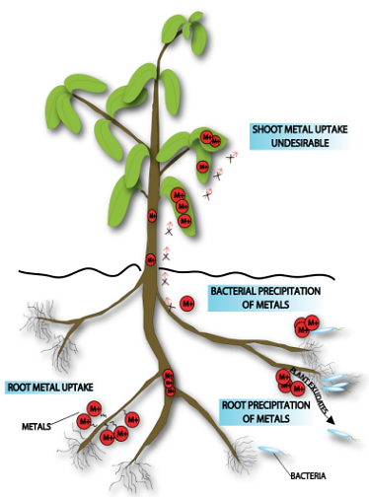
phytostabilization
5
Iron King Mine tailings
Low pH
High Salinity
Low Nutrients
Plants don’t grow
High metals
Mendez and Maier, 2008. Environ. Health Perspec.

Slide 6
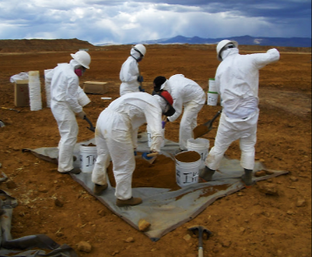
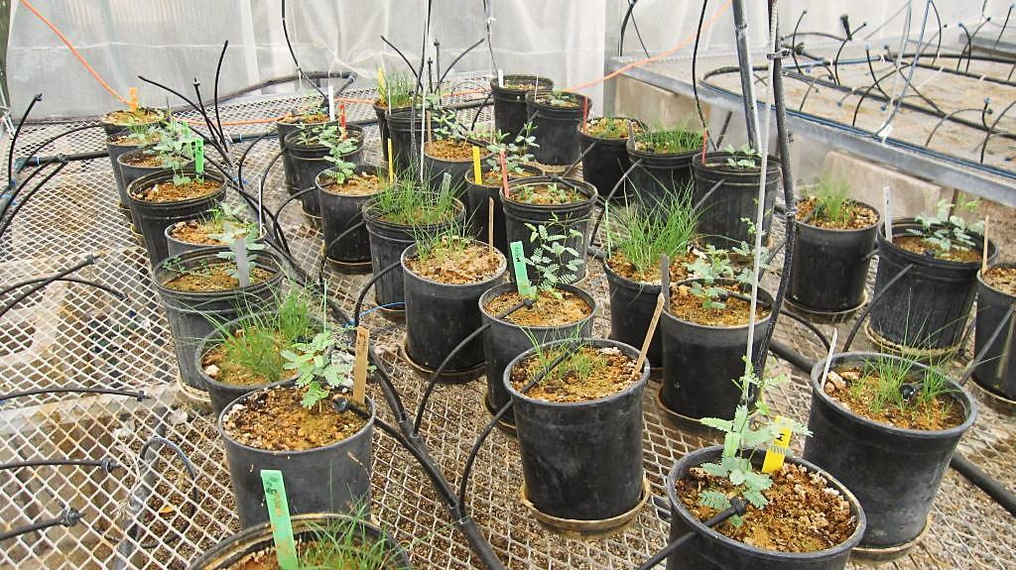
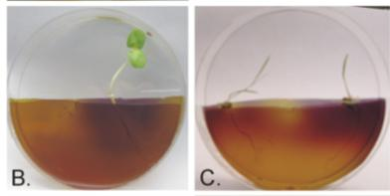
Greenhouse
6
Amendments
Native plants selection
15 species
Compost
Lime
Irrigation
Buffalo grass (BG) –Buchloe dactyloides
Arizona fescue (AF) –Festuca arizonica
Quailbush (QB) – Atriplex lentiformis
Mountain mahogany (MM) –Cercocarpus montanus
Mesquite (MQ) –Prosopis juliflora
Catclaw acacia (AC) – Acacia greggi
Solis-Dominguez F. A., et.al.. 2012, Environ. Sci. Technol.

Slide 7
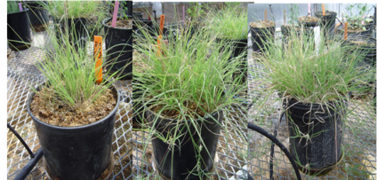
Greenhouse
7
Plant Biomass
Neutrophilic heterotrophic and Plant biomass
Buffalo grass
Not shoot metal uptake, except for Zn in quailbush
10% 15% 20%
Solis-Dominguez F. A., et.al.. 2012, Environ. Sci. Technol.

Slide 8
OBJECTIVE
8
To determine whether successful results from greenhouse studies can be translated to the field, and also, to identify the parameters that indicate successful phytostabilization at IKMHSS.

Slide 9
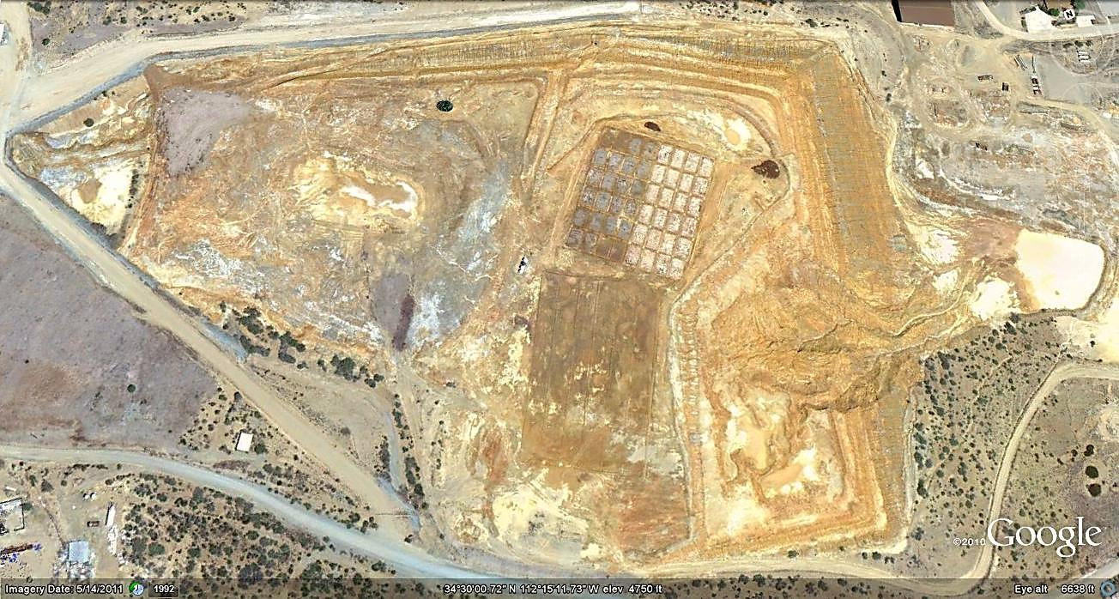
9
METHODOLOGY -Field plot and treatments-
Seeds
Buffalo grass (BG)
Arizona fescue (AF)
Quailbush (QB)
Mountain mahogany (MM)
Mesquite (MQ)
Catclaw acacia (AC)
N
300 ft
127 ft
PHASE I

Slide 10
10
METHODOLOGY -Field implementation-
3. Sampling
1. Study Area
2. Site Preparation
5. Irrigation
Setup Complete
4. Seeding

Slide 11
11
PARAMETERS -Measured-
CANOPY COVER
Daubenmire frame method
NEUTROPHILIC HETEROTROPHIC BACTERIA
Plate counts on R2A agar
SHOOT METAL UPTAKE
Microwave digestion and ICP-MS analysis

Slide 12
RESULTS
12
1
2
3
Neutrophilic Heterotrophic Counts
Canopy
Cover
Shoot metal
uptake
After 5 and 17 months
of phytostabilization for PHASE I

Slide 13
RESULTS -phase I -
13
1
Canopy
Cover
Canopy Cover
There is no cover vegetation for the unamended control compared with those treated with compost.
Canopy cover is higher than 30% after 5 months for those treated with compost and seeds. Then, after 17 months they have decrease to 20%.
Canopy cover after 17 months looks healthy. And it is more similar to the surroundings.
On those unseeded treatments canopy cover ranges from 7 to 16% due to volunteer plants (plants that grew without having been planted) have established after 17 months.

Slide 14
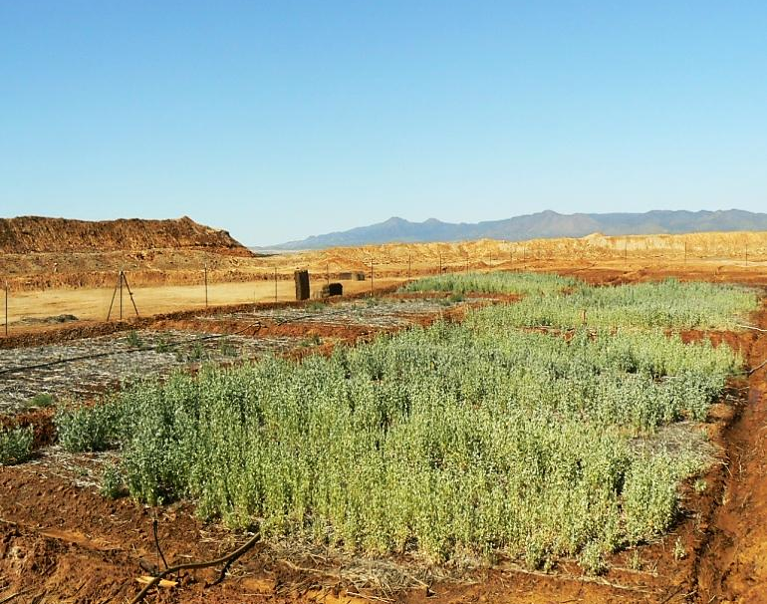
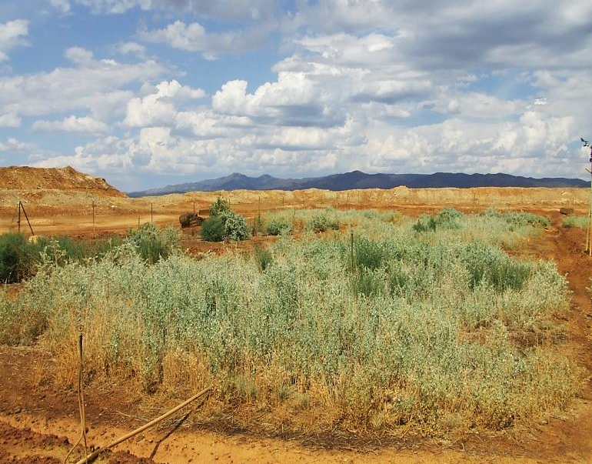
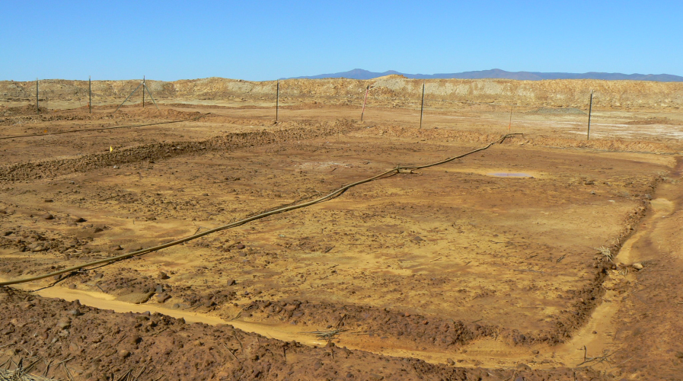
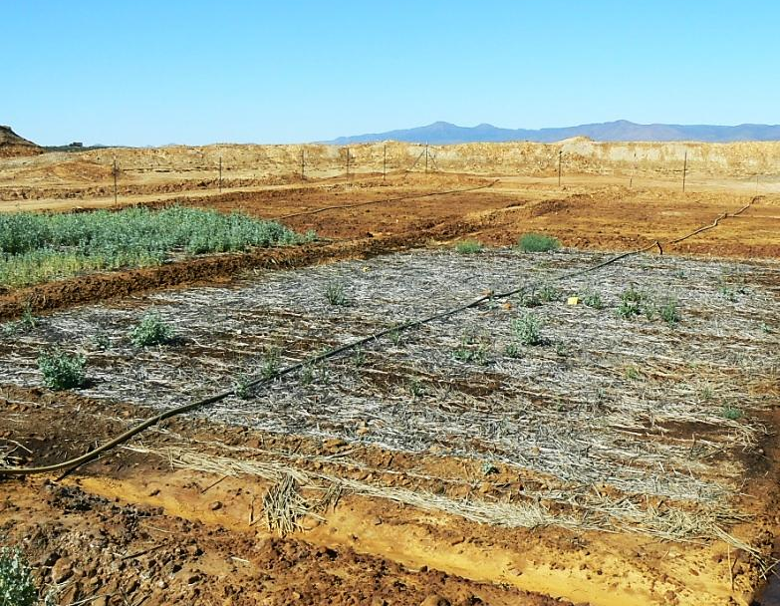
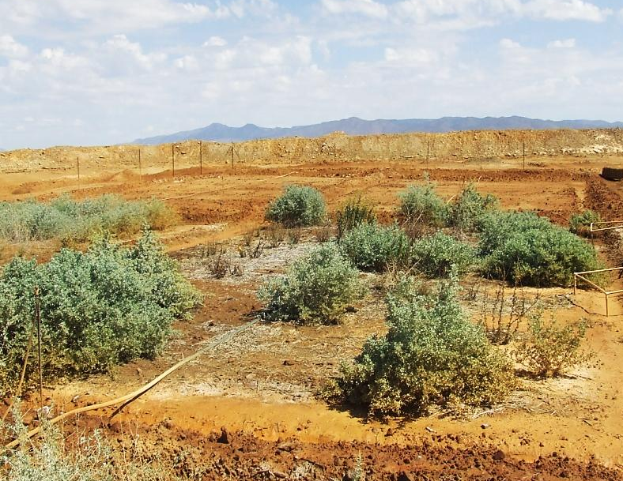
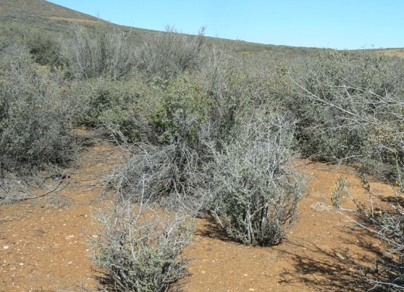
1
14
2010
2011
20% compost + Seeds
Canopy
Cover
5 Months
17 Months
Unamended irrigated control
Sept. 2011
20% compost + No Seeds
Off-site
5 Months
17 Months
Sept. 2011

Slide 15
15
Buffalo grass
Blooming and seeding after 17 months
Quailbush

Slide 16
RESULTS -PHASE i-
2
16
NHBC
Neutrophilic Heterotrophic Bacterial Counts
Unamended control results showed bacterial counts of 10² to second and how they increase 2 or 3 orders of magnitude at time 0 with the rate of compost.
NHBC increase 1 or 2 orders of magnitude with time on those plots treated with compost, after 14 months.
Taking into account that for 0 months we only have tailings, compost and seeds, and after 14 months we have a vegetation cover established, we can see that there is likely an interaction between microorganisms and plants.

Slide 17
17
RESULTS -Phase I-
3
Shoot metal
uptake
The National Research Council has defined the domestic animal toxicity limits for cattle being 30, 100, and 500 mg/kg for As, Pb, and Zn, respectively.
Metal accumulation in shoot tissue for buffalo grass and quail bush do not exceed the domestic animal toxicity limits at any rate of compost with an exception for zinc in buffalo grass, which is slightly higher.
ª DATL= domestic animal toxicity limit.

Slide 18
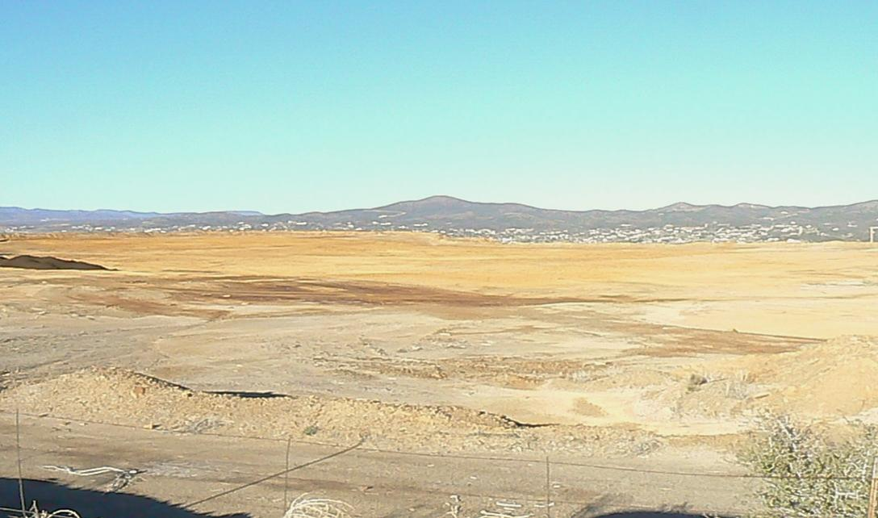
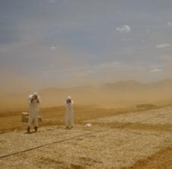
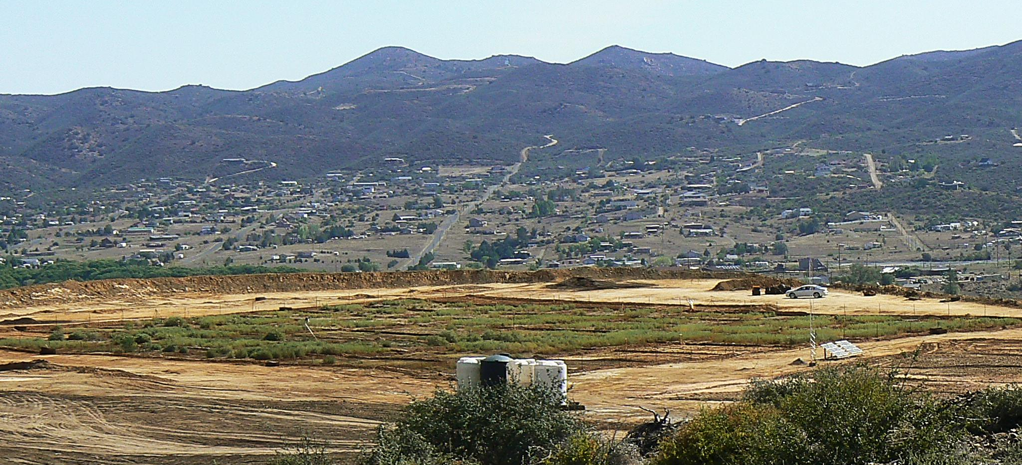
September, 2011
18
April, 2010
September, 2011

Slide 19
SUMMARY

Slide 20

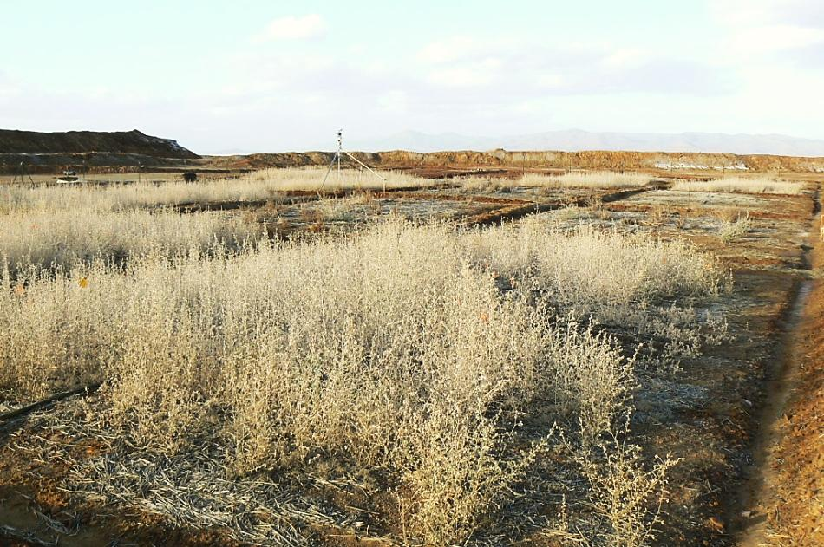
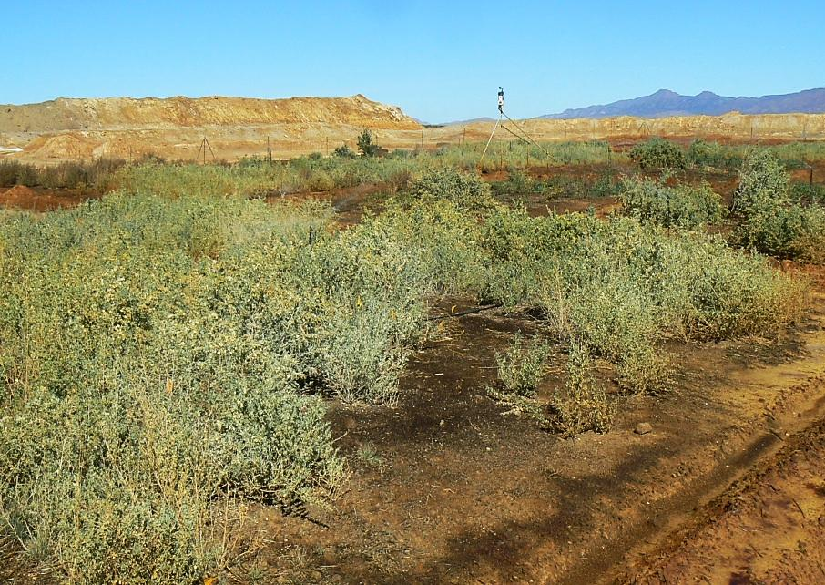
20
Phytostabilization was successfully scaled from the greenhouse to the field.
Direct planting achieved a canopy cover equivalent to the surrounding area. We will follow tailings characteristics over time to see if they improve as a medium for plant growth.
Percent canopy cover, neutrophilic heterotrophic bacteria, and shoot uptake of metal(oids) are promising criteria to use in evaluating phytostabilization success.
Phase I –March, 2011-
Phase I –October, 2011-
REFERENCES
Mendez M.O., Maier R.M., 2008. Rev Environ Sci Biotechnol 7:47–59
Epelde L., et al., 2010, Environ Pollut 158:1576–1583
Solis-Dominguez, F. A., et.al.. 2012, Environ. Sci. Technol.,46 (2), pp 1019–1027.

Slide 21

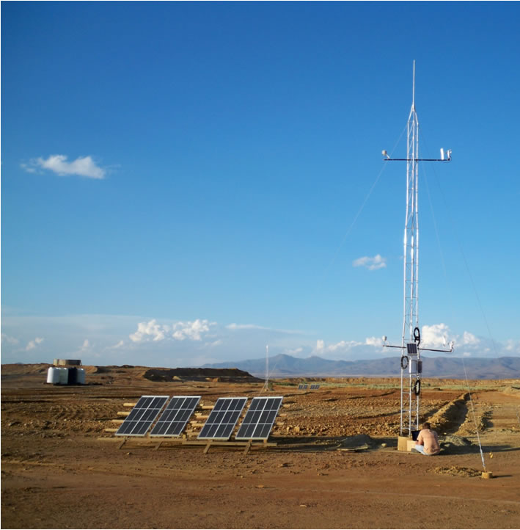
21
What is next ?
Effect of lime and use of transplants
Stopping irrigation
Self-sustainability of vegetative cap
Metal mobility and bioavailability (Soil-Water-plant)
Relationship between vegetative cover and dust emissions
10-meter dust flux tower (1 of 3) designed to measure meteorological parameters and vertical dust fluxes from the contaminated tailings.

Slide 22


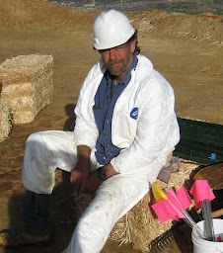
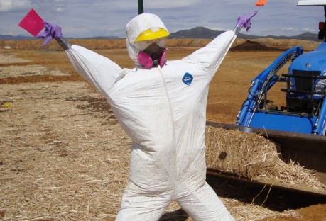
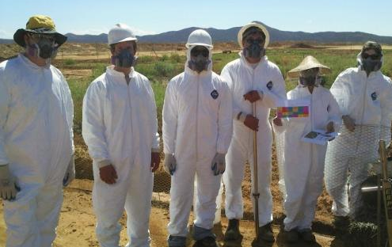
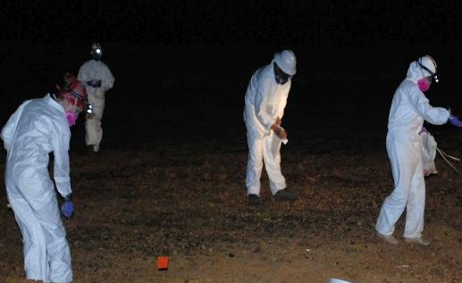
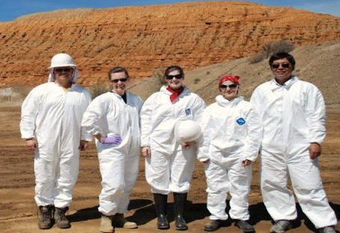
ACKNOWLEDGMENTS
22
University of Arizona
Funding
NIEHS SRP Grant P42 ES04940
EPA
Leah Butler
Monika O’Sullivan
ADEQ
Brian Stonebrink
North American Industries
Stephan Schuchardt (site owner)
Photos:
Corin Hammond
Juliana Gil-Loaiza
Karis Nelson
Robert Root
Alexis Valentin-Vargas
Raina Maier, PI
Jon Chorover, PI
Eric Betterton, PI
Scott White, Field expert
Mary Kay Amistadi
Janae Csavina
Travis Borillo-Hutter
Jason Field
Xiaodong Gao
Corin Hammond
Sarah Hayes
David Hogan
Karis Nelson
Robert Root
Richard Rushforth
Fernando Solis-Dominguez
Lane D. Undhjem
Alexis Valentin-Vargas

Slide 23

THANKS
**You can follow the field study at :
http://cals.arizona.edu/crops/irrigation/azdrip/BostonMill/IK/photolog.htm
Superfund Research Program University of Arizona
http://superfund.pharmacy.arizona.edu/
Juligil@email.arizona.edu
?
Questions

Slide 25
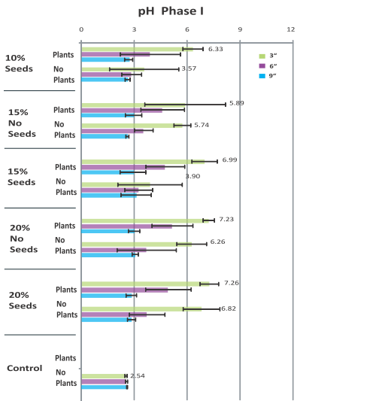

Slide 26
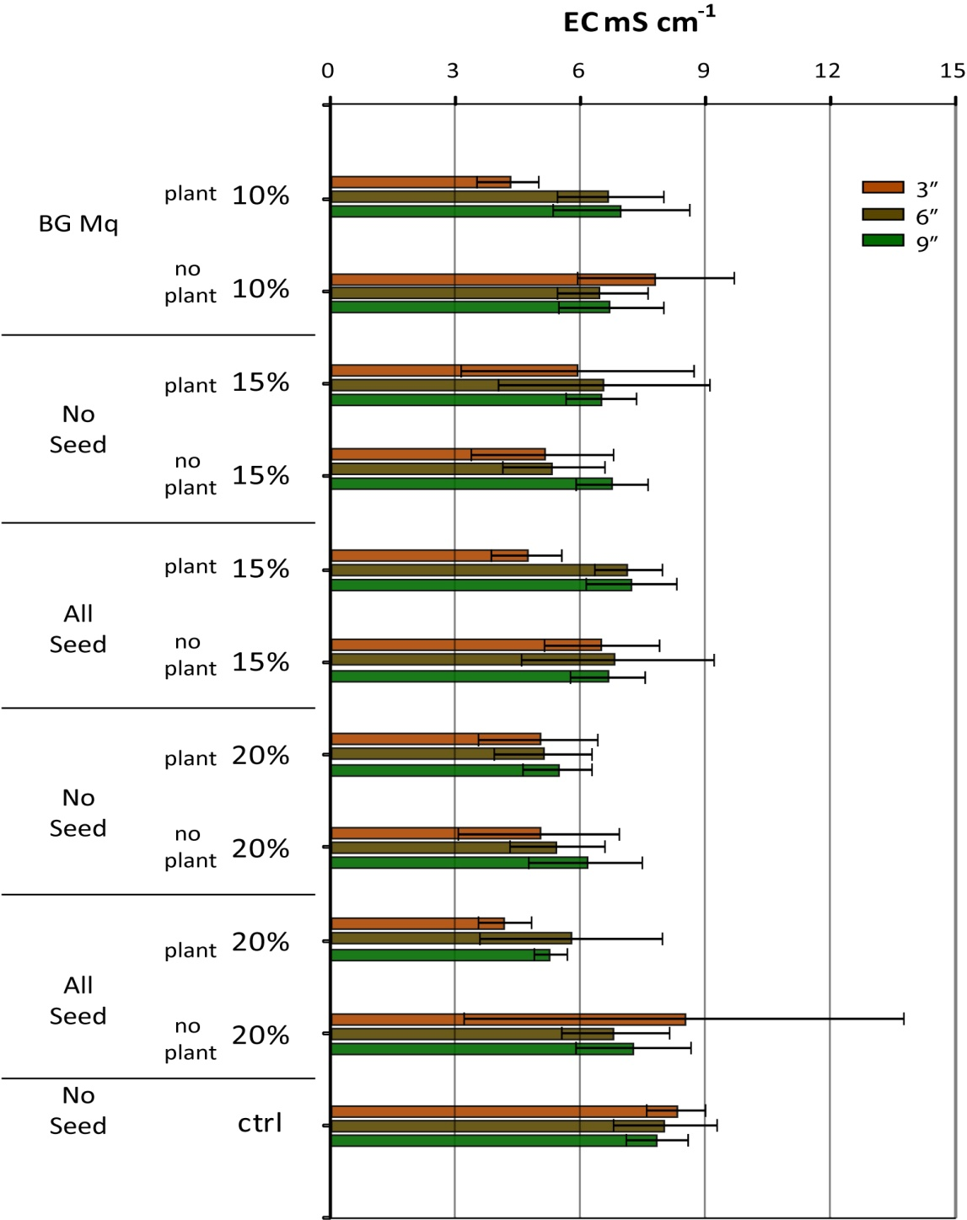

Slide 27
METHODOLOGY -Canopy Cover-
Two diagonal transects
Placement of frames and calculation
Daubenmire frame method

