Slide 1



Mine Dewatering and Water Management at Barrick Goldstrike Mine in the Carlin Trend, Nevada
Johnny Zhan, Ph.D.
Presented at U.S. EPA Hardrock Mining Conference 2012
Denver, CO, USA, April 3-5, 2012
Notes:
Good morning Ladies and Gentlemen. My name is Johnny Zhan. I am the Regional Manager of Hydrology for Barrick Gold of North America.

Slide 2
Presentation Contents
Introduction to Barrick and Goldstrike
Goldstrike Dewatering System
Goldstrike Monitoring System
Impact Evaluation
Conclusions
Notes:
My talk includes the followings 5 sections.

Slide 3
Unit Conversion
Distance:
1 meter = 3.3 feet
Flow rate:
1 liters/second = 16 gallons/minute (gpm)
Weight (Gold):
1 tonne = 32,000 troy ounces
Notes:
In this presentation, I will use both imperial and metric systems interchangeably. As an example,

Slide 4
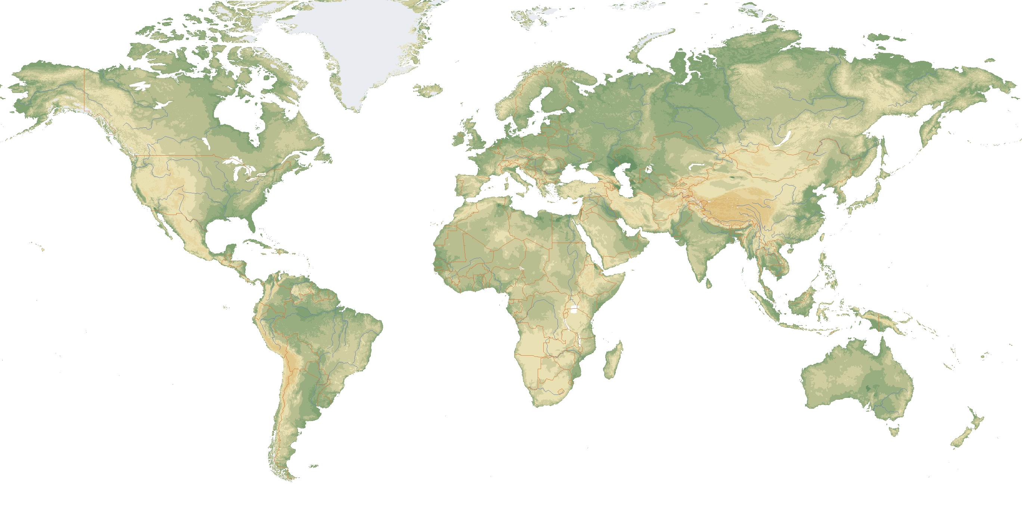
1. Introduction – Barrick
Donlin Creek
North
America
Goldstrike
Turquoise Ridge
Marigold
Bald Mountain
Cortez
Ruby Hill
Round Mountain
Golden
Sunlight
Hemlo
Jabal Sayid
Reko Diq
Pueblo Viejo
African
Barrick
Australia
Pacific
North Mara
Kabanga
Tulawaka
Bulyanhulu
Buzwagi
Lagunas Norte
South
America
Porgera
Pierina
Lumwana
Plutonic
Zaldívar
Darlot
Cerro Casale
Lawlers
Granny Smith
Pascua-Lama
Veladero
Kanowna
Kalgoorlie
Cowal
Mine
Project
Notes:
4
4
Barrick entered the gold business in the middle ’80s. Now we have 26 operational mines and many advanced projects around the world. The Square symbols represent the mines and circles represent the projects which will become mines in the future if they are proven to be economically viable.
Barrick global operations include 3 regional business units plus African Barrick Gold. In 2011, Barrick produced about 7.7 M oz of gold. In our business plan, we will produce about 9 M oz per year by 2016.
Our resources are located in 12 different countries which minimizes our concentration risk to any one country and provides a lower risk profile.

Slide 5
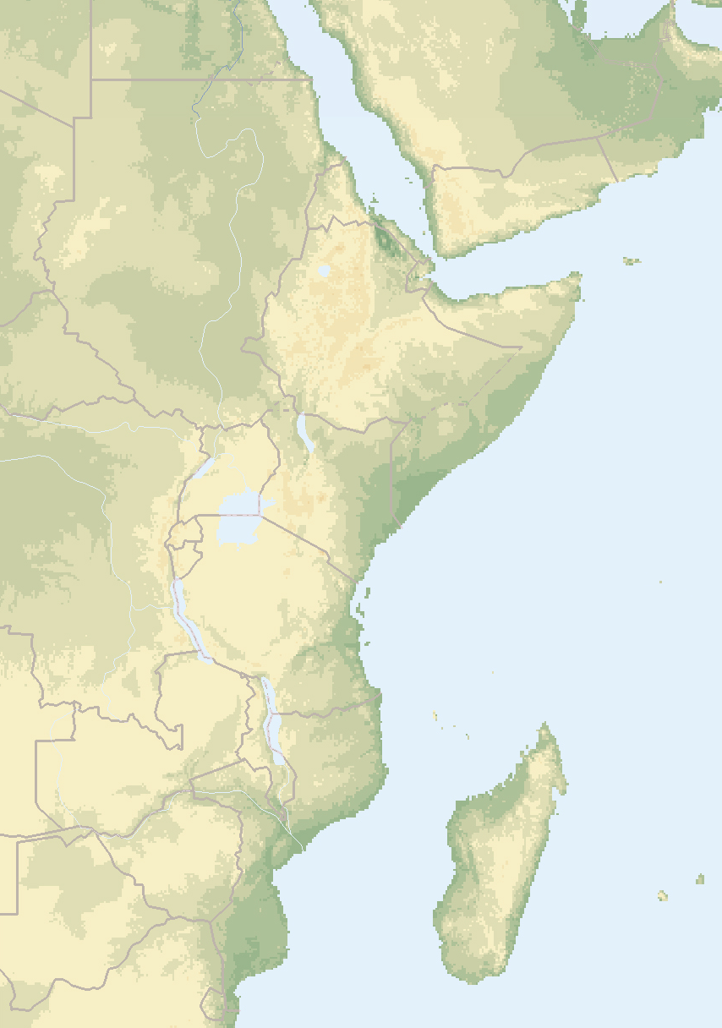
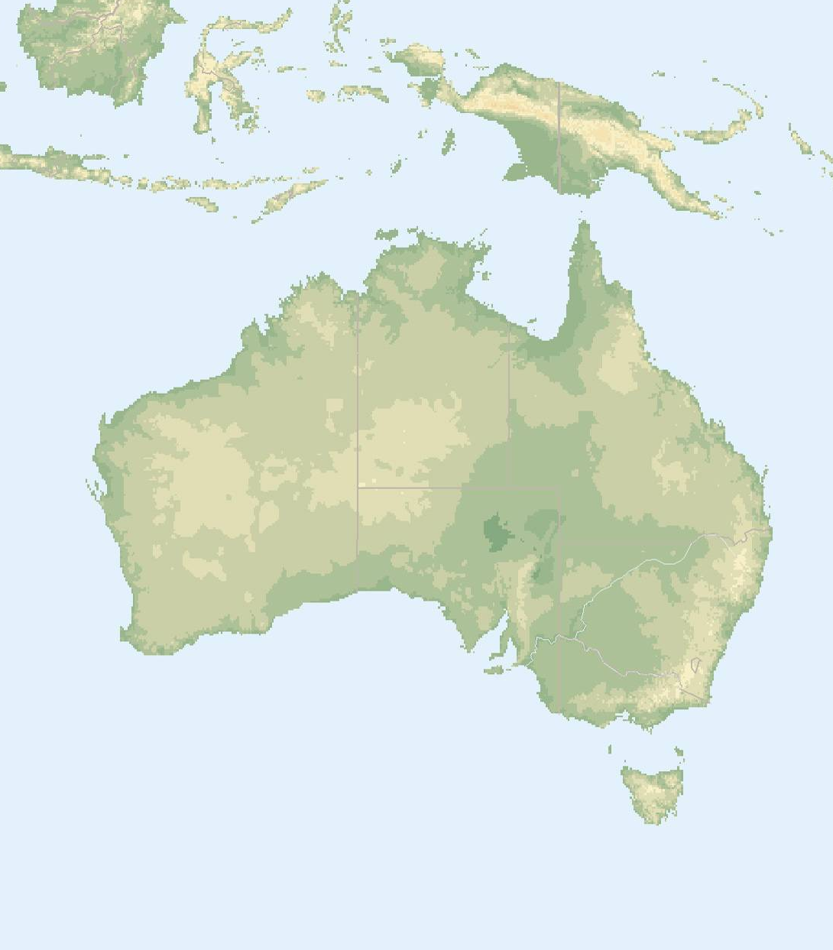
Barrick Global Operations – Equinox Addition
Jabal Sayid
P A P U A
N E W G U I N E A
SAUDI ARABIA
Porgera
A U S T R A L I A
Plutonic
Lawlers
Darlot
Granny Smith
Kanowna
Kalgoorlie
Cowal
Lumwana
ZAMBIA
Mines
Projects
Notes:
5
5
In June 2011, Barrick purchased Equinox with $7.4 M and add one copper mine and one copper project in our portfolio.

Slide 6
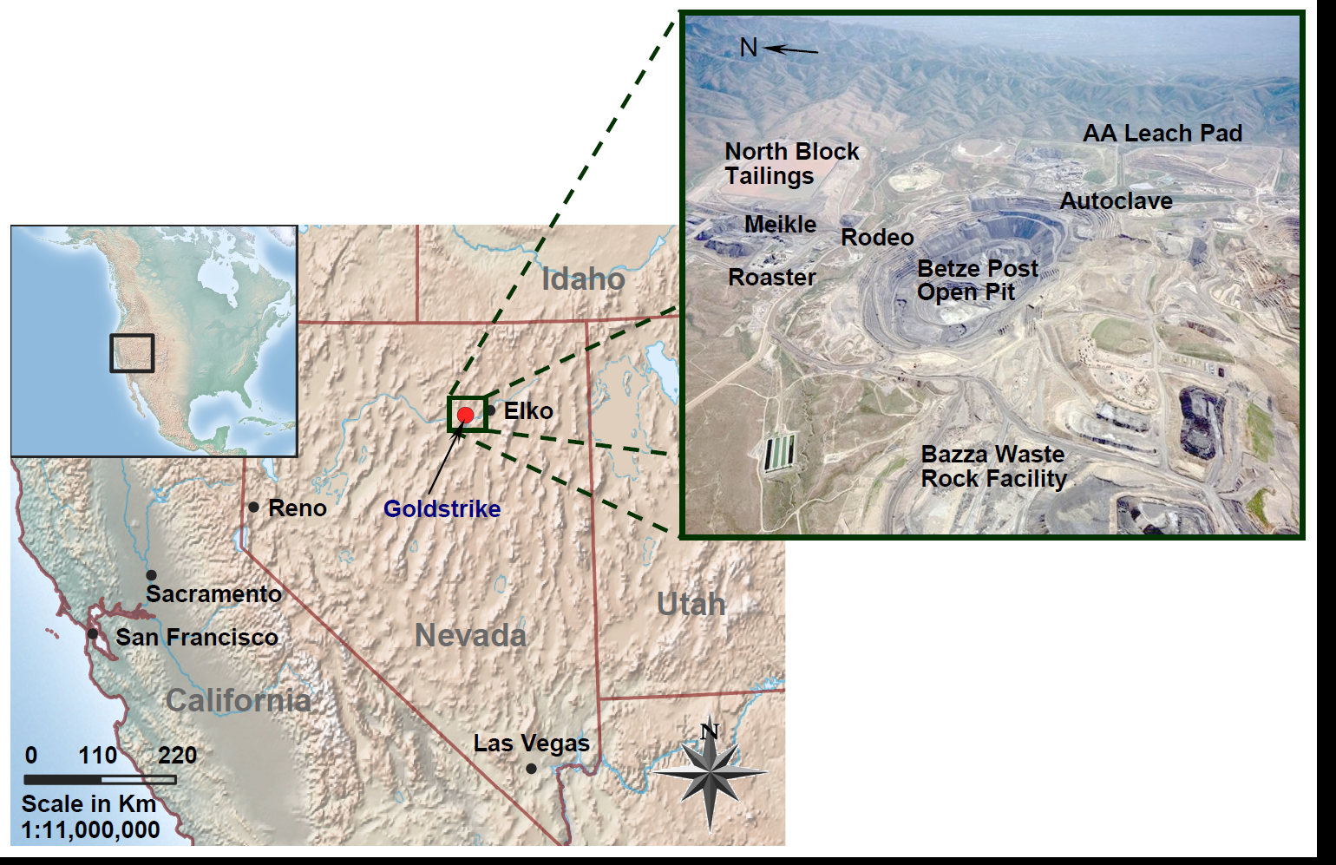
1. Introduction – Goldstrike Mine
Notes:
Barrick Goldstrike is Barrick’s flagship mine. Barrick has produced about 100 M ounces of gold, while Goldstrike along produced about 39 M ounces.
The Goldstrike Mine is located in the Carlin Trend in Elko, Nevada, USA. It operates both open pit and underground mines.

Slide 7
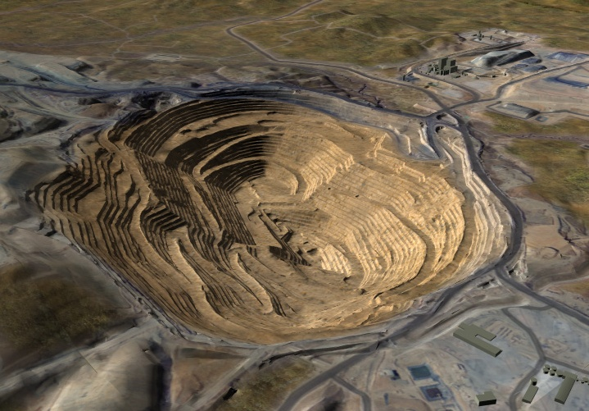
Open Pit
3,700 m
2,000 m
400 m
Notes:
Goldstrike operates the Betze/Post open pit. It is the largest single gold open pit in the US.

Slide 8
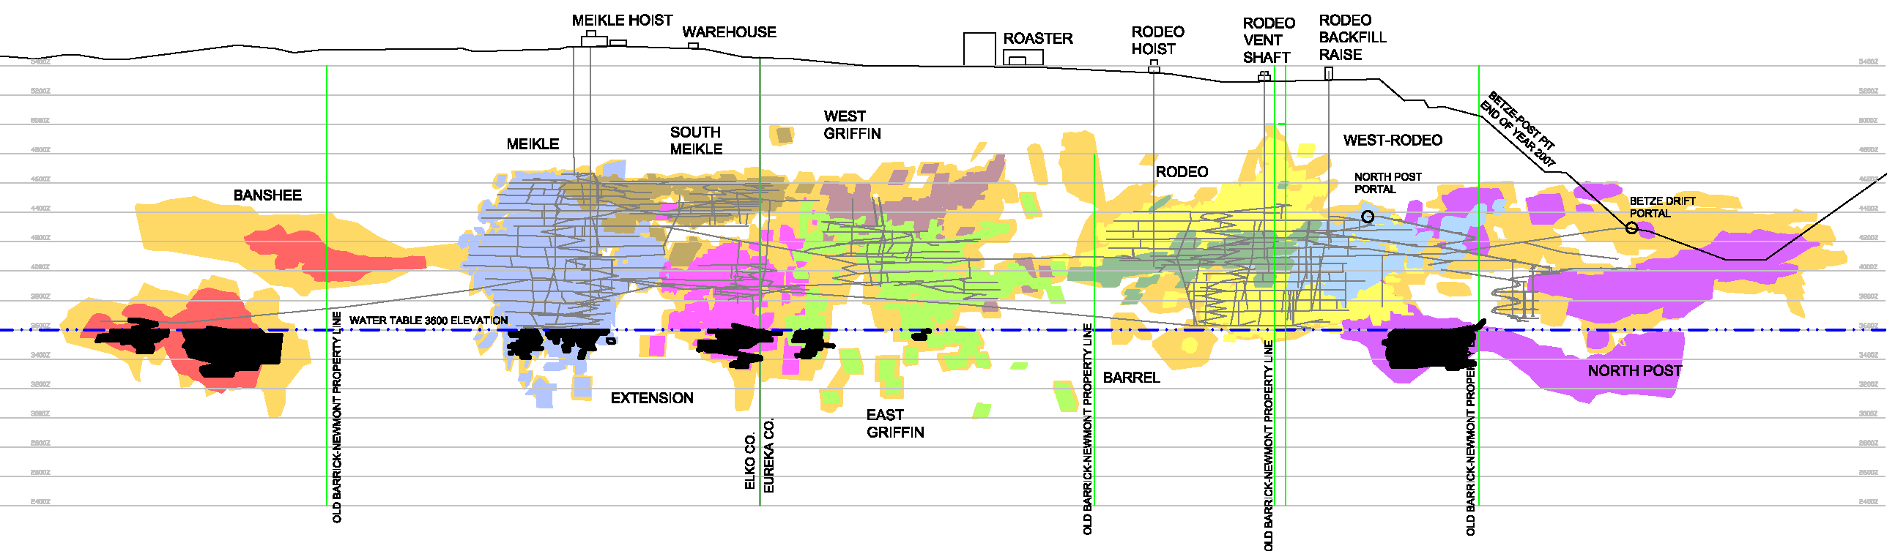
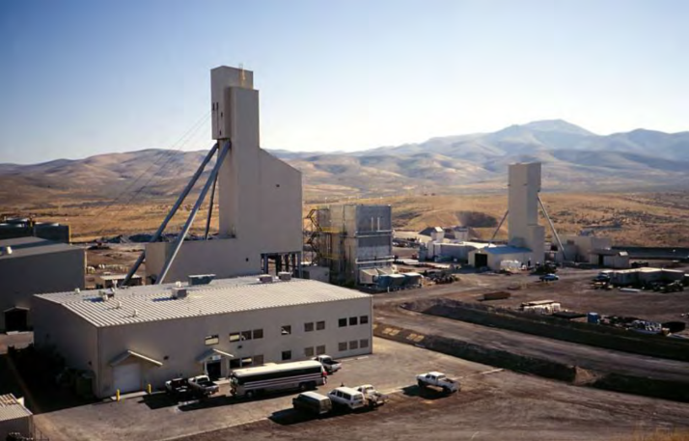
Underground Mines
Pre-mining water table
1600 m amsl
Current water table
1100 m amsl
with a drawdown of 500 m
Notes:
Goldstrike also operates the Meikle and Rodeo underground mines with an annual production more than 1 M ounces of gold.
The ore body is below the pre-mining water table. The top dashed line illustrates the pre-mining water table while the bottom dashed line shows the current water table.

Slide 9
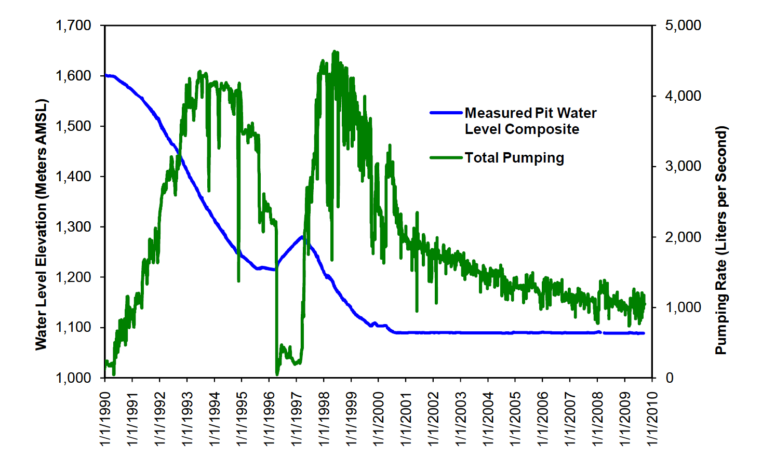
2. Goldstrike Dewatering System
Notes:
Goldstrike started the dewatering program in the early 1990’s. The peak dewatering rate was as high as 4500 l/s or 70,000 gpm. The water table has been lowered about 500 m. As indicated in this chart, the targeted water table was reached in 2000 and consequently the maintenance dewatering rate is continuously decreasing as expected.

Slide 10
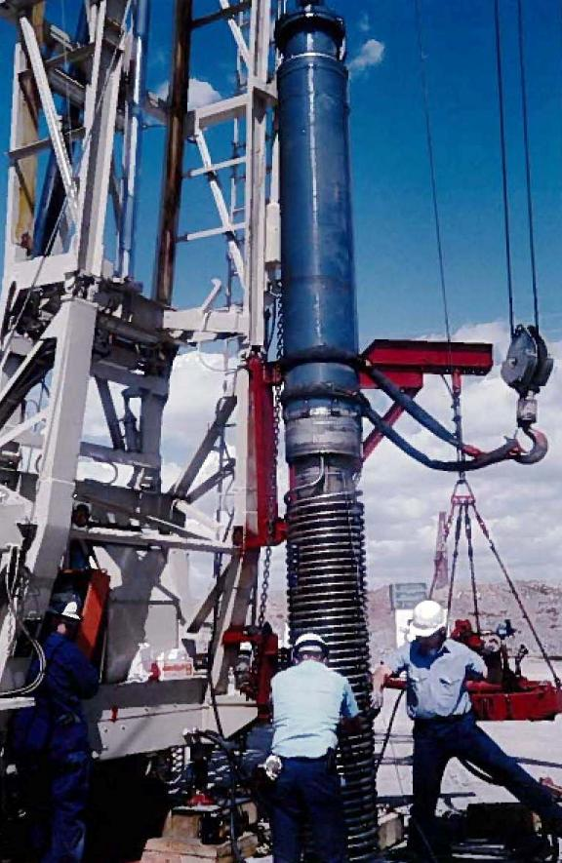
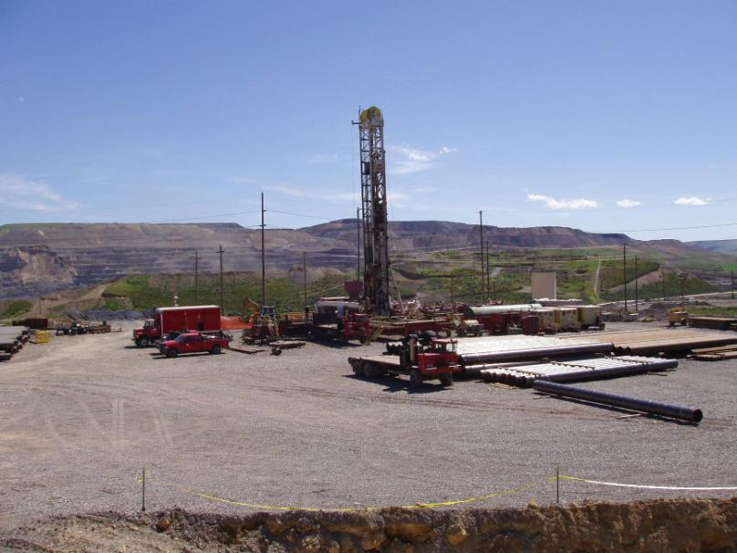
Dewatering System - Active
Pumping well -
Depth: 1000 m
Diameter: 50 cm
Rate: 200 l/s (3,000 gpm)
Power: 2,000 HP
Cost: US$3 Million/Each
Notes:
Goldstrike implements both an active dewatering program and a passive dewatering program. Active dewatering is achieved by continuous pumping from the aquifers. The wells are just magnificent with depth about 1000 m and 50 cm diameter. Including pump and drilling costs, each well costs us about 3 million US dollars. We have drilled about 44 of these types of large wells.

Slide 11
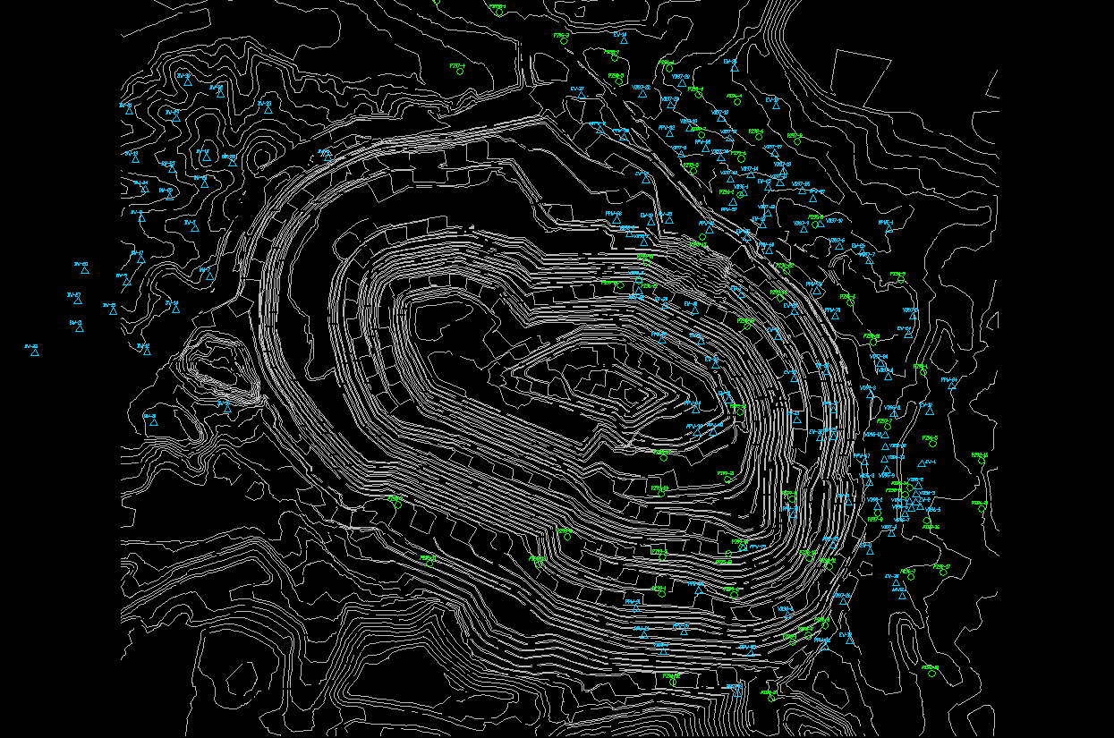
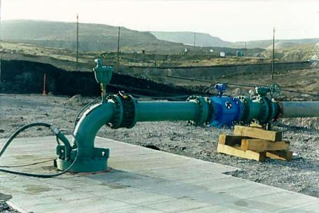
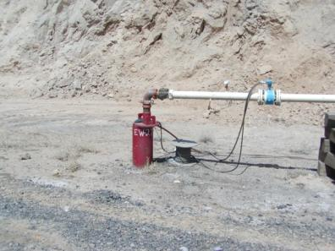
Dewatering System - Active
Piezometer
Regional Well
Local Well
Notes:
Blue triangles in the west show all regional pumping wells just like the wells in the previous slide;
blue triangles in the east show some small size local dewatering wells, which we have hundreds of;
green circles are piezometers just around the pit area

Slide 12
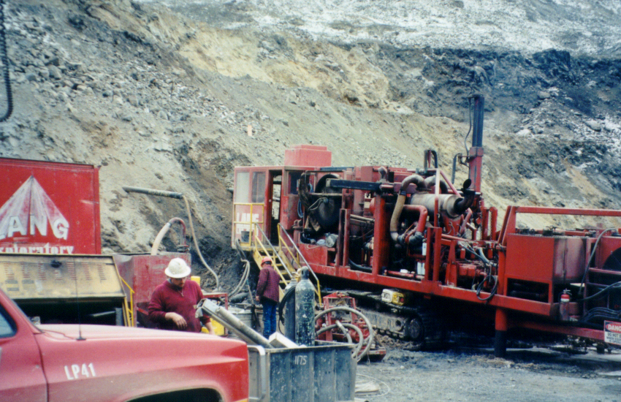
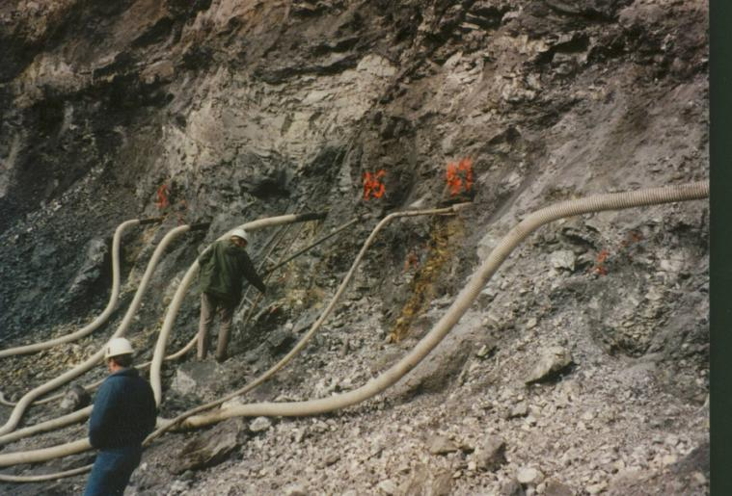
Dewatering System - Passive
Notes:
Passive dewatering includes both vertical drains and horizontal drains.
Left picture shows horizontal drain drilling and right picture shows an array of horizontal drains drilled into the relative wet spots to minimize pore pressure behind the high wall.

Slide 13
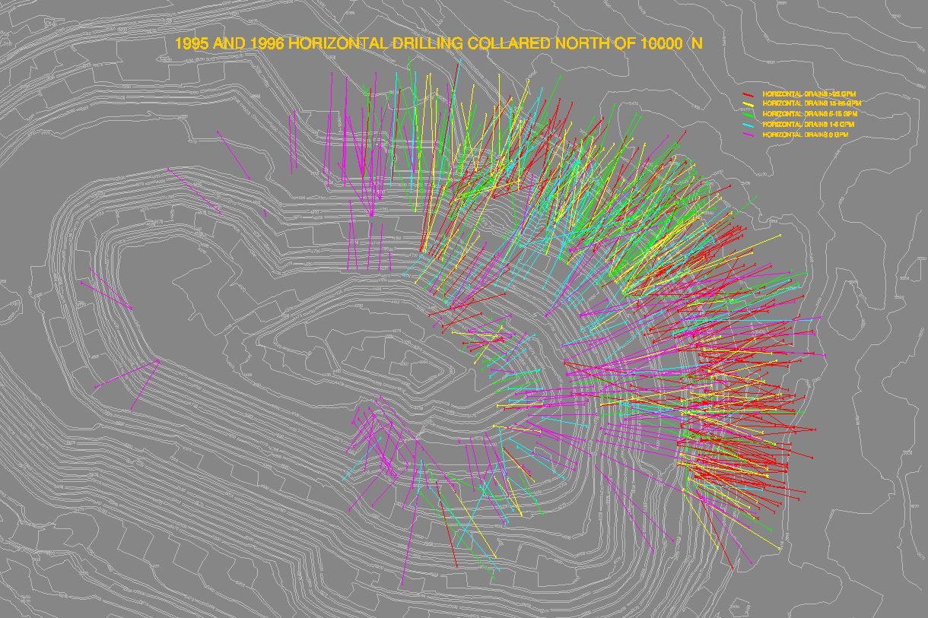
Dewatering System - Passive
HD (1994 – 2002)
Numbers: 1800
Length: 10 – 450 m
Total Length: 380 km
Notes:
This slide just shows the horizontal drains we drilled in two years - 1995 and 1996.
Totally, we drilled about 1800 drains. Their lengths vary between 10 m to 450 m. If adding all lengths together, the total length is about 380 km (240 miles).

Slide 14
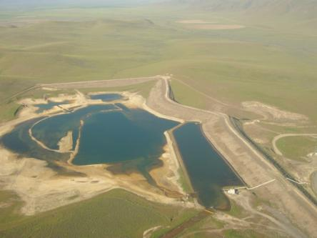
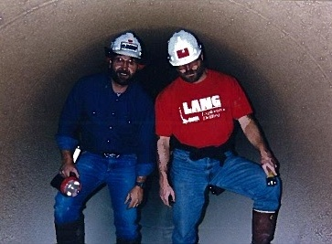
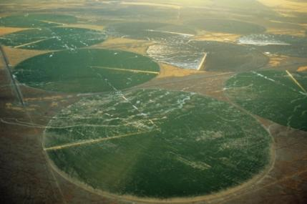
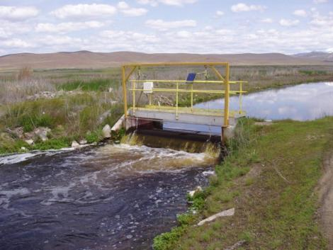
Water Management System
560,000 m²/Each
Notes:
When water is pumped out from the well field, a small portion is used for mine operation such as process makeup, dust control and exploration. The majority of water is sent to the Boulder Valley through the 72 inch pipe (this picture shows the size of the pipe). In the summer, the water is used for pivot irrigation. In winter, the water is returned to the same hydrologic basin through injection wells and ponds. Due to aquifer injection in volcanic units, water level rises above the outcrops of the bedrock and forms springs. This man-made spring water, just like excess mine water, is used for irrigation in the summers and ire-injected again in the winters.

Slide 15
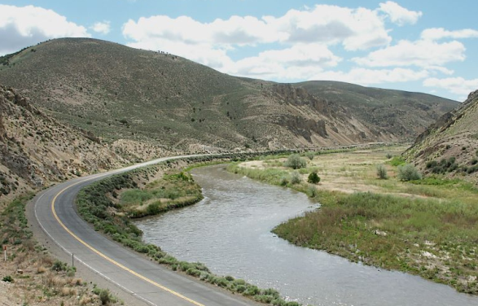
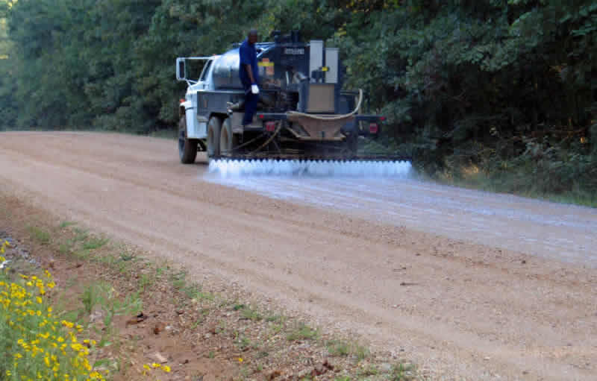
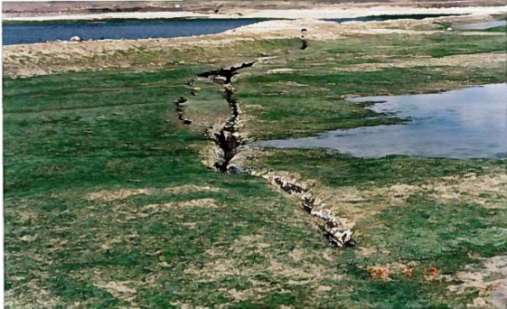

Cumulative Water Balance
Notes:
This pie-chart shows where the water goes. The mine consumes about 10%. 52% of water is re-injected into the same hydrological basin, and 27% is used for irrigation. As a rule of thumb, 20%-30% of irrigation water will become return flow re-entering the aquifer with the remaining being evapotranspirated.

Slide 16
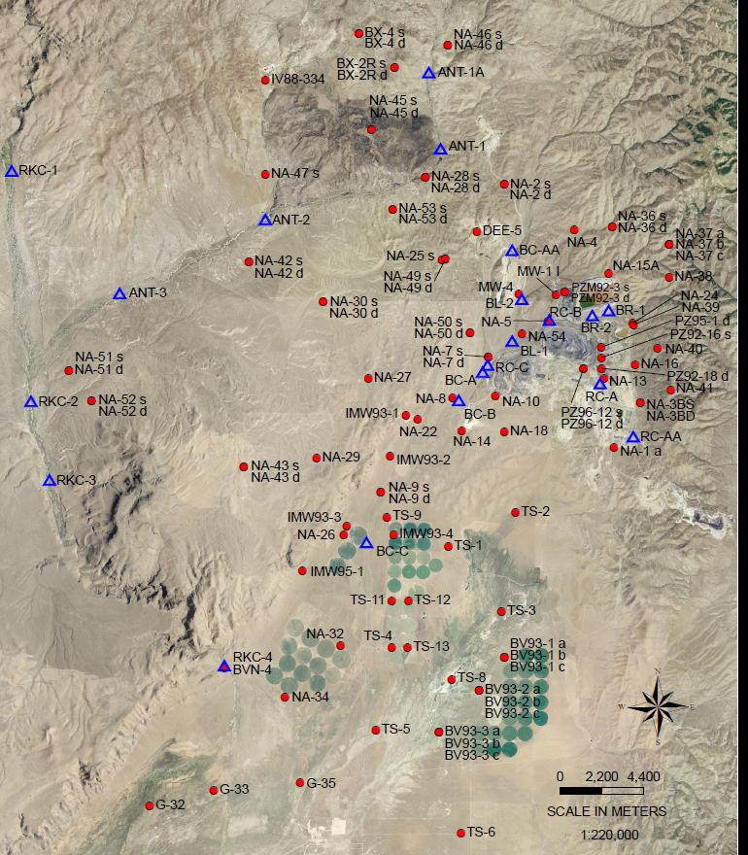
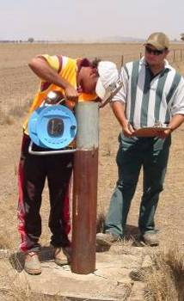
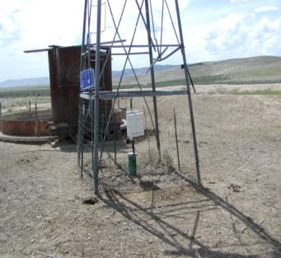
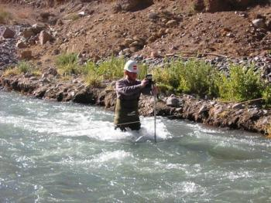

3. Goldstrike Monitoring System – 15,000 km²
Manual/Automatic Groundwater Monitoring
Manual/Automatic Surface Water Monitoring
Notes:
An extensive monitoring program is used to measure the hydrogeological responses to the mine dewatering. The program covers 600 square miles, or 1500 square km. We have hundreds of regional monitoring wells and two dozen surface water monitoring stations . The pictures shown on the left illustrate both automatic and manual measurements. In the automatic systems, the stations are powered by solar panels, data is recorded in a datalogger, and transferred back to the office either by radio or cell phone modules.

Slide 17
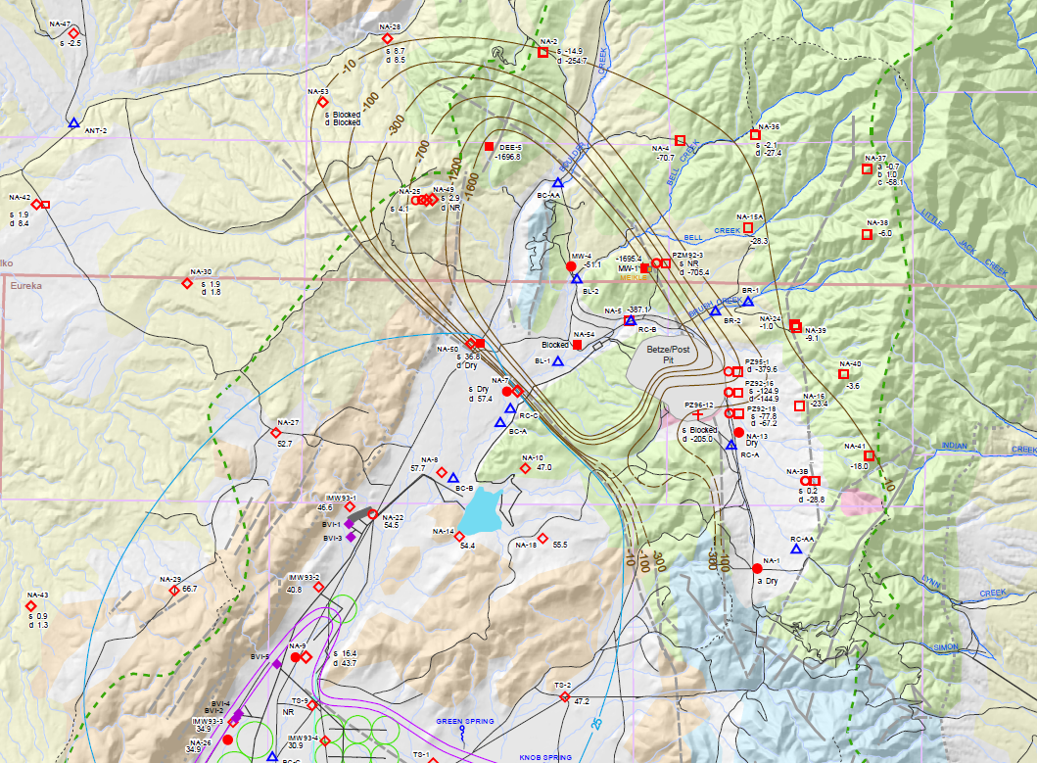
Water Level Change To-Date
Drawdown
Mounding
Notes:
At Goldstrike, it was found that that drawdown is restricted by the NW to SE parallel faults. Between the faults, the water table acts just like a bathtub. Recirculation between the infiltration basin is restricted. For example, at the pre-mining condition, water level is higher at the left side with a difference of 600 feet. Now because of dewatering and infiltration, water level is higher at the right side with a difference of 1,100 feet. The hydraulic gradient is completely reversed.

Slide 18
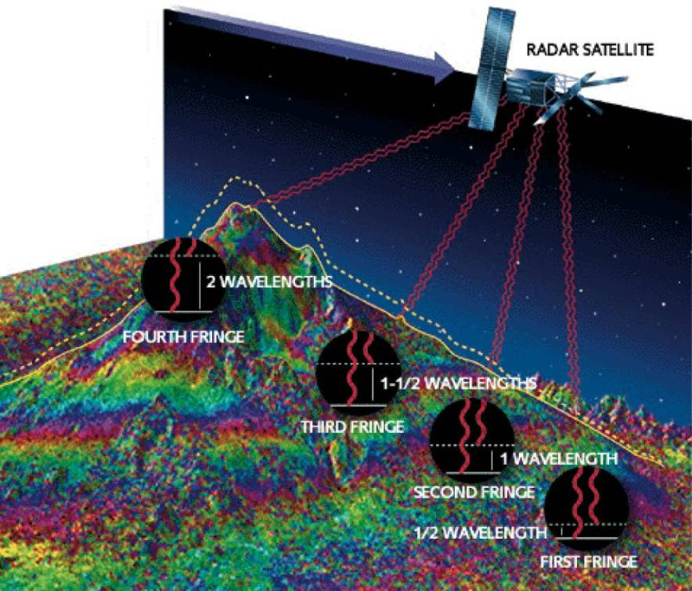
New Tools – Ground Deformation
A New Assessment Tool - Interferometric Synthetic Aperture Radar (InSAR)
Identified Subsidence/Uplift Associated with Mine Dewatering
100km x 100km coverage at 5m pixel resolution
From Massonnet, 1997
Notes:
At Barrick, we have started to use a new satellite/remote sensing tool, called InSAR, to identify bedrock subsidence associated with mine dewatering. These satellites were launched by the European Space Agency in 1992 . They use C-band (56 mm wavelength) satellite radar data to measure subsurface ground movement by comparing two scenes taken at different times.
The radar scenes cover 100km x 100km coverage at 5m pixel resolution.

Slide 19
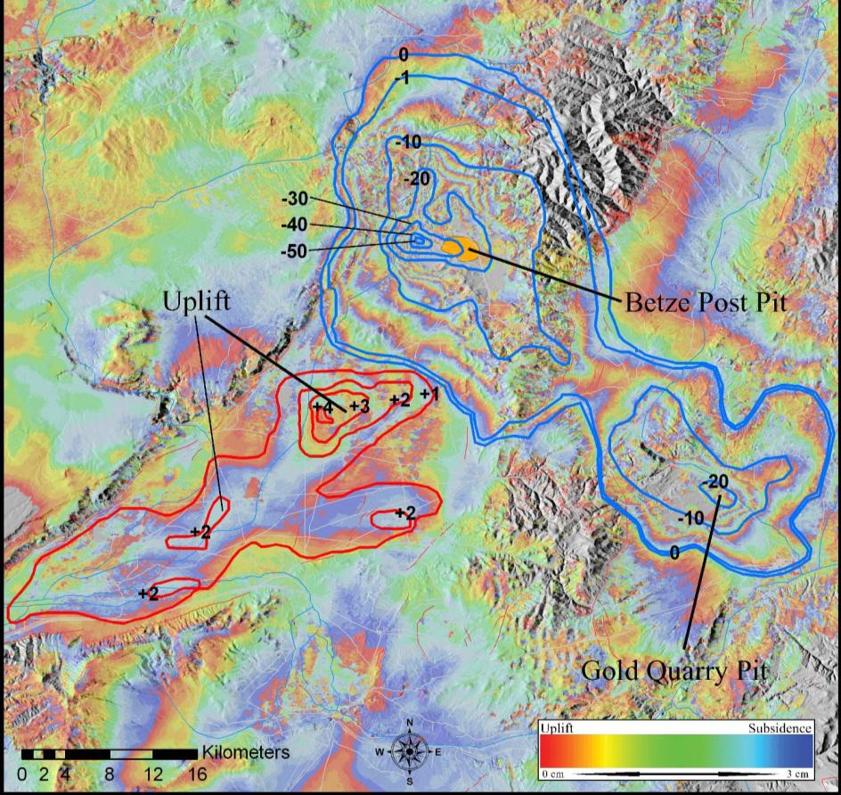
Ground Deformation – InSAR Results
Subsidence
Uplift
Subsidence and Uplift
June 1, 1992 – Nov 26, 2000
From Katzenstein, 2008
Notes:
The wave phase changes between two senses are color-coded to create color fringes in a red-yellow-green-blue color sequence. One fringe represents one wavelength which is 56 mm.
It was found that since 1992, the maximum subsidence is about 50 cm. If you recall previous drawdown contours, you will find that drawdown contours measured by water levels and subsidence contours measured by inSAR are nearly identical.
Interesting enough, aquifer infiltration has resulted in ground crust uplift.

Slide 20
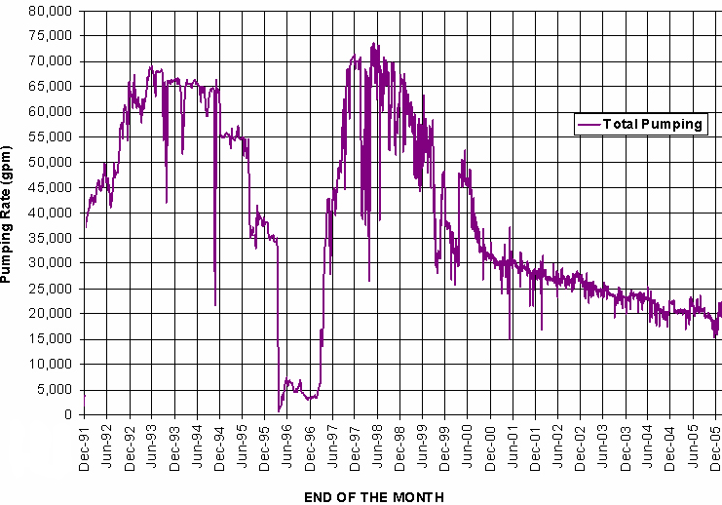
Monitoring System – InSAR Results
From Katzenstein, 2008
Notes:
The upper chart shows the pumping rates and drawdown.
Deformation rate changes perfectly correspond with water level changes.

Slide 21
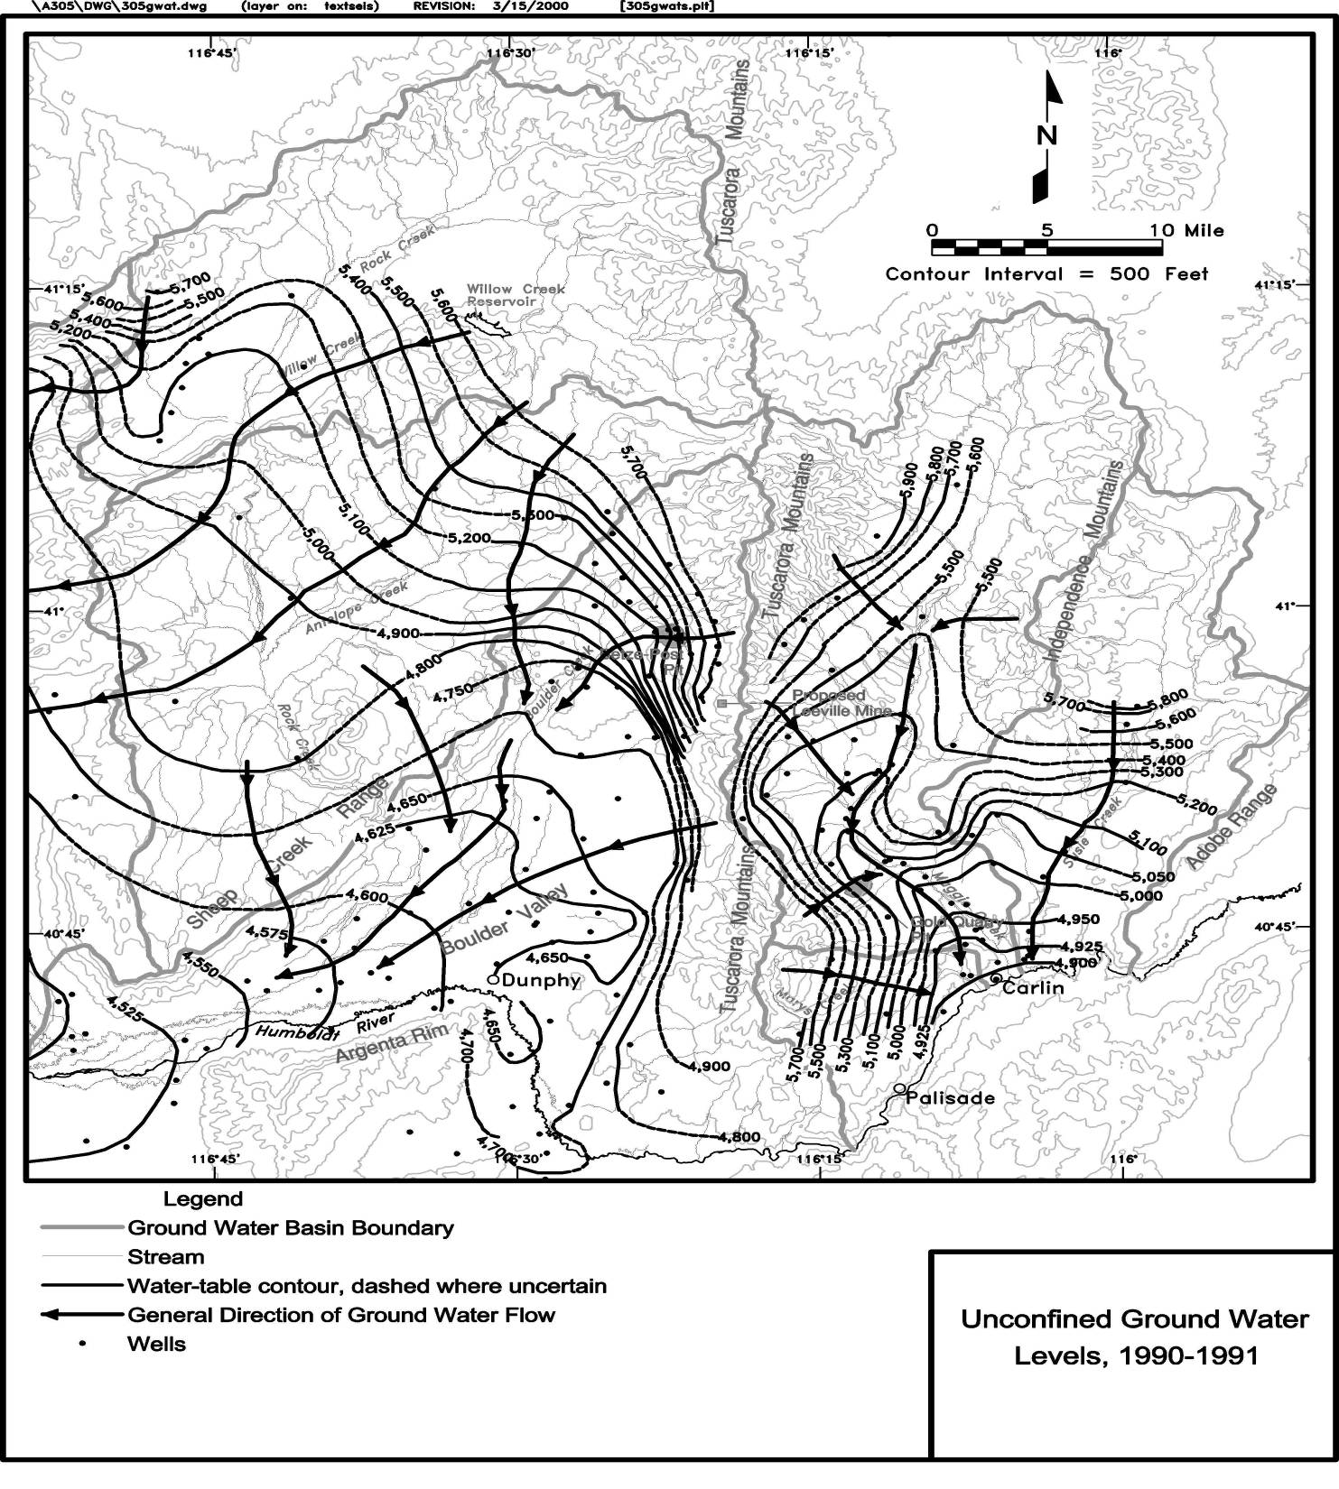
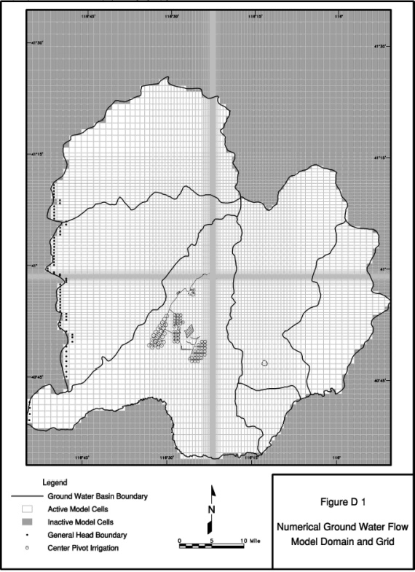
4. Impact Evaluation – Flow Model
Pre-Mining Water Level
(1990-1991)
MODFLOW
Model Grids
From Maurer et al., 1996
Notes:
Pre-mining water levels are shown on this picture. In general, water flow from northeast toward southwest.
The Goldstrike numerical model covers six hydrological basins.

Slide 22
Flow Model – Steady State (Pre-mining)
Notes:
This slide shows observed and simulated pre-mining water levels of 167 wells. Good agreement was achieved.

Slide 23
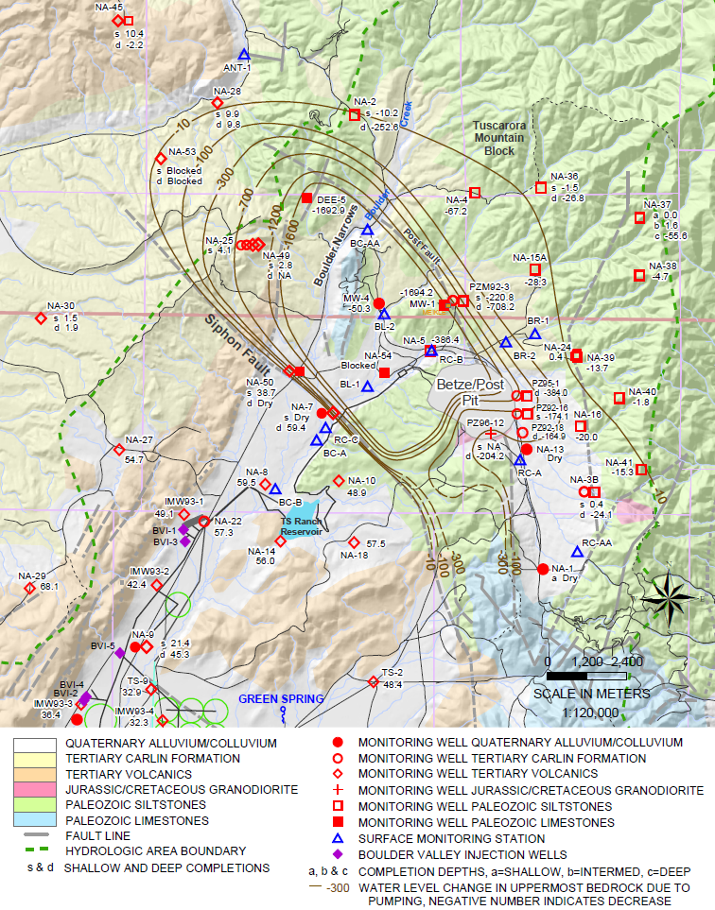
Flow Model – Transient (Pit Area)
Notes:
In this slide, the pink line shows the observed drawdown in the pit area and the rest of the lines show the simulated water levels in different model layers. Again, the 1700 feet of drawdown was accurately reproduced by the model.

Slide 24
Flow Model – Transient (Mountain Block)
Notes:
This slide shows both simulated and observed water levels in the same hole located in the mountain block recharge zone. Apparently, vertical gradient is reasonably mimicked.

Slide 25
Flow Model – Transient (Infiltration Basin)
Notes:
This slide shows both the simulated and observed water levels in the infiltration basin. Please note that infiltration only happens in non-irrigation seasons. The seasonable trends were accurately captured.

Slide 26
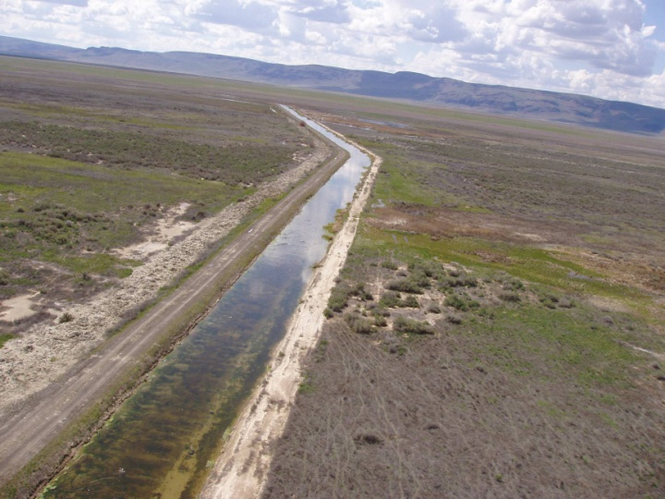
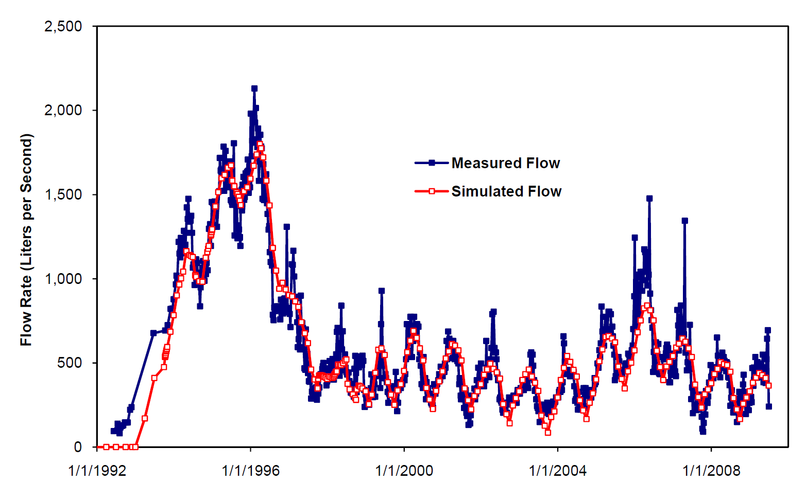
Flow Model – Transient (Surface Water)
Notes:
This slide shows the simulated and observed spring flows generated from pond infiltration.

Slide 27
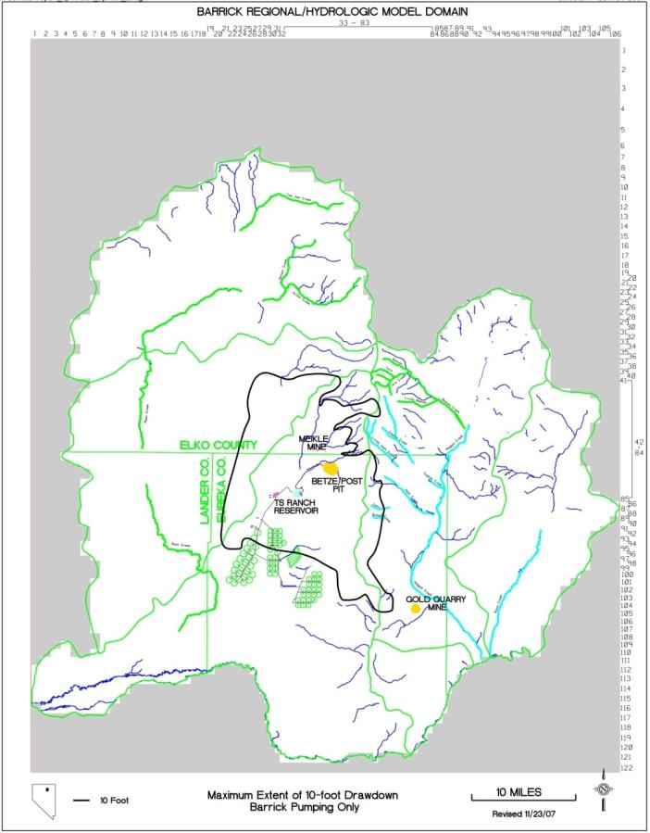
Flow Model – Projection
Simulated Maximum Drawdown (10 feet)
Post-Mining Pit Lake Recovery
Notes:
Finally, the well calibrated flow model was used for pit lake study.
Based on the model, it will take approximately 400 years for the pit to reach its final equilibrium stage.
The right picture shows the maximum 10 ft drawdown around the pit.

Slide 28
5. Conclusions
Groundwater pumping at Goldstrike has resulted in 520 m of drawdown around the mine site.
Most of the water pumped at the mine has been returned to the same hydrologic basin.
Extensive monitoring program, assisted by modern satellite technology and by robust modeling, has identified aquifer responses.
Improvement of the water-management system, the monitoring network, the modeling and analysis continue at Goldstrike.
Notes:
Finally, I come up with following conclusions:

Slide 29

Thank You for Your Attention!

