Slide 1
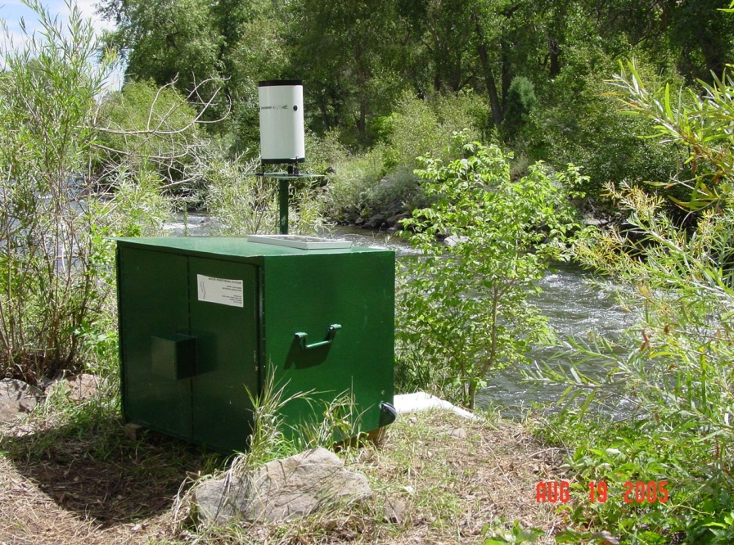
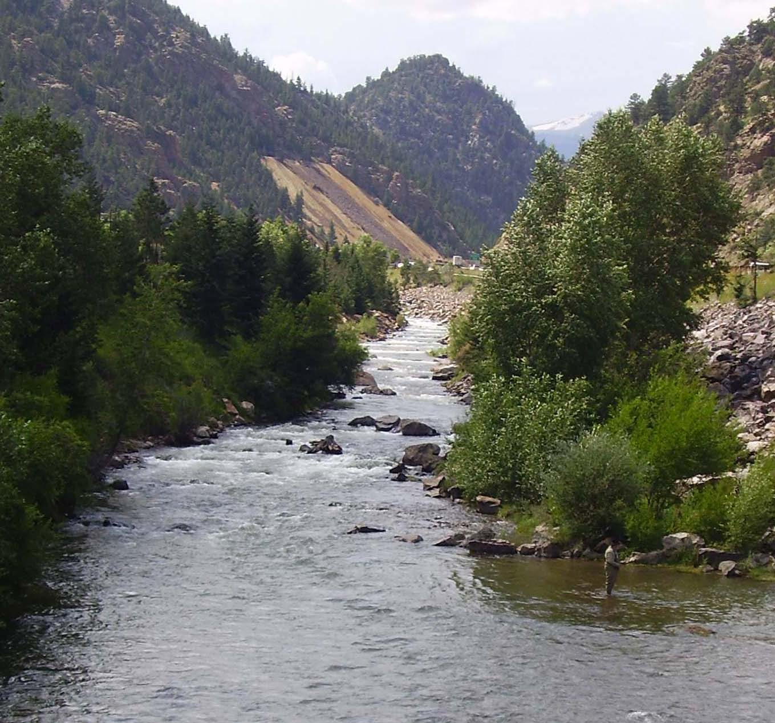
Water-Quality and Streamflow Time Trends, Upper Clear Creek Watershed (Colorado) – Systematic Long-Term Monitoring Fulfills a Range of Information Needs
Presented by
Timothy D. Steele, Ph.D.
TDS Consulting Inc., 783 Lafayette Street, Denver, CO 80218
USEPA Hardrock Mining Conference 2012, Session 6, April 4, 2012

Slide 2
Overview of This Oral Presentation
Network-Design Concepts
The Upper Clear Creek Watershed
Historical institutional & monitoring perspectives
Monitoring strategies and range of data sources
Examples – Long-Term Time Trends
Systematic, dynamic monitoring
Recent addition of automatic-sampler instrumentation
Information types and assessment products (examples)
Discussion and Questions
Follow-Up: Poster Session II -- Tonight

Slide 3
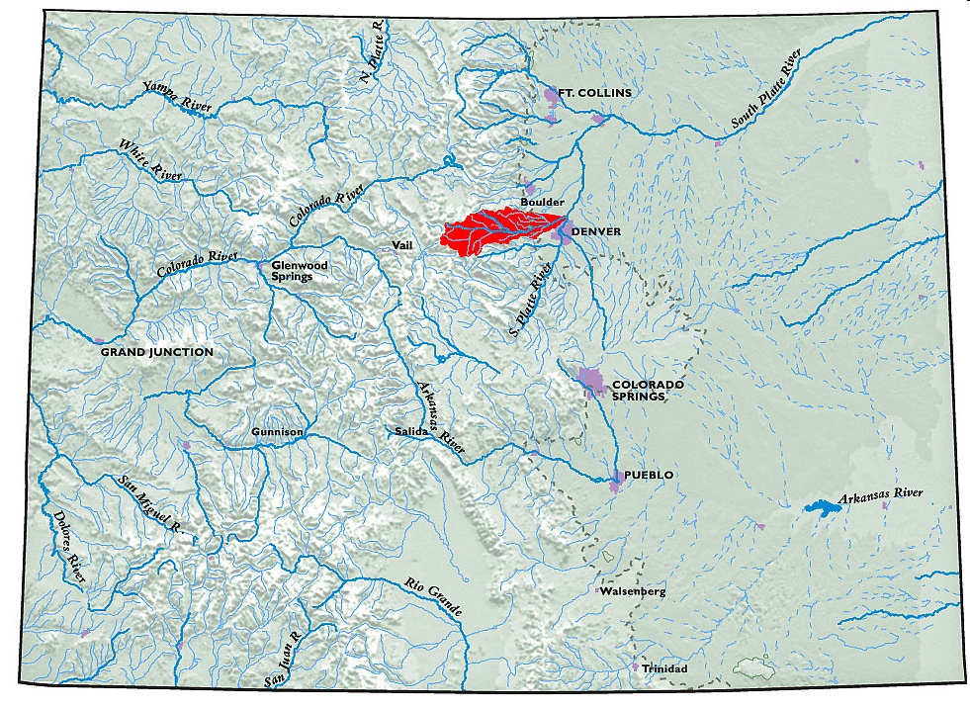
Clear Creek Watershed - Colorado

Slide 4
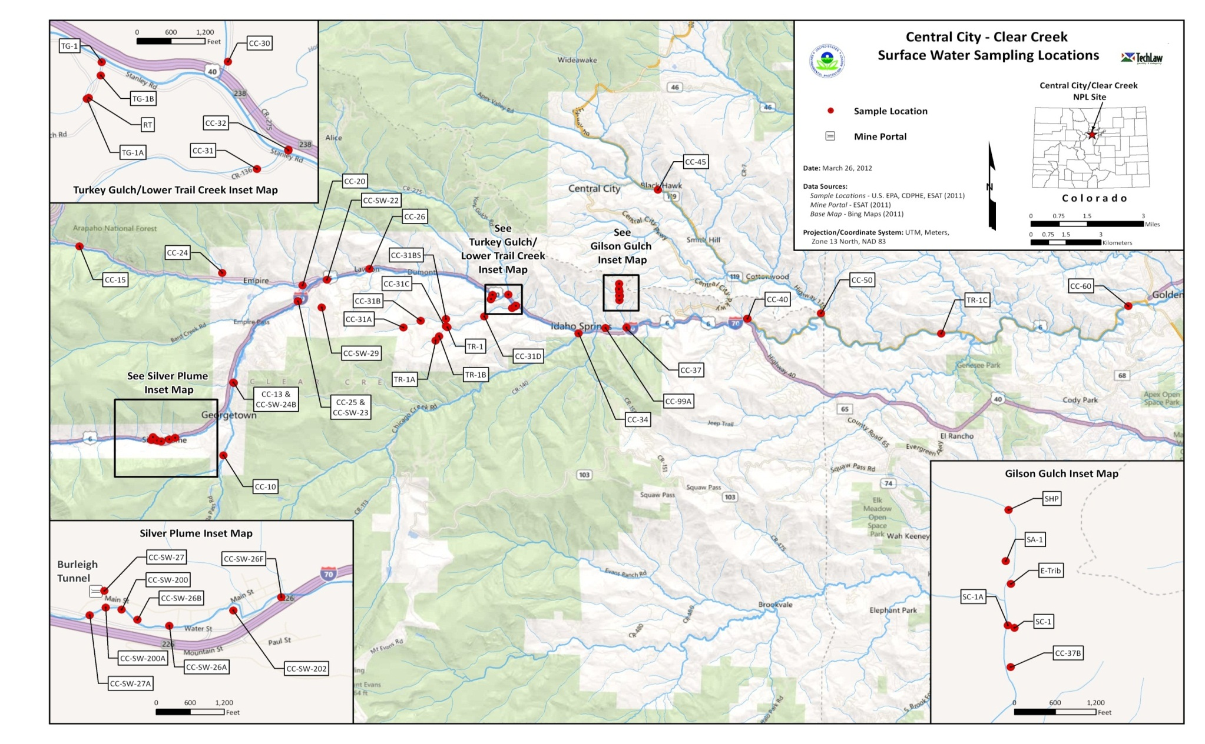
Upper Clear Creek Watershed – Monitoring Sites
Notes:
50 of the 164 sites; supported by USEPA-ESAT

Slide 5
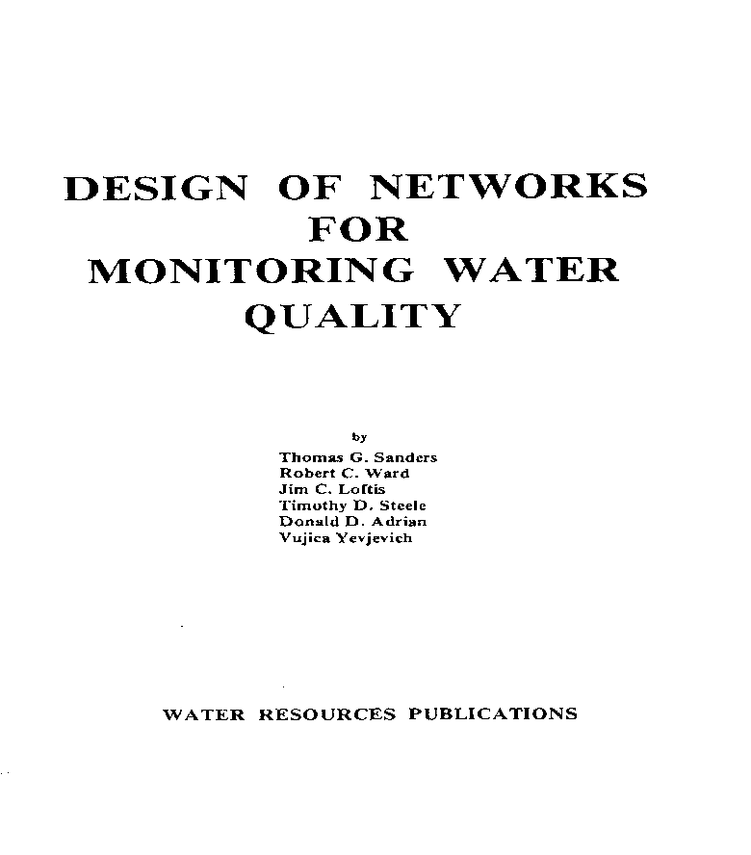
Monitoring-Program Functions – How Networks Tend to “Mature” over Time:

Slide 6
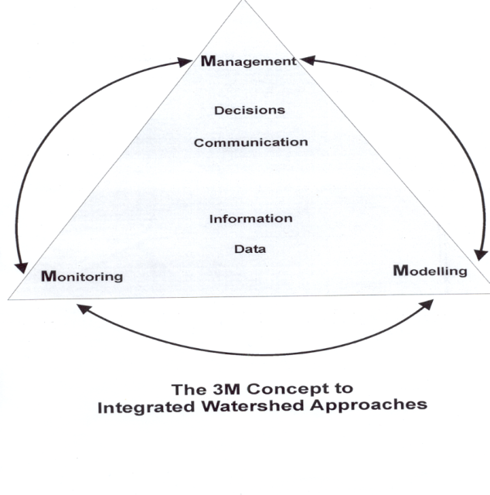
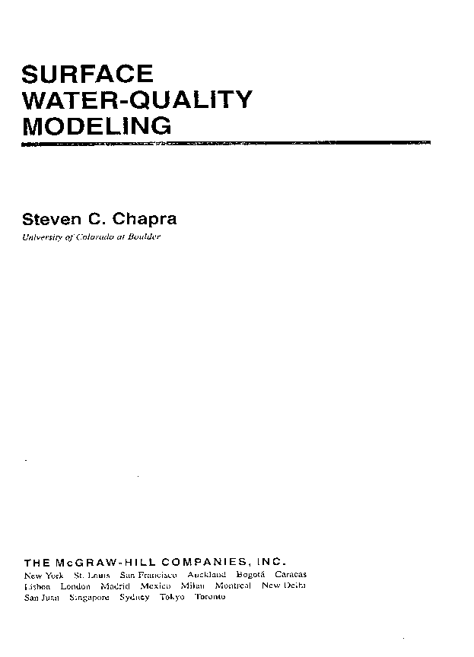
Data Transformation →→→→ Information

Slide 7
Institutions and Politics -- Highlights
Clear Creek/Central City Superfund Investigative Area
Clear Creek Watershed Management Agreement
Adopted 1993; 23 entities (27stakeholders in 2010)
Upper Clear Creek Watershed (Basin) Association
208 WQ planning/management entity; public meetings
Affiliates: CDOT, Molson-Coors, Climax Molybdenum, and
Clear Creek Watershed Association (CCWF)
501(c)(3) grants’ administration; project implementation
Standley Lake Cities (SLCs) – Westminster, Northglenn, Thornton (and Arvada)
State and Federal agencies: CDPHE, CDOW, USFS, etc.

Slide 8
Water-Quality/Hydrologic Data Sources in the Upper Clear Creek Watershed
Streamflows, USGS-WRD, five active gages (+ three)
Water-quality: nutrients, sediment-related, field
UCCWA-SLCs → originally 18 stream sites, now 4 key + 9 hi/low
“Secondary” sources: BHCCSD & CDPHE-WQCD
Includes monitoring of wastewater treatment plants
Added automatic-samplers, four “key” monitoring sites
Trace metals (total/dissolved), HRD, field variables
USEPA (analyses since 1994); SLCs (sampling, 1994-2004)
Other sources: CDOW, RiverWatch, BBCCSD, CDPHE (Argo)
TOCs (recent SLCs); some major ions: Mg, Ca, Cl, Alk, SO₄
Possible needs: suspended sediment, PCPs, radionuclides

Slide 9
18 Years – Systematic TMs Monitoring Data
Notes:
At key sites, systematic (8X per year); 4 during high flows, and 4 during low flows. Equal weighting for seasonal stream standards.

Slide 10
Hardness Concentrations – Seasonal Pattern (Underlying Basis for Seasonal HRD-Based TMs Stream Standards)
Notes:
Other methods for calculating Ac/Cr TMs standards – recalc Zn standard

Slide 11
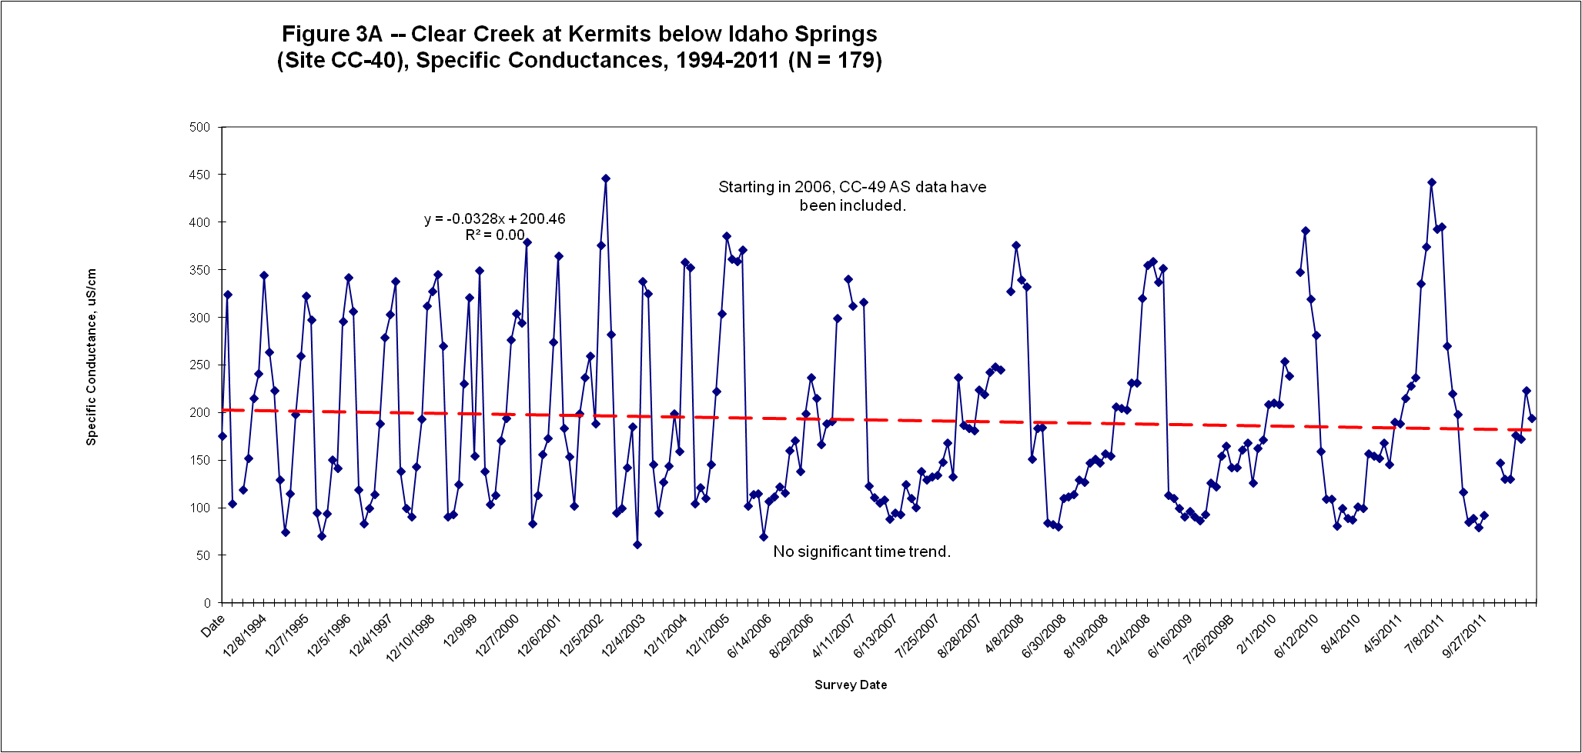

Slide 12
Specific Conductance – Expanded Scale (1994-2005)

Slide 13
Argo Tunnel Adit – A Primary Mining-Related Point Source in the Upper Clear Creek Watershed

Slide 14
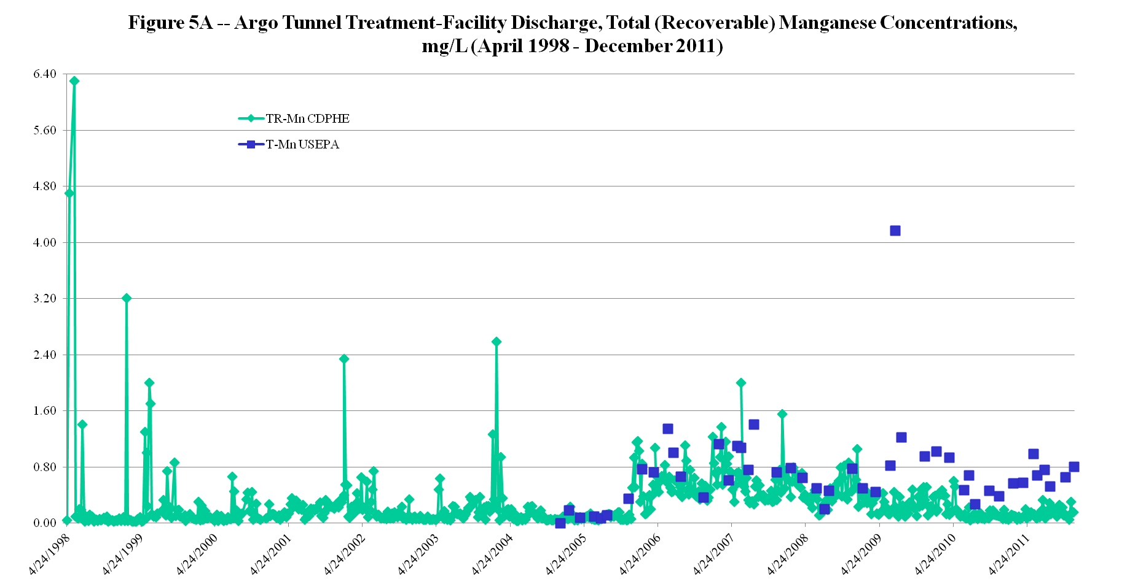

Slide 15
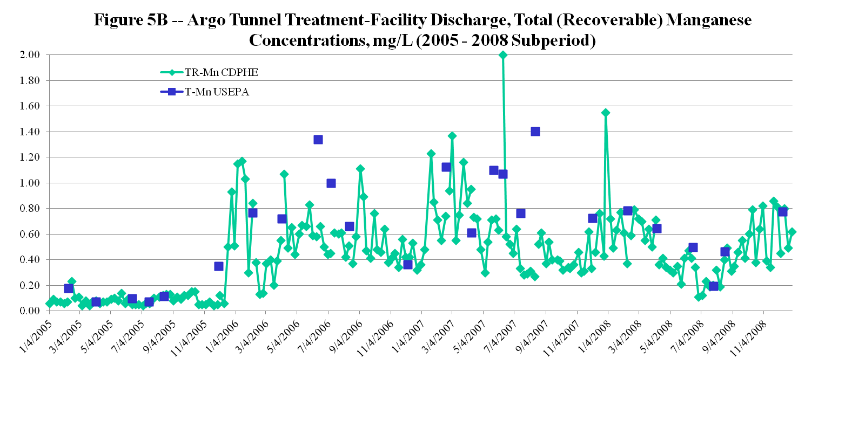

Slide 16
319 NPS Grant – Gilson Gulch Remediation Project – Pre-/During-Project TMs Characterization
Notes:
For Gilson Gulch, water-quality characterization occurred intermittently since 2000. Project implementation was during 2010 and 2011. No immediate WQ benefits (in terms of decreasing concentrations) were exhibited by these D-TMs. The importance of continuing post-project monitoring in order to assess WQ benefits is noteworthy here and is hereby recommended.

Slide 17
Trail Creek – Pre-/During-Project TMs Characterization over a Longer Period of Time (5 & 2 years, respectively)
Notes:
For Trail Creek, more pre-project sampling surveys were conducted. For D-TMs, some seasonality in concentrations is noted but not for all. D-Zn exhibited a slight decreasing time trend; in contrast, D-Mn concentrations slightly increased over time (with an anomalous value on 7/30/10 associated with a storm event). The concentration increases on this date were not so extreme for other D-TMs. However, T-TMs concentrations were quite high on this date (because of being sediment-related).

Slide 18
Upper Clear Creek Watershed – Annual Streamflows (1995-2011 Water Years)
Notes:
17-year averages: 197 cfs (CC-40); 16.4 cfs (CC-50); 200 cfs (CC-60).
Qs at Golden decrease from 254 cfs (1995-1999) to 179 cfs (2000-2011).

Slide 19
Annual D-Zinc Loads, Upper Clear Creek Watershed Upstream Monitoring Locations (1995-2011 Water Years)
Notes:
17-year average D-Zn loads: CC-25, 20,730 lbs/y; CC-20, 4,670 lbs/y; CC-26, 23,880 lbs/y.
Average D-Zn loads decrease from 36,400 lbs/y (1995-1999) to 18,680 lbs/y (2000-2011).

Slide 20
Annual D-Zinc Loads, Upper Clear Creek Watershed Downstream Monitoring Locations (1995-2011 Water Years)
Notes:
17-year average D-Zn loads: CC-40, 68,720 lbs/y; CC-50, 23,310 lbs/y; CC-60, 61,250 lbs/y
Average loads decrease from 117,640 lbs/y (1995-1999) to 37,849 lbs/y (2000-2011).

Slide 21
UCC Watershed – An Example of WWTP Long-Term Total-Nitrogen Concentration Time Series

Slide 23
Some Monitoring/Data Points to Ponder:
Systematic monitoring as several benefits
Data end-user needs should be incorporated into any SAP
Data adds “value” when transformed into information
Post-project remedial-action monitoring is critical
Basic questions:
How does a WQ monitoring network “mature”?
What constitutes a sufficient period of record?
What is the preferred scheduling/frequency in a year?
How can field data/analytical lab costs be controlled?
How does one deal with varying minimum detection limits?
Promote monitoring-program collaboration/coordination (reduce/minimize overlap by myriad of data collectors)
Database repository – file updates/maintenance/stability
Colorado’s Data Sharing Network (DSN) is being encouraged for use

Slide 24
Acknowledgements
Co-authors of Poster Paper (same title; tonight)
J. David Holm, CCWF consultant
Mary Boardman, CDPHE-HMWMD
Mike Holmes, USEPA Region 8 (TMs “Champion”)
Upper Clear Creek Watershed Association
Clear Creek Watershed Foundation
CDPHE-HMWMD’s, USGS-WRD’s (D.A. Wentz/R.E. Moran) & Tom Wildeman’s (CSM) Argo Data
Ron J. Abel, ex-CDPHE-HMWMD (review comments)
Note: Opinions and statements expressed herein are the author’s alone and don’t reflect any policies & stances of any of these organizations.

Slide 25
Thanks for your attention & interest – Questions? [or come by Poster #1, Session II]
Notes:
Two examples of recent watershed report products: UCC Watershed Plan and the 2011 TMs Addendum documents.

