Slide 1
Preliminary Design of
Water Balance Covers:
A Method from the ACAP Data Set
William H. Albright, PhD
Desert Research Institute
Reno, Nevada 89512 USA
www.acap.dri.edu
Craig H. Benson, PhD, PE, DGE
University of Wisconsin-Madison
Madison, Wisconsin 53706 USA

Slide 2
Water Balance Covers: Sponge Concept
Precipitation
Evapotranspiration
Infiltration
“Sponge”
Percolation if S > S_{c}
S = soil water storage
S_{c} = soil water storage capacity

Slide 3
ACAP Site Locations

Slide 4
ACAP: The Field Program
Nationwide: 12 sites, 8 states
Large (10 × 20 m) drainage lysimeters
Conventional technology
  Composite
  Clay barrier
Alternative technology
  Water balance
  Capillary barrier

Slide 5
Water Balance Covers Evaluated by ACAP

Slide 6
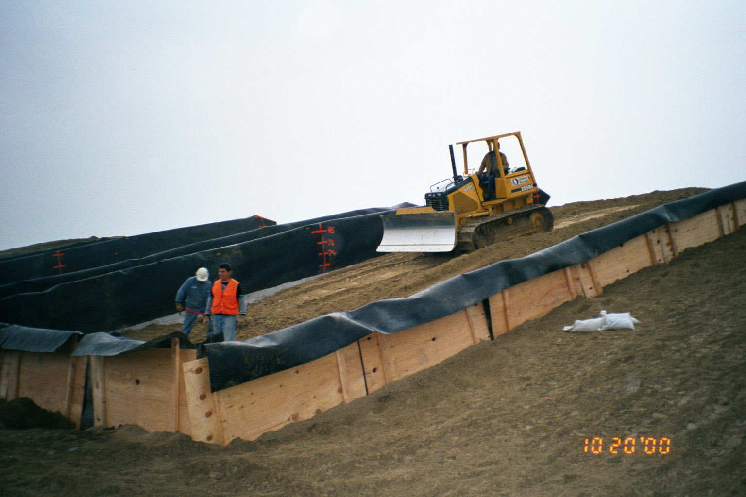
Full-scale equipment and methods

Slide 7
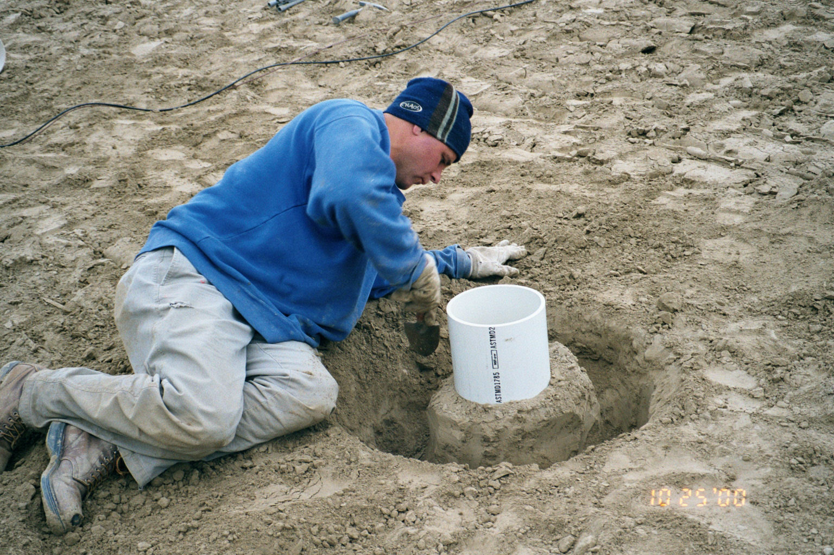
Undisturbed sample to capture as-built soil properties

Slide 8
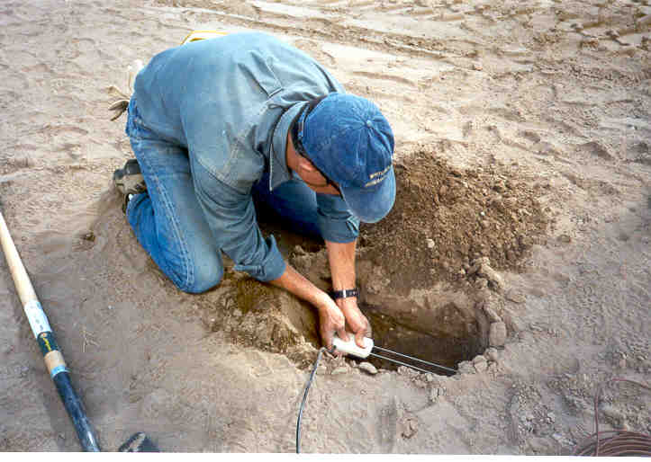
Water content probe to monitor soil water status

Slide 9
Data Summary
Site | Maximum |  |  | Average
 | Precip. (mm) | Perc. (mm) | Year | Precip. (mm) | Perc. (mm)
Albany, GA | 1380.2 | 218.3 | 4 | 1202.3 | 109.2
Altamont, CA | 498.6 | 139.3 | 4 | 379.7 | 44.8
Apple Valley, CA | 272.0 | 1.8 | 3 | 167.4 | 0.5
Boardman, OR (Thin) | 210.8 | 0.0 | 3 | 181.4 | 0.0
Boardman, OR (Thick) |  | 0.0 |  |  | 0.0
Cedar Rapids, IA | 898.4 | 366.1 | 4 | 930.0 | 207.3
Helena, MT | 351.5 | 0.1 | 5 | 272.4 | 0.0
Marina, CA | 406.9 | 82.4 | 4 | 462.8 | 63.3
Monticello, UT | 662.9 | 3.4 | 5 | 387.0 | 0.7
Omaha, NE (Thin) | 612.4 | 101.0 | 1 | 732.5 | 56.1
Omaha, NE (Thick) |  | 57.9 |  |  | 27.0
Polson, MT | 308.1 | 0.4 |  | 349.1 | 0.2
Sacramento, CA (Thin) | 361.2 | 108.4 | - | 422.0 | 54.8
Sacramento, CA (Thick) | 455.7 | 8.5 | 3 |  | 2.7
Underwood, ND | 585.2 | 9.4 | 1 | 384.1 | 7.1

Slide 10
ACAP: The Products
Nation-wide field-scale data set for composite, compacted clay and water balance covers
Measured changes to soil hydraulic properties due to pedogenesis
Published results
  www.acap.dri.edu
25 workshops
A new method for feasibility assessment and preliminary design

Slide 11
How Do Water Balance Covers Work?
Natural water storage capacity of finer textured soils
Soil water storage typically seasonal
Water removal by evaporation and transpiration
Percolation occurs when soil water storage exceed total storage capacity
Key: Need to know required storage, S_{r}.
We always knew how to store water, we did not know how to determine ‘how much’
The ACAP data set from a nation-wide network of field-scale test sections provides a method to determine S_{r}
The method is based on data, not estimates from models

Slide 12
Water Balance Covers: How They Function

Slide 13
We Answered 2 Questions: When & How Much
1. Determine when water accumulates.
2. Define how much water accumulates.
Example: for fall-winter months at sites without snow, water accumulates in the cover when the monthly precipitation (P_{m}) exceeds 21 mm, on average.

Slide 14
Thresholds for Water Accumulation
Examined P, P/PET, and P-PET as indicators of water accumulation and found P/PET threshold works best.
Data segregated into two climate types (with & without snow and frozen ground) and two periods in each year (fall-winter and spring-summer).
Water accumulates when P/PET threshold exceeded.
Climate Type | Season | Threshold
No Snow & Frozen Ground | Fall-Winter | P/PET > 0.34
 | Spring-Summer | P/PET > 0.97
Snow & Frozen Ground | Fall-Winter | P/PET > 0.51
 | Spring-Summer | P/PET > 0.32
Fall-winter = September - February
Spring-summer = March - August

Slide 15
How Much Water Accumulates?
1. Use water balance approach: ΔS = P – R – ET – L – P_{r}
Δ S = change in soil water storage
R = runoff
P = precipitation
ET = evapotranspiration
L = lateral internal drainage (assume = 0)
P_{r} = percolation
2. ET is unknown, but is a fraction (β) of PET: ET = β PET
3. R, L, and P_{r} can be lumped into losses (Λ)
Simplify to obtain: ΔS = P – β PET – Λ
4. Equation used to compute monthly accumulation of soil water storage if P, PET, β, and Λ are known.

Slide 16
Parameters for Water Accumulation Equation
Δ S = P – β PET – Λ
Climate Type | Season | β (-) | Λ (mm)
No Snow & Frozen Ground | Fall-Winter | 0.30 | 27.1
 | Spring-Summer | 1.00 | 167.8
Snow & Frozen Ground | Fall-Winter | 0.37 | -8.9
 | Spring-Summer | 1.00 | 167.8
0
Two sets of β and Λ parameters (fall-winter & spring-summer) for a given climate type.

Slide 17
Monthly Computation of Required Storage (S_{r})
P_{m} = monthly precipitation
PET_{m} = monthly PET
β_{FW} = ET/PET in fall-winter
β_{SS} = ET/PET in spring-summer
Λ_{FW} = runoff & other losses in fall-winter
Λ_{SS} = runoff & other losses in spring-summer
Fall-Winter Months
Spring-Summer Months
Include only months that exceed P/PET threshold
If ΔS_{m} < 0, set ΔS_{m} = 0

Slide 18
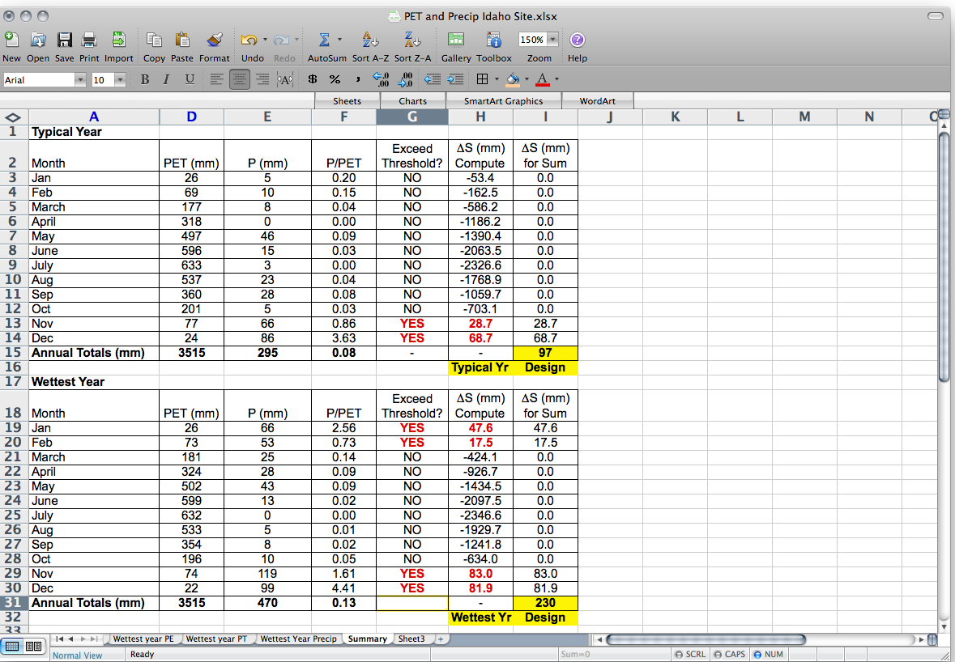
Example: Idaho Site (snow & frozen ground)
For months below threshold, set ΔS = 0
Δ S = P – 0.37*PET
(Fall-Winter)
β = 0.37, Λ = 0
Store 97 mm for typical year, 230 mm for wettest year

Slide 19
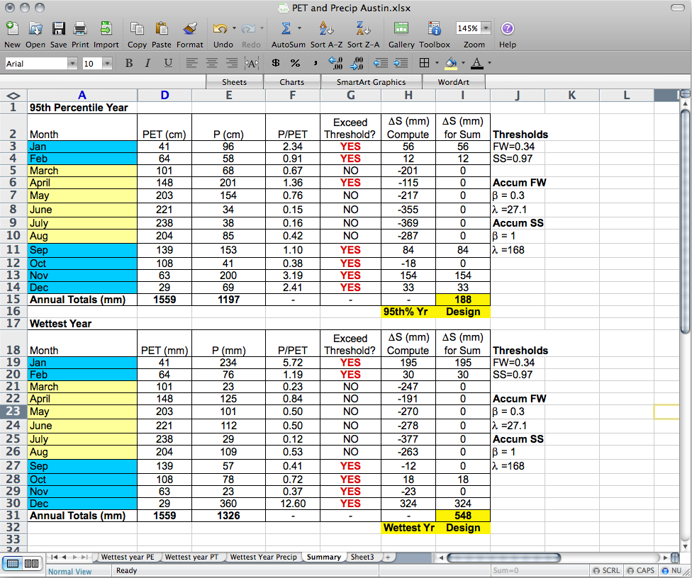
Example: Texas Site (no snow & frozen ground)
For months below threshold, set ΔS = 0
ΔS = (P – 0.37*PET)-27
(Fall-Winter)
β = 0.3, Λ = 27
Store 188 mm for 95th percentile year,
548 mm for wettest year

Slide 20
Predicted and Measured S_{r}
Good agreement between computed and measured required storage.

Slide 21

Conclusion:
A Two-Step Method for Design of Water Balance Covers
1. Preliminary design: estimate required thickness using ACAP approach based on a robust, nation-wide field data set
Refine the design with numerical simulations to evaluate:
  Important design parameters
  “what if?” assessments
Read the book

