Slide 1

NATO SPS Study "Prevention and Remediation Issues in Selected Industrial Sectors "
Ljubljana, 17 – 22 July 2007
RNDr. Josef Tomas
Remediation of Cretaceous Sediments affected by uranium in-situ leaching (ISL) in the Czech Republic
MINISTRY OF ENVIRONMENT, CZECH REPUBLIC
Prague 2007

Slide 2
NATO SPS Study "Prevention and Remediation Issues in Selected Industrial Sectors "
Ljubljana, 17 – 22 July 2007
Geological map of the Czech Republic Scale 1 : 1 000 000
MINISTRY OF ENVIRONMENT, CZECH REPUBLIC
Prague 2007

Slide 3
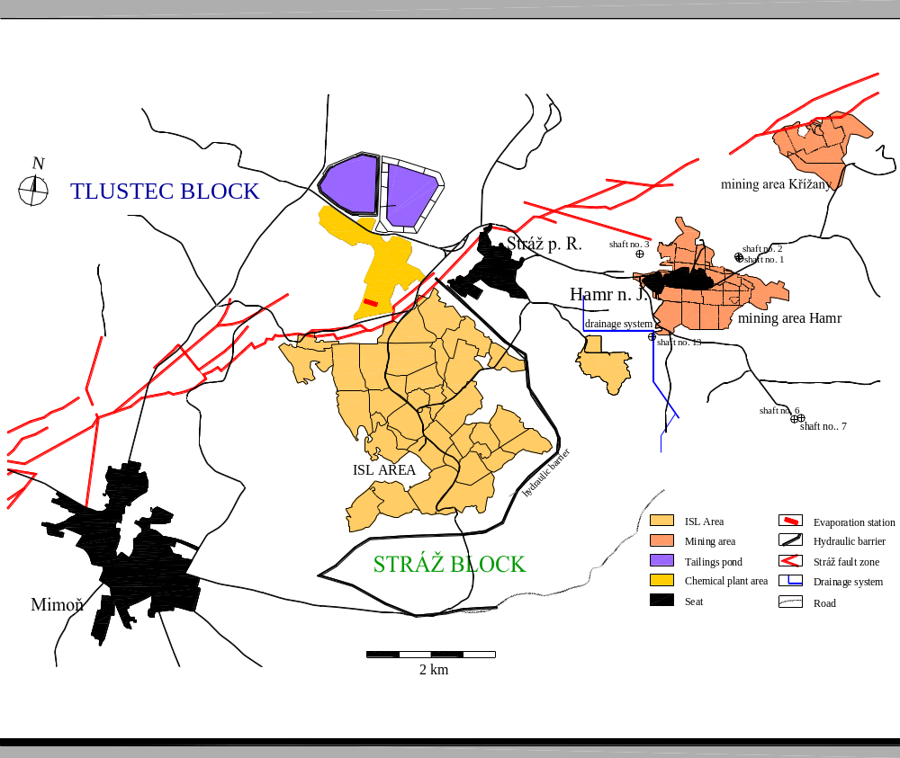
remediation area
Praha
Brno

Slide 4
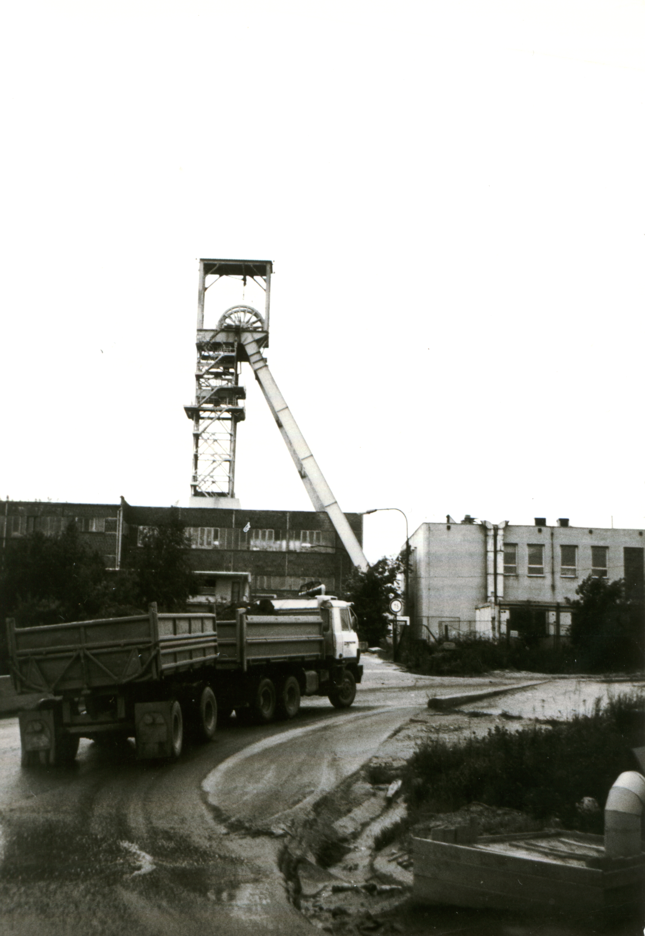
History of deep mining
1978
start of mining at Hamr I
1982
start of mining at Křížany I
1990 - 2003
end of mining and liquidation of Křížany
1993 – 2004
end of mining and liquidation of Hamr

Slide 5
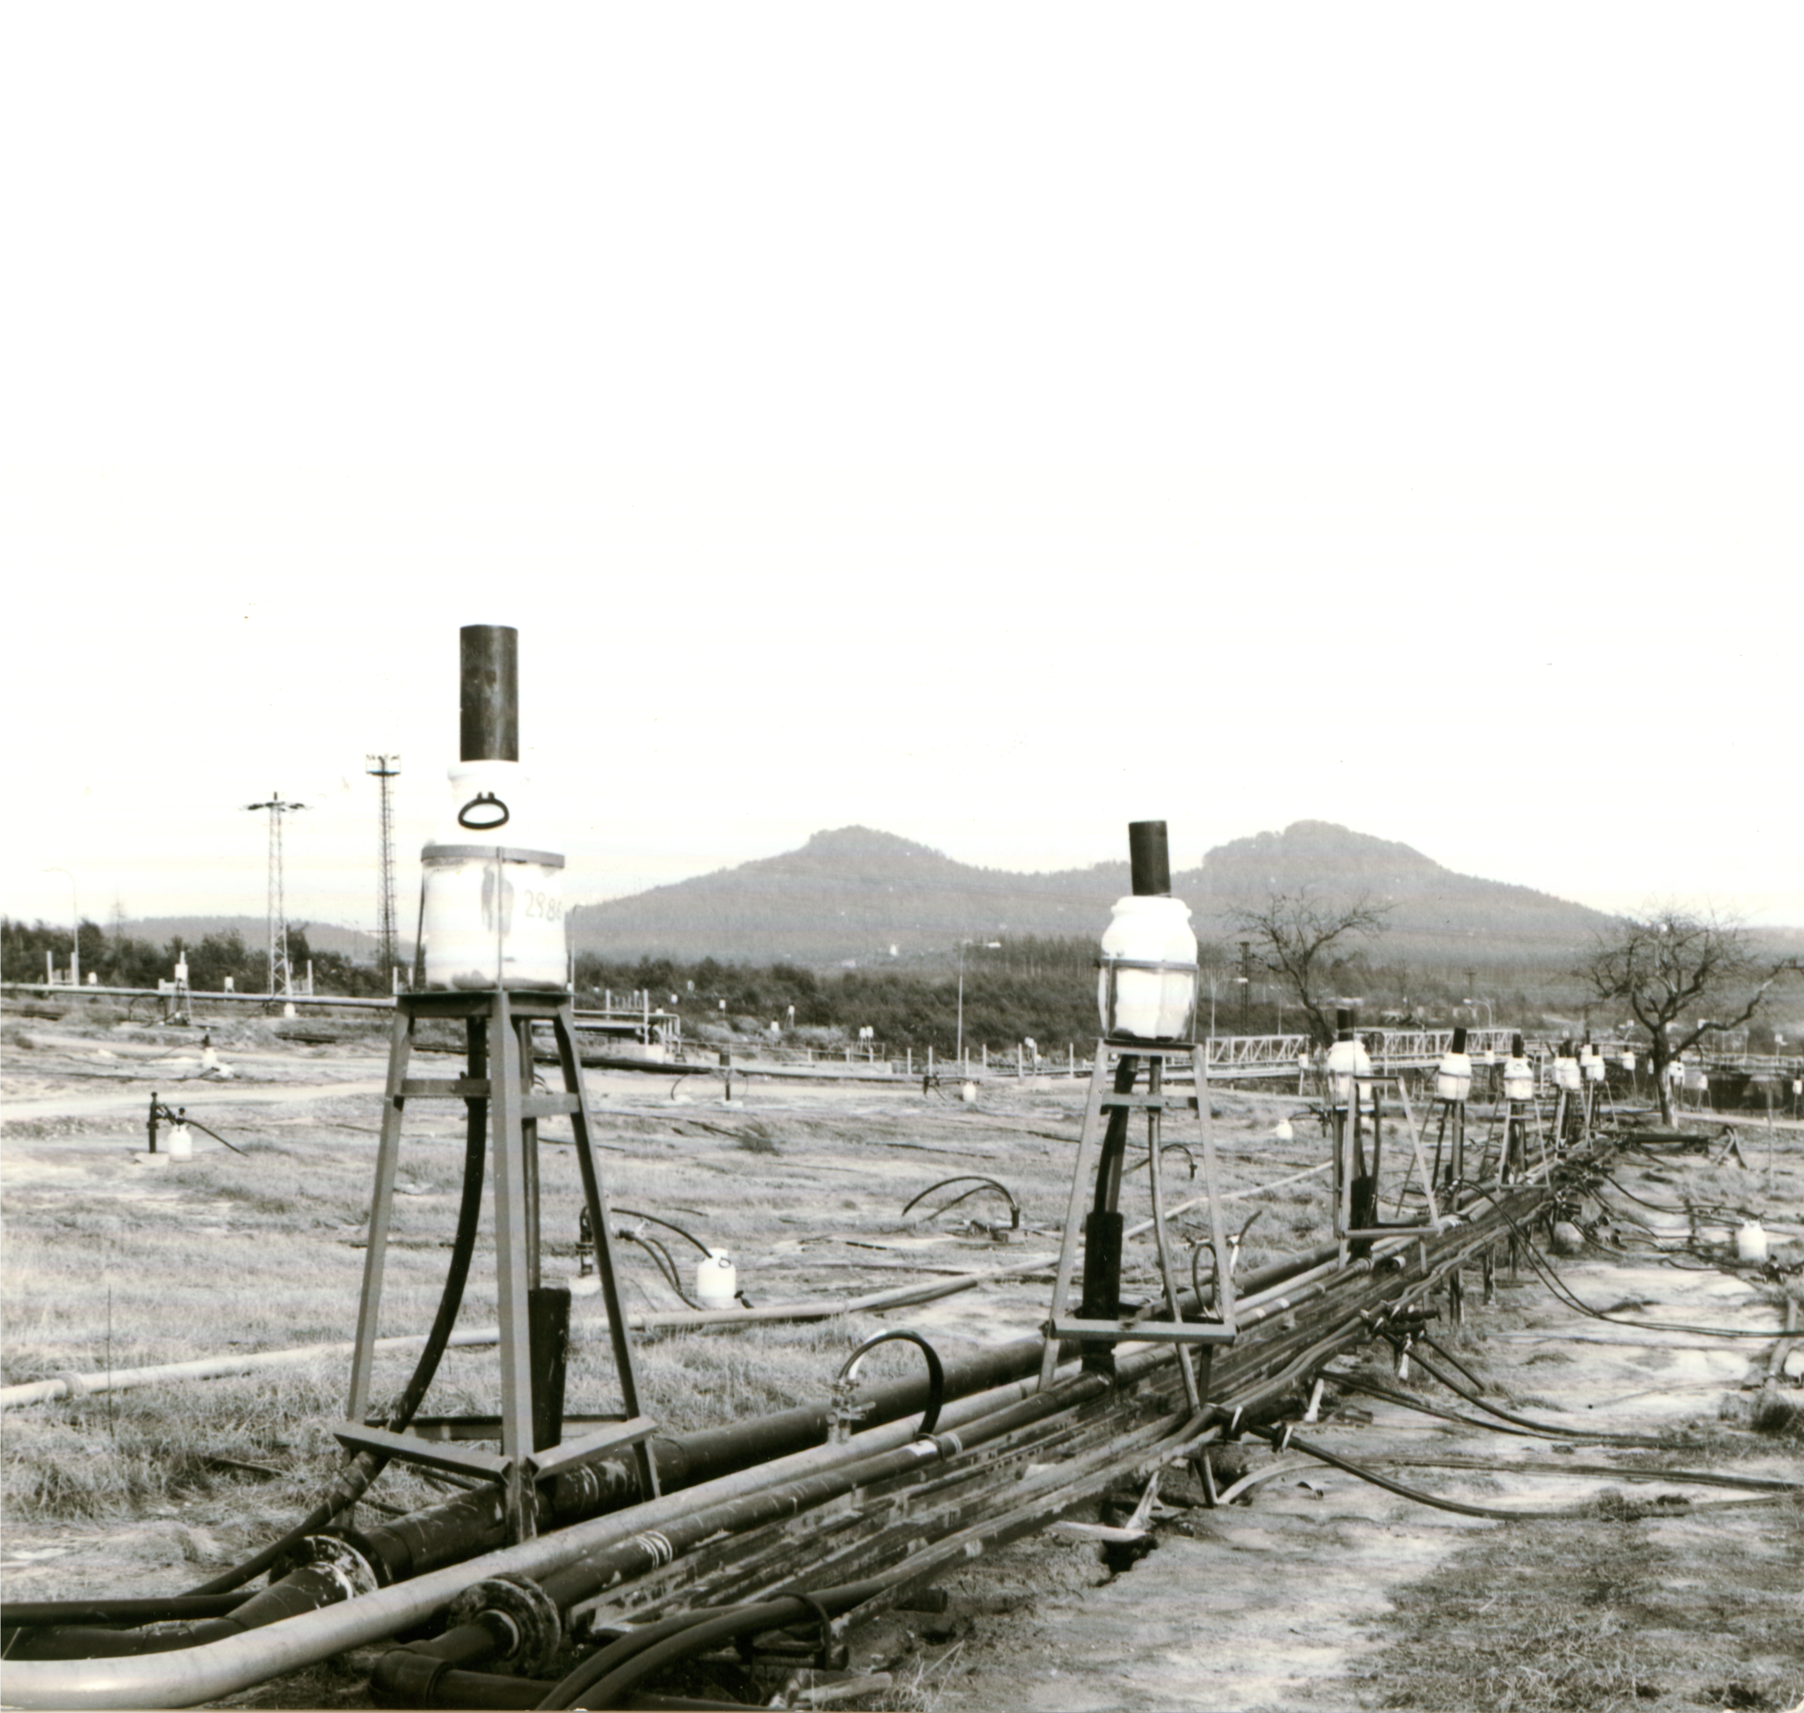
History
of chemical mining
1966 - 1967
1st leaching experiments
1974
beginning of chemical mining
1996
start of the remediation

Slide 6
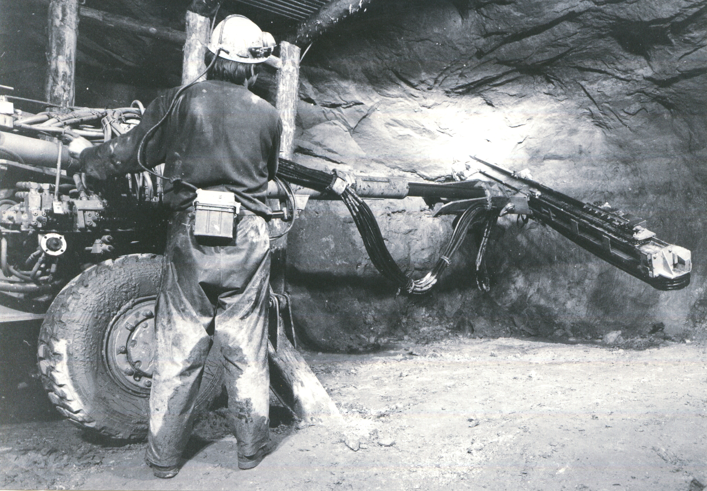
Uranium production
1967 - 1996
more than 27 000 t of uranium
deep mining - 11 600 t
chemical mining - 15 800 t

Slide 7
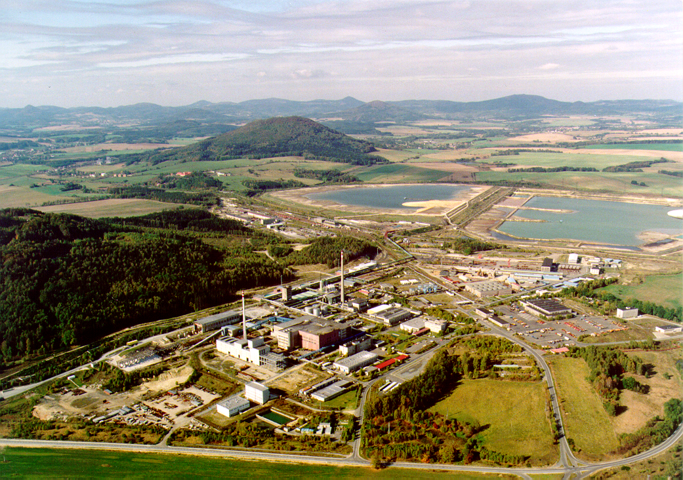
Stráž - chemical treatment
plant and tailings ponds

Slide 8
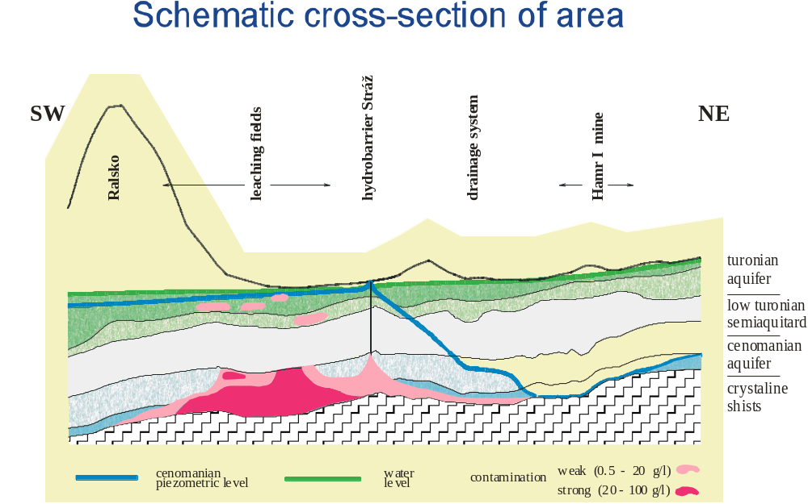
Schematic cross-section
of the area

Slide 9
Principle of hydrobarriere
DISCHARGE
CLEANING
URANIUM
SEPARATION
cenomanian water level
hydrobarriere
HAMR I MINE
leaching fields
strongly
concentrated
solutions
DRAINAGE

Slide 10
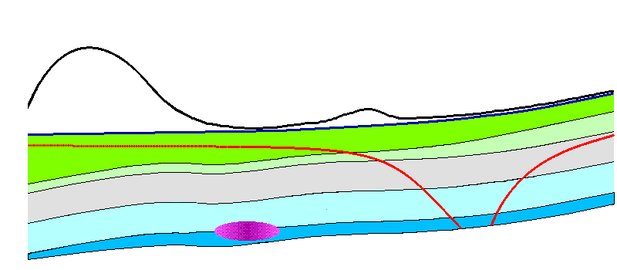
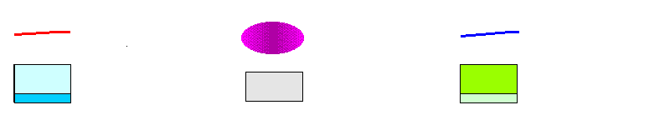
Piezometric heads
Before HB construction
Ralsko
HAMR
deep mine
leaching
fields
water level in
v cenomanian aquifer
water level in
turonian aquifer
contamination
cenomanian aquifer
semi-permeable
layer
turonian aquifer

Slide 11
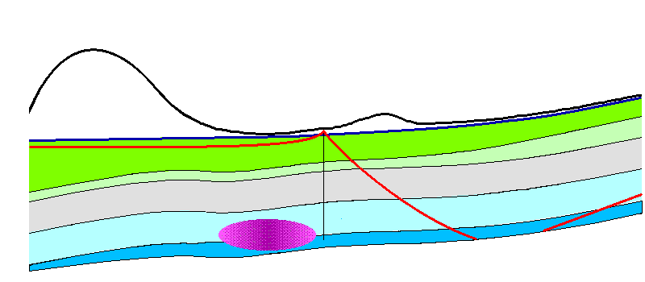
Piezometric heads
Before operation of evaporation station
Ralsko
HAMR
deep mine
leaching
fields
water level in
v cenomanian aquifer
water level in
turonian aquifer
contamination
cenomanian aquifer
semi-permeable
layer
turonian aquifer

Slide 12

Piezometric heads
Current situation – evaporation station at work
Ralsko
HAMR
deep mine
leaching
fields
water level in
v cenomanian aquifer
water level in
turonian aquifer
contamination
cenomanian aquifer
semi-permeable
layer
turonian aquifer

Slide 13
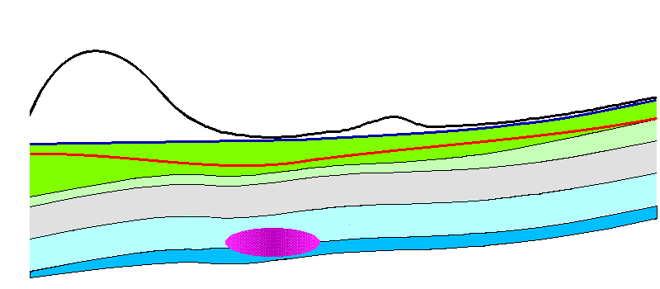
Piezometric heads
During remediation – Hamr mine flooded
Ralsko
HAMR
deep mine
leaching
fields
water level in
v cenomanian aquifer
water level in
turonian aquifer
contamination
cenomanian aquifer
semi-permeable
layer
turonian aquifer

Slide 14
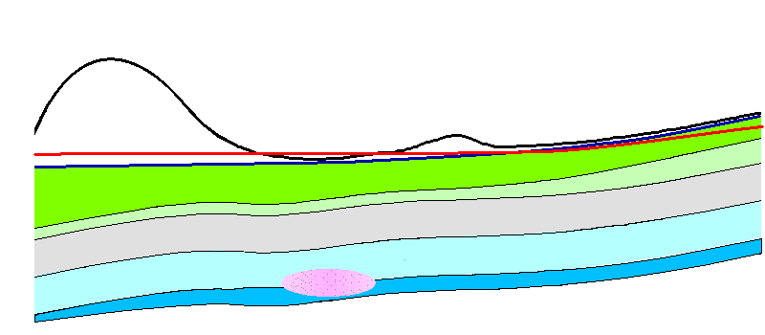
Piezometric heads
At the end of remediation process
Ralsko
HAMR
deep mine
leaching
fields
water level in
v cenomanian aquifer
water level in
turonian aquifer
contamination
cenomanian aquifer
semi-permeable
layer
turonian aquifer

Slide 15
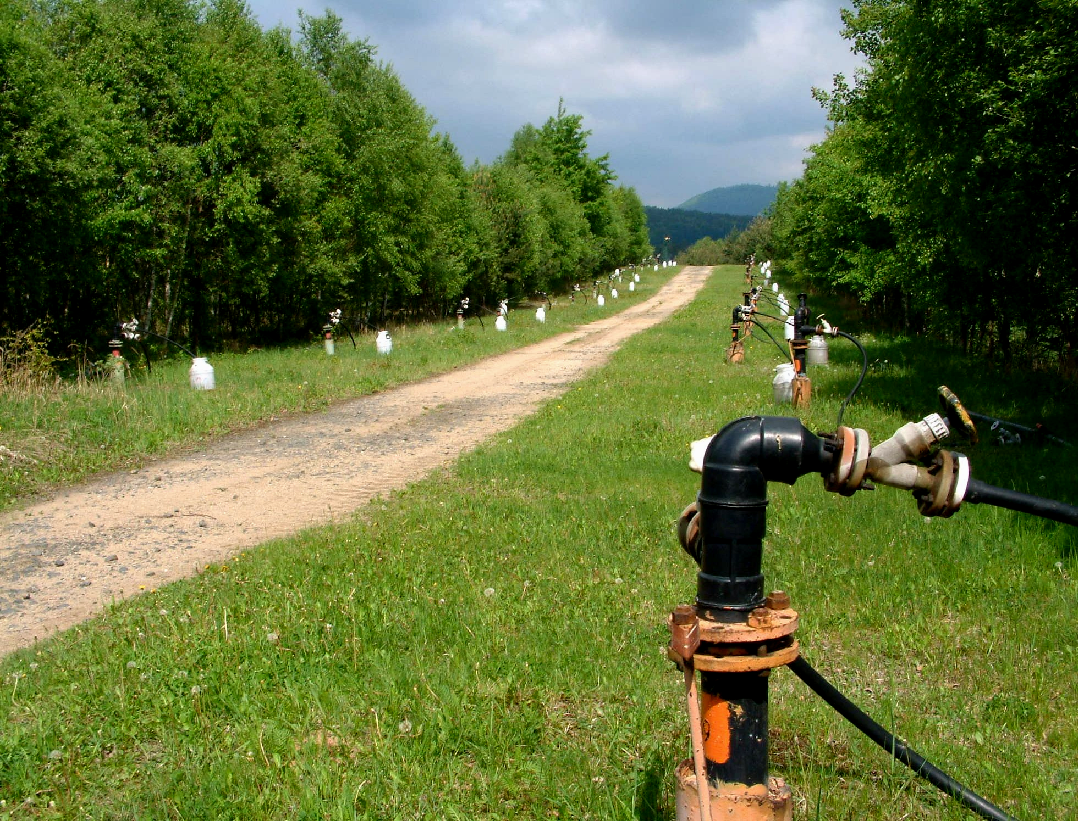
During chemical leaching
8 000 technological wells
were drilled
Area of leaching fields 628 ha
Chemicals consumption:
H₂SO₄ 4 100 000 t
HNO₃ 320 000 t
NH₄⁺ 111 000 t
HF 16 000 t

Slide 16
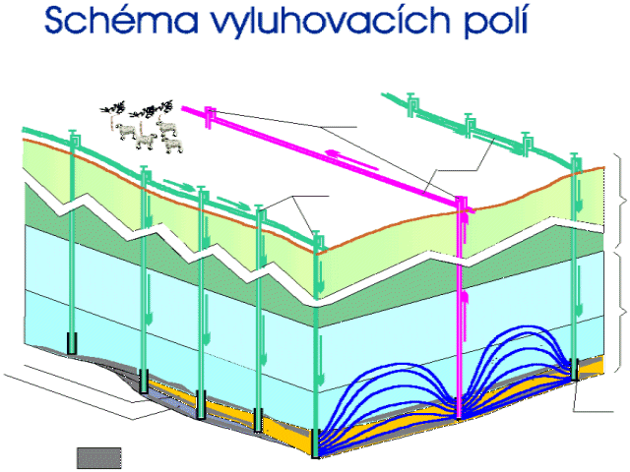
Scheme of leaching fields
Pumping
wells
Pipelines
Permeable turonian horizon
Injection
wells
Turonian
horizon
Non-permeable lower turonian horizon
Fucoid sandstone
Cenomanian
horizon
Friable sandstone
Wash-out horizon
Fresh-water sediments
Opened
part of well
Uranium
ore

Slide 17
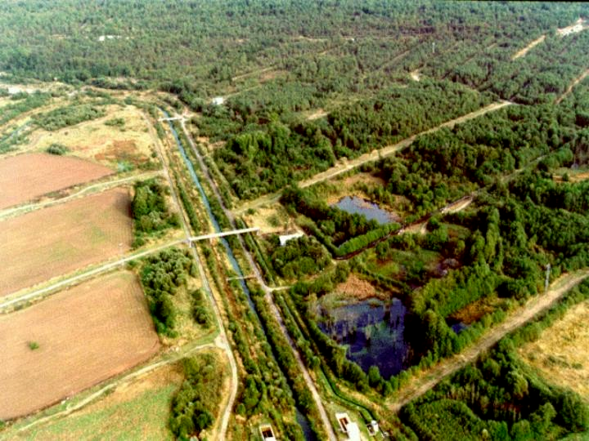
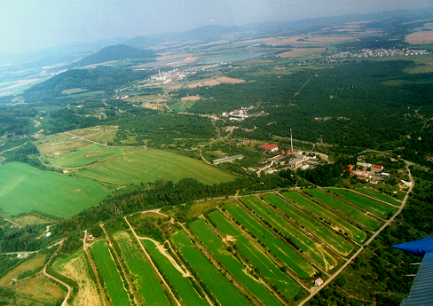
Present extent of contamination
Influenced volume of groundwater - cca 300 mil. m³
Amount of TDS - 4,8 mil. t
There of:
SO₄²⁻ - 3,9 mil. t
Al - 420 000 t
Fe - 110 000 t
NH₄⁺ - 90 000 t

Slide 18
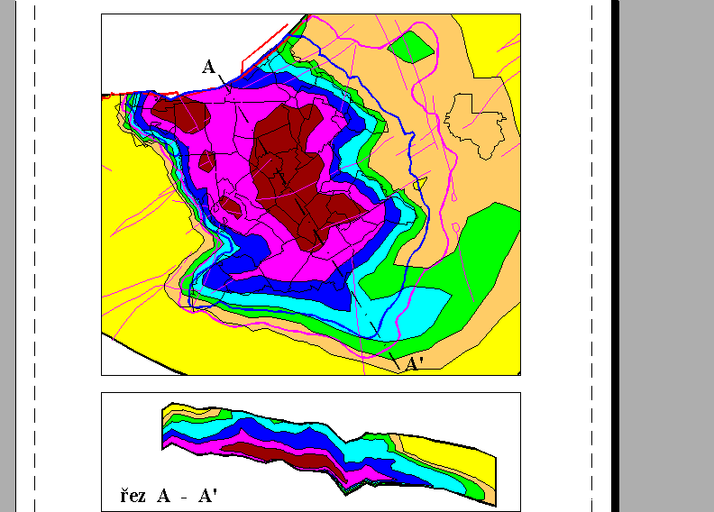
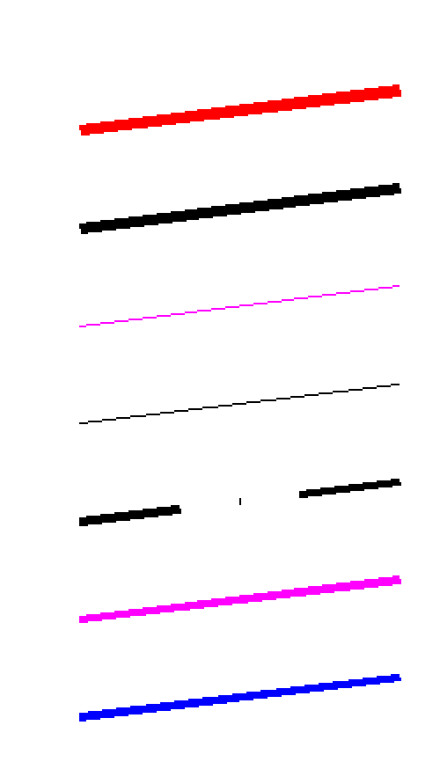
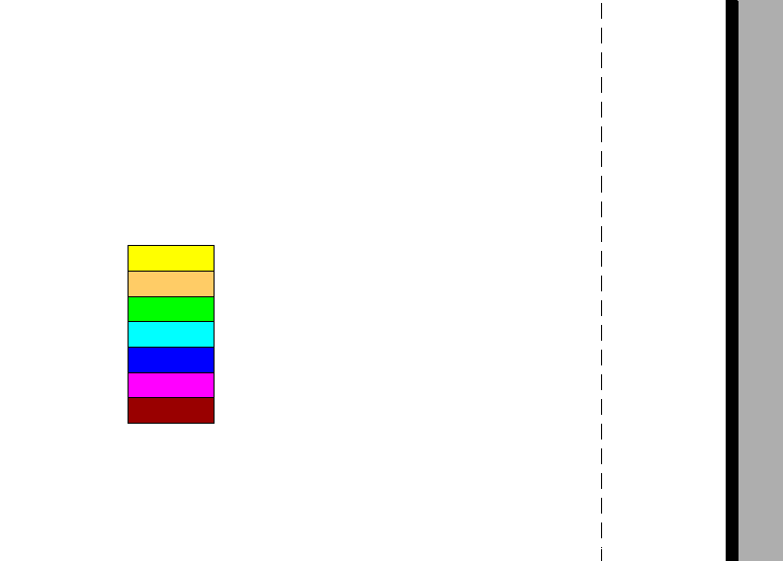
Present extent of contamination
Stráž fault
model boundary
tectonic lines
leaching fields
cross-section
3 g/l limit
8 g/l limit
TDS concentration [g/l]
< 3
3 - 8
8 - 15
15 - 30
30 - 50
50 - 80
> 80

Slide 19
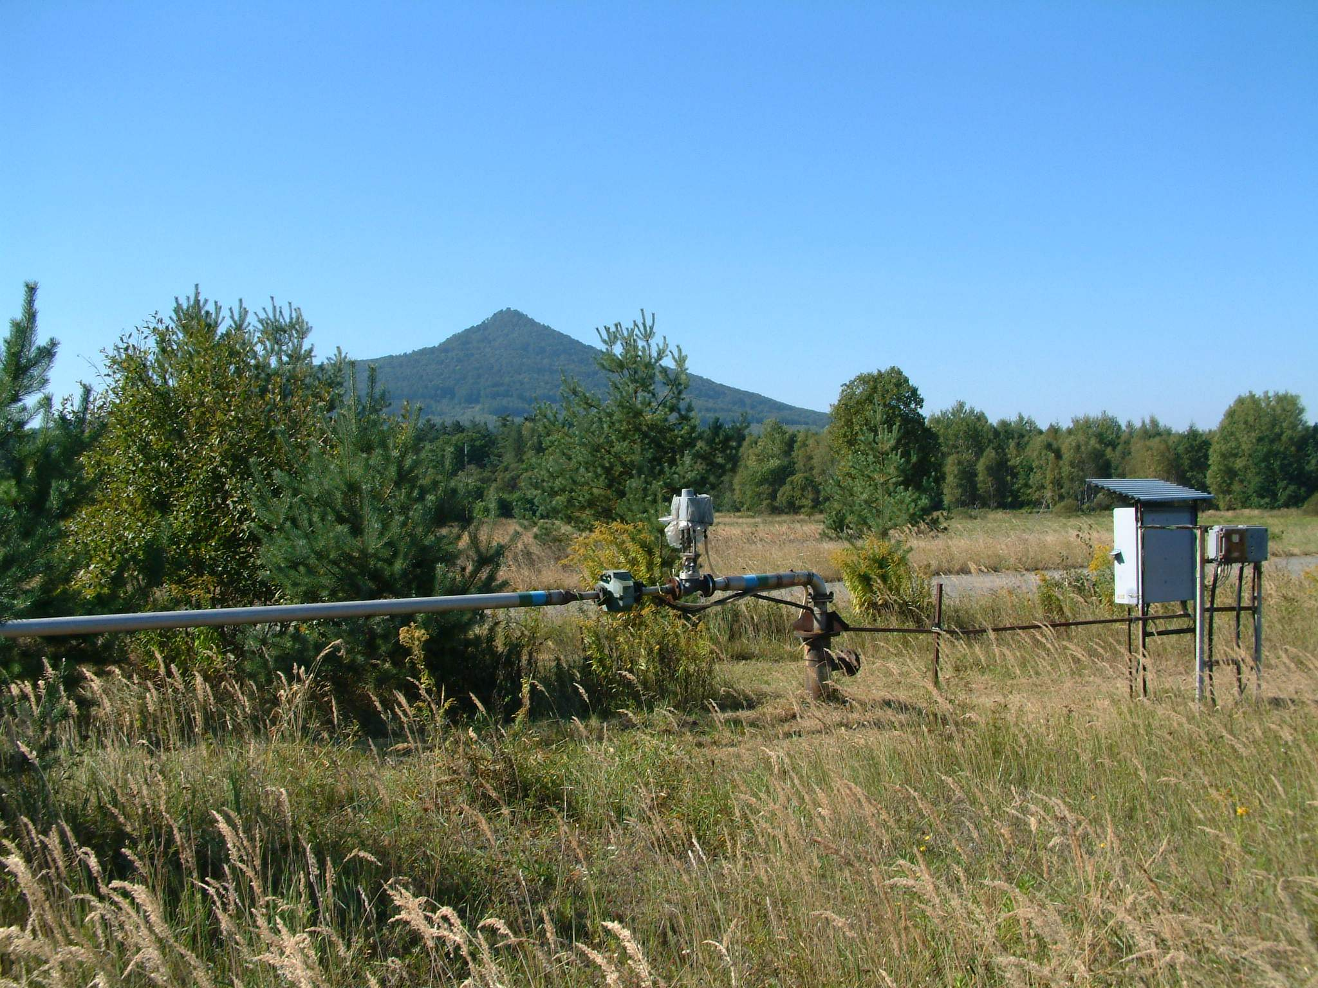
Reaching of safe state
in the underground
From the ground it is necessary to remove cca 3,7 mil. t of contaminants

Slide 20
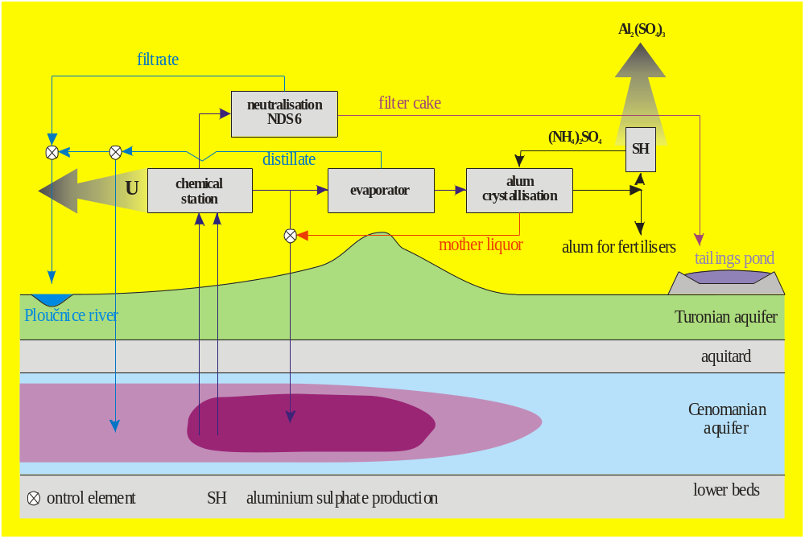
Scheme of present remedial technologies

Slide 21
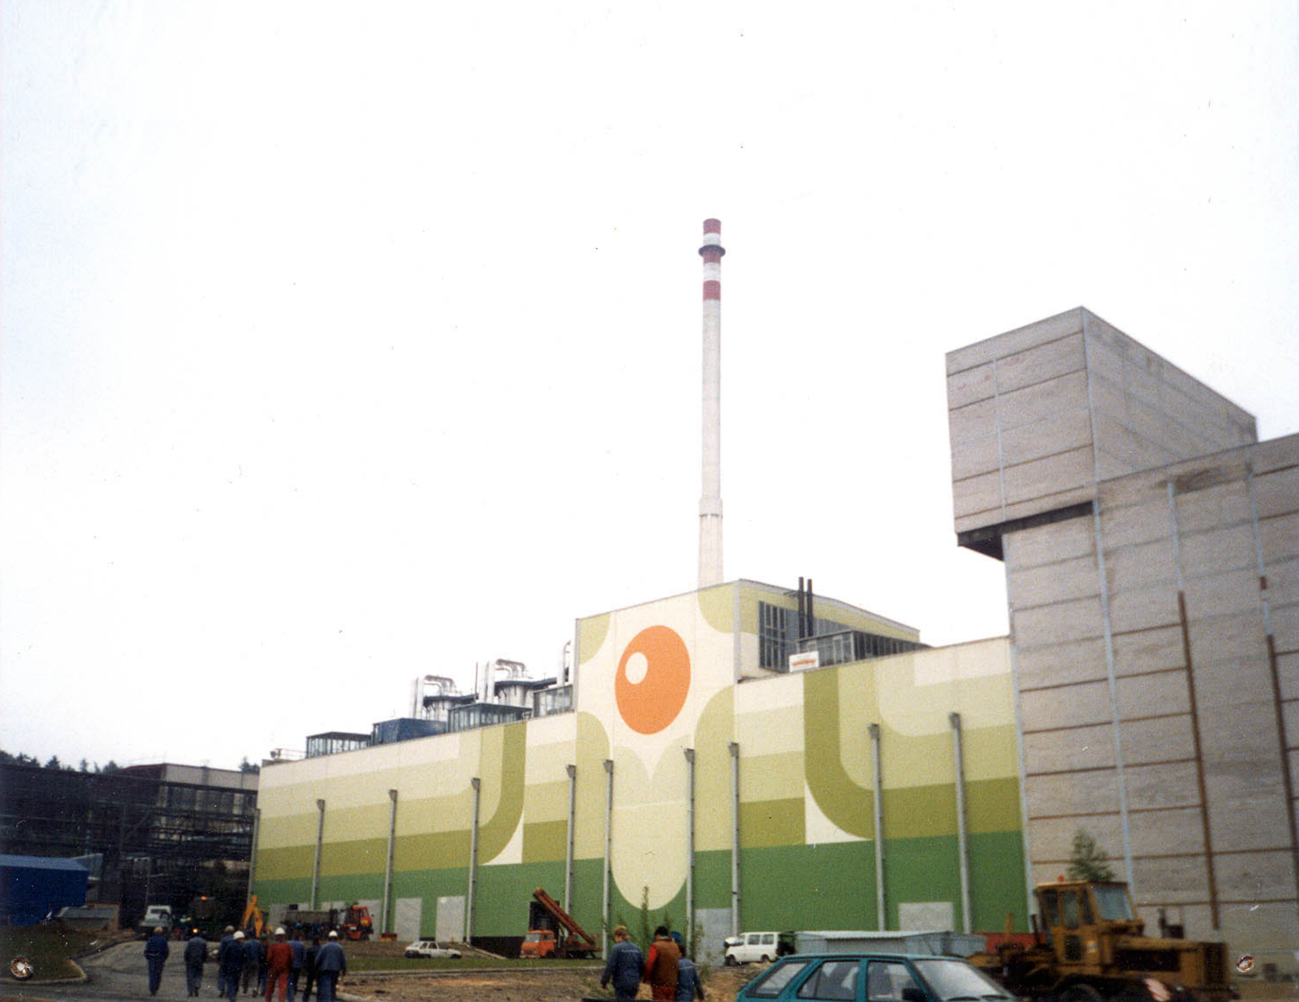
Capacity of present remedial technologies
for withdrawing of contamination
Production and reprocessing of alum:
up to 35 000 t TDS per year
Neutralization:
up to 30 000 t TDS per year
Present remediation well net
End of remediation 2100

Slide 22
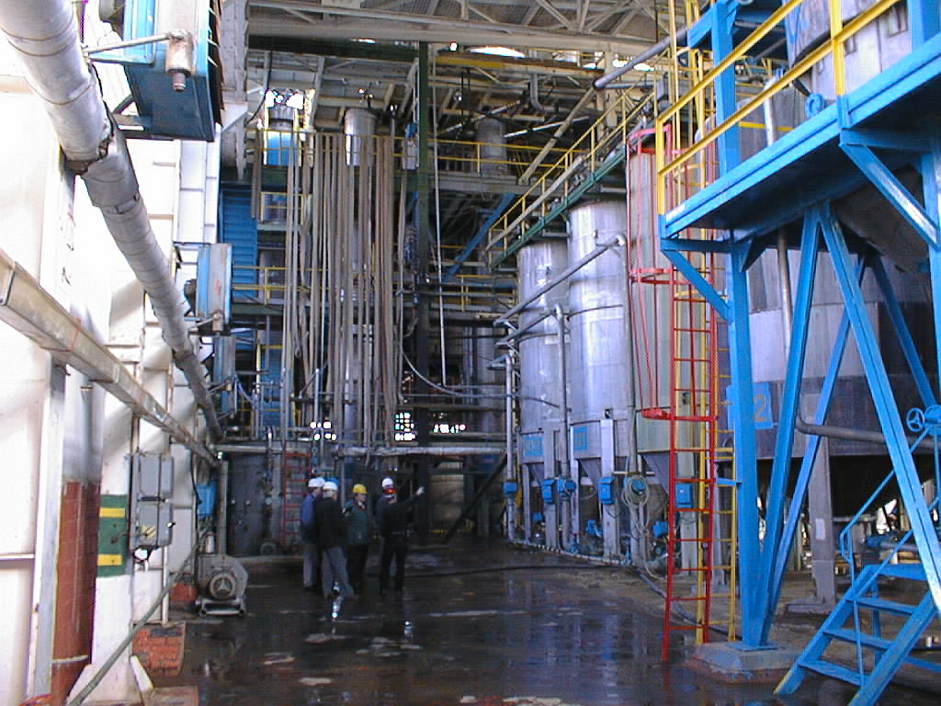
Realisation of new remedial technologies
II. stage of aluminium sulphate production
- end of 2007
Another neutralisation station
- end of 2012
Neutralisation of mother liquor
- end of 2009

Slide 23
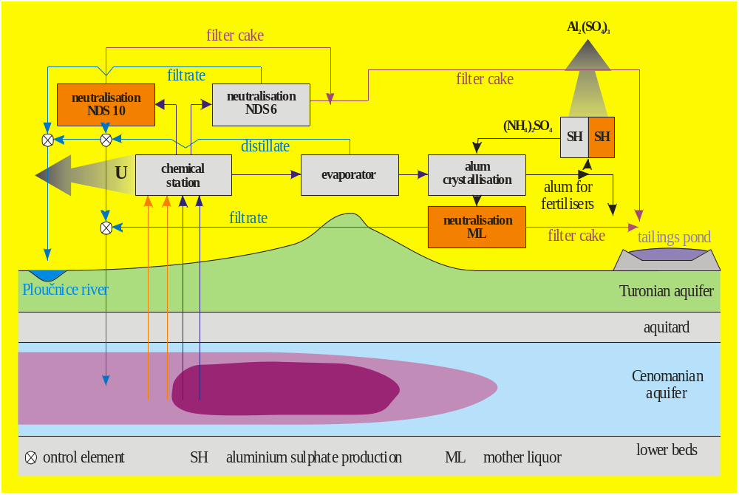
Complete scheme of remedial technologies

Slide 24
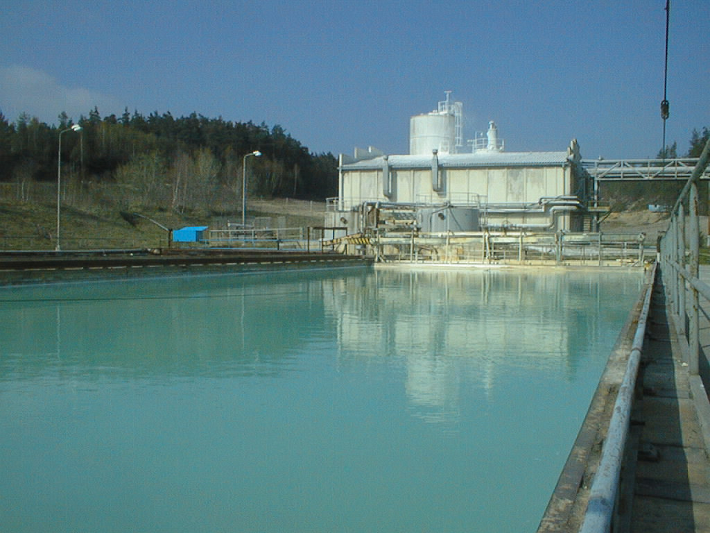
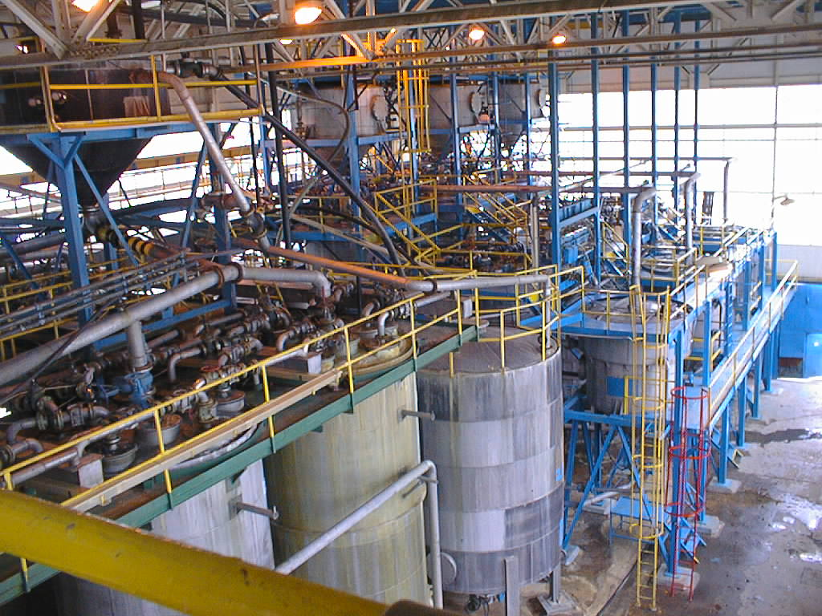
Capacity of complete remedial technologies
for liquidation of contamination
Neutralisation:
up to 110 000 t TDS per year
Production and reprocessing of alum and mother liquor liquidation:
up to 80 000 t TDS per year
Completed remediation well net
End of remediation 2035

Slide 25
NATO SPS Study "Prevention and Remediation Issues in Selected Industrial Sectors "
Ljubljana, 17 – 22 July 2007
Thank you for your attention
MINISTRY OF ENVIRONMENT, CZECH REPUBLIC
Prague 2007

