Slide 1
Leveraging Resources for Brownfields Revitalization
A Step-By-Step Guide
One of a series of Leveraging Webcasts from the U.S. Environmental Protection Agency’s Office of Brownfields & Land Revitalization

Slide 2


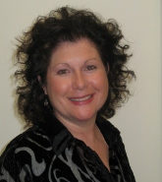
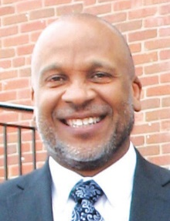
Today’s Speakers
Patricia Overmeyer – Land Revitalization Coordinator, Office of Brownfields and Land Revitalization, U.S. EPA
Matt Ward – Sustainable Strategies DC
Teri Goodmann – Assistant City Manager, City of Dubuque, IA
Maurice Jones – Economic Development Director, City of Dubuque, IA

Slide 3
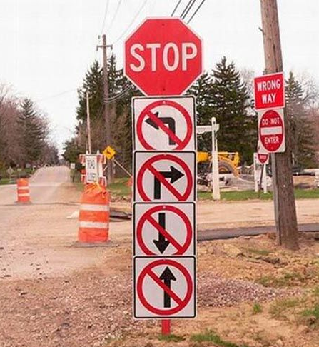
Challenges of Funding
Brownfields Revitalization
While EPA Brownfield grants can help launch projects . . .
There are still funding challenges
  Cleanup costs can exceed grants
  May need resources for infrastructure upgrades, design & engineering, and redevelopment costs
  Myriad of federal, state, private and philanthropic funding sources can be tough to identify, pursue and use
  Particularly hard for small, rural or distressed communities, or brownfields with limited reuse options or weak markets

Slide 4

EPA Efforts to Promote Best Practices in Leveraging
In 2015 at the 20th anniversary of the national Brownfields Program, U.S. EPA launched the “Next Generation Brownfield Initiative”
Key focus area is leveraging resources for brownfields & community revitalization
New guidebook on “Setting the Stage for Leveraging Resources for Brownfields Revitalization” at www.epa.gov/sites/production/files/2016-4/documents/final_leveraging_guide_document_4-19-16.pdf
2016-2017 webcasts on leveraging best practices and “Meet the Funders” series

Slide 5

14 Steps to Successfully Leveraging Resources for Brownfields & Community Revitalization

Slide 6

1. Organize a Project Team
Local leadership is essential
  Need to establish and maintain commitment to community projects
  Commitment to collaboration at onset
Designate a “brownfields champion” (aka project manager)
Create a cross-sector team representing key stakeholders, neighborhood associations, organizations, developers, consultants, others
Regularly update key stakeholders on progress

Slide 7

2. Articulate a Clear Community Vision & Identify Priorities
  Begin with the end in mind
    Connect brownfields opportunities to local priorities and a broader community vision
  Develop and articulate a vision for each brownfields area with the involvement of landowners, residents, community leaders, developers, and local businesses
  View brownfields as opportunities for economic development, not as liabilities
  While many sites may exist, focus on priority brownfields

Slide 8

3. Build and Maintain Local Stakeholder & Citizen Support
Public support is critical
  Early and frequent involvement and engagement
  Clearly communicate what the completed project will look like and what benefits are likely to result
Think beyond public hearings
  Community charrettes & forums
  Newsletters and the local media
  Social media outreach
  Create a citizen advisory board
Engage with private landowners & developers
Communicate with state and federal agencies, and State and Congressional representatives

Slide 9

4. Delineate Brownfield Project Components & Project Phases
Funding needs and sources may differ at different phases of a project
Successful strategy starts with clearly delineated project components and phases
Components may include:
  Demolition, site preparation, and projects related to housing, economic development, waterfront restoration, stormwater, trail restoration, etc.
Phases may include:
  Planning, site acquisition, assessment, cleanup, construction (can be phased), operation

Slide 10

5. Create Estimates of Project Costs
Estimate project costs for each key component and phase
Necessary before beginning to identify best potential funding sources
Cost estimates can be revised over time
Some communities do this in-house and others hire professionals to develop estimates. Can also include vendor preliminary estimates

Slide 11

6. Identify the Best Mix of Funding Sources for Components & Phases
  Grants, subsidized loans, tax credits, tax-increment or fee assessment districts, public-private partnerships, technical assistance
  Key Sources to Consider:
    State, regional and federal funding agencies
    Community, regional, corporate, and national philanthropies
    Site redevelopers or private investors
    Banks and other traditional lenders
    Federal or state tax incentives
    Local funds and incentive tools
  EPA’s 2015 Brownfields Federal Programs Guide
  Ultimate funding targets may impact how the project is conceived and designed

Slide 12

7. Create a “Resource Roadmap” for Project Priorities
  A “Resource Roadmap” is a document identifying revitalization priorities, their key components and phases, and the estimated cost for each component and phase
  Maps potential sources of funding, funding ranges, matching requirements, application deadlines, competitiveness factors, key contacts
  Guide for project teams, local leadership and funding patrons

Slide 13

8. Develop a Strategy for Cost-Sharing & Leveraging
  Matching/cost-sharing funds are critical to securing external grants and investments
  Demonstrates community’s commitment to the project and instills confidence
  Requires significant planning and budgeting well in advance of the funding application
  Secure commitments early, even if contingent upon the receipt of a future grant or loan
  Consider non-financial or in-kind resources
  Fit different sources together to create matches

Slide 14

9. Assess Feasibility of Debt Financing
Debt financing strategies for capital costs
  Consider early on if your community has the capacity (and desire) to use debt financing
Government-backed or -subsidized tools
  HUD Section 108 Guaranteed Loans
  FHLB Community Investment Programs
  USDA Community Facilities loans
  Brownfields Revolving Loan Funds
General Obligation Bonds
Tax-Increment Financing / Assessment Districts

Slide 15
10. Create a Briefing Sheet for Each Priority Project
Tips for Creating Effective Briefing Sheets
  Keep it short (no more than 1 sheet/2 pages)
  Describe key aspects of project, benefits and outcomes of project, momentum/support, and remaining project needs/gaps
  Include specific funding requests
  Include main point of contact for inquiries
  Make it attractive (pictures, renderings, logos)
  Can be tailored to specific funders
  Update briefing sheet as goals are achieved, new partnerships are formed, or objectives change
Distribute widely and often

Slide 16
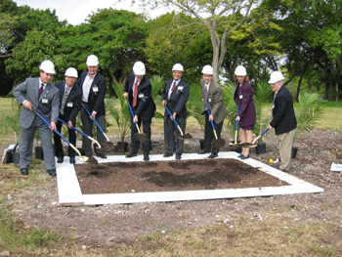
11. Seek State Backing
  States offer funding & technical assistance
      Targeted economic development assistance, brownfields financing, infrastructure funding, subsidized loans, tax incentives, and more
  Federal funds often pass through states
  Federal, philanthropic, and private funders view state backing as a sign of project momentum and success
  Involve state elected officials in the process

Slide 17

12. Collaborate with Federal Agency Officials
Engage early with relevant federal officials
  Familiarize them with the specific project, community vision, goals & key components
  Officials can often support and help guide local projects
Federal agencies regularly host webinars to explain their funding and technical assistance programs
Make visits to federal agency HQ & regional offices
Stay in touch and update regularly
Invite federal & state officials to project-related local events

Slide 18
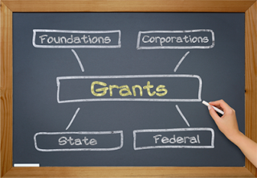
13. Prepare for Grant Writing
Plan ahead to write competitive applications
Determine grant-writer
Most agencies post information early online
Effective preparation includes:
  Determining eligibility and fit for grants
  Identifying what activities can be funded
  Determining the most appropriate applicant organization
  Development compelling theme & story
  Mapping stakeholder support
Follow the instructions and answer every question thoroughly… losing easy points happens more often than you think!
Request a debrief from funding agency if unsuccessful, to improve for next time

Slide 19

14. Celebrate Success
  Celebrate achievements & grants
  Thank funding agencies & key supporters (may be needed again in the future)
  Hold groundbreaking ceremonies & ribbon-cutting events
  Cultivate & promote media coverage
  Build confidence, gratitude, and pride for future revitalization projects

Slide 20

Dubuque, IA Riverfront Revitalization

Slide 21
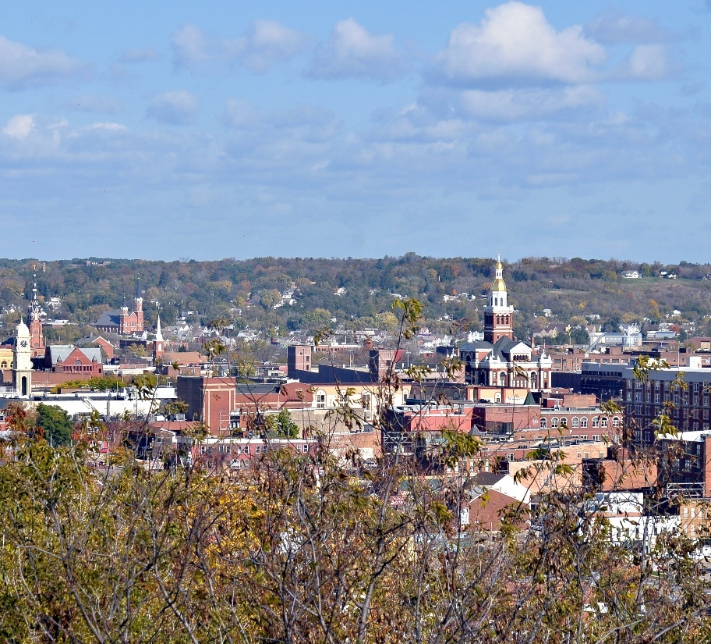
Dubuque … A Little Background
History and Demographics
  Oldest city in Iowa
  Population – approximately 59,000
  Located on the banks of the Mississippi River
  Formerly a fur-trading post, lead mining community, manufacturing center, and meatpacking hub
  Significant brownfields contamination
  Strong sustainability and historic reuse ethic

Slide 22
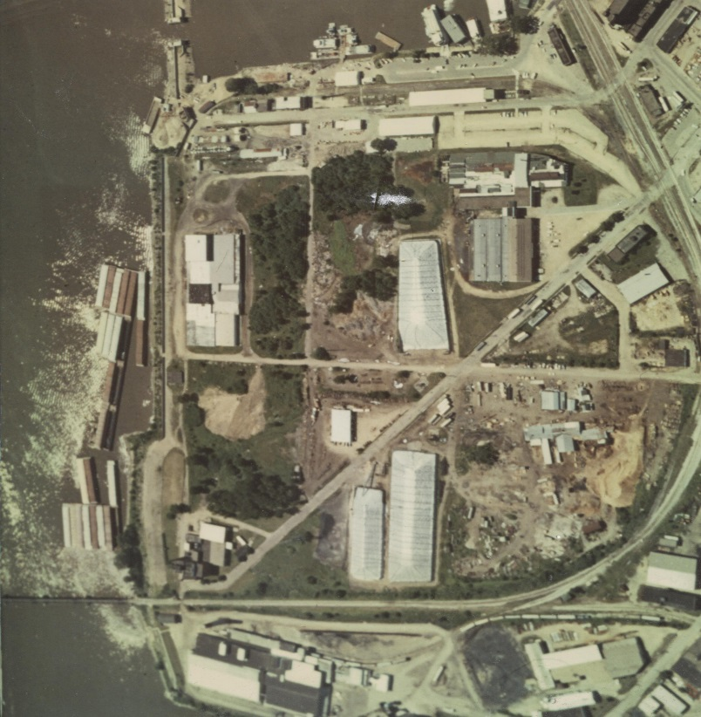
Reclaiming Dubuque’s Waterfront
Port of Dubuque
  By the 1990s, the 120-acre waterfront area was plagued by a host of environmental issues due to the mix of heavy industrial uses
  City was physically and psychologically disconnected from Mississippi River
  Dubuque residents developed a revitalization vision through a number of planning processes

Slide 23
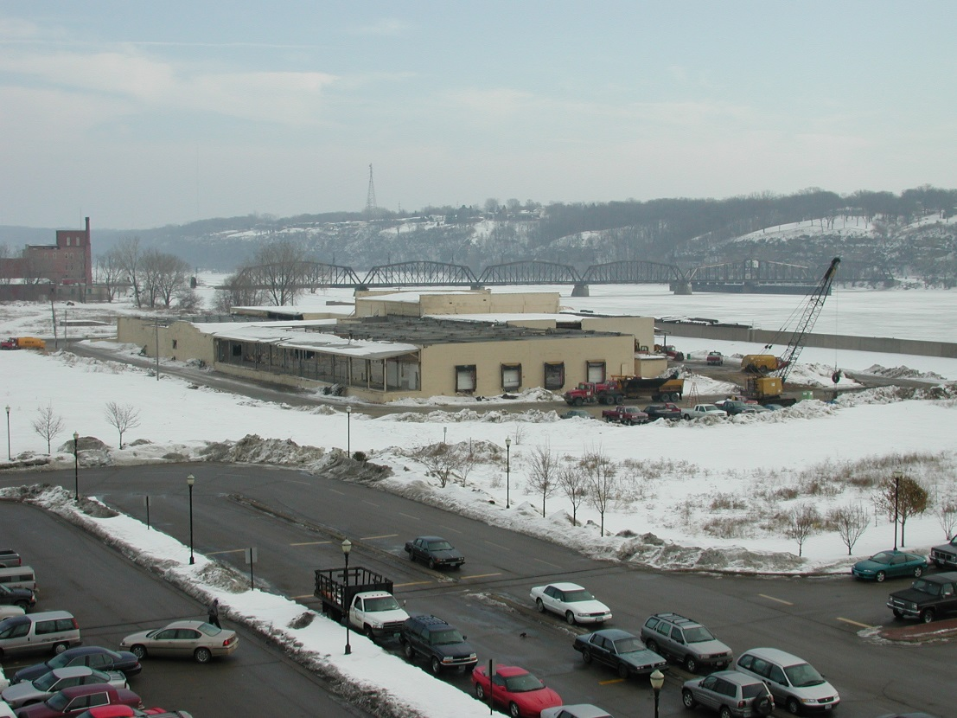
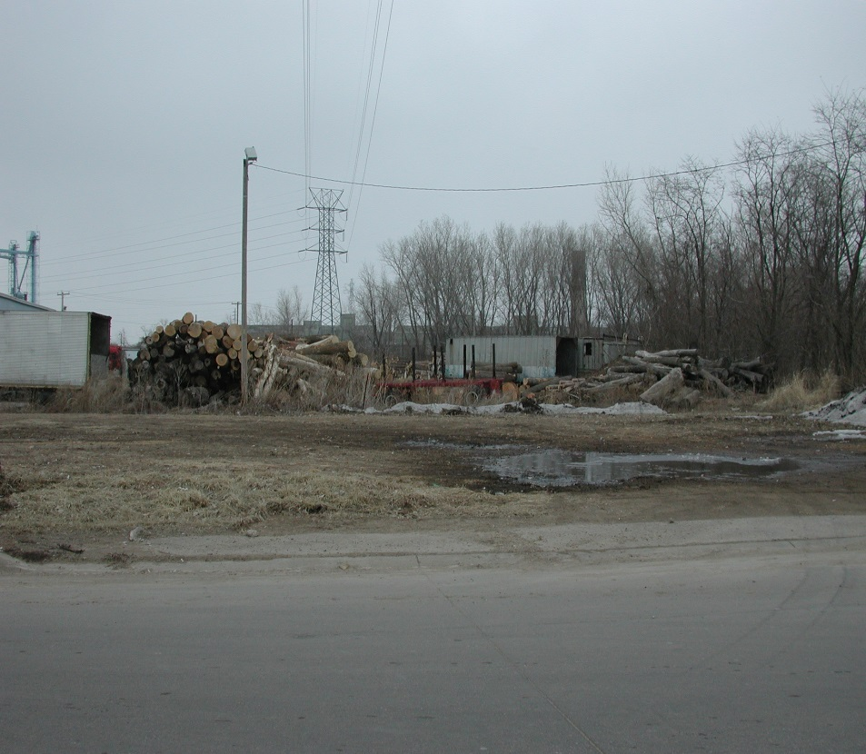
Dubuque Waterfront Brownfields

Slide 24
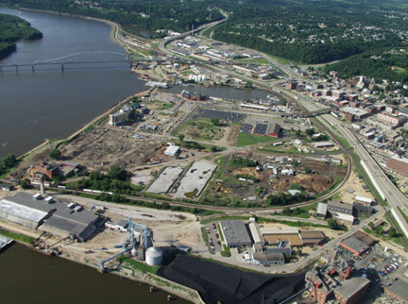
The North Port Story
Challenges
  Home to shipbuilding and repair facilities, railroads, bulk petroleum and coal storage operations, food processing plants, farm machinery manufacturers, and lead mining activities – but now under-utilized
  Suffered from hazardous waste and petroleum contamination

Slide 25
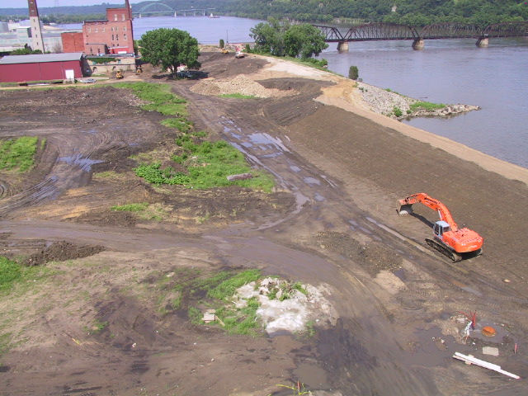
North Port’s Revitalization
EPA Resources
  Brownfield resources were among the earliest dollars raised for the North Port redevelopment
    2002 Brownfields Assessment Grant – 12 Phase I and 6 Phase II environmental site assessments
    2003 Brownfields Cleanup Grant – Remediation of petroleum plume

Slide 26
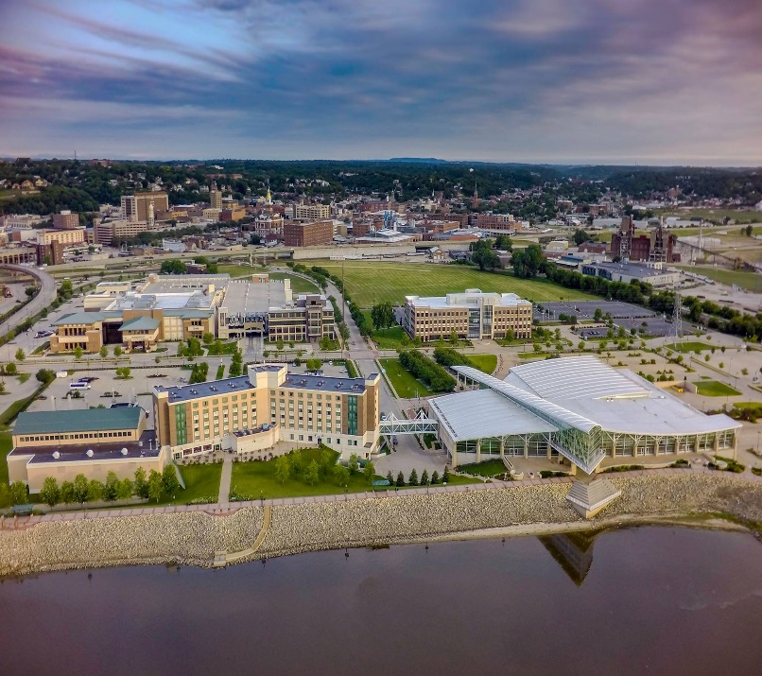
North Port’s Revitalization
Leveraging Success
  EPA Brownfields dollars helped to unlock resources for the North Port’s revitalization
  More than $500+ million leveraged in public and private support
  Significant federal and state funding
  Created a community model for accomplishing big goals

Slide 27
North Port’s Revitalization
Other Federal Dollars
  Institute for Museum and Library Services: More than $100,000 to support riverfront restoration planning
  Economic Development Administration: Land prepared and infrastructure upgraded with Public Works funding
  U.S. Department of Housing and Urban Development: $800,000 for the Riverfront Discovery Center
  National Fish and Wildlife Service & National Park Service: Over $1 million for the Riverfront Development Center and other activities
  U.S. Department of Health and Human Services: $3 million for the development of exhibits at the River Discovery Center

Slide 28
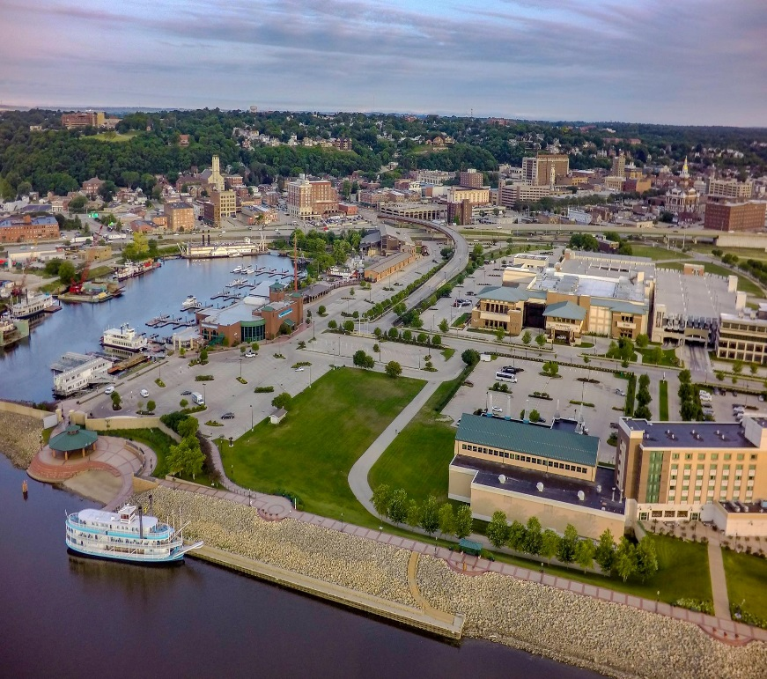
North Port’s Revitalization
State Resources
  $48 million in grants from community tourism, “Vision Iowa,” and other state programs to support riverfront development, the Mississippi River Museum and Aquarium, and other key components of the North Port project

Slide 29
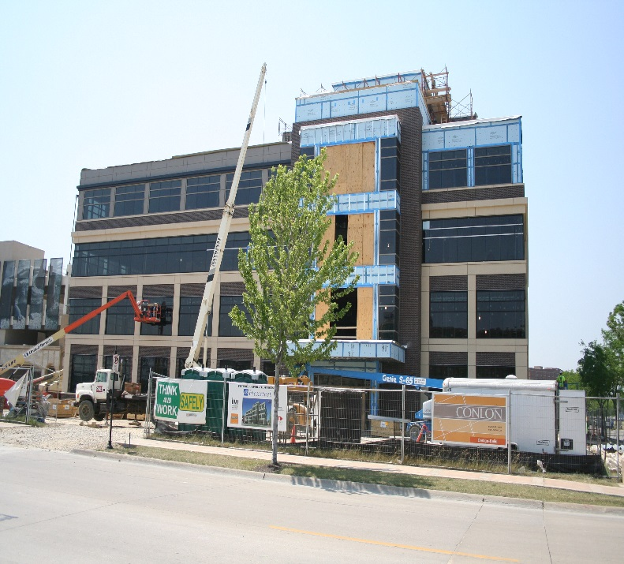
North Port’s Revitalization
Private Sector Support
  Developers and other private sector interests have dedicated more than $300 million to the North Port revitalization

Slide 30
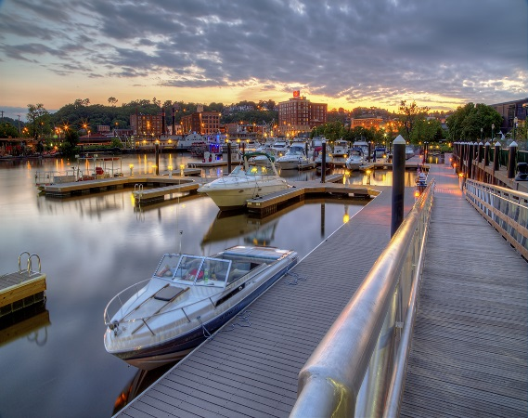
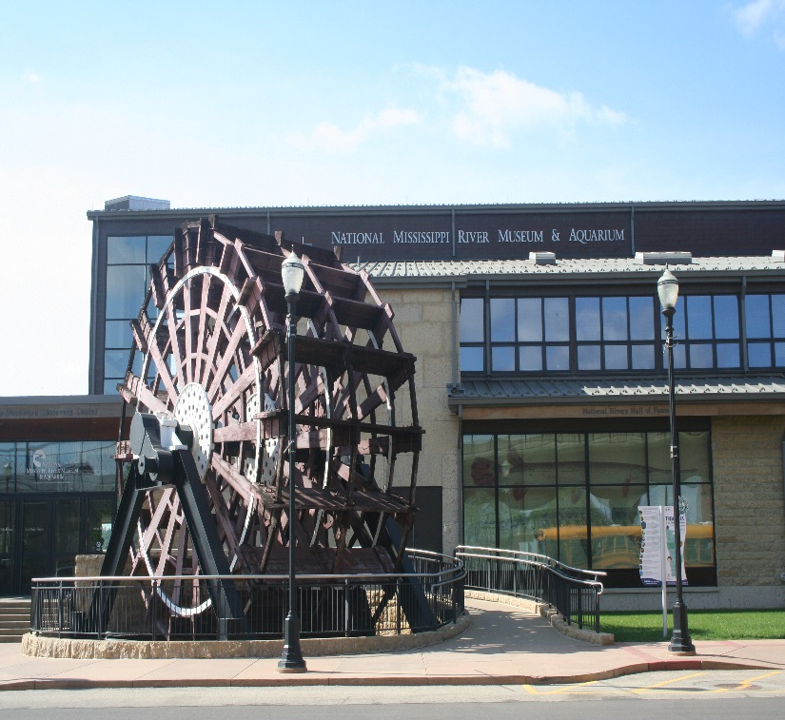
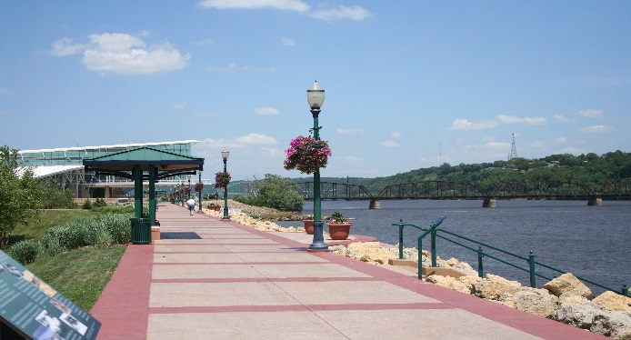
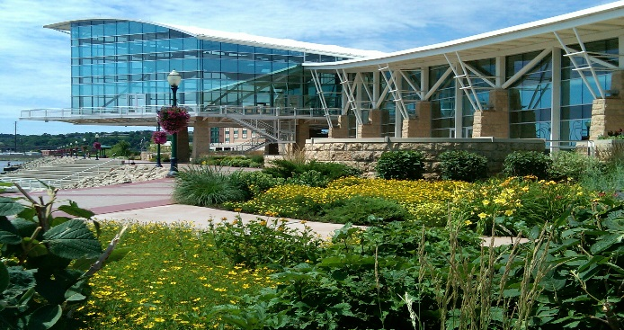
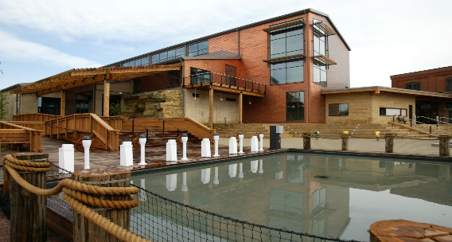
The North Port Today
Major Renewal
Photo montage of North Port after revitalization

Slide 31
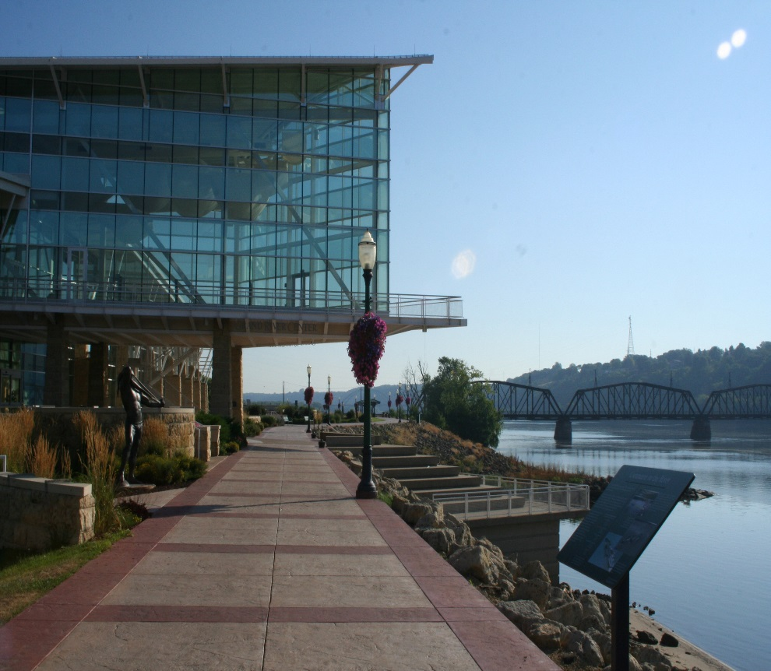
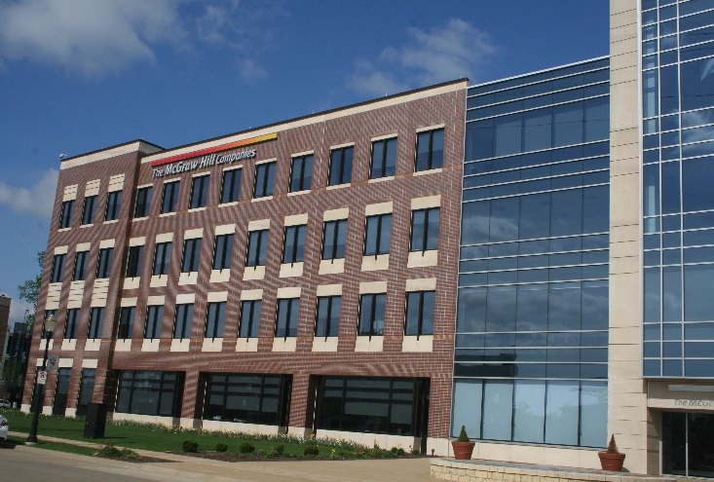
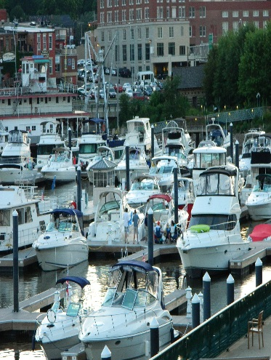
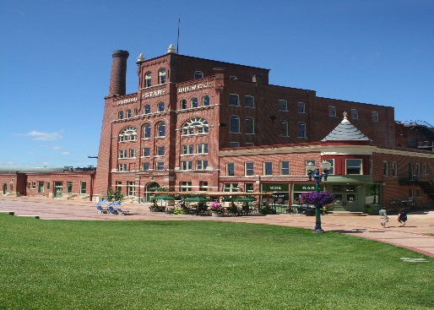
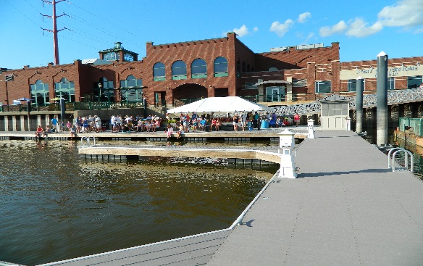
The North Port Today
Major Renewal
Photo montage of North Port after revitalization

Slide 32
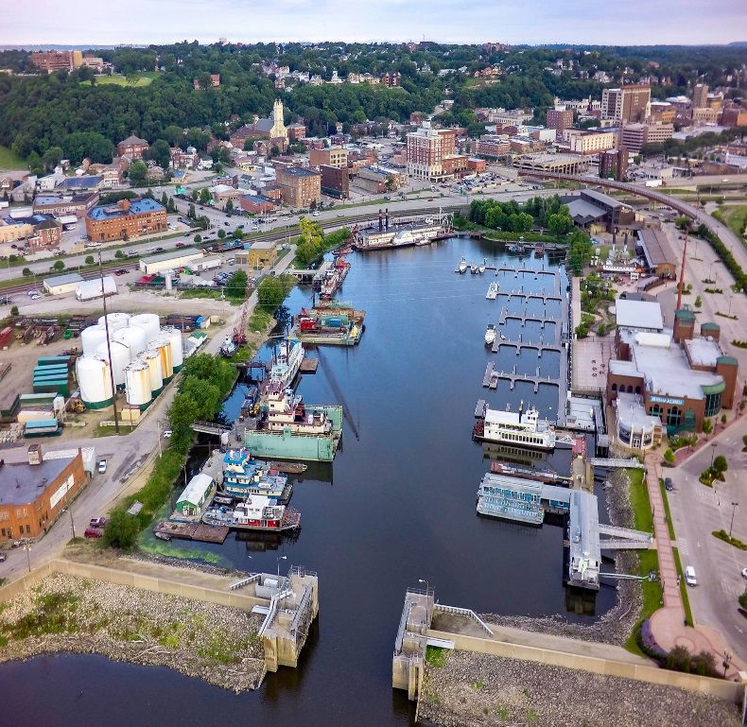
Replicating the Model
Other Successes
  Main Street
  Historic Millwork District
      Recipient of EPA’s Smart Growth Achievement Award
  South Port
      Awarded $200,000 EPA Brownfields Area-Wide Planning Grant
    Part of $31.5 million HUD National Resilience Grant award in 2016

Slide 33
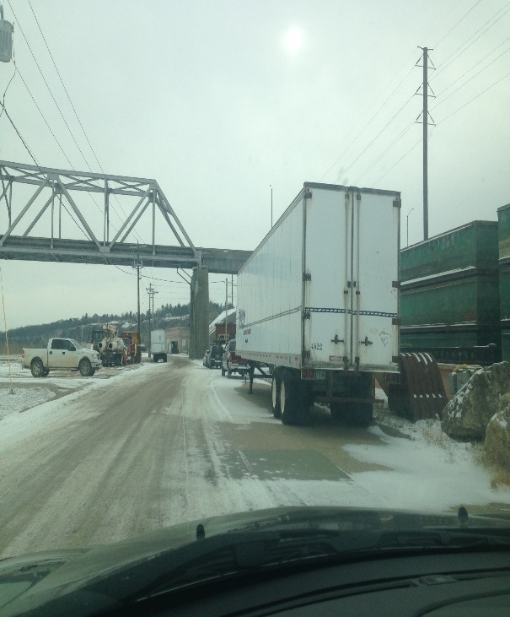
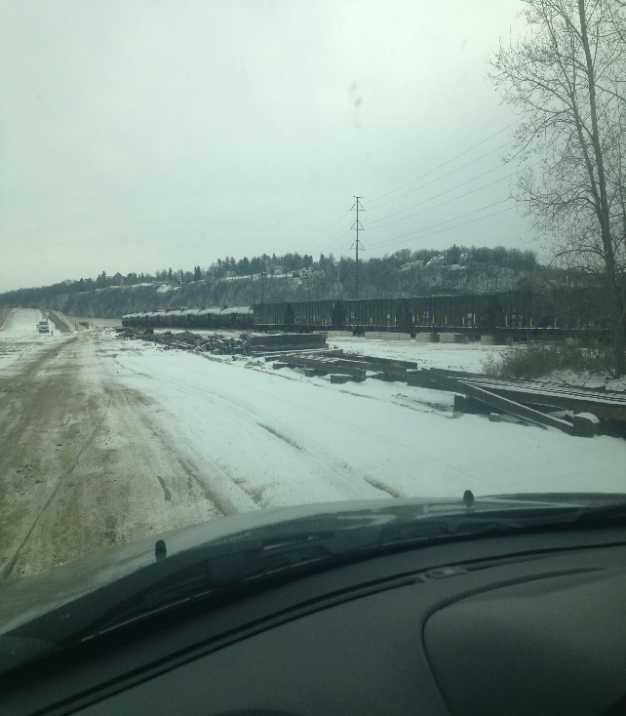
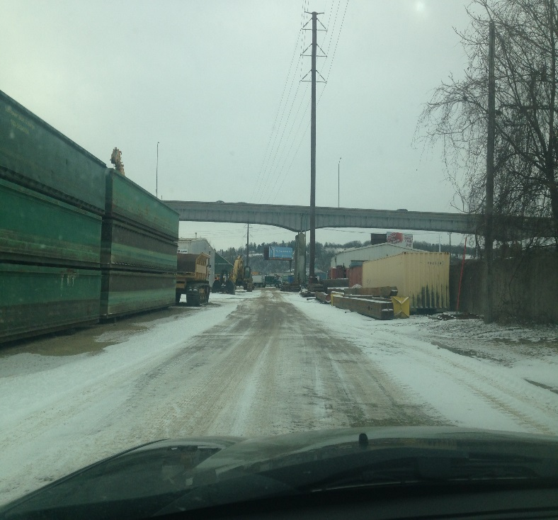
Replicating the Model
EPA Brownfields AWP Grant
South Port Focus Area

Slide 34
South Port Concepts

Slide 35

Keys to Success
Important Steps
  Strong local leadership
  Engaged citizenry
  Planning, planning, planning
  Municipal investments
  Clear funding requests
  Relationships at all levels
  Celebrating successes

Slide 36
Q&A / Discussion
Type your question in the dashboard on your webcast screen

