Slide 1
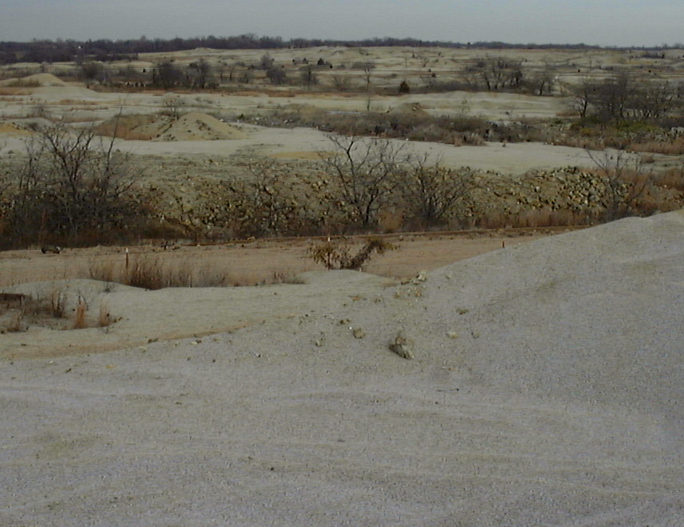
Residuals based approaches Efficacy and costs
Sally Brown
Mark Sprenger
Michele Mahoney

Slide 2
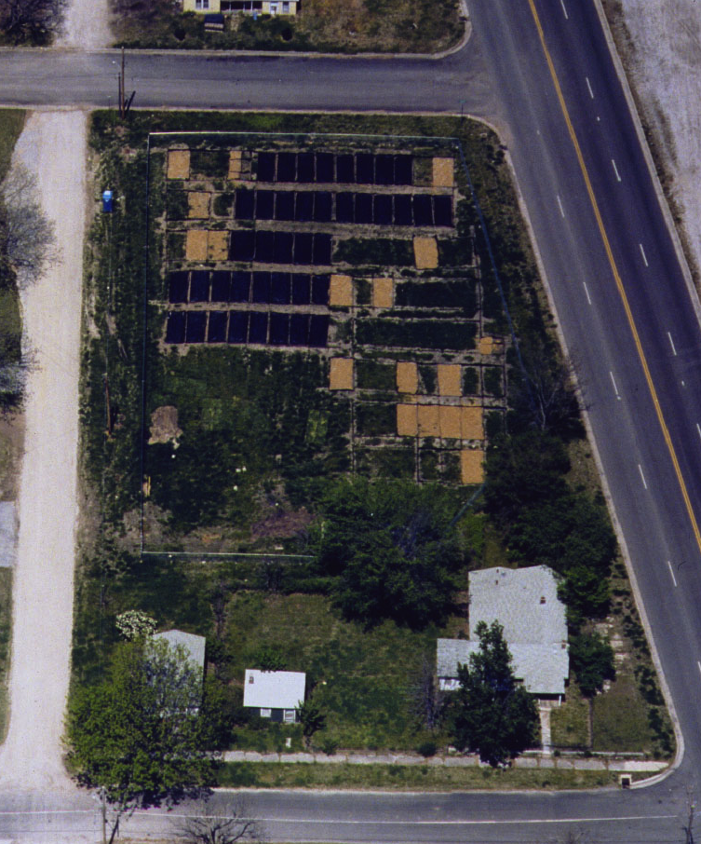
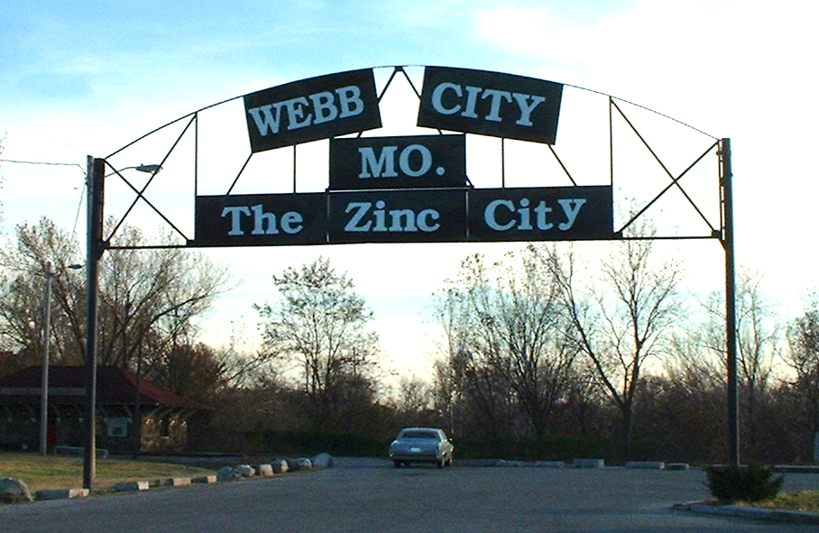
Joplin, MO
City plots part of RTDF INNERT group
My first trip to SW MO

Slide 3
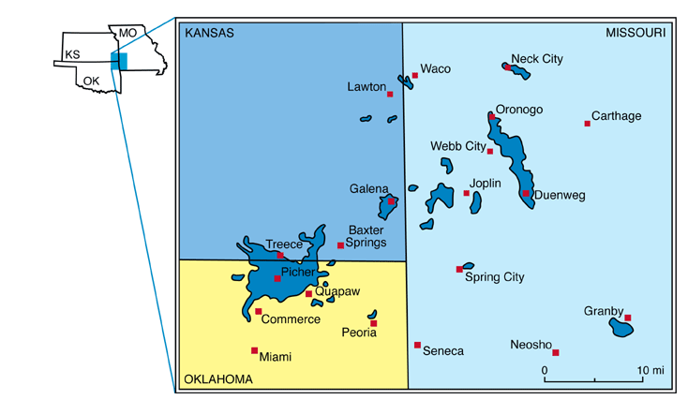
Tri- State Mining District
http://www.kgs.ku.edu/Publications/pic17/pic17_1.html

Slide 4
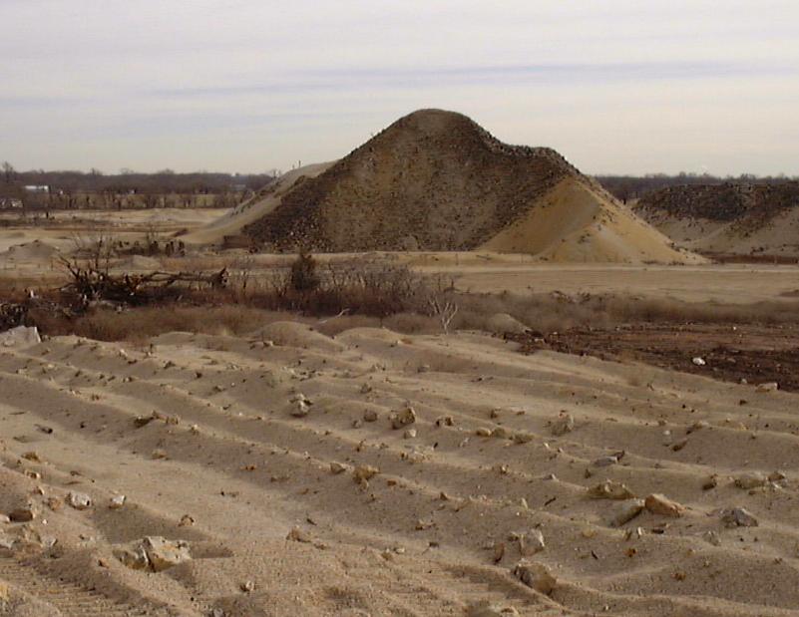
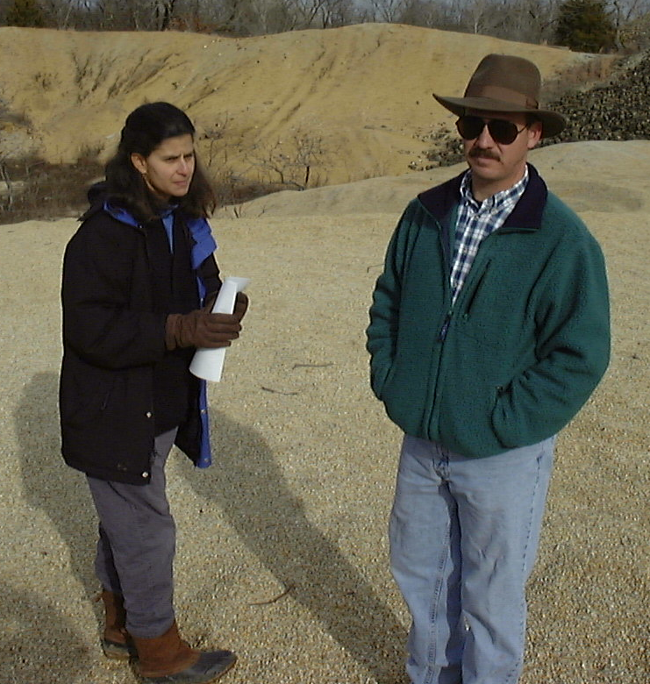
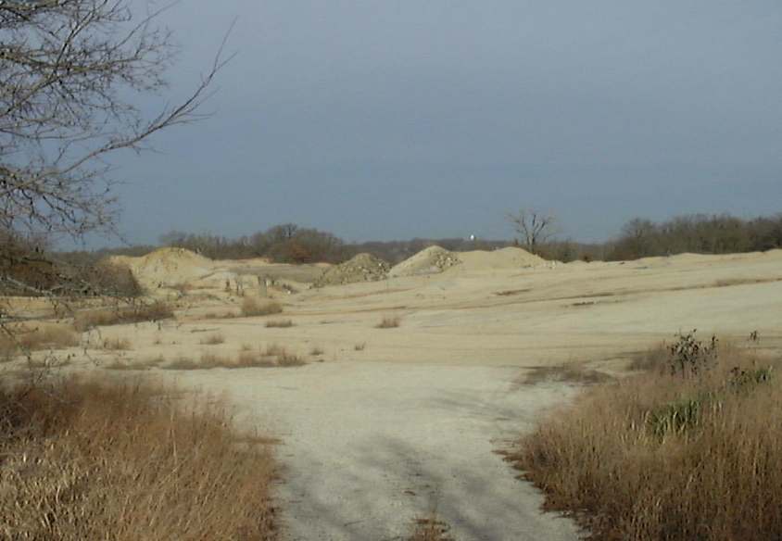
Jasper County
Tailings project started in 1999
Back when I (and Mark Doolan) were young….

Slide 5
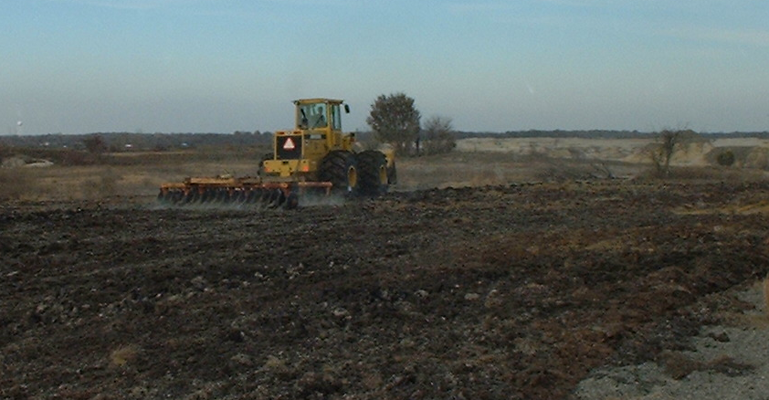
Large –scale biosolids demo
Biosolids + lime applied at low and high rates to sites in the New Repository and Old Repository
Composts tested by MO DNR

Slide 6
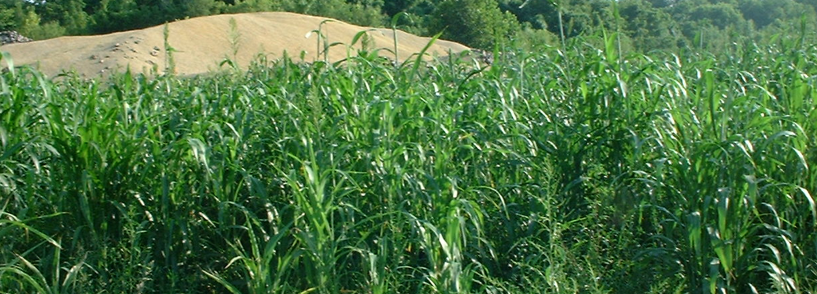
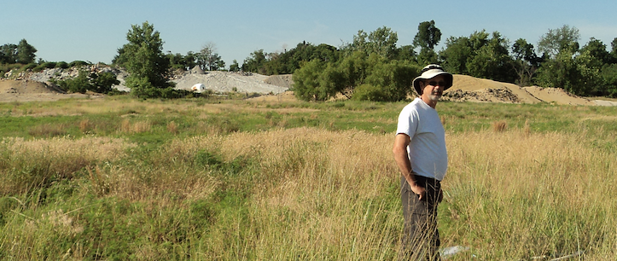
Short and long term sampling

Slide 7
Soil Zn Plant Zn 2001 2012

Slide 8
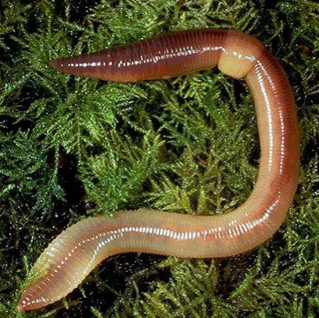
2001-

Slide 9
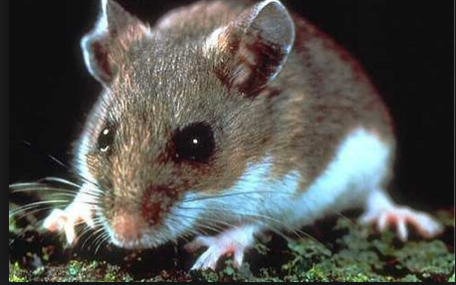
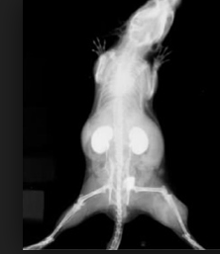
2002-
Trapping rate 19%
Normal 3-5%
92 kidneys collected
61 normal
22 indication of Cd exposure
4 potential function compromise
9 not able to analyze

Slide 10
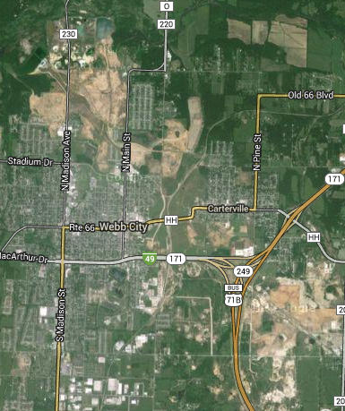
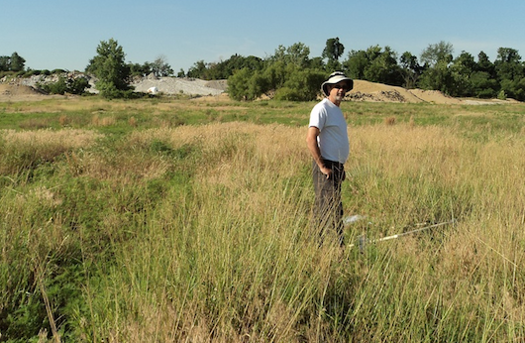
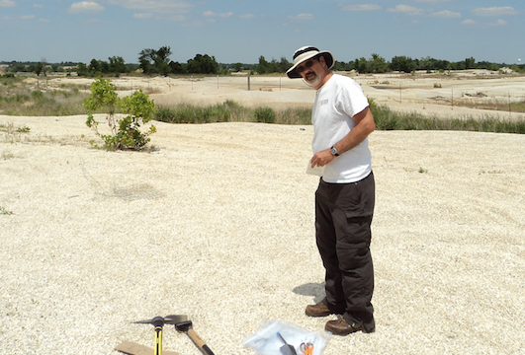
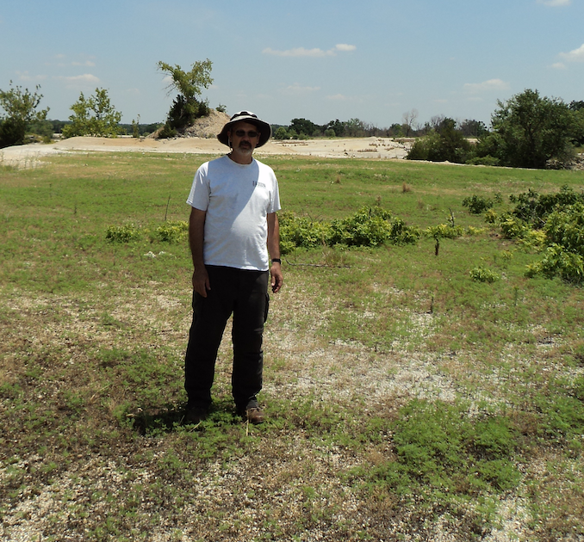
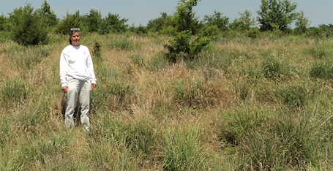
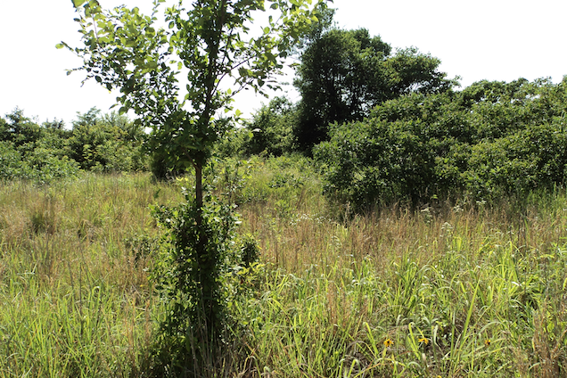
A
B
C
D
E

Slide 11
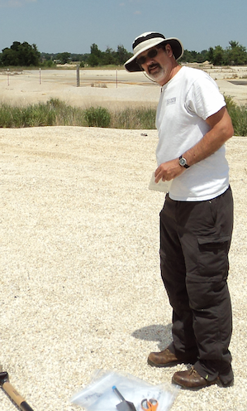
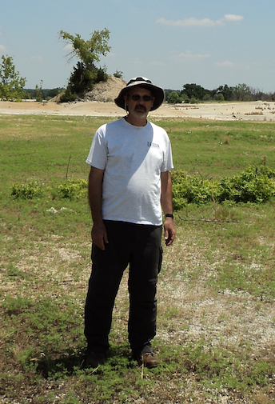
Control
5% Cover
0 Yield
Low Biosolids
50% Cover
14.5 Yield

Slide 12
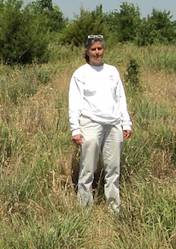
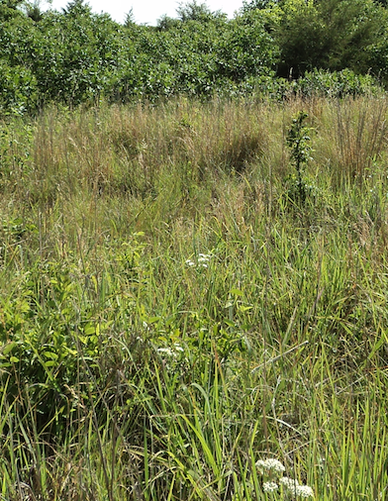
High Biosolids
94% Cover
47 Yield
Topsoil
92.5% Cover
44 Yield

Slide 13
Building Soil

Slide 14
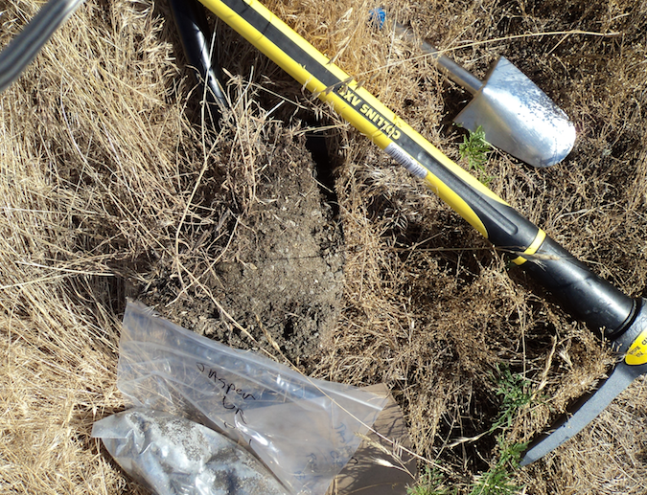
Treatment | M3 P | Total C | Bulk Density | % H₂O
 |  | % | g cm⁻³ | 0.1 bar
Control | 133 | 0.56 | 1.52 | 3.63
Biosolids high | 738 | 6 | 0.82 | 30.5
Topsoil | 17 | 2.75

Slide 15
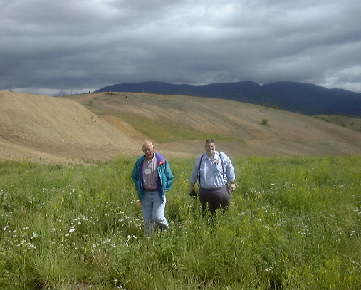
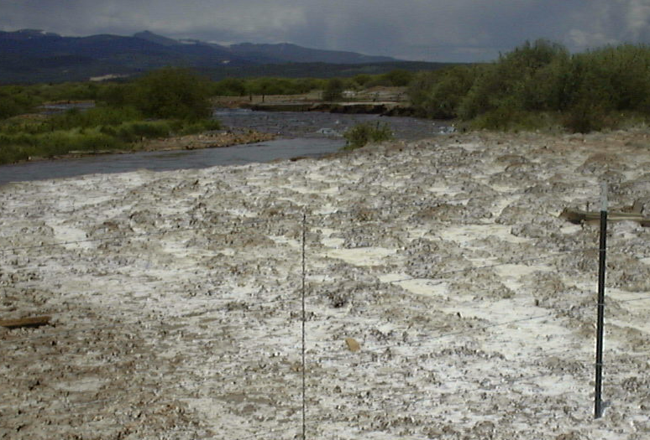
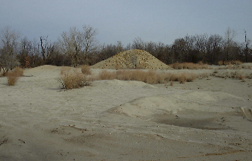
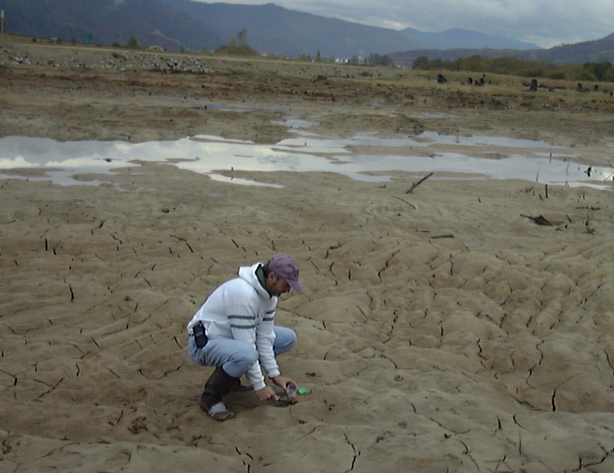
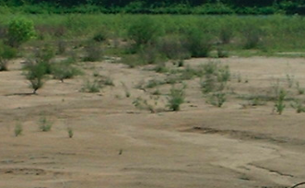
Jasper one of many
Bunker Hill, ID
Leadville, CO
Bunker Hill, ID
Wetland
Joplin, MO
Tar Creek, OK

Slide 16
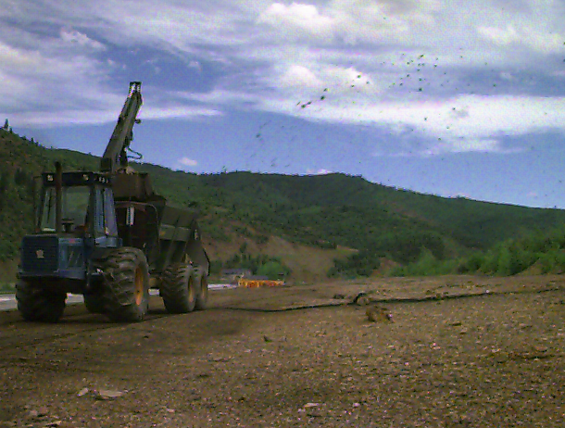
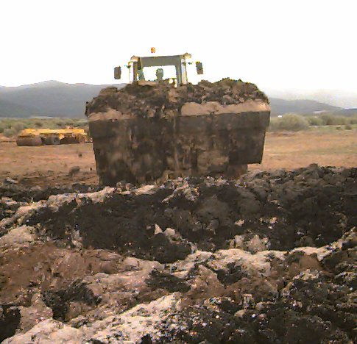
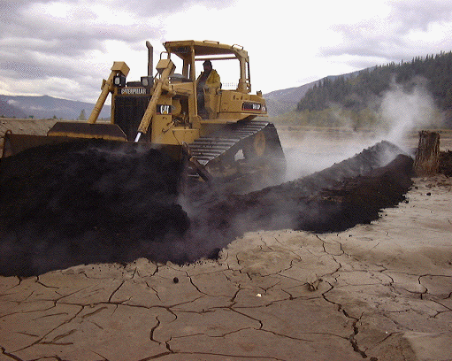
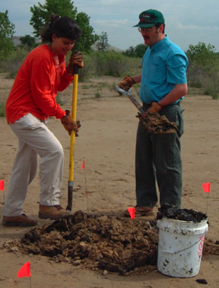
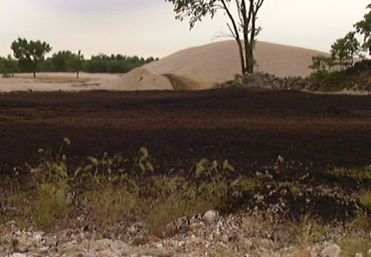
Surface application of biosolids and wood ash
Biosolids sugar beet lime, CaO
Biosolids and lime, incorporated
Lime stabilized biosolids + Fe
Surface application of compost and wood ash

Slide 17
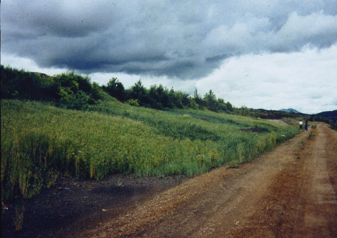
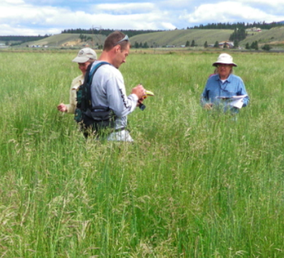
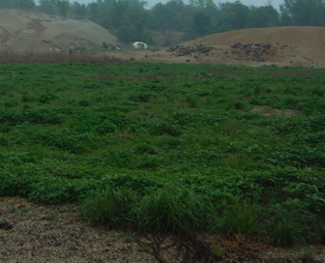
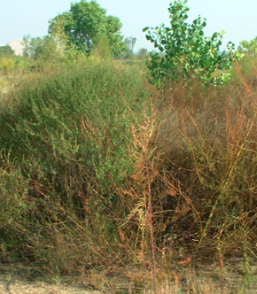
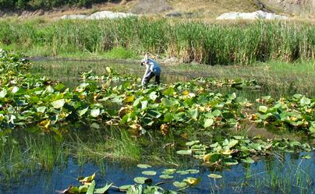

Slide 18
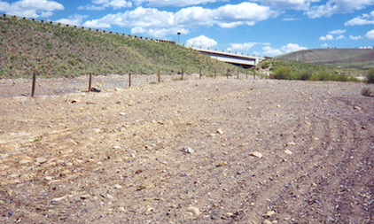
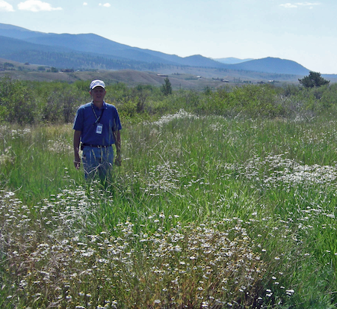
Amendments work

Slide 19
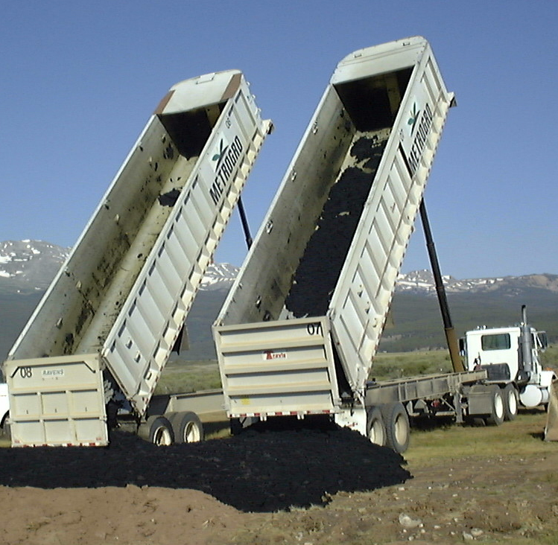
But they can be a pain
Working with generators
Regulatory issues
Supply issues
Transport issue
Harvesting topsoil- easy and proven alternative

Slide 20
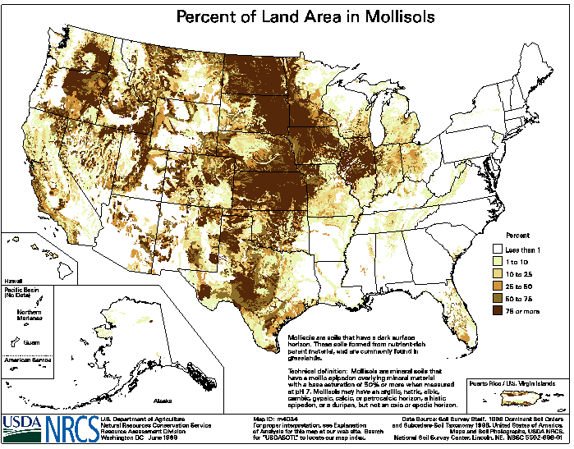
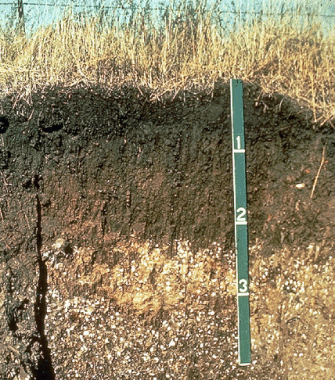

Slide 21
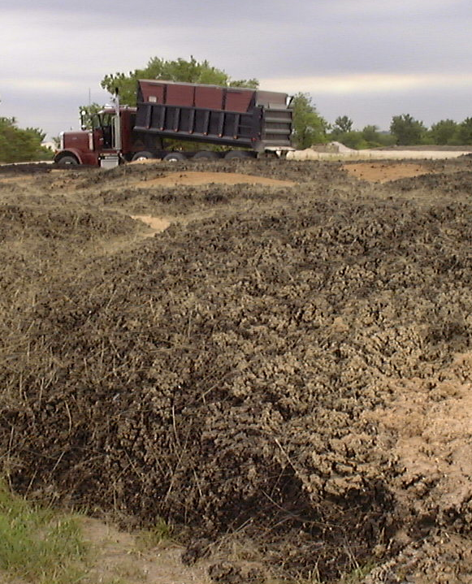
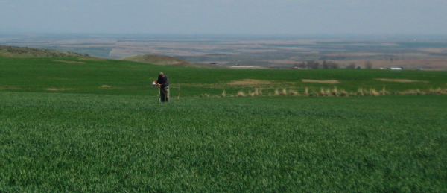
Environmental Costs
Topsoil replacement
15 cm
Biosolids/residuals
336 Mg

Slide 22
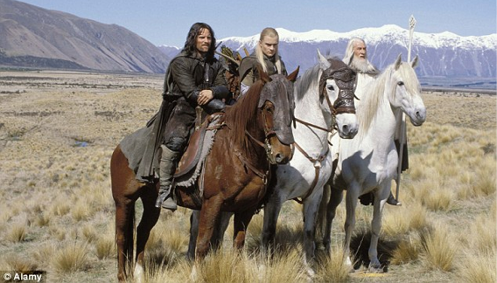
Topsoil
Current accounting
Ecosystem accounting
Pay the farmer
Pay the transport
Attempt to put a value on the services we get from nature
1997 Ecosystem services worth $33 trillion annually
17% of New Zealand GDP from soil

Slide 23
Rather than
Rate of soil formation
0.058 to 0.083 mm yr⁻¹
1875-1900 years to replace top 15 cm
No farming during that time
USDA Conservation Reserve Program
$241,000 per ha

Slide 24
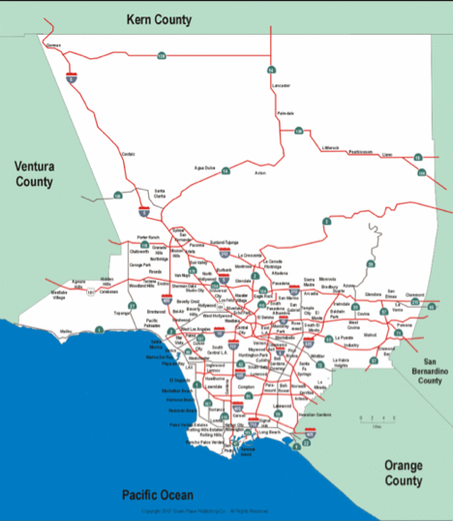
607,000 hectares of mine impacted lands = 6700 km²= 0.5 Los Angeles
6700 km² = 670,000 ha
670,000 * $ 241 000
$160.8 Billion

Slide 25
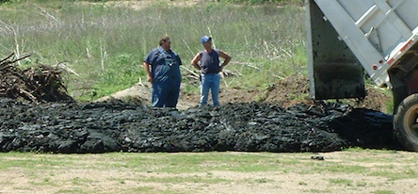
Residuals instead then
Biosolids
MO produces 227,000 dry tons annually
60% are incinerated
136,200
Enough for 402 ha per year

Slide 26
$$ of biosolids (as CO₂e) per 336 tons or 1 ha
Combustion
Energy to dry 1.2
Fugitive N2O emissions 483
Transport 0.6
Total emissions
485 tons CO₂ per ha
Restoration
Fertilizer credit -80
Soil carbon storage -89
Transport 8
Total sequestration
-156 tons CO₂ per ha

Slide 27
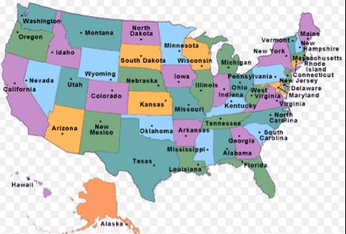
607,000 hectares / 402 ha biosolids per year 1 667 years
7.2 million tons produced annually
50% beneficially used = 3.6 million tons available
10,714 acres per year = 57 years

Slide 28
People aren’t the only things that poop
Animal | Animal number | Total US dry tons produced
 | million
Dairy Cow
 | 9 | 18.6
Beef Cattle
 | 25.8 | 32.8
Swine
Finish | 120 | 26.4
Poultry
Layer | 292 | 2.8
Broiler | 8 600 | 55.4

Slide 29
Conclusions
Residuals based restoration effective over long term
Animal endpoints
Plant endpoints
Alternate accounting
True cost of soil harvesting
True value of residuals based approaches

