Slide 2
Mine Restoration Using Municipal BioSolids

Slide 3
Mine Restoration Using Municipal BioSolids Vegetation – “Hello” !

Slide 4
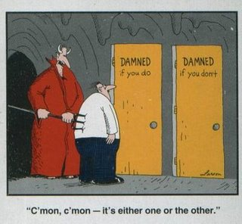
Mine Restoration Using Municipal BioSolids Vegetation – “Hello” ! Or Vegetation - Hell ?????

Slide 5
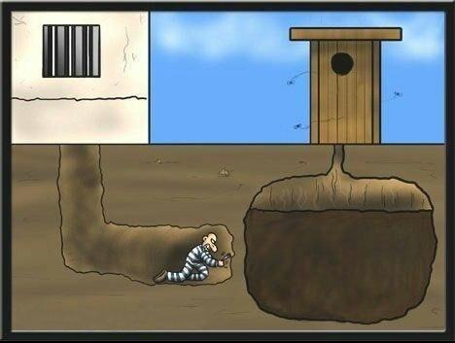
Mine Restoration Using Municipal BioSolids Finding a way out? Or Getting in deep doo-doo?

Slide 6
Vegetative Community Analysis of Biosolids Test Plots After Five to Ten Years of Growth
Rick Black (ENVIRON International)
Richard K. Borden (Rio Tinto)

Slide 7
THEN
1863 - The hill that is to be the Bingham Canyon Open Pit Copper Mine - Kennecott Utah Copper
Notes:
In the early days -- from about 1863 to 1900 -- mining in Bingham Canyon was all underground. Miners dug tunnels into the mountain with picks, shovels, and dynamite. At that time, they were mostly looking for lead, gold, and silver. The riches of the mountain attracted miners from all over to Bingham Canyon. By 1874, the population in the canyon reached 1,400 -- and growing. As the mining operation grew, the Utah Copper Company kept adding more efficient equipment. That allowed them to remove greater amounts of ore and boosted daily production. By the 1930s, "The Hill" was mostly gone and had started to become "The Pit."

Slide 8
NOW
2012
The Bingham Canyon Open Pit Copper Mine
Kennecott Utah Copper
Notes:
Back in 1906, the steam shovels of the Utah Copper Company removed 100,000 tons of material per month. Today, Kennecott Utah Copper removes 500,000 tons of material every day! Kennecott's Bingham Canyon Mine has produced more copper than any mine in history -- more than 17 million tons. Plus, it has produced 23 million ounces of gold, 190 million ounces of silver, and 890 million pounds of molybdenum.The Pit is now about 3,960 feet deep, and still growing. Engineers estimate that it can go about another 650 feet deeper. At that point, it would cost too much to haul the ore out of the mine and Kennecott Utah Copper couldn't make a profit.

Slide 9
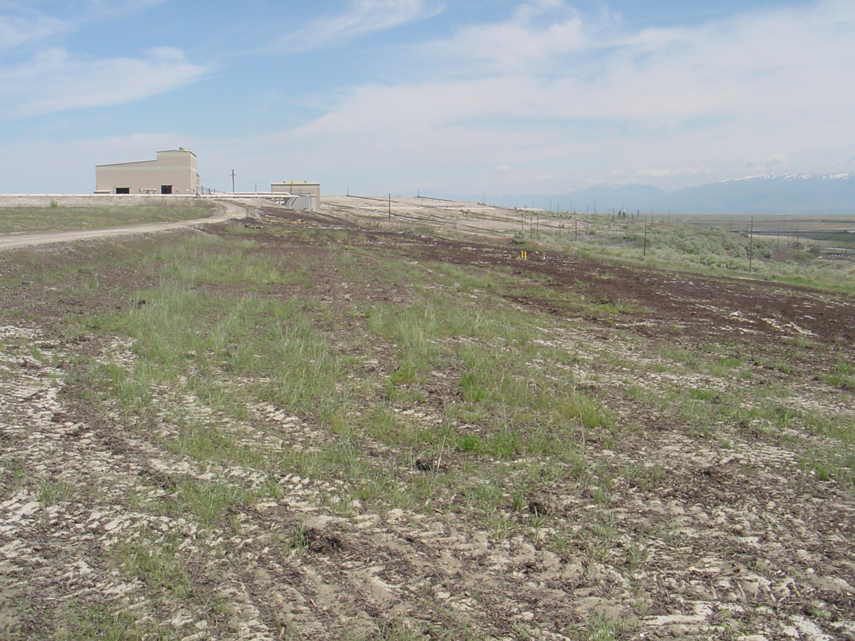
“Development that meets the needs
of the present generation,
without undermining the capacity of
future generations to meet their needs.”
Notes:
Development that meets the needs of the present generation without undermining the capacity of future generations to meet their needs.”
9

Slide 10
South Salt Lake Biosolids
Notes:
Composted Municipal and Human Waste. At South Salt Lake Biosolids, they mix the Biosolids with green waste - primarily wood chips. The application of municipal biosolids during reclamation has been gaining acceptance in recent years.

Slide 11
Inexpensive
Delivered on site
Dust cover
Organic matter
Moisture Retention
High in nitrogen
Notes:
The material is often free, or at the most, the cost of delivery. It provides a dust cover. Biosolids provide organic material in a very non-organic substrate. Biosolids are rich in nitrogen.

Slide 12
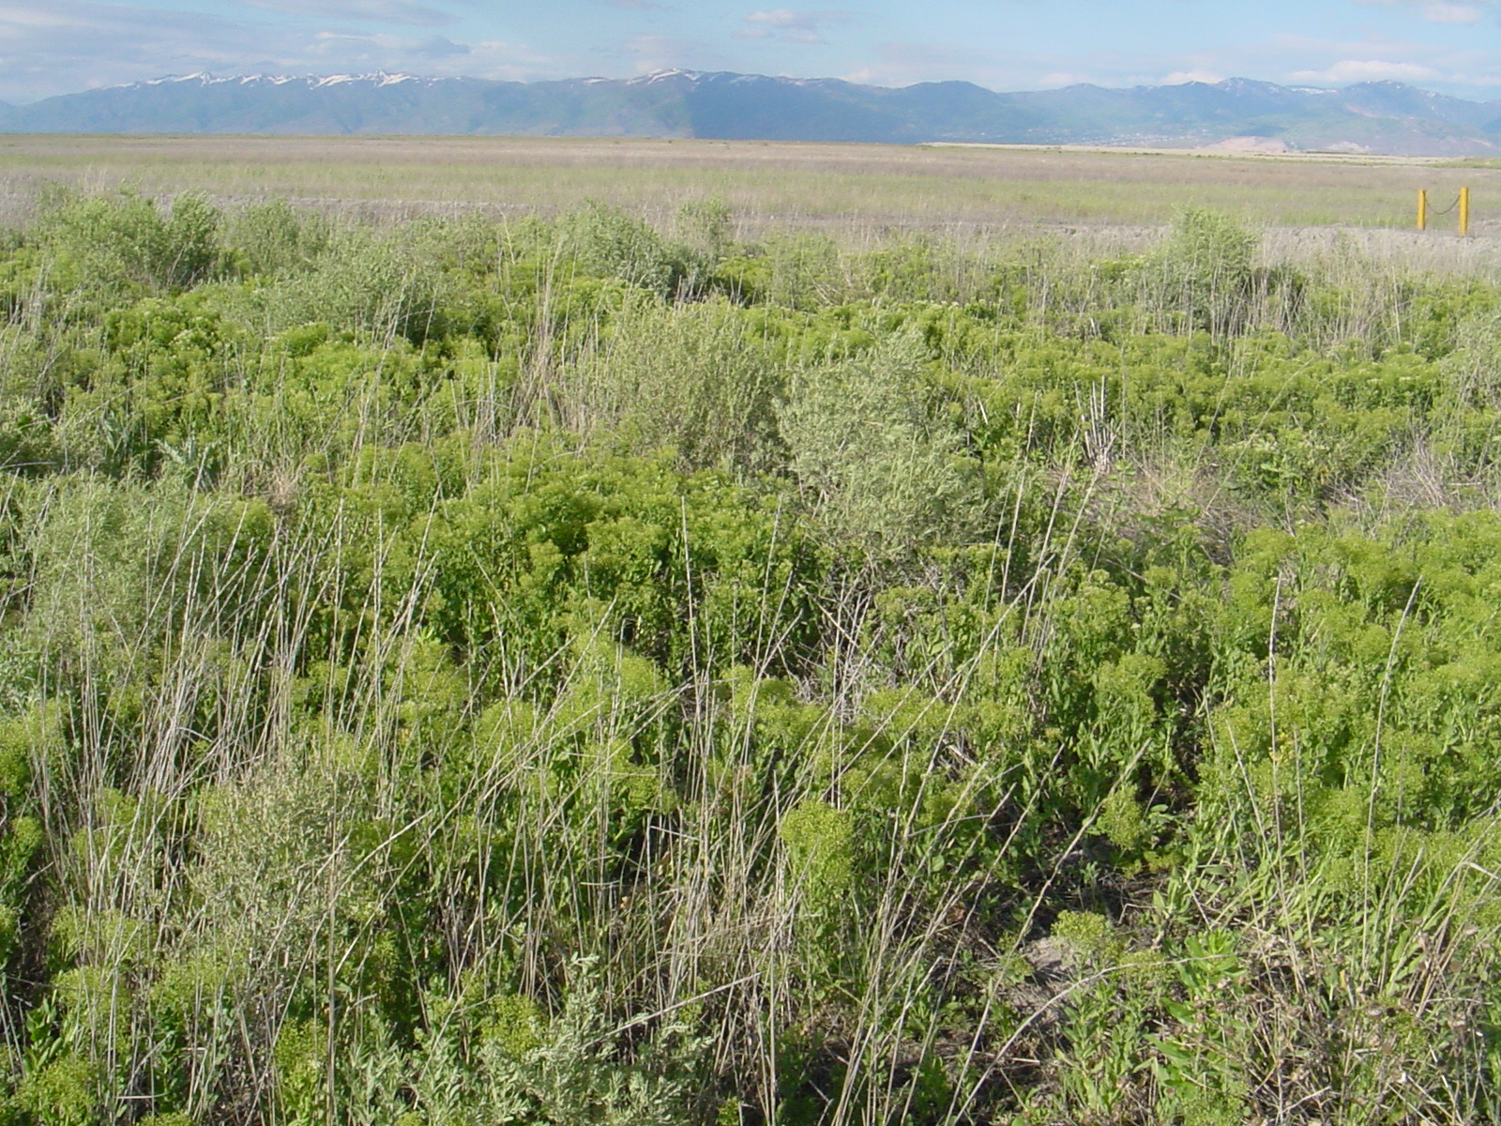
Reclamation Test Plots established in 1995 and in 2000
Semi-Arid climate
Annual Precipitation = 15-20 inches
Elevation between 4400 and 6200 feet
Notes:
Several reclamation test sites were established at the mine in 1995 and 1996. These sites were designed to test the effect of biosolids (composted municipal sewage sludge) application during the reclamation of tailings, waste rock and gravel-pit surfaces. The study area has a semi-arid climate and average annual precipitation varies between about 15 and 20 inches/year. The test plots are located between 4400 and 6200 feet above mean sea level.

Slide 13
Reclamation Test Plots established in 1995 and in 2000
Tailings
Waste-rock dumps
Gravel-pit surfaces
Lime Treatment
Top Soil Treatment
Bio-Solid App.s 0,10,15,20,30 tons/ac
Notes:
Several reclamation test sites were established at the mine in 1995 and 1996. These sites were designed to test the effect of biosolids (composted municipal sewage sludge) application during the reclamation of tailings, waste rock and gravel-pit surfaces. The study area has a semi-arid climate and average annual precipitation varies between about 15 and 20 inches/year. The test plots are located between 4400 and 6200 feet above mean sea level.

Slide 14
Methodology
Test Plot Selection
Detailed documentation available on establishment date and treatment received
Plots were older than 5 years (7-10 in some cases)
Plots had not been disturbed since establishment
Location and borders of plots identifiable in the field
Notes:
Test plots were selected for analysis if they met the following criteria: 1) documentation was available that detailed the treatments each plot received when it was established, 2) the plots were more than five years old, 3) the plots had not been disturbed since establishment, and 4) the location and borders of the plots could be confidently identified in the field

Slide 15
Methodology
Vegetation Sampling
RelevÉ (“sample stand”) method - Barbour et al. 1987
Absolute percent cover of each plant species - Braun-Blanquet
Notes:
Average Absolute Cover for each test plot was calculated by averaging the median-point of the Braun Blanquet cover classes for each species at each of the quadrats (sub-plots). These average absolute cover values for each species was totaled and reported as total absolute vegetative cover at each plot. The total absolute vegetative cover for any one plot can exceed 100% as there could be several layers of vegetation contributing to the total (grasses, forbs, shrubs).

Slide 16
Methodology
Vegetation Sampling
RelevÉ (“sample stand”) method - Barbour et al. 1987
Absolute percent cover of each plant species - Braun-Blanquet
Sociability of each plant species - Braun-Blanquet

Slide 17
Methodology
Methodology
Vegetation Sampling
RelevÉ (“sample stand”) method - Barbour et al. 1987
Absolute percent cover of each plant species - Braun-Blanquet
Sociability of each plant species - Braun-Blanquet
Vigor of each plant species

Slide 18
Site 01-04 Tailings (Elevation 4400 feet)
BioSolids
(20-30t/ac)
Non-BioSolids
Weedy | # Spp. |  | 2 |  |  |  | 2
Species | Cover |  | 11% |  |  |  | 88%
Non-Weedy | # Spp. |  | 5 |  |  |  | 1
Species | Cover |  | 60% |  |  |  | 0.2%
Total | # Spp. |  | 7 |  |  |  | 3
All Spp. | Cover |  | 71% |  |  |  | 88%

Slide 19
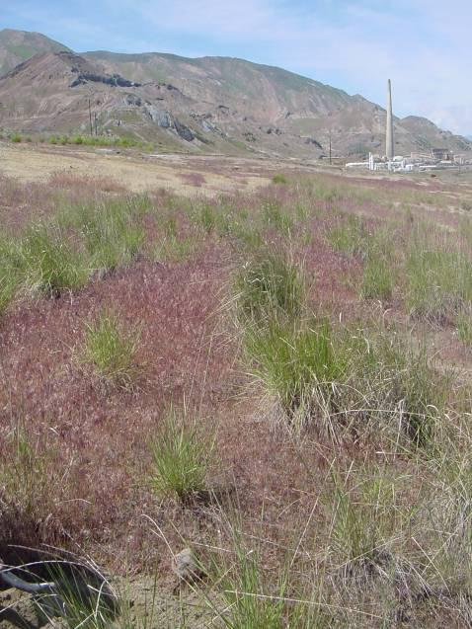
Site 01-05 Tailings (Elevation 4400 feet)
Non-BioSolids
BioSolids
(10-30 t/ac)
Weedy | # Spp. |  | 2 |  |  |  | 2
Species | Cover |  | 11% |  |  |  | 54%
Non-Weedy | # Spp. |  | 3 |  |  |  | 2
Species | Cover |  | 64% |  |  |  | 46%
Total | # Spp. |  | 5 |  |  |  | 4
All Spp. | Cover |  | 75% |  |  |  | 100%

Slide 20
Site 01-06 Waste Rock (Elevation 6150 feet)
BioSolids
(30 t/ac)
Non-BioSolids
Weedy | # Spp. |  | 3 |  |  |  | 4
Species | Cover |  | 6% |  |  |  | 92%
Non-Weedy | # Spp. |  | 2 |  |  |  | 2
Species | Cover |  | 16% |  |  |  | 0.4%
Total | # Spp. |  | 5 |  |  |  | 7
All Spp. | Cover |  | 22% |  |  |  | 93%

Slide 21
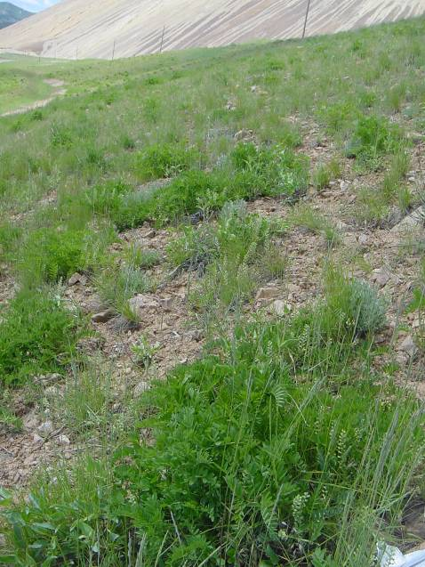
Site 01-06 Waste Rock &Soil (Elevation 6150 ft)
BioSolids
(30 t/ac)
Non-BioSolids
Weedy | # Spp. |  | 7 |  |  |  | 6
Species | Cover |  | 17% |  |  |  | 101%
Non-Weedy | # Spp. |  | 14 |  |  |  | 7
Species | Cover |  | 62% |  |  |  | 7%
Total | # Spp. |  | 21 |  |  |  | 14
All Spp. | Cover |  | 79% |  |  |  | 108%

Slide 22
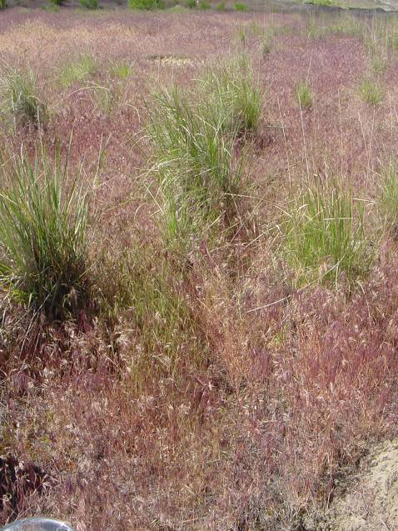
Site 01-07 Waste Rock (Elevation 6050 feet)
BioSolids
(30 t/ac)
Non-BioSolids
Weedy | # Spp. |  | 5 |  |  |  | 8
Species | Cover |  | 8% |  |  |  | 99%
Non-Weedy | # Spp. |  | 14 |  |  |  | 8
Species | Cover |  | 120% |  |  |  | 29%
Total | # Spp. |  | 19 |  |  |  | 16
All Spp. | Cover |  | 128% |  |  |  | 128%

Slide 23
Site 01-09 Gravel Pit–no lime (Elevation 5400 ft)
BioSolids
(0,15,20 t/ac)
Non-BioSolids
Weedy | # Spp. |  | 6 |  |  |  | 7
Species | Cover |  | 1.5% |  |  |  | 59%
Non-Weedy | # Spp. |  | 15 |  |  |  | 6
Species | Cover |  | 33% |  |  |  | 60%
Total | # Spp. |  | 21 |  |  |  | 13
All Spp. | Cover |  | 35% |  |  |  | 119%

Slide 24
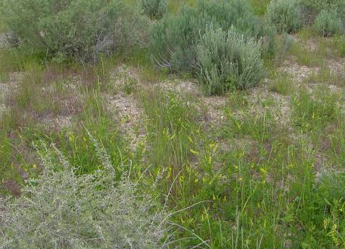
Site 01-09 Gravel Pit (Elevation 5400 ft)
BioSolids
(0,15,20 t/ac)
Non-BioSolids
Weedy | # Spp. |  | 4 |  |  |  | 7
Species | Cover |  | 0.7% |  |  |  | 85%
Non-Weedy | # Spp. |  | 14 |  |  |  | 3
Species | Cover |  | 48% |  |  |  | 25%
Total | # Spp. |  | 18 |  |  |  | 10
All Spp. | Cover |  | 49% |  |  |  | 110%

Slide 25
Comparison of Absolute Cover and Species Richness between Paired Test Plots

Slide 27
y=2.252x+16.958
R² = 0.7047

Slide 28
y = -1.825 + 75.774
R² = 0.3641

Slide 29
Comparison of Absolute Cover and Species Richness between Paired Test Plots

Slide 30
Notes:
Several reclamation test sites were established at the mine in 1995 and 1996. These sites were designed to test the effect of biosolids (composted municipal sewage sludge) application during the reclamation of tailings, waste rock and gravel-pit surfaces. The study area has a semi-arid climate and average annual precipitation varies between about 15 and 20 inches/year. The test plots are located between 4400 and 6200 feet above mean sea level.

Slide 31
Questions ?

