Slide 1
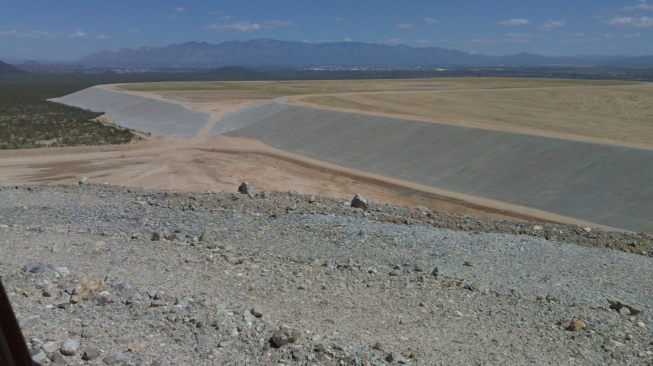



Characterization of Waste Rock Borrow Material for Use as Rock Armor to Reduce Tailing Impoundment Side-slope Erosion
Jason Keller, Mike Milczarek, Tim Hawthorne, Scott Rogers, Robert Litle, Tom Klempel, Matt Grabau, Robert Rice, Margaret Buchanan

Slide 2
Mission Mine Tailing Reclamation
Approximately 1200 acres of tailings
  350 acres of side-slopes
Rock armor slopes per bankruptcy agreement (Previous reclamation highly eroded)
Waste rock is cheapest source, but need:
  Erosion resistant material
  Non-acid generating, low metal leaching
  775,000 tons of material per 12 inches of depth
Revegetation not a primary criteria

Slide 3
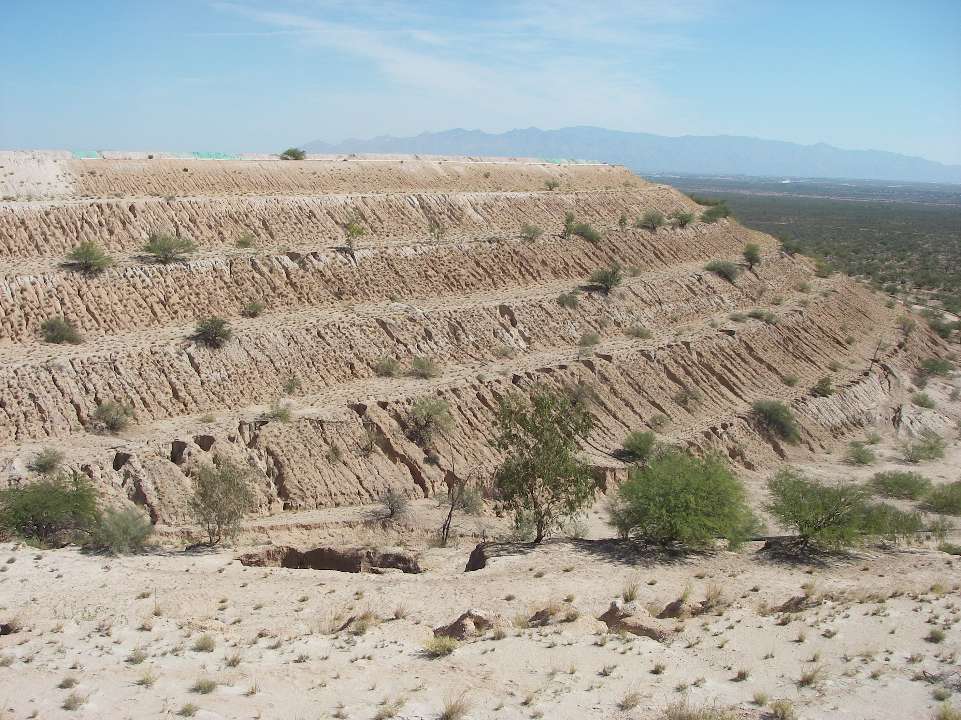
Historic Reclamation ASARCO Mission Tailing 1&2

Slide 4
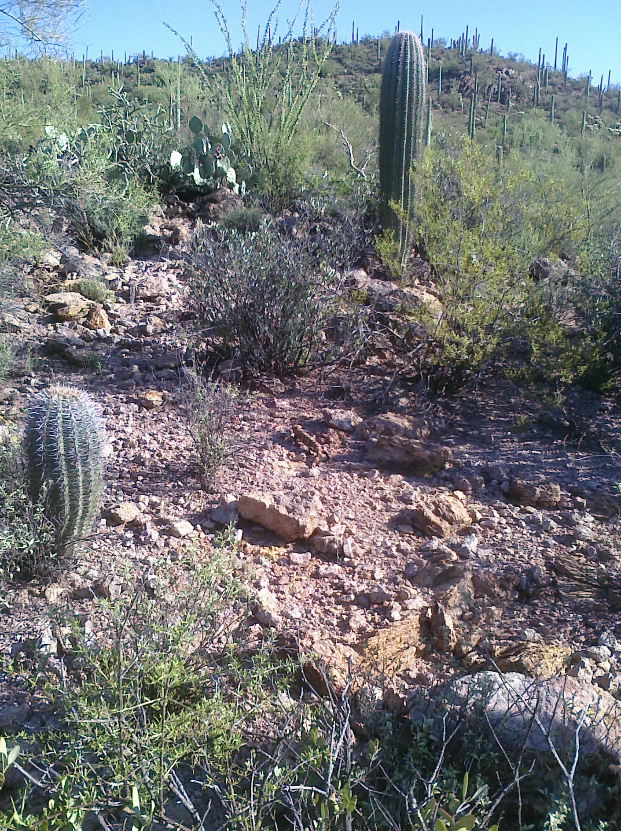
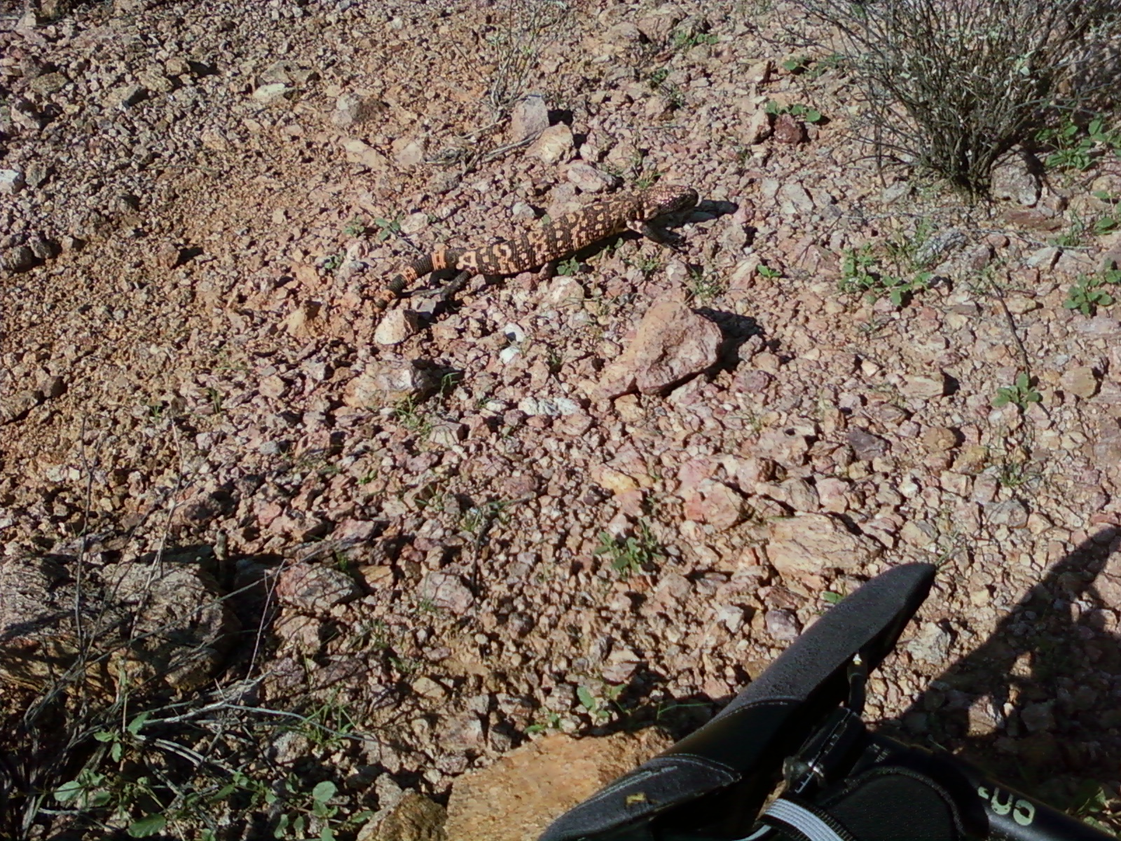
Natural Side-Slopes (Sonoran Desert)

Slide 5
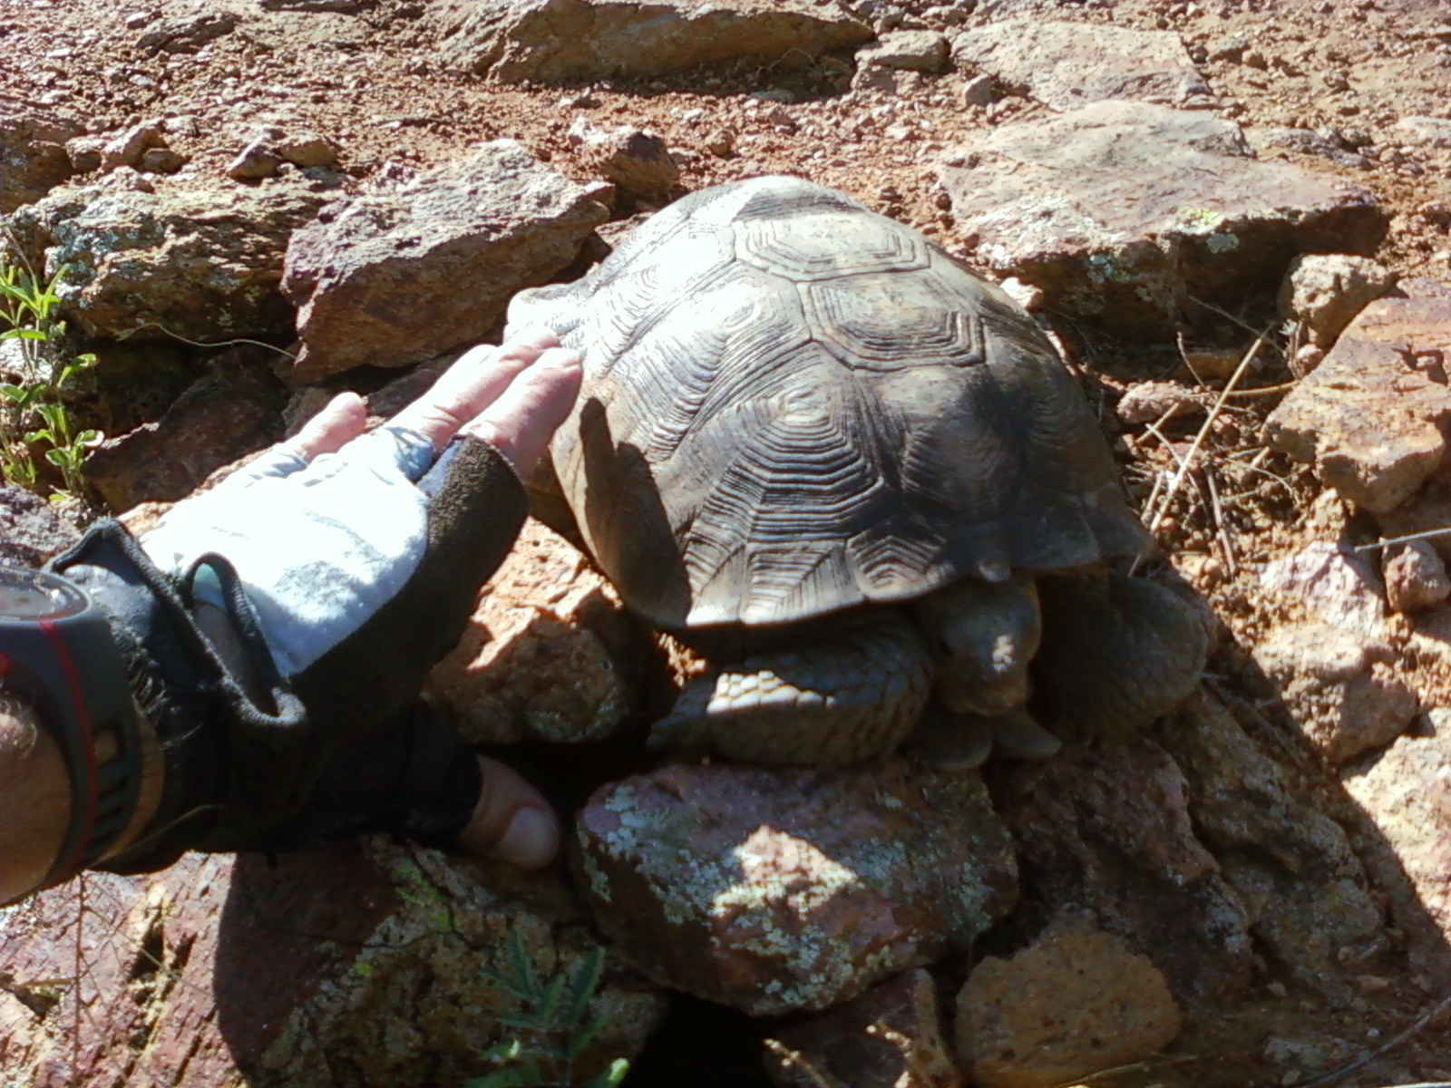
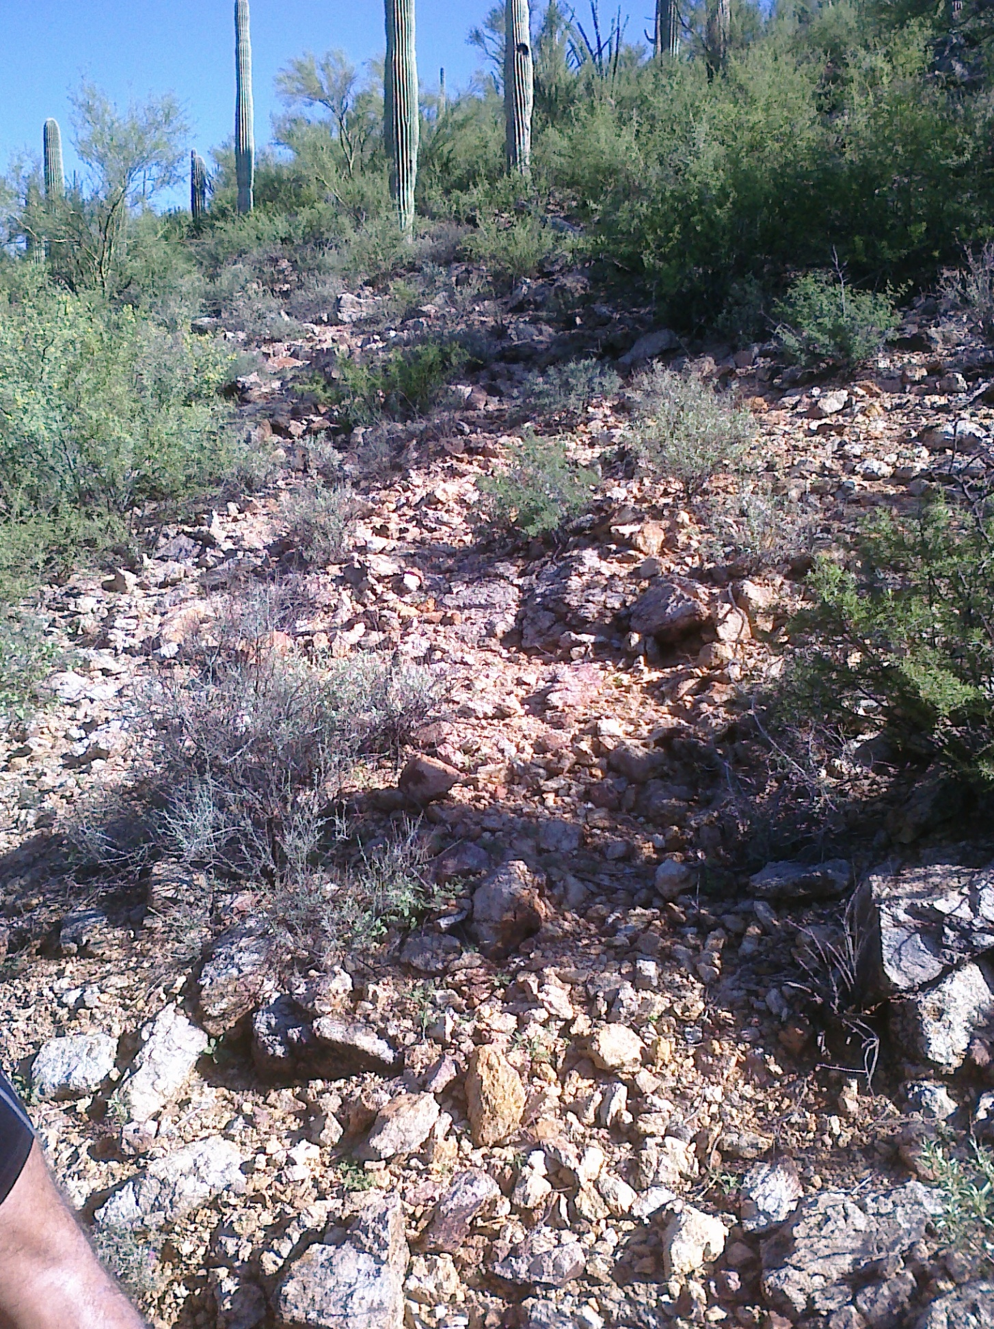
Natural Side-Slopes (Sonoran Desert)

Slide 6
Study Objectives
Identify rock armor sources with > 50% material > 0.5 inches (12.5 mm); geochemically not reactive
Waste rock borrow material assessment:
  Identify potential borrow material based on previous geochemical data
  Characterize particle size distributions (PSDs) and geochemical characteristics of various waste rock sources
  Evaluate potential phyto-toxicity, revegetation potential
Erosion analysis of borrow material:
  Erosion modeling (RUSLE2)
  Rock armor field erosion test

Slide 7
WASTE ROCK CHARACTERIZATION

Slide 8
Acid Base Accounting (ABA)
ABA provides indication of propensity of material to produce acid mine drainage
  Acid-neutralization potential (ANP) = assets
  Acid-generating potential (AGP) = liabilities
  Net neutralization potential (NNP) = ANP – AGP = equity
Favorable rock armor ABA criteria: NNP > 0 (ANP/AGP > 1)

Slide 9
Waste Rock Armor Sources
Potentially acceptable rock types
  Volcanics (low Acid Generating Potential (AGP), low Acid Neutralization Potential (ANP))
  Argillite (moderate AGP and ANP)
  Arkose (mix of high and low AGP, moderate ANP)
Six different source areas

Slide 10
Waste Rock
Characterization Approach
Test pits and trenches
  Visual logging of material types and oxidation levels
  Digital images of rock piles and trench walls
Composite and selected sample testing:
  Split-Net imaging – Particle Size Distribution (PSD) (n=189)
  Laboratory PSD (n=28)
  pH and Acid-Base Accounting (ABA) (n=111)
  Soil fertility and leachable metals (n=39)

Slide 11
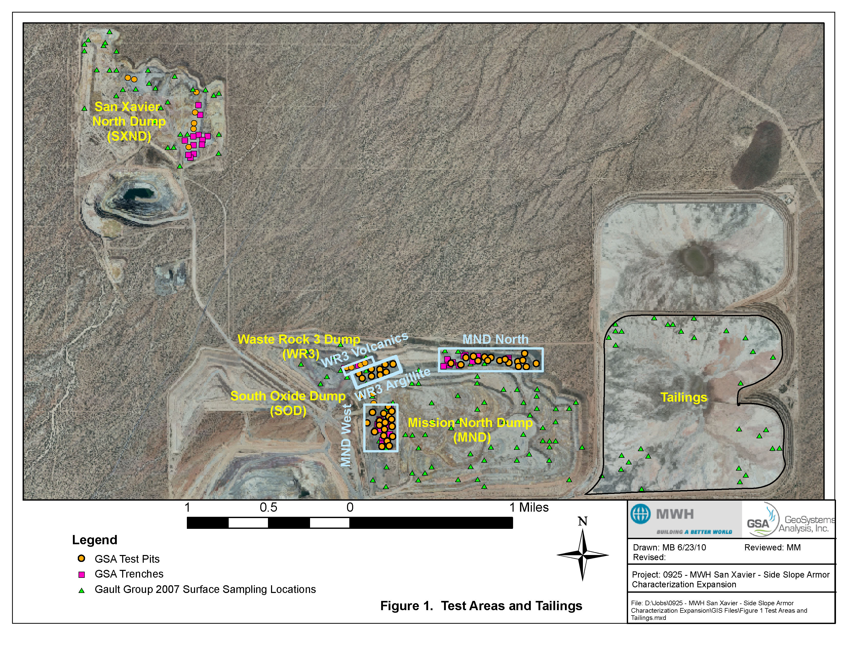

Slide 12
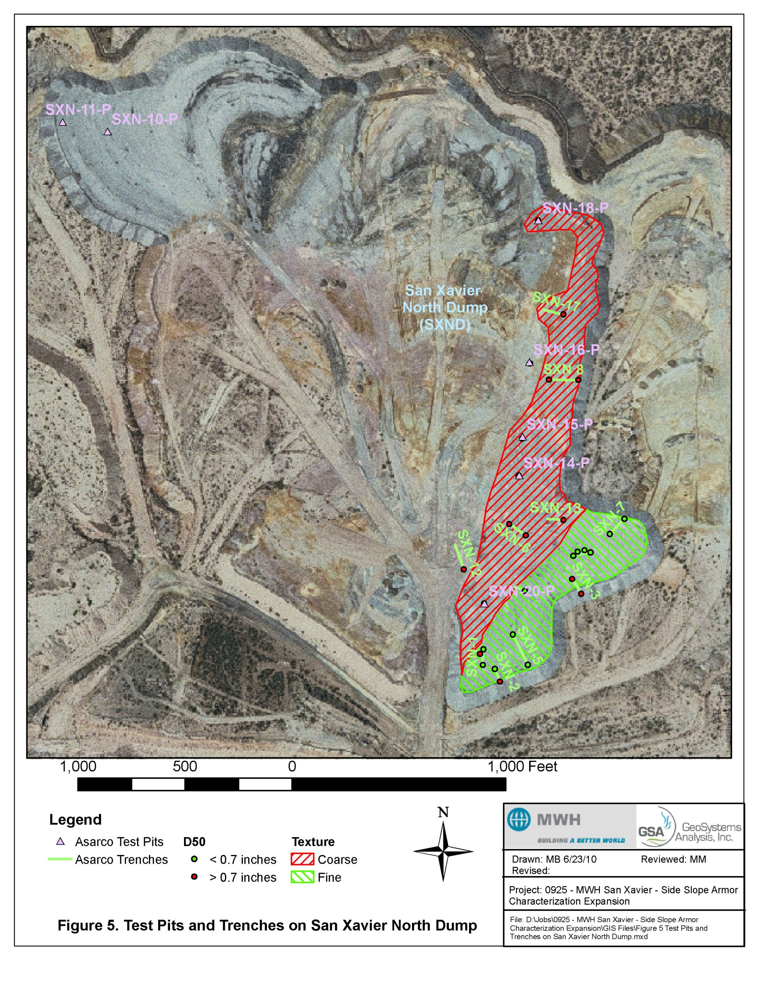

Slide 13
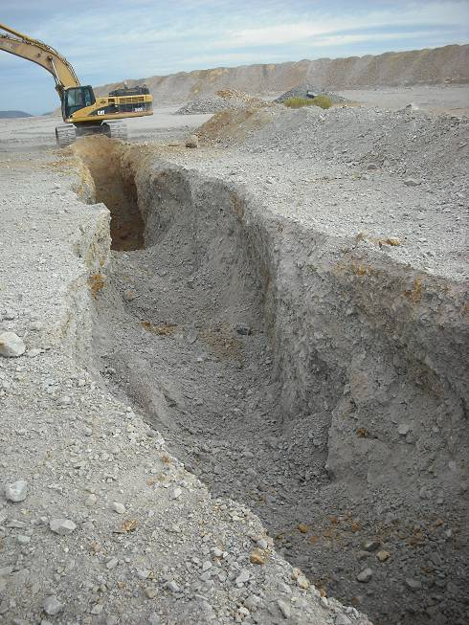
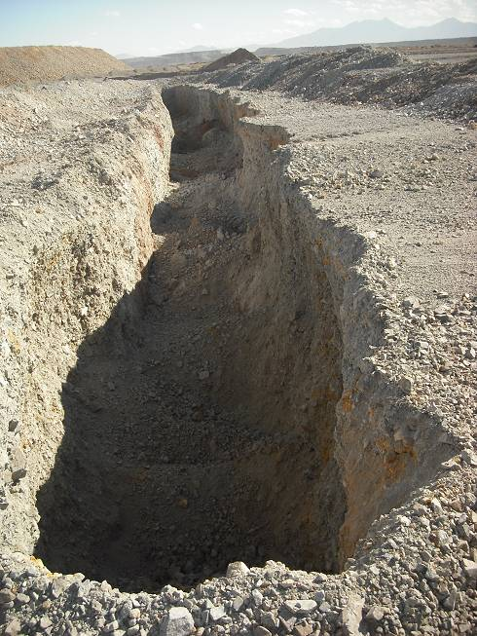
Trenching on MND West

Slide 14
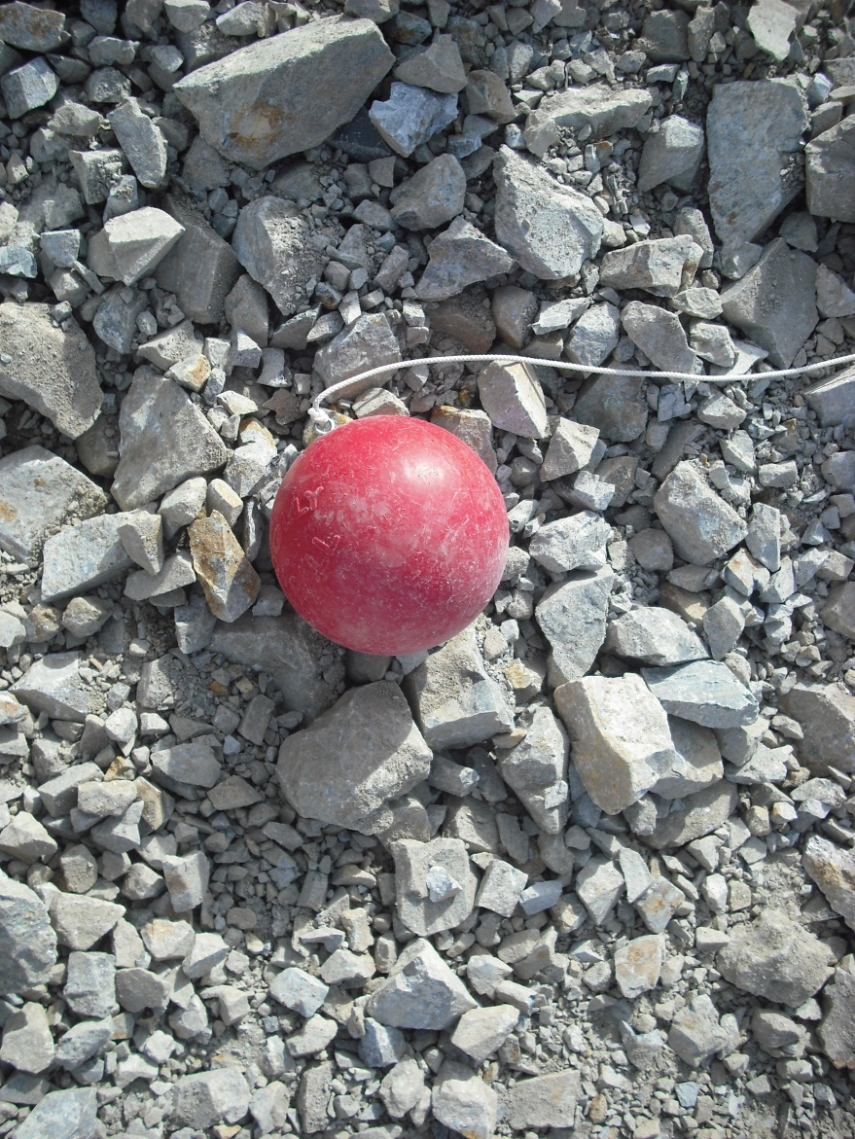
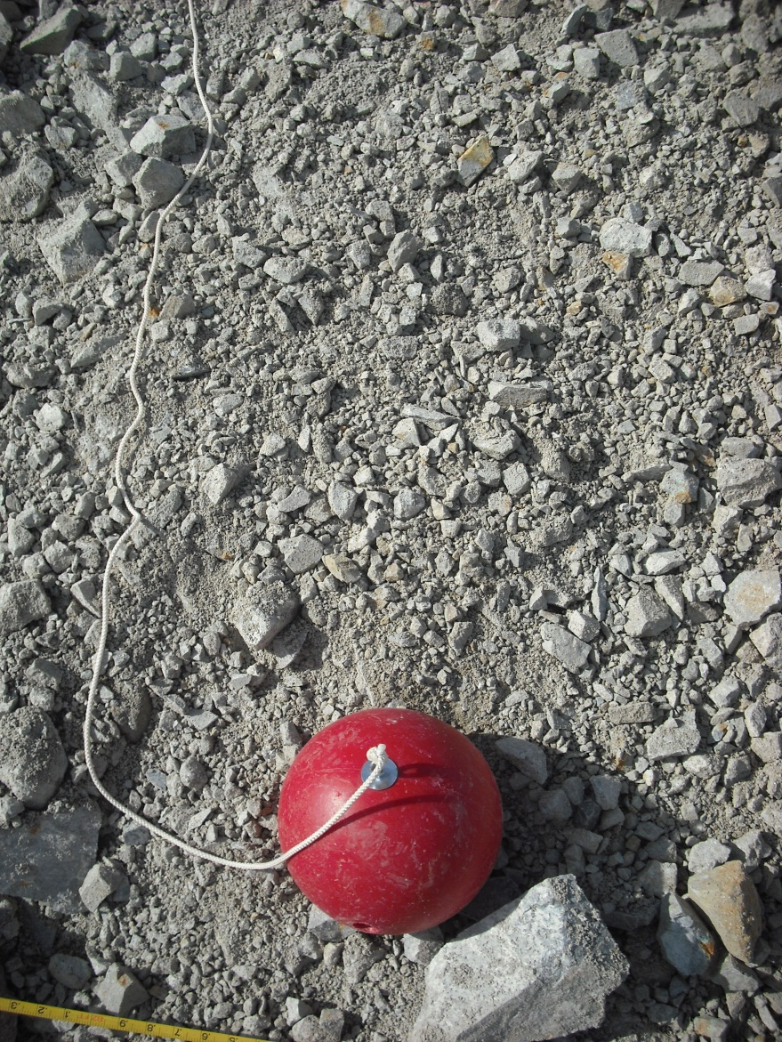
Split-Net Image Analysis

Slide 15
Characterization Results
Initial Screening
  WR3 Argillite: Significant oxidation and highly variable NNP
  WR3 Volcanics: 50% material < 0.2 inches
  SOD Area: 50% material < 0.4 inches and Negative NNP
  In-Pit Argillite: Negative NNP
  MND North Argillite, MND West Argillite, SXND Arkose meet screening criteria
Mean Particle Diameter
  MND North Argillite: 0.9 inches
  MND West Argillite: 0.8 inches
  SXND Arkose: Coarse = 1.5 inches; Fine = 0.3 inches
  Mean diameter minus one standard deviation still meets criteria
  More SXND Arkose material > 3.7 inches compared to MND Argillite material

Slide 16
Geochemical Data
MND North Argillite (n=27) | 2.1% pyrite sulfur, 119 tons CaC0₃/1000 tons | pH = 7.7 (91% samples pH > 7) | ANP/AGP = 1.73
MND West Argillite (n=35) | 2.1% pyrite sulfur 94 tons CaC0₃/1000 tons | pH = 7.6 (97% samples pH > 7) | ANP/AGP = 1.37
SXND Arkose (n=24) | 1.1% pyrite sulfur 56 tons CaC0₃/1000 tons | pH = 7.8 (97% samples pH > 7) | ANP/AGP = 1.83
Alluvium (n=10) | 0.15% pyrite sulfur 98 tons CaC0₃/1000 tons | pH = 7.6 (100% samples pH > 7) | ANP/AGP = 34

Slide 17
Soil Fertility and Metals Data
All samples showed moderate salinity (4 to 5 dS/m)
High copper values above potential phytotoxicity thresholds
Zinc and boron above potential phytotoxicity thresholds in some samples
Native plant species adapted to high-salinity or copper conditions may not be adversely affected

Slide 18
EROSION ANALYSIS

Slide 19
Erosion Analyses
Model potential erosion under various scenarios (using PSD data and RUSLE2)
  Fine, average and coarse argillite material
  150 to 600 foot slope length
  Furrowing and revegetation
  Vary percentage of “gravel” cover
Implement argillite field erosion test pads
  12 inches argillite over 12 inches alluvium
  Unripped, Ripped (6 inches and 24 inches)
Simulated rainfall with water truck spray:
  2 inch rain over 30 minutes (Test #1)
  4.5 inch rain over 60 minutes (Test #2)

Slide 20
Erosion Modeling Results
Predicted annual Argillite erosion rates increase with slope length (2X from 150 ft to 600 ft)
Furrowing along the contour on average decreases the predicted erosion by about 10%
Increasing the gravel cover by 10% reduces predicted erosion rates by approximately 25%
Coarse Argillite best
Limit Argillite use to 3:1 slopes < 300 ft

Slide 21
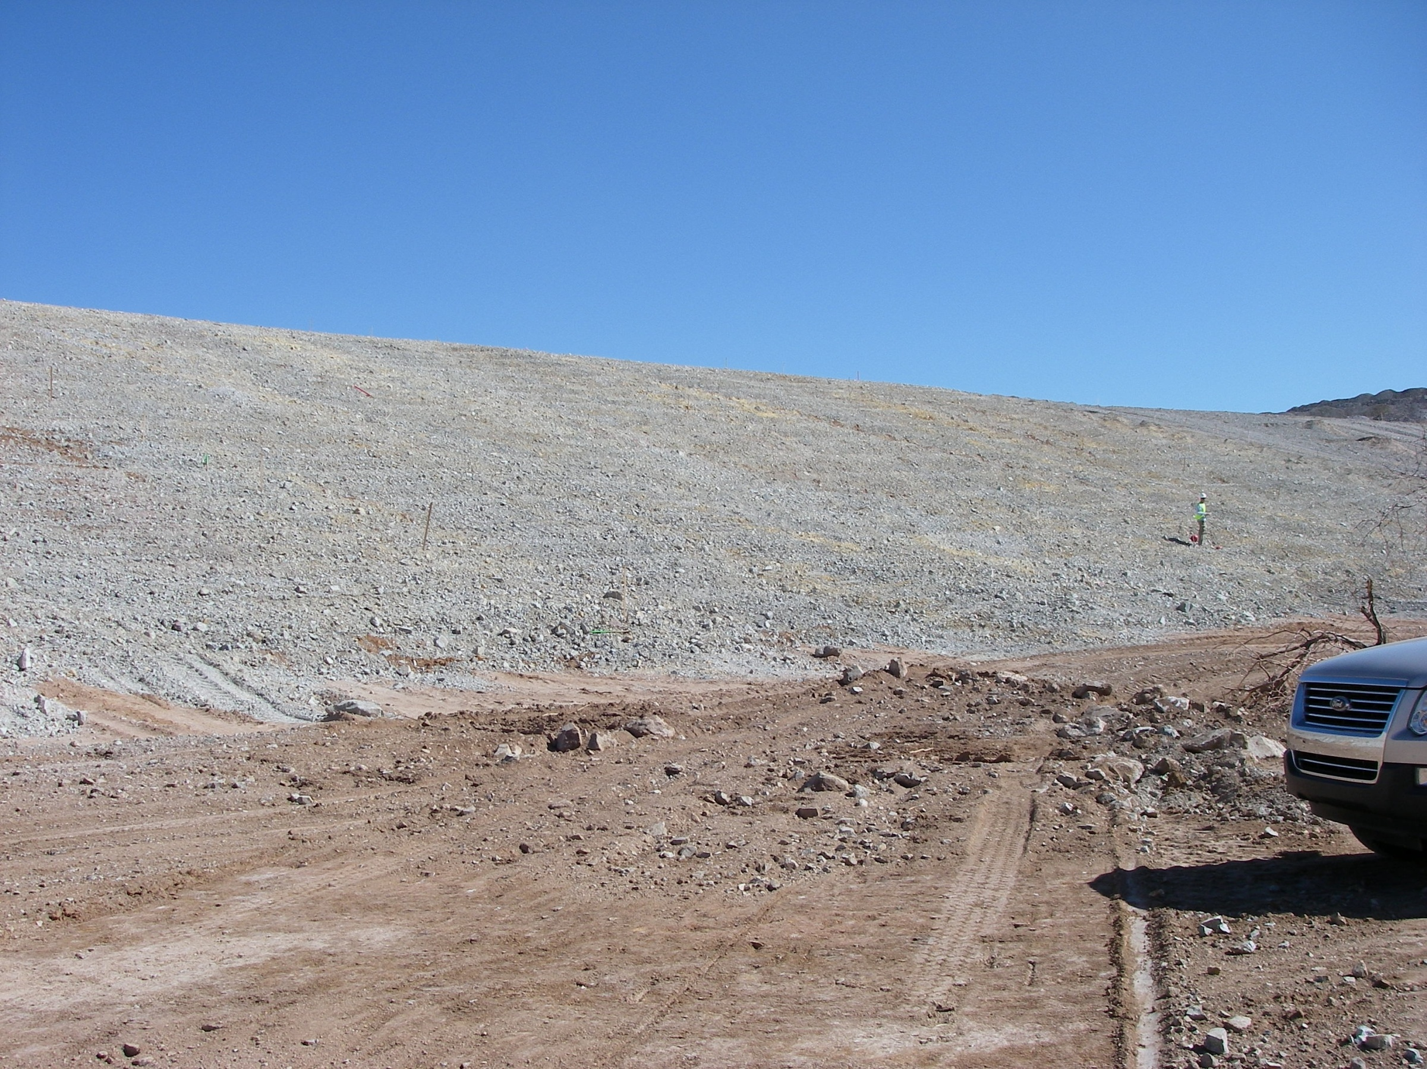
Erosion Test #2

Slide 22
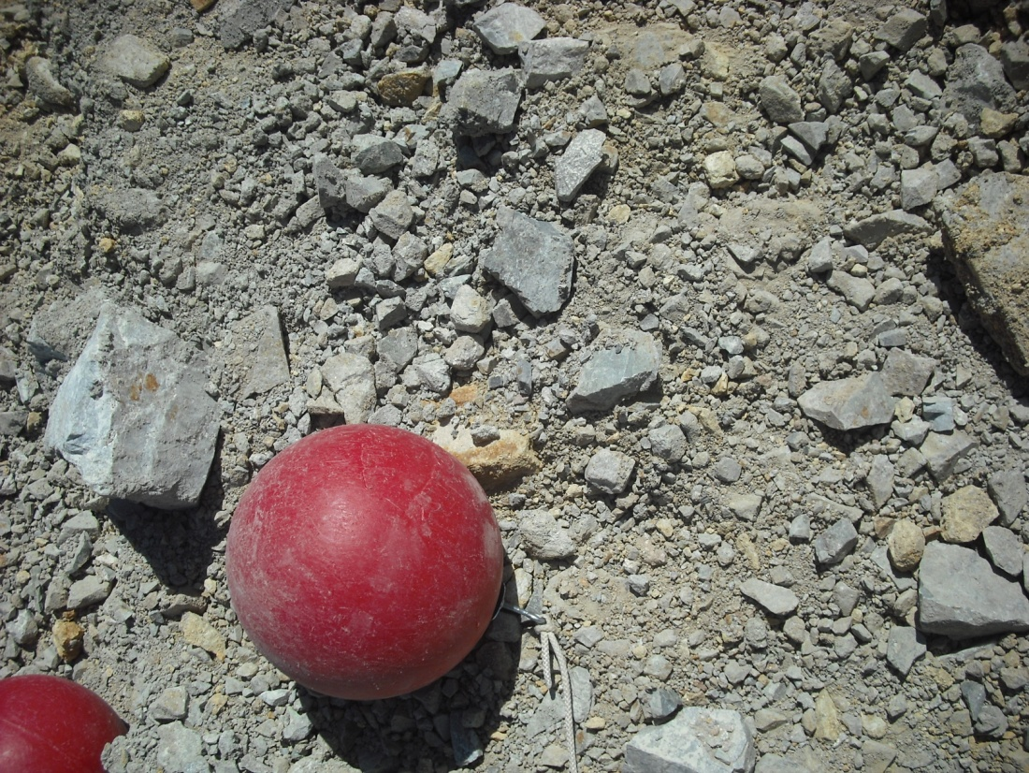
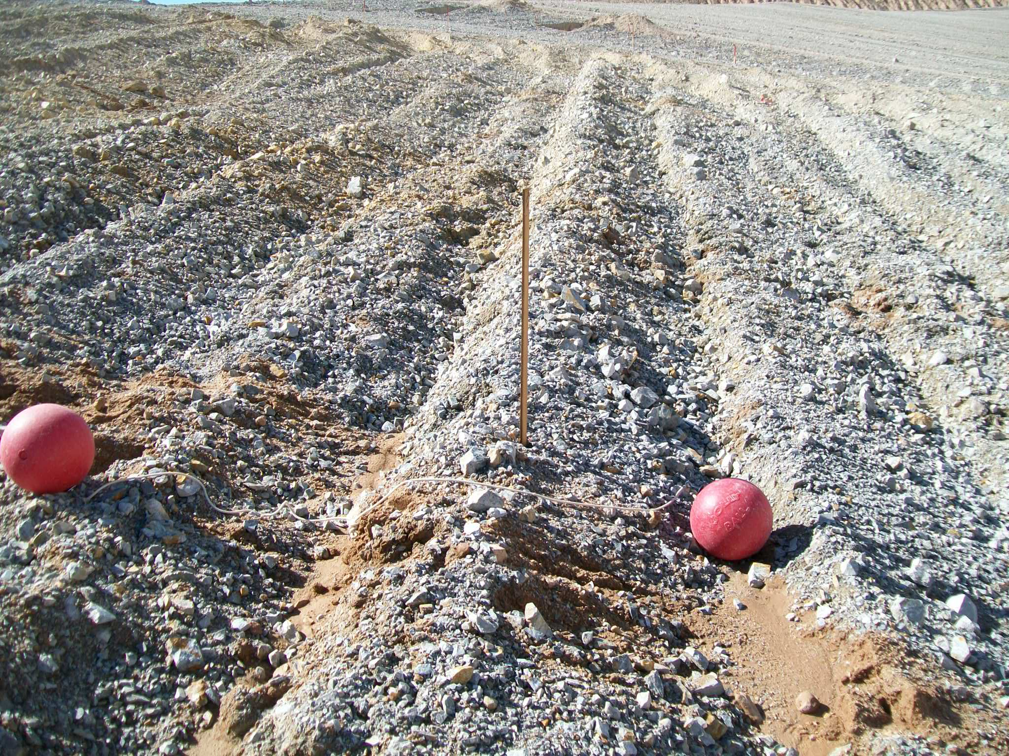
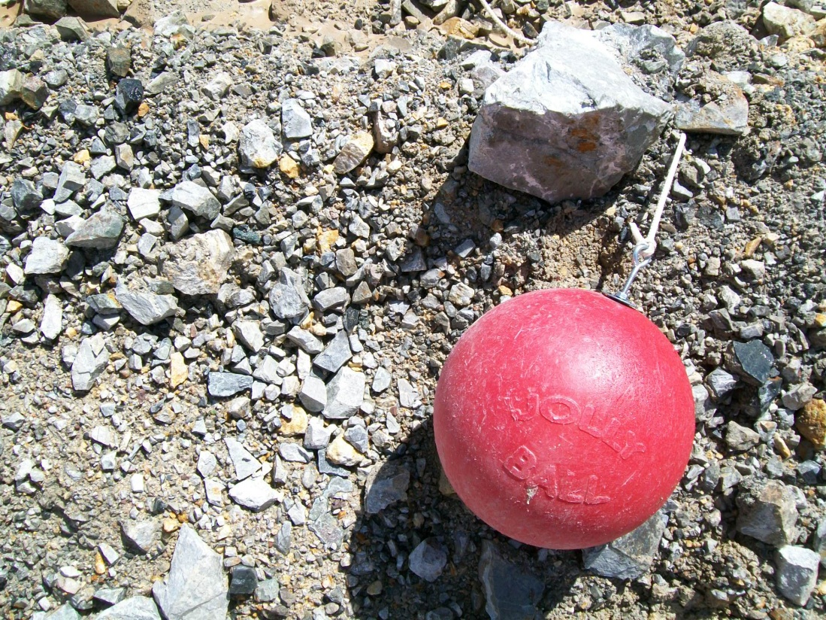
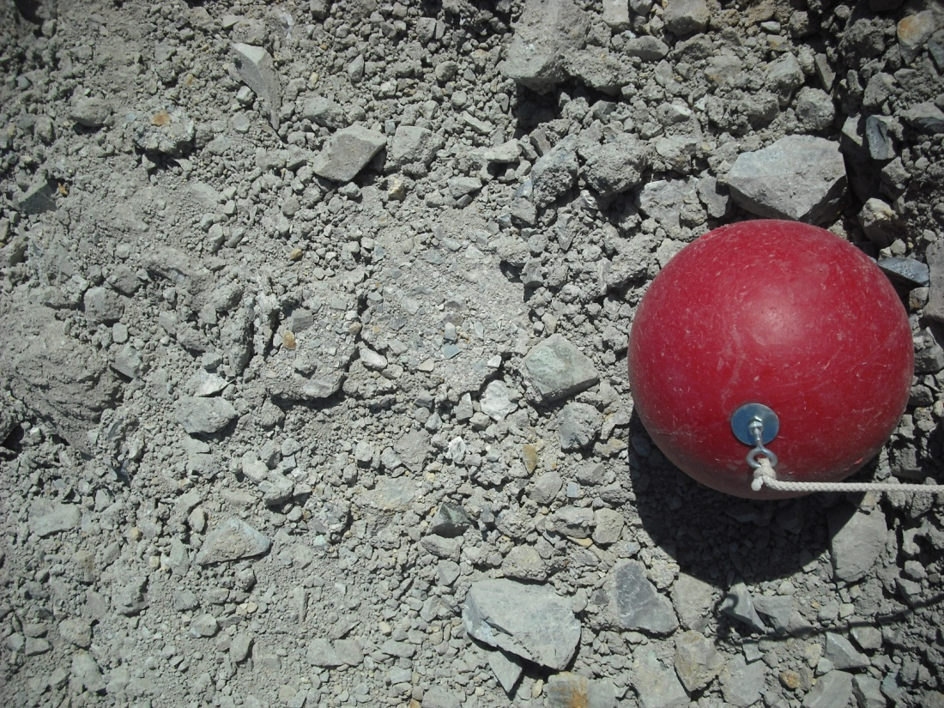
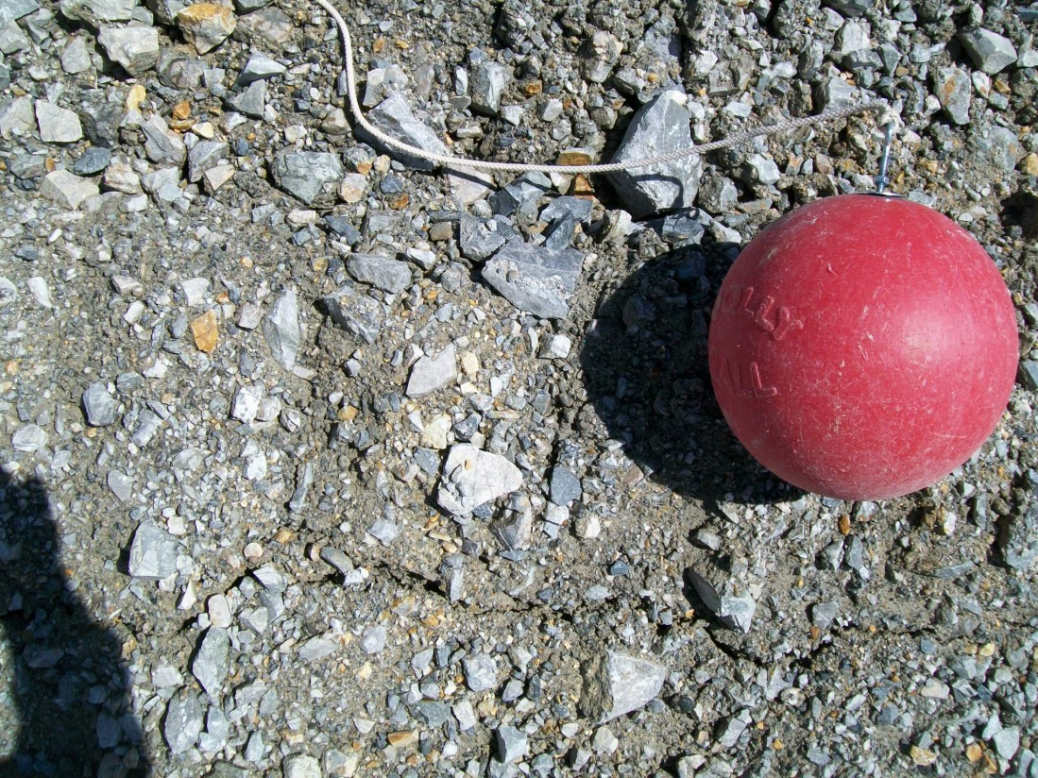
Before
After

Slide 23
Erosion Test Results
No significant differences in PSD between pre-and post-test ripping plots
Argillite ripped to 24 inches was most erosion resistant
Cascading and rilling observed where ripping not perpendicular to slope, or shallow furrows
Ripping treatments did not show effective mixing of the alluvium and argillite rock armor material

Slide 24
Conclusions
Waste rock armor that is erosion resistant and geochemically inactive is available
Side-slope reclamation design
  One foot of alluvium base over tailings (extra ANP, potential for rooting medium)
  One foot of rock armor material
Full-length slope design (no benches):
  MND West and North Argillite areas for use on slopes < 300 feet
  SXND Arkose areas for use on slopes > 300 feet
  Need to segregate visibly oxidized waste rock
Revegetation potential?? – recommend salt tolerant seed mix

Slide 25
THE REAL EROSION TEST

Slide 26
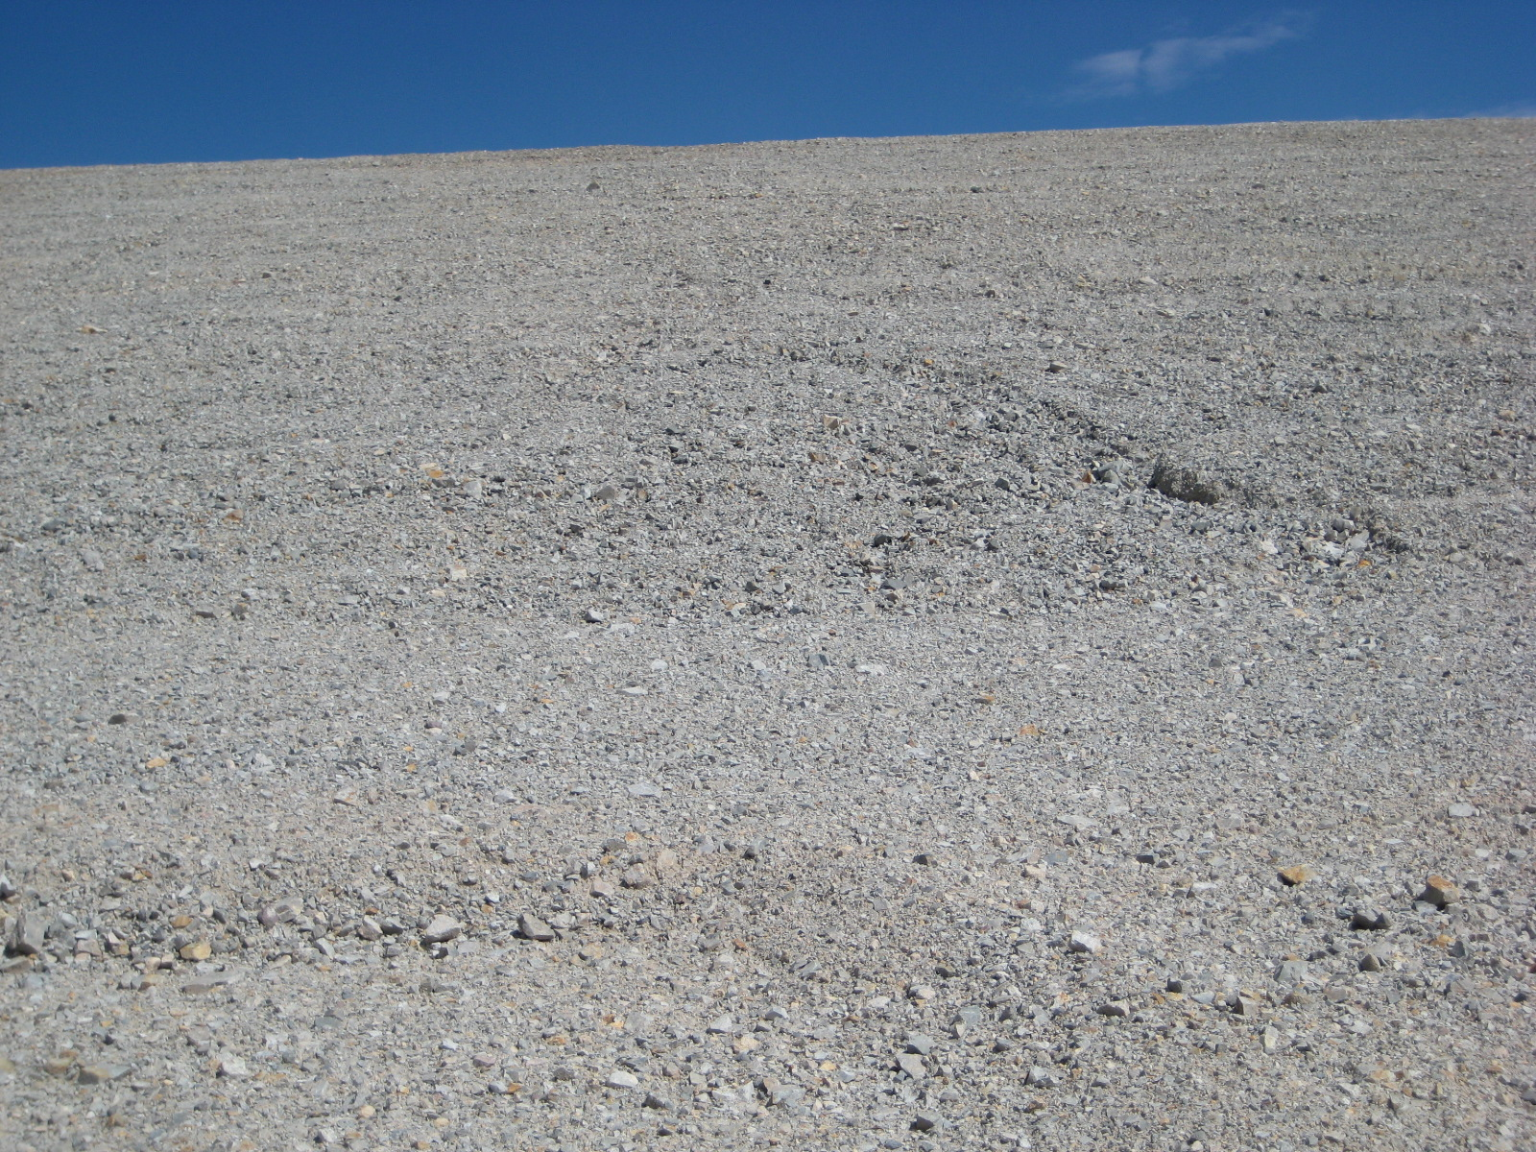
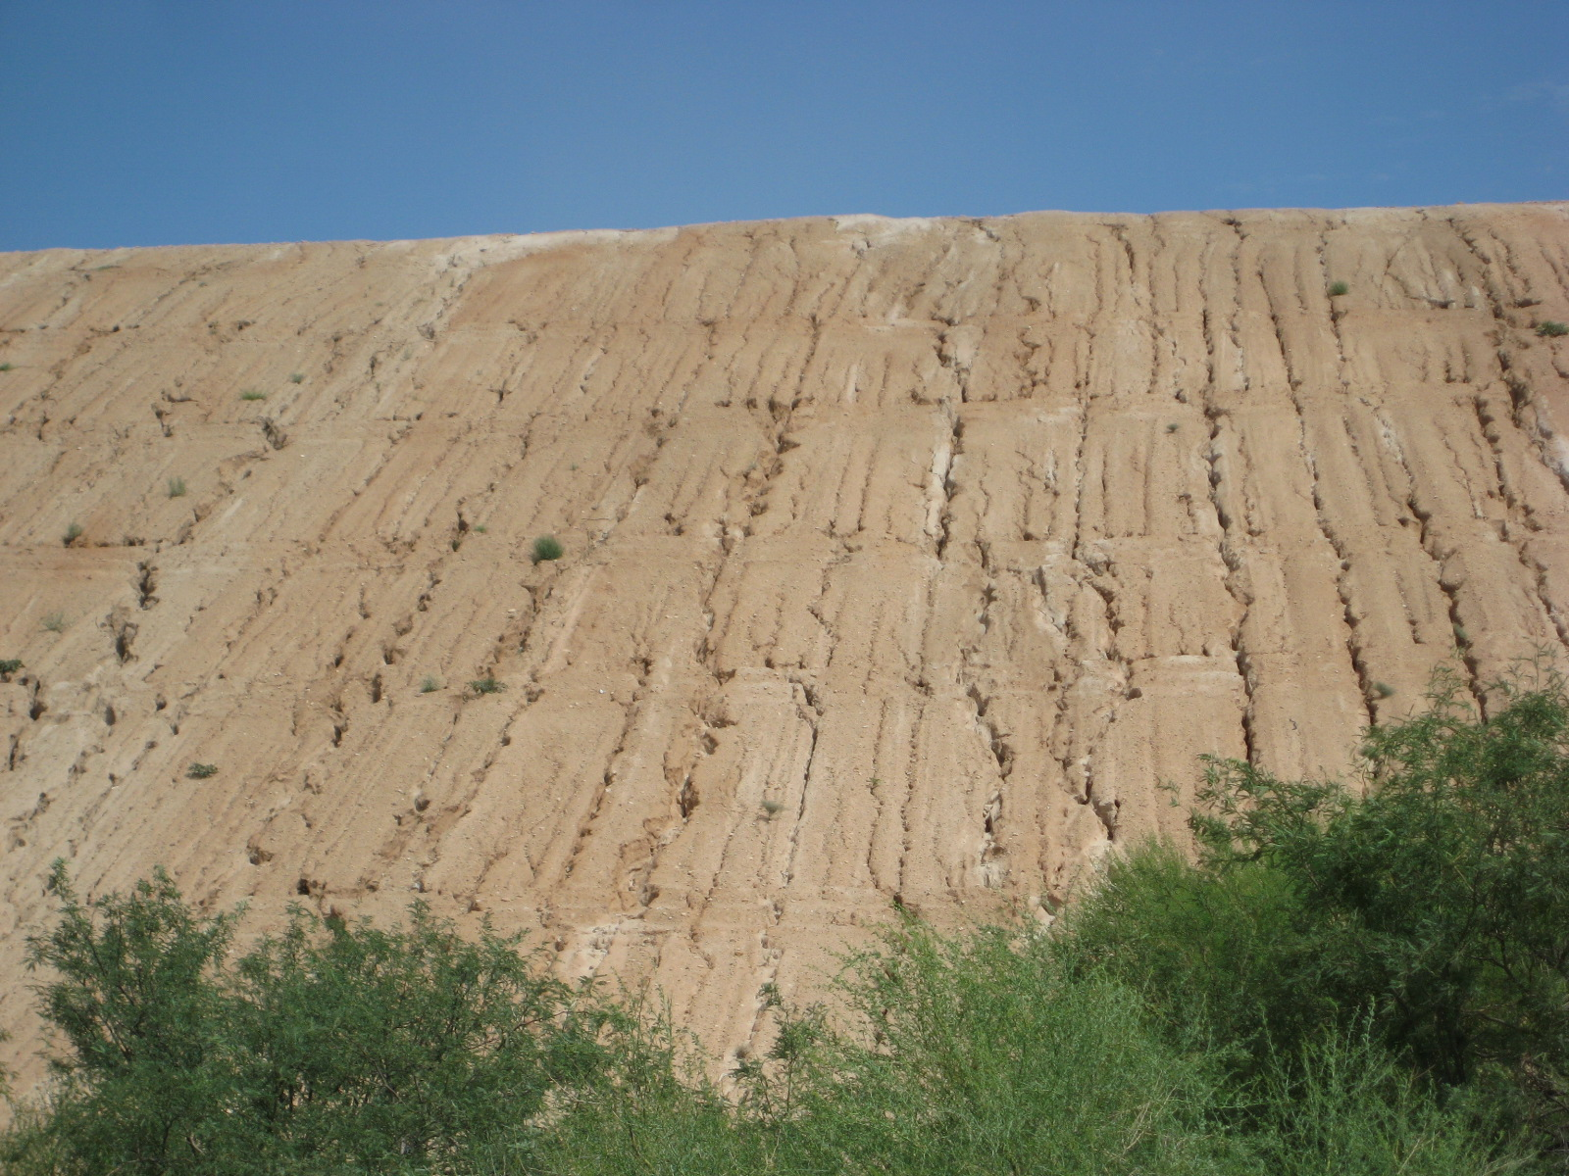
Erosion on alluvium
July 27 – 2.75 inch event (1 hour)
July 30 – 2.52 inch event

Slide 27
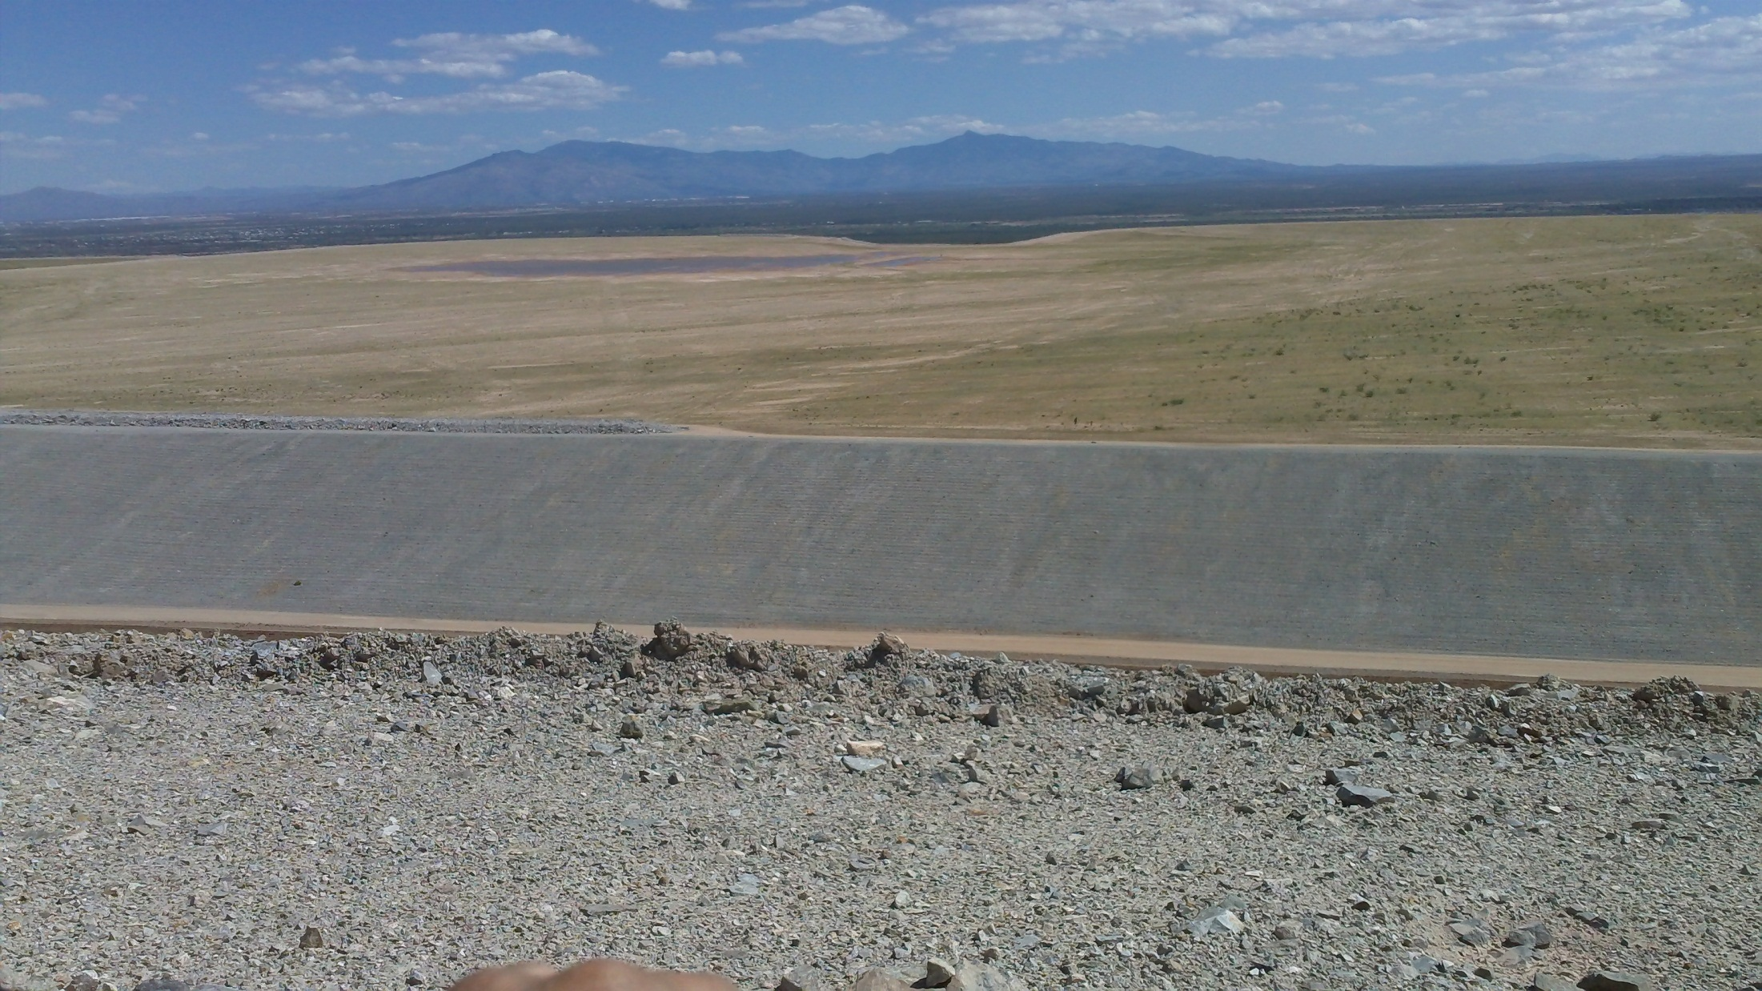
Tailing 1-2

Slide 28
Tailing 3

Slide 29
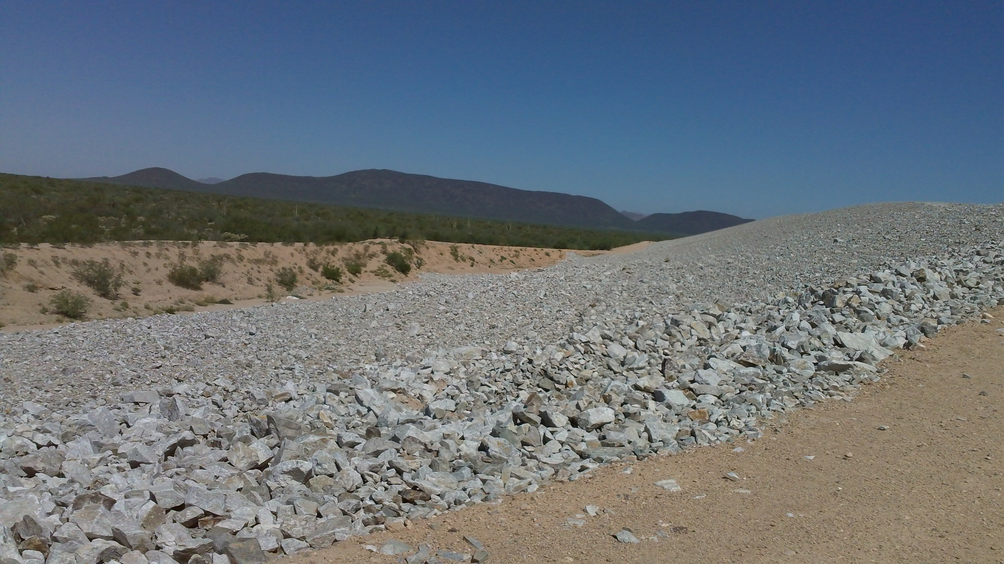
Arkose

Slide 30
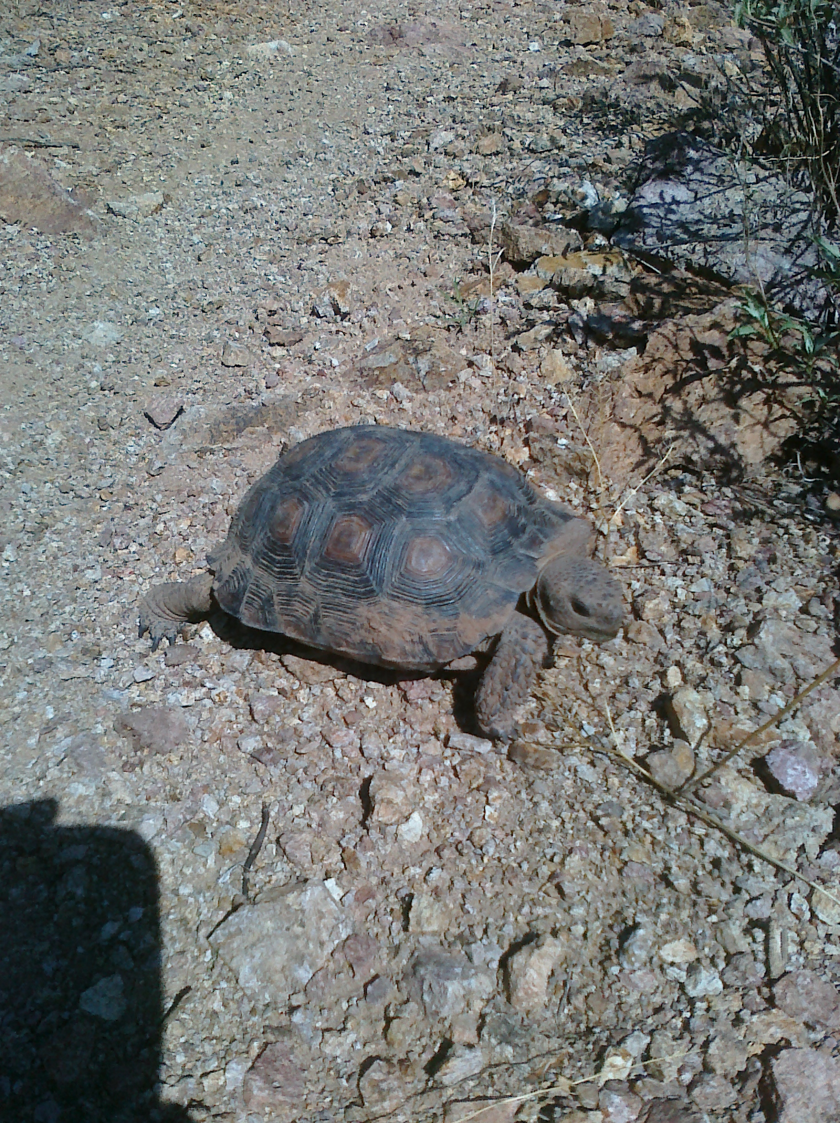
THANK YOU!

Slide 31
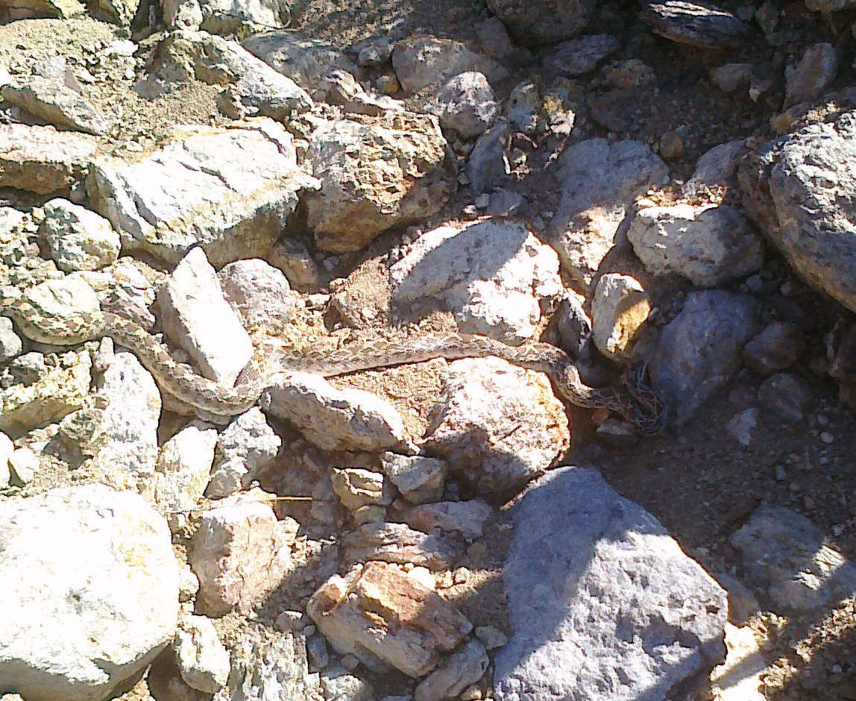
THANK YOU!

